Slide 1
1 Corinthians 9:27 (NKJV)
²⁷ But I discipline my body and bring it into subjection, lest, when I have preached to others, I myself should become disqualified.

Slide 3
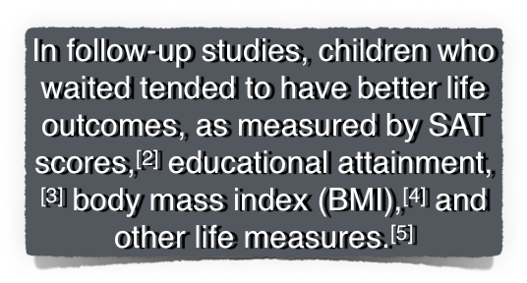
1 now or 2 later (15 minutes)
1/3 chose now -
1/3 yielded before time -
1/3 waited & got 2

Slide 4
Essential For Success:
Athletics
Work Performance
Finances
Health
Time Management
Relationships
Spiritual Growth

Slide 5
1602 ἐγκράτεια (egkrateia), είας (eias), ἡ (hē): n. fem.; ≡ Str 1466; TDNT 2.339—LN 88.83 self-control (Ac 24:25; Gal 5:23; 2Pe 1:6+)
1603 ἐγκρατεύομαι (egkrateuomai): vb.; ≡ Str 1467; TDNT 2.339—LN 88.83 control oneself, exercise self-control (1Co 7:9; 9:25+)
1604 ἐγκρατής (egkratēs), ές (es): adj.; ≡ Str 1468; TDNT 2.339—LN 88.84 self-controlled, disciplined (Tit 1:8+)
Swanson, J. (1997). Dictionary of Biblical Languages with Semantic Domains: Greek (New Testament) (electronic ed.). Oak Harbor: Logos Research Systems, Inc.

Slide 6
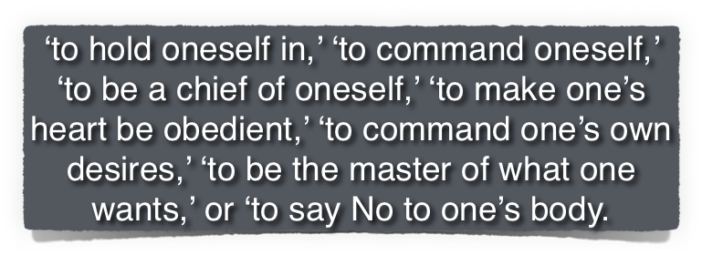
Ecclesiastes 12:13 (NKJV)
¹³ Let us hear the conclusion of the whole matter: Fear God and keep His commandments, For this is man’s all.
Swanson, J. (1997). Dictionary of Biblical Languages with Semantic Domains: Greek (New Testament) (electronic ed.). Oak Harbor: Logos Research Systems, Inc.

Slide 7
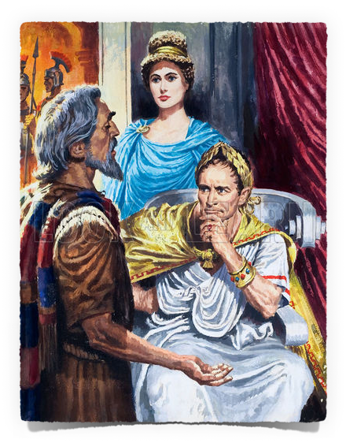
Acts 24:25 (NKJV)
²⁵ Now as he reasoned about righteousness, self-control, and the judgment to come, Felix was afraid and answered, “Go away for now; when I have a convenient time I will call for you.”

Slide 8
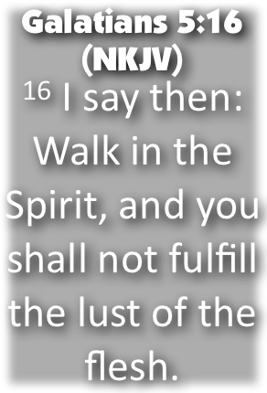
Galatians 5:22–23 (NKJV)
²² But the fruit of the Spirit is love, joy, peace, longsuffering, kindness, goodness, faithfulness, ²³ gentleness, self-control. Against such there is no law.

Slide 9
2 Peter 1:5–7 (NKJV)
⁵ But also for this very reason, giving all diligence, add to your faith virtue, to virtue knowledge, ⁶ to knowledge self-control, to self-control perseverance, to perseverance godliness, ⁷ to godliness brotherly kindness, and to brotherly kindness love.

Slide 10
1 Corinthians 7:9 (NKJV)
⁹ but if they cannot exercise self-control, let them marry. For it is better to marry than to burn with passion.

Slide 11
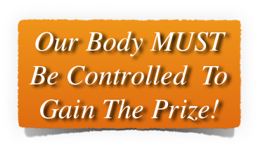
1 Corinthians 9:25–27 (NKJV)
²⁵ And everyone who competes for the prize is temperate in all things. Now they do it to obtain a perishable crown, but we for an imperishable crown. ²⁶ Therefore I run thus: not with uncertainty. Thus I fight: not as one who beats the air. ²⁷ But I discipline my body and bring it into subjection, lest, when I have preached to others, I myself should become disqualified.

Slide 12
Contributing Factors of Self Discipline
Our Up-Bringing -
Our Mentors / Associations -
Cultural Influences -
What We Believe -
Who Is In Charge? -

Slide 13
To Whom We Are Accountable. - Prov 1:7; Eccl. 12:13; James 4:7; Gen 39:7-12; Dan 3:17,18; Josh 24:15
What We Know / Learn / Believe - 2 Tim 3:10-17; Rom 10:17
The Strength of Our Convictions. - Dan 1:8; Acts 4:20; Heb 11:6; Rev 2:10
Our Choice Surroundings. - 1 Cor 15:33; Prov 9:6; 2 Pet 2:6-9
The Depth of Our Values. - Mat 6:19-24, 33; Heb 11:24-27
The Desire For Our Goals. - 1 John 3:3; 2 Cor 4:17,18

Slide 14
How we use our abilities & for whom - Mat 25:14-30
To control our passions, emotions / or let them control us. - Col 3:5-9
To control our tongue / or not - James 3:1-14
What we think - 2 Cor 10:3-5

Slide 15
Gird up / Be sober - 1 Peter 1:13
Trust God’s provisions - 1 Pet 1:13
Being obedient children - 1 Pet 1:14
Not of the world - but transformed by the renewing of our mind - 1 Pet 1:14; Rom 12:1,2; Col 3:5-17; 2 Cor 10:5
Be Holy as our God, our Father is Holy - 1 Pet 1:15,16; Eph 5:1; Heb 12:1-3
Live in fear / reverence - we will be judged - 1 Pet 1:17; 2 Cor 5:10
Knowing the high price of our redemption - 1 Pet 1:18-21; 2 Cor 5:14

Slide 16
Do you struggle with controlling yourself when trying to do God’s will?
Perhaps this lesson has motivated you to be more serious about self-control.
You will make the decision to be under the control of the Lord today or NOT -

Slide 17
Don McClain
W. 65th St church of Christ / December 16, 2007

Slide 18
1 Corinthians 9:27 (NKJV)
²⁷ But I discipline my body and bring it into subjection, lest, when I have preached to others, I myself should become disqualified.
Charts by Don McClain
Prepared March 25-26, 2016 / Preached March 27, 2016
West 65th Street church of Christ / P.O. Box 190062; Little Rock AR 72219 / 501-568-1062
Email – donmcclain@sbcglobal.net - http://w65stchurchofchrist.org/coc/

Slide 19
1 Corinthians 9:24–27 (NKJV)
²⁴ Do you not know that those who run in a race all run, but one receives the prize? Run in such a way that you may obtain it. ²⁵ And everyone who competes for the prize is temperate in all things. Now they do it to obtain a perishable crown, but we for an imperishable crown.

Slide 20
1 Corinthians 9:24–27 (NKJV)
²⁶ Therefore I run thus: not with uncertainty. Thus I fight: not as one who beats the air. ²⁷ But I discipline my body and bring it into subjection, lest, when I have preached to others, I myself should become disqualified.

