Slide 1
Jeremiah 6:16 (NKJV)
¹⁶ Thus says the Lord: “Stand in the ways and see, And ask for the old paths, where the good way is, And walk in it; Then you will find rest for your souls. But they said, ‘We will not walk in it.’

Slide 2
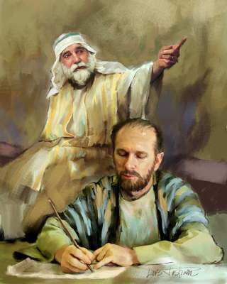
Jeremiah’s Ministry
Jeremiah: A priest from the village of Anathoth in Benjamin just a few miles northeast of Jerusalem.
Jeremiah's prophecies were written down by Baruch, his scribe (36:4,27-28,32).

Slide 3
Jeremiah’s Ministry
Began 13th year of the reign of King Josiah (1:2; 25:3), i.e., 627 B.C., (1:6).
Prophesied after Nebuchadnezzar destroyed Jerusalem in 586 B.C. (39:1-10; 43:7-8; 44:1),
Lasted about 50 years.

Slide 4
Jeremiah’s Ministry
Judah had rejected the Lord for idols (2:13,32; 5:19; 7:18,31; 17:1-2; 19:4-5).
Guilty of gross personal unrighteousness (5:1,7-8,25-28; 6:13).
The Jews hypocritically claimed to be God's people (5:2; 7:9-11),

Slide 5
Jeremiah’s Ministry
They refused to hear God's word (6:16-19; 7:25-26; 25:3-7; 36:20-24),
They refused to be corrected (5:3,21; 6:15; 17:23; 44:15-18),
Followed false prophets who spoke what the people wanted to hear (5:30-31; 6:14; 7:8; 14:13-14)

Slide 6
Jeremiah’s Ministry
Called Judah to repent (3:1; 7:4-7)
They refused (6:16-17; 20:1-2; 32:2-5; 37:11-21; 38:1-13; 43:1-7).
He foretold their destruction (5:9-10,14-18,29; 6:22-26; 7:16,32-34; 14:15-16; 25:8-10).
Israel was to be so destroyed as a nation that they could never be made whole again (19:10-11).

Slide 7
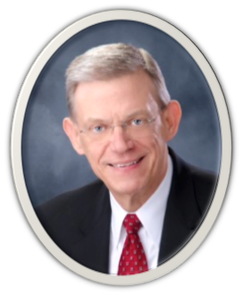
Rubel Shelly
“The Spirit of God is still moving and acting in the church today and we must be more open to it. The result will be exhilarating changes in the worship and mission of the church. It has been a mistake to emphasize ‘the old paths’ because we need to be open to change. . . . “The church has got to change. If it doesn’t change, my kids are not going to stay with it. I’m probably not going to stay with it… Mine was the last generation that would tolerate indoctrination.”
-Rubel Shelly - “The Church In The 90’s: The Challenge Of Change” - Behold The Pattern, Goebel Music, 284-322

Slide 8
The Context …
Jeremiah 6:10 (NKJV)
¹⁰ To whom shall I speak and give warning, That they may hear? Indeed their ear is uncircumcised, And they cannot give heed. Behold, the word of the Lord is a reproach to them; They have no delight in it.
The people’s attitude toward God’s word - 10
Notes:
The hand of God was stretched out against Jerusalem and justifiably so. Everyone, even the spiritual leaders, was guilty of greed. The religious leaders tried to heal the serious wounds of the nation with assurances of peace. The leaders felt no shame over their conduct. They “did not even know how to blush.” When God punished them, however, they would share the humiliating fate of those they misguided (6:12–15).
Smith, J. E. (1992). The Major Prophets (Je 6:9–15). Joplin, MO: College Press.

Slide 9
The Context …
Jeremiah 6:11–12 (NKJV)
¹¹ Therefore I am full of the fury of the Lord. I am weary of holding it in. “I will pour it out on the children outside, And on the assembly of young men together; For even the husband shall be taken with the wife, …
The people’s attitude toward God’s word - 10
The consequences of the people’s disobedience - 11,12

Slide 10
The Context …
Jeremiah 6:11–12 (NKJV)
The aged with him who is full of days. ¹² And their houses shall be turned over to others, Fields and wives together; For I will stretch out My hand Against the inhabitants of the land,” says the Lord.
The people’s attitude toward God’s word - 10
The consequences of the people’s disobedience - 11,12

Slide 11
The Context …
Jeremiah 6:13 (NKJV)
¹³ “Because from the least of them even to the greatest of them, Everyone is given to covetousness; And from the prophet even to the priest, Everyone deals falsely.
The people’s attitude toward God’s word - 10
The consequences of the people’s disobedience - 11,12
The extent of the people’s sins (least to greatest) - 13

Slide 12
The Context …
Jeremiah 6:14 (NKJV)
¹⁴ They have also healed the hurt of My people slightly, Saying, ‘Peace, peace!’ When there is no peace.
The people’s attitude toward God’s word - 10
The consequences of the people’s disobedience - 11,12
The extent of the people’s sins (least to greatest) - 13
The false message of peace the people believed - 14

Slide 13
The Context …
Jeremiah 6:15 (NKJV)
¹⁵ Were they ashamed when they had committed abomination? No! They were not at all ashamed; Nor did they know how to blush. Therefore they shall fall among those who fall; At the time I punish them, They shall be cast down,” says the Lord.

Slide 14
Jeremiah 6:16 (NKJV)
¹⁶ Thus says the Lord: “Stand in the ways and see, And ask for the old paths, where the good way is, And walk in it; Then you will find rest for your souls. But they said, ‘We will not walk in it.’

Slide 15
“Thus Says The LORD”
God Spoke - to them through the prophets – Heb 1:1; 2 Pet 1:20,21
God Speaks through Jesus – Deut 18:15; Mt 17:5; 28:18-20; Heb 1:1,2
God Speaks - to us through the BIBLE - the Holy Spirit guided the apostles into all truth which they wrote down – Jn 14:26; 15:26; 16:13; 1 Co 14:37; Ep 3:3-5; 2 Tim 3:16,17; Jude 1:3

Slide 16
"Stand in the ways and see,”
Stand – Stop . . . Pause & reflect. Haggai 1:5; 2 Cor 13:5
In the ways – There is more than one way to travel – Mat 7:13,14;
And see – Understand where you are – Act 17:11; 1 Jo 3:19-24
Notes:
This challenge to serious thought needs to be issued to many in our day: those who follow the crowd, those who go in for novelty for novelty’s sake, those who choose pleasure or money or position as the highest good in life, those who worship at the shrine of science or scholarship or institutional religion.
Green, L. J. (1972). Jeremiah. In H. F. Paschall & H. H. Hobbs (Eds.), The teacher’s Bible commentary (p. 439). Nashville: Broadman and Holman Publishers.

Slide 17
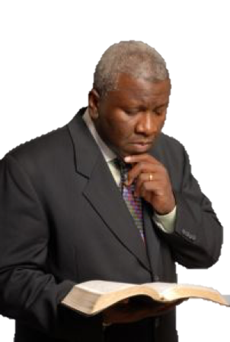
“And ask for the old paths,”
Ask – “What has God said?” Acts 17:11; 2 Tim 3:16,17; 1 Pet 4:11
Need to seek God & His way - Mat 5:6; John 7:17
The Old Paths – The revealed pattern – 1 Cor 11:1,2; Phili 3:17; 4:9; 2 Tim 1:13; 2 The 2:5; Ju 3
God’s Law, testimonies, judgments … Psalm 119:97-104

Slide 18
“where the good way is,”
The Good Way –
God’s way, which is revealed in the Bible, is the ONLY GOOD WAY! - Psalm 19:7-9; Mat 7:13,14; Jn 14:6; 2 Tim 3:16,17
Our way, if not also God’s way, is NOT good!! - (I think; I feel; I know; I want; etc.) - Prov 14:12; Jer 10:23; Mat 15:7-9;

Slide 19
“And walk in it;”
We have a choice - Josh 24:15; Deut 30:11-20; Rom 6:16-18; 10:5-17
Obey what the Lord says – Jer 7:23; Mt 7:21-27; Joh 13:17; 15:10; Rom 1:5; 6:16-18; Jam 1:22-25; Heb 5:8,9
Staying within the revealed pattern – Col 3:17; 1 Pet 4:11; 2 Cor 5:7; 1 Tim 1:13; Mat 21:23-25

Slide 20
“And walk in it;”
Examples of Some Who DID NOT!
Cain – (Gen. 4:7) – Heb 11:4
Nadab & Abihu – (Lev. 10:1,2)
Moses – (Num 20:8-24)
King Saul – (1 Sam. 13 & 15)
David’s ox cart – (1 Chr. 13:7-12; 15:2-13)
Jeroboam – (1 Kings 12:25-33)
Uzziah – (2 Chr. 26:16-23)
Warning To US - 2 John 1:9,10

Slide 21
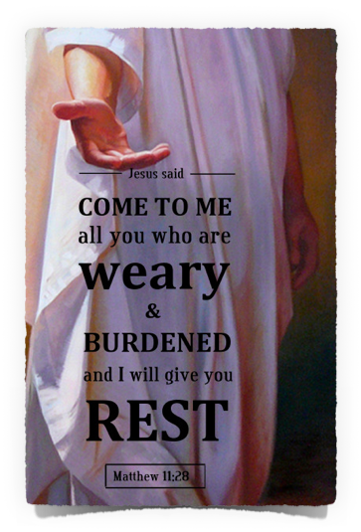
“Then you will find rest for your souls”
ONLY IF - we obey the Lord and stay within the revealed pattern will we find rest for our souls! – Rom 2:7; Heb 5:8,9; Rev 22:14
The path of morality
The path of salvation
The path of worship
The path of church work

Slide 22
“But they said, 'We will not walk in it.'”
They chose their way rather than God’s way - 2:13; 10:23; Rom 1:18-25
The consequences – Jeremiah 6:17-20; Deut 30:17-19; Rom 2:8; 2 Thes 1:7-9; Heb 12:25

Slide 23
Will WE Hear The Lord?
God’s word is JUST as relevant today as it has ever been! - 2 Thes 2:15
¹⁵ Therefore, brethren, stand fast and hold the traditions which you were taught, whether by word or our epistle.

Slide 24
Will WE Hear The Lord?
God’s word is JUST as relevant today as it has ever been! - 2 Thes 2:15
Last forever - 1 Peter 1:22-25; Ps. 102:12, 26; Mat 24:35;
Forever settled in heaven - 119:89; Is. 40:8;
Will be judged by the words of Jesus - John 12:28; Rev 22:18,19

Slide 25
Will WE Hear The Lord?
The restoration plea - “Back to the Bible!” - (Josiah 2 Kin 22,23; Ezra, Nehemiah)
Being a local church committed to following the Old Paths, where the good way is, in doctrine & practice! - (Acts 2:42-47; 2 Tim 1:13)
Plan of salvation - (Mk 16:16)
Worship - (Jn 4:24; Heb 12:28)
Work - (1 Cor 14; 1 Thes 1:8; 2 Cor 8:1-5; 1 Cor 16:1,2)

Slide 26
Will WE Hear The Lord?
When we move away from the firm foundation of a “thus saith the Lord” we:

Slide 27
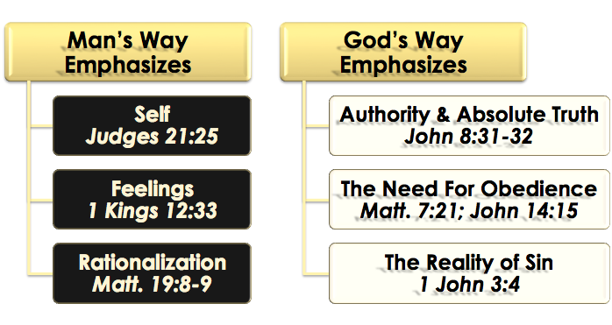
Will WE Hear The Lord?

Slide 28
Will you hear the Lord?
Jeremiah 6:16 (NKJV)
¹⁶ Thus says the Lord: “Stand in the ways and see, And ask for the old paths, where the good way is, And walk in it; Then you will find rest for your souls. But they said, ‘We will not walk in it.’

Slide 29
Will you hear the Lord?
Consider where you are on the road to salvation?
Ask for the old paths?
Walk in them?
Find rest for your soul?
They didn’t – will you?

Slide 31
Jeremiah 6:16 (NKJV)
Charts by Don McClain
Prepared August 30-Sept 3, 2016 / Preached Sept 4, 2016
West 65th Street church of Christ / P.O. Box 190062 / Little Rock AR 72219
501-568-1062 / 501-749-6928 / Email – donmcclain@sbcglobal.net
Prepared w/ Keynote More lessons: http://w65stchurchofchrist.org/coc/sermons/

Slide 32
Isaiah 55:1–11 (NKJV)
¹ “Ho! Everyone who thirsts, Come to the waters; And you who have no money, Come, buy and eat. Yes, come, buy wine and milk Without money and without price. ² Why do you spend money for what is not bread, And your wages for what does not satisfy? Listen carefully to Me, and eat what is good, And let your soul delight itself in abundance. ³ Incline your ear, and come to Me. Hear, and your soul shall live; And I will make an everlasting covenant with you— The sure mercies of David.

Slide 33
Isaiah 55:1–11 (NKJV)
⁴ Indeed I have given him as a witness to the people, A leader and commander for the people. ⁵ Surely you shall call a nation you do not know, And nations who do not know you shall run to you, Because of the Lord your God, And the Holy One of Israel; For He has glorified you.” ⁶ Seek the Lord while He may be found, Call upon Him while He is near. ⁷ Let the wicked forsake his way, And the unrighteous man his thoughts; Let him return to the Lord, And He will have mercy on him; And to our God, For He will abundantly pardon.

Slide 34
Isaiah 55:1–11 (NKJV)
⁸ “For My thoughts are not your thoughts, Nor are your ways My ways,” says the Lord. ⁹ “For as the heavens are higher than the earth, So are My ways higher than your ways, And My thoughts than your thoughts. ¹⁰ “For as the rain comes down, and the snow from heaven, And do not return there, But water the earth, And make it bring forth and bud, That it may give seed to the sower And bread to the eater, ¹¹ So shall My word be that goes forth from My mouth; It shall not return to Me void, But it shall accomplish what I please, And it shall prosper in the thing for which I sent it.

