Slide 2
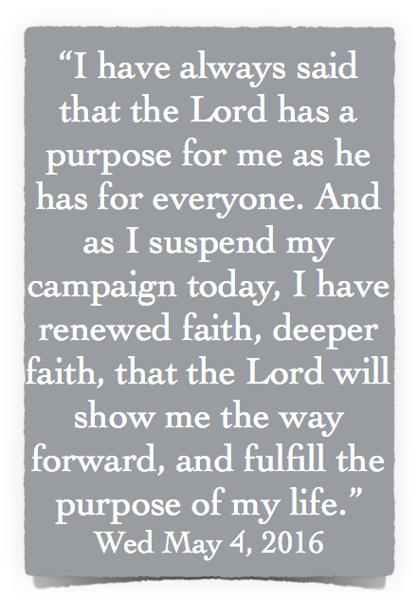
John Kasich , Governor of Ohio

Slide 4
FALSE Concepts
1 Samuel 15:13,20,21; 2 Peter 2:1-3
Assumes - God has a purpose & takes control over every little thing - (Rom. 14:6)
Signs - Waiting for some sort of “sign” or “feeling” (Eccl. 11:4; 1 Cor 1:18-25)
Pragmatism - if it works or is profitable - (Ps 73:3; He 12:6)

Slide 5
FALSE Concepts
1 Samuel 15:13,20,21; 2 Peter 2:1-3
Intuition, thoughts, can be wrong - (Acts 26:9-11; Prov 14:12; Mark 8:33)
Dreams - God has used them before & during the revelation of scripture, but today He speaks to us through His Son, i.e., through completed revelation - (Jude 3,8; Jer 23:25-27; 2 Tim 3:16)

Slide 6
FALSE Concepts
1 Samuel 15:13,20,21; 2 Peter 2:1-3
Misunderstanding / misuse of Romans 8:14,16, 28, as many as are led by the Spirit … bears witness with our spirit - All things work together for good - (Rom 8:28)
To be led by the Spirit is to be led by the word He inspired - (8:2; John 20:30,31; Heb 10:16,17; 1 Pet 1:11,12; Re. 2:7, 11, 17, 29; 3:6, 13, 22)

Slide 7
1 Corinthians 4:6 (NKJV)
⁶ Now these things, brethren, I have figuratively transferred to myself and Apollos for your sakes, that you may learn in us not to think beyond what is written, that none of you may be puffed up on behalf of one against the other.
Too MANY voices
Subjectivism / Mysticism / Pragmatism

Slide 8
It Is True God Had A Specific Purpose For …
Jeremiah - Jeremiah 1:5
Paul - Acts 9:15; Gal 1:15,16
Jesus - Mat 1:21; Acts 2:23; Pet 1:20; John 18:37

Slide 9
What about providence?
Things going on behind the scenes we cannot know - (Rom 8:18-26; Esth. 4:14)
We must trust God - what He has revealed - What He commands & what He promises to the faithful - (Book of Esther; Mat 6:24-34; 1 Pet 5:10)

Slide 10
Unconditional & Conditional
God’s purpose to provide salvation for sinful men was “accomplished in Christ” (Eph. 1:9-11, 3:11; Rom 9:1-10:4).
God’s purpose of saving men in Christ is accomplished when men believe & obey the gospel - (2 Thes 2:13,14; Act 2:23,38,47; Rom 8:28-30)

Slide 11
That I Be Saved
God’s desire & will is for you to be saved - 1 Tim 2:4; 2 Pet 3:9; Jn 3:16; Mat 11:28-30; 23:37; Ez 18:31,32
God will accomplish that which he has purposed to do, i.e., save eternally all who love Him and by faith obey the gospel - Rom 8:28-32; Heb 6:13-20; 1 Pet 1:3-9

Slide 12
That I Praise Him
Mankind was created with the urge to “worship" - Ecc. 3:11
God seeks men to worship Him in Spirit & truth - Jn 4:23,24; Acts 15:17; 17:24-31
The church, God’s chosen people, have been saved that we may proclaim the praises of Him who has called us out of darkness - 1 Pet 2:9; 2 Pet 1:3,4; Ep 5:19

Slide 13
That I Become Like Christ
Jesus is our perfect example - My purpose in life is to follow Him - 1 Pet 2:21; Mat 16:24-26
Jesus obeyed His Father - My purpose is to obey the Father by obeying His Son - Mat 17:5; 7:21-23; Heb 5:8,9
God’s purpose is to glorify all the faithful in Christ - Rom 8:28-30; 13:14; Phili 3:21; 1 John 3:2

Slide 14
That I Serve Others
We are saved to serve - Acts 2:41-47; 1 Cor. 12:12-27; Rom 12:3-8; Gal 5:13
We are to assemble to serve - Heb 10:24-25; 1 Cor 13,14
We are to encourage & support one another at all times - Rom 12:15; 15:1,2; 1 Thes 5:11

Slide 15
That I Tell Others About Christ
Jesus’ “purpose” was to "preach the kingdom of God" - Lk 4:43
The early disciples were taught to teach others - Mat 4:19; Lk 5:8-11; Mat 28:19; Acts 4:20; 8:4
The early church"sounded forth” the word of the Lord - 1 Thes 1:8
Our purpose is to be a light to the dark world - Mat 5:13-16; Phili 2:14-16

Slide 18
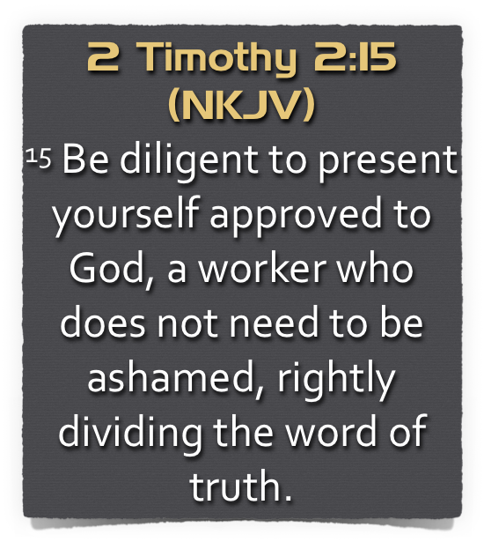

Slide 19
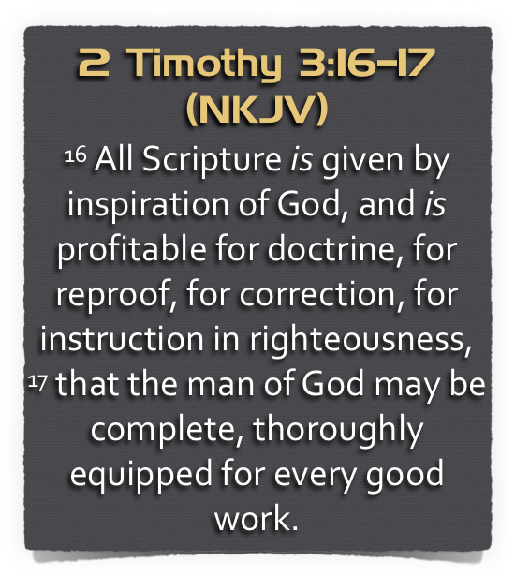

Slide 20
Am I Striving To Fulfill My Purpose?
By Being Saved?
By Praising God?
By Becoming Like Christ?
By Serving Others?
By Telling Others About Christ?

Slide 21
Ecclesiastes 12:13–14 (NKJV)
¹³ Let us hear the conclusion of the whole matter: Fear God and keep His commandments, For this is man’s all. ¹⁴ For God will bring every work into judgment, Including every secret thing, Whether good or evil.

Slide 24
Acts 17:23–31 (NKJV)
²³ for as I was passing through and considering the objects of your worship, I even found an altar with this inscription: TO THE UNKNOWN GOD Therefore, the One whom you worship without knowing, Him I proclaim to you: ²⁴ God, who made the world and everything in it, since He is Lord of heaven and earth, does not dwell in temples made with hands. ²⁵ Nor is He worshiped with men’s hands, as though He needed anything, since He gives to all life, breath, and all things.

Slide 25
Acts 17:23–31 (NKJV)
²⁶ And He has made from one blood every nation of men to dwell on all the face of the earth, and has determined their preappointed times and the boundaries of their dwellings, ²⁷ so that they should seek the Lord, in the hope that they might grope for Him and find Him, though He is not far from each one of us; ²⁸ for in Him we live and move and have our being, as also some of your own poets have said, ‘For we are also His offspring.’

Slide 26
Acts 17:23–31 (NKJV)
²⁹ Therefore, since we are the offspring of God, we ought not to think that the Divine Nature is like gold or silver or stone, something shaped by art and man’s devising. ³⁰ Truly, these times of ignorance God overlooked, but now commands all men everywhere to repent, ³¹ because He has appointed a day on which He will judge the world in righteousness by the Man whom He has ordained. He has given assurance of this to all by raising Him from the dead.”

