Slide 1
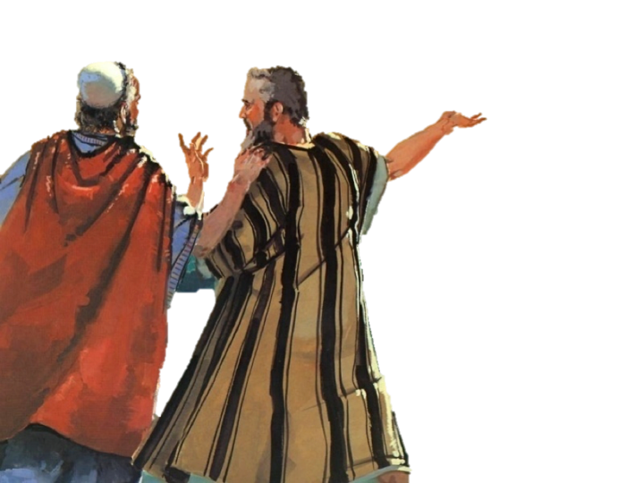
Wholehearted
To The End
Joshua 14:14 (NKJV)
¹⁴ Hebron therefore became the inheritance of Caleb the son of Jephunneh the Kenizzite to this day, because he wholly followed the Lord God of Israel.

Slide 2
Numbers 14:20–24 (NKJV)
²⁰ Then the Lord said: “I have pardoned, according to your word; ²¹ but truly, as I live, all the earth shall be filled with the glory of the Lord—²² because all these men who have seen My glory and the signs which I did in Egypt and in the wilderness, and have put Me to the test now these ten times, and have not heeded My voice, ²³ they certainly shall not see the land of which I swore to their fathers, nor shall any of those who rejected Me see it. ²⁴ But My servant Caleb, because he has a different spirit in him and has followed Me fully, I will bring into the land where he went, and his descendants shall inherit it.

Slide 3
Wholehearted
To The End
“…because he wholly followed the Lord.”
Numbers 14:24
Numbers 32:11-12
Deuteronomy 1:35-36
Joshua 14:9
Joshua 14:14

Slide 4
Joshua 14:6–14 (NKJV)
⁶ Then the children of Judah came to Joshua in Gilgal. And Caleb the son of Jephunneh the Kenizzite said to him: “You know the word which the Lord said to Moses the man of God concerning you and me in Kadesh Barnea. ⁷ I was forty years old when Moses the servant of the Lord sent me from Kadesh Barnea to spy out the land, and I brought back word to him as it was in my heart.

Slide 5
Joshua 14:6–14 (NKJV)
⁸ Nevertheless my brethren who went up with me made the heart of the people melt, but I wholly followed the Lord my God. ⁹ So Moses swore on that day, saying, ‘Surely the land where your foot has trodden shall be your inheritance and your children’s forever, because you have wholly followed the Lord my God.’ ¹⁰ And now, behold, the Lord has kept me alive, as He said, these forty-five years, ever since the Lord spoke this word to Moses while Israel wandered in the wilderness; and now, here I am this day, eighty-five years old.

Slide 6
Joshua 14:6–14 (NKJV)
¹¹ As yet I am as strong this day as on the day that Moses sent me; just as my strength was then, so now is my strength for war, both for going out and for coming in. ¹² Now therefore, give me this mountain of which the Lord spoke in that day; for you heard in that day how the Anakim were there, and that the cities were great and fortified. It may be that the Lord will be with me, and I shall be able to drive them out as the Lord said.”

Slide 7
Joshua 14:6–14 (NKJV)
¹³ And Joshua blessed him, and gave Hebron to Caleb the son of Jephunneh as an inheritance. ¹⁴ Hebron therefore became the inheritance of Caleb the son of Jephunneh the Kenizzite to this day, because he wholly followed the Lord God of Israel.

Slide 8
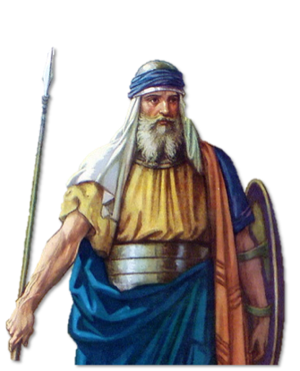
Wholehearted
“…because he wholly followed the Lord.”
Caleb willingly obeyed the Lord – Num. 13:30,31
Caleb trusted in the Lord – Num. 14:6-10
Caleb waited on the Lord – Josh 14:10
Caleb was faithful to the Lord – Josh 14:10-14
Caleb received his inheritance – Josh 14:10-14; 15:13,14

Slide 9
Wholehearted
We must follow the Lord fully too!
Love the Lord with all our heart, soul, mind & strength – Mark 12:29-31; Mat. 6:33
Fully committed to the LORD – (value, focus, loyalty) — Mat 6:19-24
Obey the Lord from the heart – Rom 6:16,17

Slide 10
Wholehearted
We must follow the Lord fully too!
Intellect — or mind, is our ability to acquire knowledge, think, and reason. (Rom. 12:2)
Emotions — affections, desires! — (Col. 3:1,2)
Will — we give God our will by obeying Him — (Jos 24:14; Rom 6:16-18)

Slide 11
Wholehearted
We must follow the Lord fully too!
“Man was made to know good with his mind, to desire it with his affections once he knows it, and to cleave to it with his will once he has felt its attraction”
(J. I. Packer).

Slide 12
Wholehearted
We must follow the Lord fully too!
From the heart – Rom 6:17
Leaving the world & ourselves behind – Luke 9:57-62; 14:26-33
Obeying the gospel – Acts 2:38; 22:16; 24:25; 26:28
Despite persecution – Luke 12:51-53; 2 Tim 3:12
In all things – Mat 28:18-21

Slide 13
Wholehearted
We must follow the Lord fully too!
In obeying the gospel – Mark 16:16; Col 2:11-13
Despite the many obstacles – Acts 14:22; 1 Cor 10:13; James 5:11
To punish the ungodly – 2 Thes 1:7-9; Rom. 2:4-11; Rev 21:8; Mat 25:46
To reward the faithful – Rom. 4:19-21; Heb. 11:6; Titus 1:2; 1 Pet 1:3-9

Slide 14
Wholehearted
We must follow the Lord fully too!
We possess our souls – Luke 21:19; 1 Cor 15:58; Jam. 5:11
For the coming of Jesus – 1 Thes 1:10; Mat. 25:1-46; 2 Thes 3:5
In well doing – Rom 2:7
Through many trials & difficulties – Acts 14:22; Jam. 1:2-24; 5:7-11
For the redemption of our body – Rom 8:23-25; Phili. 3:20,21; 1 Cor. 15

Slide 15
Wholehearted
We must follow the Lord fully too!
Continuing steadfastly serving the Lord – 1 Cor. 15:58; John 12:26; Acts 2:42; Heb 10:24,25
Despite the threats – Gal. 2 Tim 4:7,8; Gal. 5:11; Rev 2:10
Being a good steward – Mat 25:14-30; Eph. 4:15,16
Teaching others – 2 Tim 2:2

Slide 16
Wholehearted
If We follow the Lord fully!
Hebrews 11:13–16 (NKJV)
¹³ These all died in faith, not having received the promises, but having seen them afar off were assured of them, embraced them and confessed that they were strangers and pilgrims on the earth. ¹⁴ For those who say such things declare plainly that they seek a homeland. ¹⁵ And truly if they had called to mind that country from which they had come out, they would have had opportunity to return. ¹⁶ But now they desire a better, that is, a heavenly country. Therefore God is not ashamed to be called their God, for He has prepared a city for them.

Slide 17
Wholehearted
If We follow the Lord fully!
Hebrews 9:15 (NKJV)
¹⁵ And for this reason He is the Mediator of the new covenant, by means of death, for the redemption of the transgressions under the first covenant, that those who are called may receive the promise of the eternal inheritance.

Slide 18
Wholehearted
If We follow the Lord fully!
Ephesians 1:11–14 (NKJV)
¹¹ In Him also we have obtained an inheritance, being predestined according to the purpose of Him who works all things according to the counsel of His will, ¹² that we who first trusted in Christ should be to the praise of His glory. ¹³ In Him you also trusted, after you heard the word of truth, the gospel of your salvation; in whom also, having believed, you were sealed with the Holy Spirit of promise, ¹⁴ who is the guarantee of our inheritance until the redemption of the purchased possession, to the praise of His glory.

Slide 19
Wholehearted
If We follow the Lord fully!
1 Peter 1:3–4 (NKJV)
³ Blessed be the God and Father of our Lord Jesus Christ, who according to His abundant mercy has begotten us again to a living hope through the resurrection of Jesus Christ from the dead, ⁴ to an inheritance incorruptible and undefiled and that does not fade away, reserved in heaven for you,

Slide 20
Wholehearted
If We follow the Lord fully!
Colossians 3:24–25 (NKJV)
²⁴ knowing that from the Lord you will receive the reward of the inheritance; for you serve the Lord Christ. ²⁵ But he who does wrong will be repaid for what he has done, and there is no partiality.

Slide 21
Wholehearted
If We Do NOT follow the Lord fully!
¹ Moreover, brethren, I do not want you to be unaware that all our fathers were under the cloud, all passed through the sea, ² all were baptized into Moses in the cloud and in the sea, ³ all ate the same spiritual food, ⁴ and all drank the same spiritual drink. For they drank of that spiritual Rock that followed them, and that Rock was Christ. ⁵ But with most of them God was not well pleased, for their bodies were scattered in the wilderness.

Slide 22
Wholehearted
If We Do NOT follow the Lord fully!
⁶ Now these things became our examples, to the intent that we should not lust after evil things as they also lusted. ⁷ And do not become idolaters as were some of them. As it is written, “The people sat down to eat and drink, and rose up to play.” ⁸ Nor let us commit sexual immorality, as some of them did, and in one day twenty-three thousand fell; ⁹ nor let us tempt Christ, as some of them also tempted, and were destroyed by serpents; ¹⁰ nor complain, as some of them also complained, and were destroyed by the destroyer.

Slide 23
Wholehearted
If We Do NOT follow the Lord fully!
¹¹ Now all these things happened to them as examples, and they were written for our admonition, upon whom the ends of the ages have come. ¹² Therefore let him who thinks he stands take heed lest he fall. ¹³ No temptation has overtaken you except such as is common to man; but God is faithful, who will not allow you to be tempted beyond what you are able, but with the temptation will also make the way of escape, that you may be able to bear it.

Slide 24
Wholehearted
If We Do NOT follow the Lord fully!
Israel was delivered - saved from Egypt, just like Caleb.
None of Caleb’s generation had faith to obey God fully except Joshua.
Caleb persevered & inherited God’s promises - except for Joshua, the rest did not!

Slide 25
Wholehearted
To The End
God does not want you to follow him with ALL your heart for PART of your days nor with PART of your heart for ALL your days.

Slide 26
Wholehearted
To The End
Let us follow Him with ALL our heart for ALL the days we have left.
2 Corinthians 5:17; 6:2

Slide 27
Don McClain

Slide 28
Wholehearted
To The End
Charts by Don McClain / Preached May 14, 2017
West 65th Street church of Christ P.O. Box 190062 / Little Rock AR 72219 /
501-568-1062 / Email – donmcclain@sbcglobal.net
Prepared using Keynote 2014 – More PPT & Audio Sermons:
http://w65stchurchofchrist.org/coc/

Slide 29
Matthew 6:19–24 (NKJV)
¹⁹ “Do not lay up for yourselves treasures on earth, where moth and rust destroy and where thieves break in and steal; ²⁰ but lay up for yourselves treasures in heaven, where neither moth nor rust destroys and where thieves do not break in and steal. ²¹ For where your treasure is, there your heart will be also.

Slide 30
Matthew 6:19–24 (NKJV)
²² “The lamp of the body is the eye. If therefore your eye is good, your whole body will be full of light. ²³ But if your eye is bad, your whole body will be full of darkness. If therefore the light that is in you is darkness, how great is that darkness!

Slide 31
Matthew 6:19–24 (NKJV)
²⁴ “No one can serve two masters; for either he will hate the one and love the other, or else he will be loyal to the one and despise the other. You cannot serve God and mammon.

