Slide 1
“They Watched HIM Closely . . .
That They Might Accuse Him”
Mark 3:2

Slide 2
Mark 3:1–6 (NKJV)
¹ And He entered the synagogue again, and a man was there who had a withered hand. ² So they watched Him closely, whether He would heal him on the Sabbath, so that they might accuse Him. ³ And He said to the man who had the withered hand, “Step forward.” ⁴ Then He said to them, “Is it lawful on the Sabbath to do good or to do evil, to save life or to kill?” But they kept silent. ⁵ And when He had looked around at them with anger, being grieved by the hardness of their hearts, He said to the man, “Stretch out your hand.” And he stretched it out, and his hand was restored as whole as the other. ⁶ Then the Pharisees went out and immediately plotted with the Herodians against Him, how they might destroy Him.

Slide 3
“They Watched Him Closely . . .
That They Might Accuse Him”
Luke 6:7 (NKJV)
⁷ So the scribes and Pharisees watched Him closely, whether He would heal on the Sabbath, that they might find an accusation against Him.

Slide 4
“They Watched Him Closely . . .
That They Might Accuse Him”
Luke 14:1–3 (NKJV)
¹ Now it happened, as He went into the house of one of the rulers of the Pharisees to eat bread on the Sabbath, that they watched Him closely. ² And behold, there was a certain man before Him who had dropsy. ³ And Jesus, answering, spoke to the lawyers and Pharisees, saying, “Is it lawful to heal on the Sabbath?”

Slide 5
“They Watched Him Closely . . .
That They Might Accuse Him”
Luke 20:19–20 (NKJV)
¹⁹ And the chief priests and the scribes that very hour sought to lay hands on Him, but they feared the people—for they knew He had spoken this parable against them. ²⁰ So they watched Him, and sent spies who pretended to be righteous, that they might seize on His words, in order to deliver Him to the power and the authority of the governor.

Slide 6
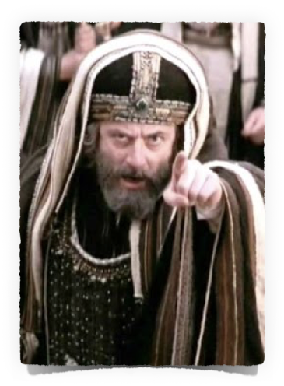
“They Watched Him Closely . . .
That They Might Accuse Him”
They Criticized Jesus … (Mark 2:1-3:6)
For What He Said (your sins are forgiven) – 2:1-12
For His Associations (He ate with sinners) – 2:13-17
And His Disciples Because of What They Didn’t Do (didn’t fast) – 2:18-22
For What His Disciples Did (plucked grain) – 2:23-28
Because He Did Good (healed ) - 3:1-6

Slide 7
Justifiable, Fair, Positive Criticism Is
GOOD & NECESSARY
Criticism - “an act of criticizing; to judge as a critic; to find fault; to blame or condemn.”- Merriam Webster
Constructive criticism - that which is expressed in love to “build up,” not to tear down — it is always expressed face-to-face, never behind their back.

Slide 8
Justifiable, Fair, Positive Criticism Is
GOOD & NECESSARY
John 7:24 (NKJV)
²⁴ Do not judge according to appearance, but judge with righteous judgment.”

Slide 9
Justifiable, Fair, Positive Criticism Is
GOOD & NECESSARY
Matthew 7:1–5 (NKJV)
¹ “Judge not, that you be not judged. ² For with what judgment you judge, you will be judged; and with the measure you use, it will be measured back to you.

Slide 10
Justifiable, Fair, Positive Criticism Is
GOOD & NECESSARY
Matthew 7:1–5 (NKJV)
³ And why do you look at the speck in your brother’s eye, but do not consider the plank in your own eye? ⁴ Or how can you say to your brother, ‘Let me remove the speck from your eye’; and look, a plank is in your own eye?

Slide 11
Justifiable, Fair, Positive Criticism Is
GOOD & NECESSARY
Matthew 7:1–5 (NKJV)
⁵ Hypocrite! First remove the plank from your own eye, and then you will see clearly to remove the speck from your brother’s eye.

Slide 12
Justifiable, Fair, Positive Criticism Is
GOOD & NECESSARY
Self Examination – 2 Cor. 13:5; Mat. 7:1-5
Attitudes, Actions & Methods hindering OUR Effectiveness For Christ - John 15:2; Heb. 12:5-11
Sin MUST Be Dealt With – Mt. 18:15-17; 2 Thes. 3:6,14
False Teachers & Divisive Brethren – Acts 18:26; 2 Jn 1:9,10; Mt. 7:16; Rom. 16:17

Slide 13
“an obsessive attitude of criticism and fault-finding, which acts to tear others down”
IS Destructive & Evil

Slide 14
“They Watched Him Closely . . .
That They Might Accuse Him”
Fruit of A Critical Spirit - Mark 2:1-3:6
Rejects clear evidence – 2:1-12
Castigates the sinner instead of teaching them – 2:13-17
Condemns the righteous & their appropriate actions – 2:18-22
Condemns the innocent – 2:23-28
Exposes our ungodliness & wickedness – 3:1-6; Jam. 4:11,12

Slide 15
“They Watched Him Closely . . .
That They Might Accuse Him”
Causes of A Critical Spirit
The Devil – Rev. 12:10; Job 1:9ff
Pride – Pro 13:10; 21:24; Jam 4:11
Self Righteousness – Luke 18:9-14
Carnality – 1 Cor. 3:1-4; Gal. 5:15
Lack of Love & Mercy – 1 Cor. 13:4-7; (unforgiving, negativity)
Ignorance – Mark 2:25;
Hypocrisy – Mat. 23:4,23, 29,30

Slide 16
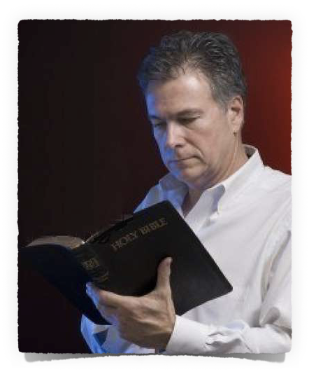
“They Watched Him Closely . . .
That They Might Accuse Him”
The Cure For A Critical Spirit
Humility – Recognizing We All Have Faults – Rom 3:23; John 8:7; Tit 3:1-5
Put On The New Man – Eph. 4:23-32; Col. 3:10-14;
Bear the Fruit of The SPIRIT – Gal. 5:22,23; 1 Co. 13:4-8
Diligently Add To Our Faith – 2 Pet. 1:5-11

Slide 17
“They Watched Him Closely . . .
That They Might Accuse Him”
The Fruit of A Godly Spirit
Honesty & Fairness – John 7:24; Prov 18:13
Patient, Long-suffering, Considerate, Forgiving – Rom 14:1-12, 19-21; Col. 3:12-14; Eph. 4:32
Seeks Peace — Rom 12:18; 2 Tim. 2:22; Heb. 12:14; Luke 17:3

Slide 18
“They Watched Him Closely . . .
That They Might Accuse Him”
The Fruit of A Godly Spirit
Honesty & Fairness – John 7:24; Prov 18:13
Patient, Long-suffering, Considerate, Forgiving – Rom 14:1-12, 19-21; Col. 3:12-14; Eph. 4:32
Seeks Peace — Rom 12:18; 2 Tim. 2:22; Heb. 12:14; Luke 17:3
Opposes injustice – John 7:24; Is. 1:17
Acts decisively against SIN – Mat. 5:29,30; 1 Cor. 5; Rom 16:17; Gal. 2:5; etc.
Does NOT partake in sinful behavior — Eph. 5:7,11
Exposes False Teachers — Mat 23; Acts 15:2

Slide 19
“They Watched Him Closely . . .
Matthew 27:35–37, 54 (NKJV)
³⁵ Then they crucified Him, and divided His garments, casting lots, that it might be fulfilled which was spoken by the prophet: “They divided My garments among them, And for My clothing they cast lots.” ³⁶ Sitting down, they kept watch over Him there. ³⁷ And they put up over His head the accusation written against Him: THIS IS JESUS THE KING OF THE JEWS … ⁵⁴ So when the centurion and those with him, who were guarding Jesus, saw the earthquake and the things that had happened, they feared greatly, saying, “Truly this was the Son of God!”

Slide 20
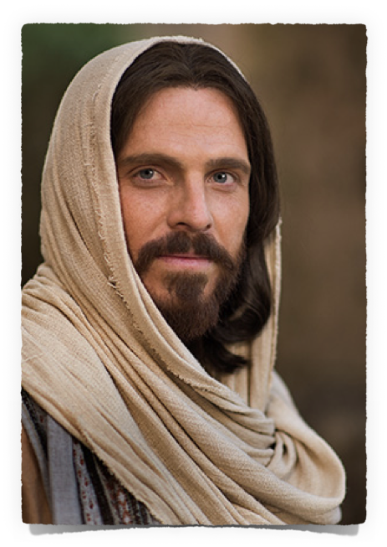
“They Watched Him Closely . . .
To honestly examine the evidence — John 20,30,31
Believe that He is the Christ, the Son of God — John 8:24
Confess Him before men — Acts 8:37; Romans 10:9,10
Repent of your sins — Luke 13:3,5; Acts 17:30
Be baptized in the name of Jesus, into Him, for the forgiveness of your sins — Acts 2:38; Romans 6:3-6
Be faithful to Him / become like Him — Heb 5:8,9; 12:1-3; Phili 2:5

Slide 21
Don McClain

Slide 22
“They Watched HIM Closely . . .
That They Might Accuse Him”
Mark 3:2
Charts by Don McClain / Preached May 21, 2017
West 65th Street church of Christ P.O. Box 190062 / Little Rock AR 72219 /
501-568-1062 / Email – donmcclain@sbcglobal.net
Prepared using Keynote 2014 – More PPT & Audio Sermons:
http://w65stchurchofchrist.org/coc/

Slide 23
Luke 6:6–10 (NKJV)
⁶ Now it happened on another Sabbath, also, that He entered the synagogue and taught. And a man was there whose right hand was withered. ⁷ So the scribes and Pharisees watched Him closely, whether He would heal on the Sabbath, that they might find an accusation against Him. ⁸ But He knew their thoughts, and said to the man who had the withered hand, “Arise and stand here.” And he arose and stood.

Slide 24
Luke 6:6–10 (NKJV)
⁹ Then Jesus said to them, “I will ask you one thing: Is it lawful on the Sabbath to do good or to do evil, to save life or to destroy?” ¹⁰ And when He had looked around at them all, He said to the man, “Stretch out your hand.” And he did so, and his hand was restored as whole as the other.

