Slide 1
The Pervasive Sin of Selfishness

Slide 2
Luke 12:13–21 (NKJV)
¹³ Then one from the crowd said to Him, “Teacher, tell my brother to divide the inheritance with me.” ¹⁴ But He said to him, “Man, who made Me a judge or an arbitrator over you?” ¹⁵ And He said to them, “Take heed and beware of covetousness, for one’s life does not consist in the abundance of the things he possesses.”

Slide 3
Luke 12:13–21 (NKJV)
¹⁶ Then He spoke a parable to them, saying: “The ground of a certain rich man yielded plentifully. ¹⁷ And he thought within himself, saying, ‘What shall I do, since I have no room to store my crops?’ ¹⁸ So he said, ‘I will do this: I will pull down my barns and build greater, and there I will store all my crops and my goods. ¹⁹ And I will say to my soul, “Soul, you have many goods laid up for many years; take your ease; eat, drink, and be merry.” ’
What shall I do
I have no room
my crops
I will do
I will
my barns
I will
my crops
my goods
I will
my soul
Soul
you have many goods laid up for many years
take your ease; eat, drink, and be merry

Slide 4
Luke 12:13–21 (NKJV)
²⁰ But God said to him, ‘Fool! This night your soul will be required of you; then whose will those things be which you have provided?’ ²¹ “So is he who lays up treasure for himself, and is not rich toward God.”
So is he who
lays up treasure for himself, and
is not rich toward God

Slide 5
“This documentary examines the inflated sense of entitlement among youth, it’s consequences and the solutions for a better future. Generations X, Y, and Z have grown increasingly self absorbed from over four decades of nurturing and education based upon boosting self esteem. It’s All About ME reveals the consequences of a society driven by instant gratification, a Me, Me, Me mentality and how younger generations can succeed in the real world.”
Notes:
http://itsallaboutmemovie.com/blog/its-all-about-me-received-the-mada-award-at-the-commffest-global-film-festival/

Slide 6
The Pervasive Sin of Selfishness
Self Centered Way of Life
Self Centered Identity
Self Centered Priorities
Self Centered View of the world

Slide 7
The Pervasive Sin of Selfishness
Self-conceit. “God resists the proud, but gives grace to the humble” - (Prov. 16:18; James 4:6,10; Luke 18:14; Rom. 12:3; 1 Cor. 10:12).
Self-willed. One who is set on having his own way. (Col. 2:23)
Self-indulgence. This is giving free course to one's own passions and inclinations. (2 Tim. 4:10; Phili 2:21; 3:19).
Self-righteousness. This is being righteous in one's own eyes. (Luke 18:9 -14; Rom. 10:1-3; Matt. 9:10-12; 2 Tim. 3:5).
Self-satisfaction. This is being pleased with who and what one is. (Rev. 3:17; 1 Cor. 10:12).

Slide 8
The Pervasive Sin of Selfishness
James 3:14–16 (NKJV)
¹⁴ But if you have bitter envy and self-seeking in your hearts, do not boast and lie against the truth. ¹⁵ This wisdom does not descend from above, but is earthly, sensual, demonic. ¹⁶ For where envy and self-seeking exist, confusion and every evil thing are there.

Slide 9
The Pervasive Sin of Selfishness
PRIDE
SELFISH
ALL SIN
Mark 7:21–22 (NKJV)
²¹ For from within, out of the heart of men, proceed evil thoughts, adulteries, fornications, murders, ²² thefts, covetousness, wickedness, deceit, lewdness, an evil eye, blasphemy, pride, foolishness.

Slide 10
The Pervasive Sin of Selfishness
PRIDE
SELFISH
ALL SIN
ROMANS 1:18-32
Reject God’s authority -. 1:18-21
Self Exaltation - 1:22- 23
Self Worship & Service - 1:24-25
Self Destruction - 1:26-32

Slide 11
The Pervasive Sin of Selfishness
2 Timothy 3:1–9 (NKJV)
¹ But know this, that in the last days perilous times will come: ² For men will be lovers of themselves, lovers of money, boasters, proud, blasphemers, disobedient to parents, unthankful, unholy, ³ unloving, unforgiving, slanderers, without self-control, brutal, despisers of good, ⁴ traitors, headstrong, haughty, lovers of pleasure rather than lovers of God, ⁵ having a form of godliness but denying its power. And from such people turn away!

Slide 12
The Pervasive Sin of Selfishness
2 Timothy 3:1–9 (NKJV)
⁶ For of this sort are those who creep into households and make captives of gullible women loaded down with sins, led away by various lusts, ⁷ always learning and never able to come to the knowledge of the truth. ⁸ Now as Jannes and Jambres resisted Moses, so do these also resist the truth: men of corrupt minds, disapproved concerning the faith; ⁹ but they will progress no further, for their folly will be manifest to all, as theirs also was.

Slide 13
The Pervasive Sin of Selfishness
⁴ For certain men have crept in unnoticed, who long ago were marked out for this condemnation, ungodly men, who turn the grace of our God into lewdness and deny the only Lord God and our Lord Jesus Christ. — Jude 4 (NKJV)
⁵ But I want to remind you, though you once knew this, …
Saved Israelites who “AFTERWARD did not believe” - (vs. 5; cf. 1 Cor. 10:1-11; Heb. 3:16)
Angels who left their proper abode - (vs. 6; cf. 2 Pet. 2:4)
Sodom & Gomorrah — (vs. 7; Gen. 19:24; 2 Pet. 2:6)
⁸ Likewise also these dreamers defile the flesh, reject authority, and speak evil of dignitaries.

Slide 14
The Pervasive Sin of Selfishness
⁴ For certain men have crept in unnoticed, who long ago were marked out for this condemnation, ungodly men, who turn the grace of our God into lewdness and deny the only Lord God and our Lord Jesus Christ. — Jude 4 (NKJV)
Jude 10–11 (NKJV)
¹⁰ But these speak evil of whatever they do not know; and whatever they know naturally, like brute beasts, in these things they corrupt themselves. ¹¹ Woe to them! For they have gone in the way of Cain, have run greedily in the error of Balaam for profit, and perished in the rebellion of Korah.

Slide 15
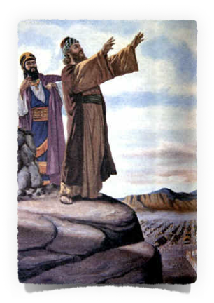
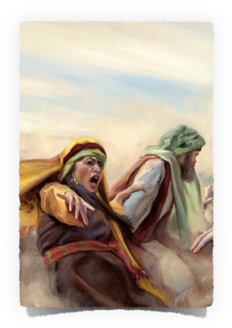
The Pervasive Sin of Selfishness
¹¹ For they have gone in the way of Cain, have run greedily in the error of Balaam for profit, and perished in the rebellion of Korah.

Slide 16
The Pervasive Sin of Selfishness
⁴ For certain men have crept in unnoticed, who long ago were marked out for this condemnation, ungodly men, who turn the grace of our God into lewdness and deny the only Lord God and our Lord Jesus Christ. — Jude 4 (NKJV)
Jude 12–13 (NKJV)
¹² These are spots in your love feasts, while they feast with you without fear, serving only themselves. They are clouds without water, carried about by the winds; late autumn trees without fruit, twice dead, pulled up by the roots; ¹³ raging waves of the sea, foaming up their own shame; wandering stars for whom is reserved the blackness of darkness forever.

Slide 17
The Pervasive Sin of Selfishness
⁴ For certain men have crept in unnoticed, who long ago were marked out for this condemnation, ungodly men, who turn the grace of our God into lewdness and deny the only Lord God and our Lord Jesus Christ. — Jude 4 (NKJV)
Jude 16–19 (NKJV)
¹⁶ These are grumblers, complainers, walking according to their own lusts; and they mouth great swelling words, flattering people to gain advantage. ¹⁷ But you, beloved, remember the words which were spoken before by the apostles of our Lord Jesus Christ: ¹⁸ how they told you that there would be mockers in the last time who would walk according to their own ungodly lusts. ¹⁹ These are sensual persons, who cause divisions, not having the Spirit.

Slide 18
My Life Should Be “ALL ABOUT GOD!”
The Fruitfulness of Selflessness
Jude 20–23 (NKJV)
²⁰ But you, beloved, building yourselves up on your most holy faith, praying in the Holy Spirit,
²¹ keep yourselves in the love of God, looking for the mercy of our Lord Jesus Christ unto eternal life.
²² And on some have compassion, making a distinction;
²³ but others save with fear, pulling them out of the fire, hating even the garment defiled by the flesh.

Slide 19
My Life Should Be “ALL ABOUT GOD!”
The Fruitfulness of Selflessness
GOD Centered Way of Life
GOD Centered Identity
GOD Centered Priorities
GOD Centered View of the world

Slide 20
My Life Should Be “ALL ABOUT GOD!”
The Fruitfulness of Selflessness
Philippians 2:1–5 (NKJV)
¹ Therefore if there is any consolation in Christ, if any comfort of love, if any fellowship of the Spirit, if any affection and mercy, ² fulfill my joy by being like-minded, having the same love, being of one accord, of one mind.

Slide 21
My Life Should Be “ALL ABOUT GOD!”
The Fruitfulness of Selflessness
Philippians 2:1–5 (NKJV)
³ Let nothing be done through selfish ambition or conceit, but in lowliness of mind let each esteem others better than himself. ⁴ Let each of you look out not only for his own interests, but also for the interests of others. ⁵ Let this mind be in you which was also in Christ Jesus,

Slide 22
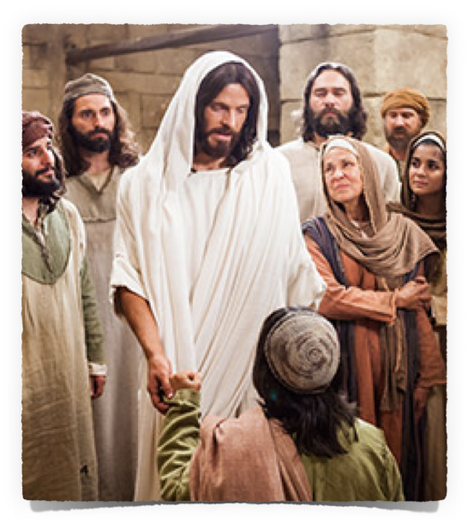
My Life Should Be “ALL ABOUT GOD!”
The Fruitfulness of Selflessness
Matthew 16:24–26 (NKJV)
²⁴ Then Jesus said to His disciples, “If anyone desires to come after Me, let him deny himself, and take up his cross, and follow Me. ²⁵ For whoever desires to save his life will lose it, but whoever loses his life for My sake will find it. ²⁶ For what profit is it to a man if he gains the whole world, and loses his own soul? Or what will a man give in exchange for his soul?

Slide 23
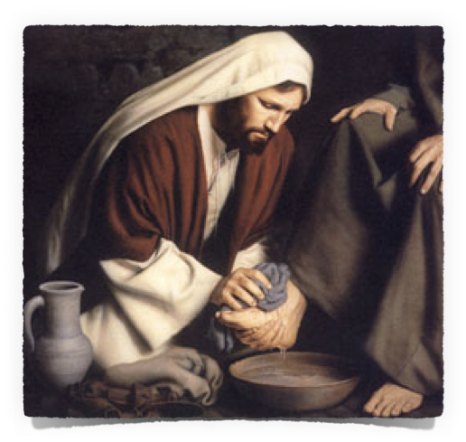
My Life Should Be “ALL ABOUT GOD!”
The Fruitfulness of Selflessness
Deny yourself – Mat 16:24; Phili 3:7,8
Put God & others FIRST - Like Jesus did - 2 Cor 8:9; Phili 2:1-10; Rom 6:16-18
Learn to LOVE! – Mark 12:29-31; Lk 10:36,37; Rom 13:8
OR LOSE EVERYTHING!

Slide 24
Don McClain
West 65th St. church of Christ - August 20,2006

Slide 25
The Pervasive Sin of Selfishness
Charts by Don McClain
Prepared March 30-April 1; 2017 / Preached April 2, 2017
West 65th Street church of Christ / P.O. Box 190062 Little Rock AR 72219 / 501-568-1062
Prepared using Keynote / Email – donmcclain@sbcglobal.net
More Keynote, PPT & Audio Sermons:
http://w65stchurchofchrist.org/coc/sermons/

Slide 26
Philippians 2:1–5 (NKJV)
¹ Therefore if there is any consolation in Christ, if any comfort of love, if any fellowship of the Spirit, if any affection and mercy, ² fulfill my joy by being like-minded, having the same love, being of one accord, of one mind. ³ Let nothing be done through selfish ambition or conceit, but in lowliness of mind let each esteem others better than himself. ⁴ Let each of you look out not only for his own interests, but also for the interests of others. ⁵ Let this mind be in you which was also in Christ Jesus,

