Slide 1
The
of
Hebrews 11:1-31
James 2:14-26
Romans 4:13-25

Slide 2
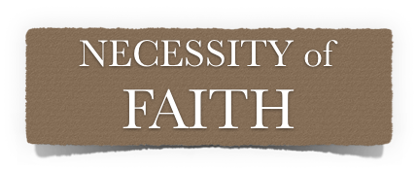
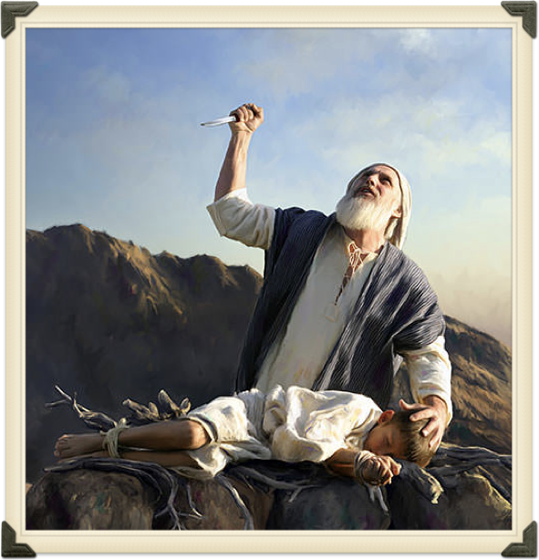
The
of
Hebrews 11:6 (NKJV)
⁶ But without faith it is impossible to please Him, for he who comes to God must believe that He is, and that He is a rewarder of those who diligently seek Him.

Slide 3
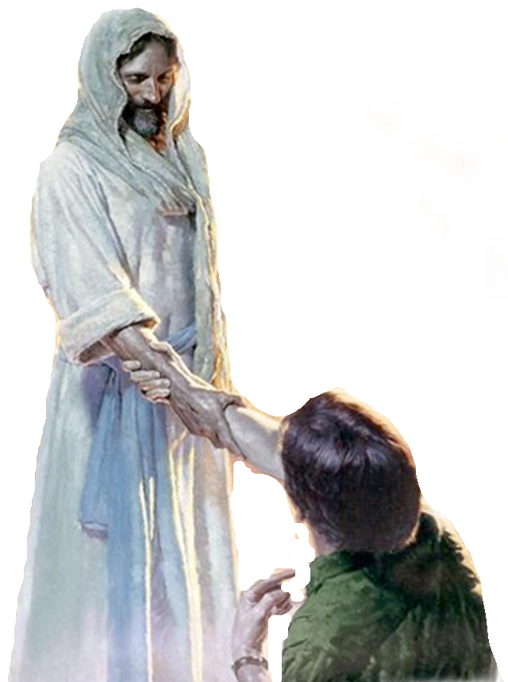
The
of
FAITH (N) / BELIEVE (V)
FAITHFUL / BELIEVING (Adj.)
FAITH (N) pistis (πίστις, 4102), “faith,” is translated “belief” (2 Thess. 2:13).
BELIEVE (V) pisteuo (πιστεύω, 4100), “to believe,” also “to be persuaded of,” and hence, “to place confidence in, to trust,” signifies, in this sense of the word, reliance upon, not mere credence.
BELIEVER (ADJ.) pistos (πιστός, 4103), (a) in the active sense means “believing, trusting”; (b) in the passive sense, “trusty, faithful, trustworthy.”
Vine’s Complete Expository Dictionary

Slide 4
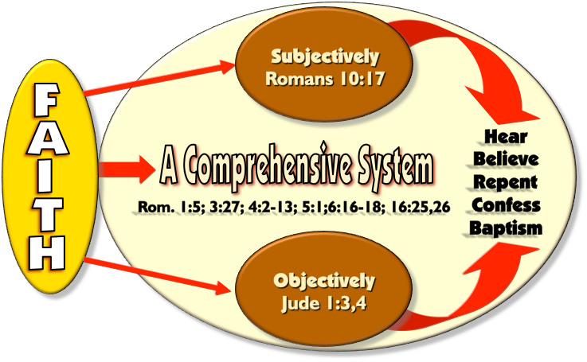
The
of

Slide 5
The
of
4102. πίστις pistis, pis´-tis; from 3982;
"...used especially of the faith by which a man embraces Jesus, i.e., a conviction, full of joyful trust, that Jesus is the Messiah -- the divinely appointed author of eternal salvation in the kingdom of God, conjoined with obedience to Christ."
(Thayer's Greek-English Lexicon, p. 511)

Slide 6
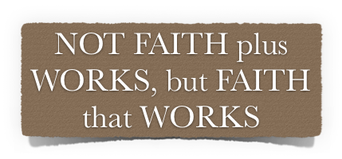
The
of
CONVICTION
Hebrews 11:6 (NKJV)
⁶ But without faith it is impossible to please Him, for he who comes to God must believe that He is, and that He is a rewarder of those who diligently seek Him.
TRUST
OBEDIENCE
believe that He is
He is a rewarder
diligently
seek

Slide 7
The
of
Hebrews 11:6 (NKJV)
⁶ But without faith it is impossible to please Him, for he who comes to God must believe that He is, and that He is a rewarder of those who diligently seek Him.
believe that He is
He is a rewarder
diligently
seek

Slide 8
The
of
James 2:22 (NKJV)
²² Do you see that faith was working together with his works, and by works faith was made perfect?

Slide 9
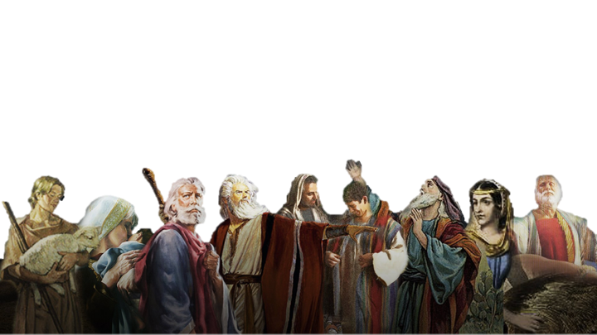
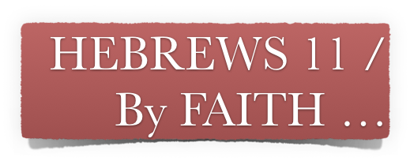
The
of
Hebrews 11:1–3 (NKJV)
¹ Now faith is the substance of things hoped for, the evidence of things not seen. ² For by it the elders obtained a good testimony. …

Slide 10
The
of
Abel offered - (4)
Enoch pleased God - (5)
Noah built the ark - (7)
Abraham obeyed - (8-10)
Sarah conceived - (11,12)

Slide 11
The
of
Abraham’s sacrifice - (17-19)
Isaac Blessed sons - (20)
Jacob blessed Joseph’s sons - (21)
Moses spurned Egypt - (23-27)
Kept passover - (28)

Slide 12
The
of
Israel crossed R. S. - (29)
Wall of Jericho fell- (30)
Rahab Spared- (31)
Judges, Kings, Prophets others- (32-38)

Slide 13
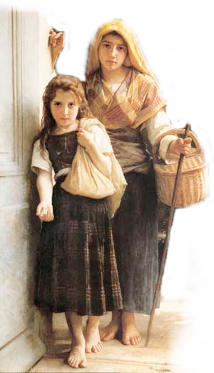
The
of
James 2:14 (NKJV)
¹⁴ What does it profit, my brethren, if someone says he has faith but does not have works? Can faith save him?

Slide 14
The
of
James 2:15–17 (NKJV)
¹⁵ If a brother or sister is naked and destitute of daily food, ¹⁶ and one of you says to them, “Depart in peace, be warmed and filled,” but you do not give them the things which are needed for the body, what does it profit? ¹⁷ Thus also faith by itself, if it does not have works, is dead.

Slide 15
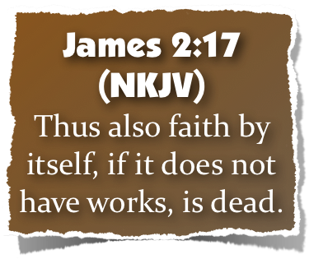
The
of
What does it profit?
Hearers but not doers? - 1:22-25
Believers who will not confess? - John 12:42; (Rom. 10:9,10)
Professors who will not obey? - Luke 6:46; Mat 7:21-23
Is it saving faith if it will not confess? repent? be baptized? — (Luke 7:7:29,30; 2 Thes. 1:7-9)

Slide 16
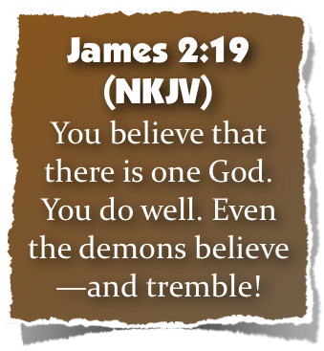
The
of
Demons believe in the one true God - (Mk 1:24; 5:7; Lk 4:34; Ac. 19:15)
Demons believe in the deity of Jesus - (Mark 3:11,12; Luke 8:30,31)
Demons believe in hell - (Mt 8:29)
Demons believe Jesus is judge and will condemn - (Mark 5:1-13)

Slide 17
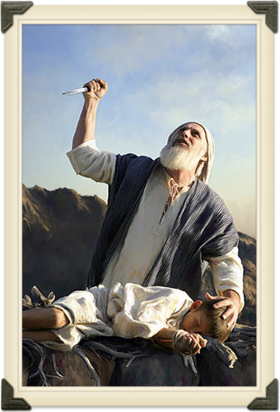
The
of
Abraham was JUSTIFIED by works - (justified, [dikaiosune - δικαιοσύνη] same term as in Rom 4:2,3,5,6; 6:16)
Abraham trusted God to the max when he obeyed God by offering Isaac! - (Heb 11:17; Rom 4:19-22; Gen 22:1-19)

Slide 18
The
of
NOT Saved By Works,
“WORKS used in two different senses
Saved By Works,
Romans 4:1-6
Justified
Counted for righteousness
Fulfilled Genesis 15:6
Strong
Not of works
James 2:21-24
Justified
Counted for righteousness
Fulfilled Genesis 15:6
Perfect
By works
WHAT Kind of FAITH did Abraham Have?

Slide 19
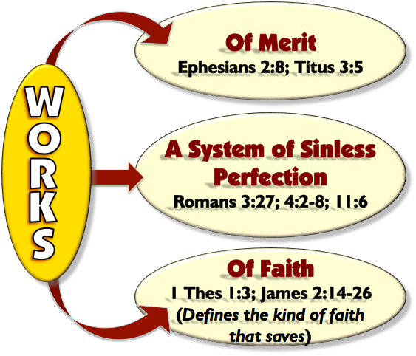
The
of
Includes:
Receiving the word
Confession
Repentance
Baptism
Faithfulness

Slide 20
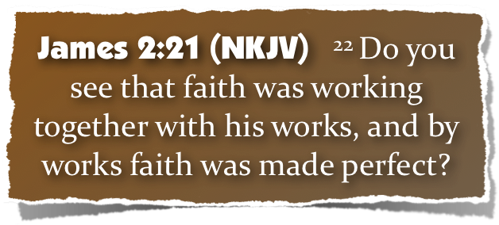
The
of
Faith motivated his obedience, which rendered his faith complete, therefore effectual - (22; Heb 11:17-19; Gal 5:6)

Slide 21
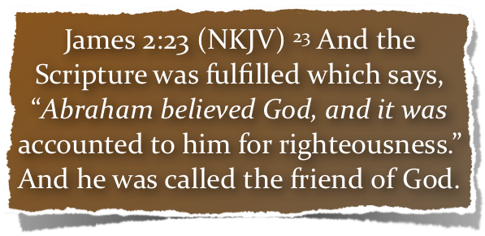
The
of
Faith was credited to Abraham as righteousness when he obeyed! - (23a; Gen 15:6; Rom 4:3; Gal. 3:6-8)
Abraham was called the friend of God! - (23b; Is 41:8; 2 Chron 20:7)

Slide 22
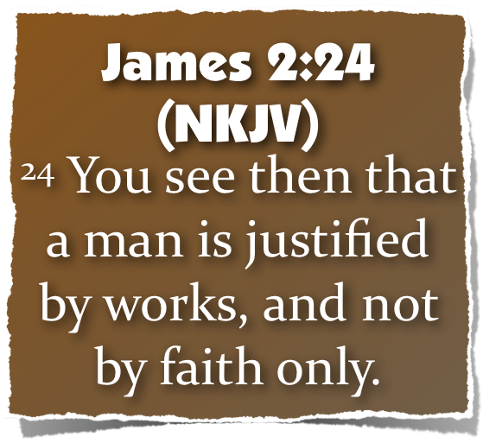
The
of

Slide 23
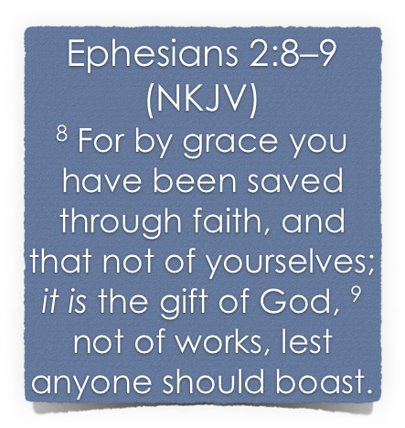
The
of
Salvation is a gift of God which no man deserves – Rom 3:23
Salvation is received through the means of our faith – John 3:16; 8:24; Heb 11:6; Rom 10:17
Salvation not earned through our own merits – Rom. 11:6
No man can boast before God – Rom. 4:2; 3:23

Slide 24
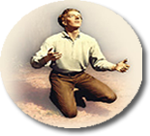
The
of
The
Basis of
(Not of
WORKS)
God's Universal Kindness, Love &
Mercy.
The Gracious
Gift of God’s Son & The Gospel -
The
Conditions We MUST meet
(WORKS)
Salvation
The
Provision
of
(Not of
WORKS)
Faith – (Repent – Confess – Be baptized - Persevere)

Slide 25
The
of
Noah saved by grace through faith – Gen. 6:8; Heb 11:7
Naaman healed by grace through faith – 2 Kings 5:1-19; Lk 4:27
Walls of Jericho fell by grace through faith – Joshua 6:2,15,16,20; Heb 11:30
The FAITH that obeys does not nullify God’s grace - but receives it!!

Slide 26
The
of
SAME principle In EVERY Age …

Slide 27
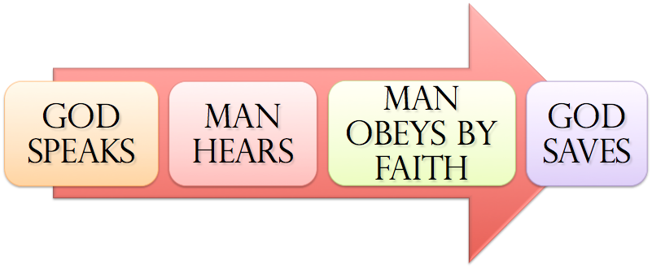
The
of
SAME principle In EVERY Age …
Noah - Gen. 6:8,13-17; 22; 7:5; Heb 11:7
Abraham – Gen 12:4; 15:6; 17:10,23; 22:3,16-18
Israel – Ex. 12:13; 14:30; Dt 30:15-19; Jos 6; 1 Cor 10:1-13
Us – Mark 16:16; Acts 2:38; 8:12,37; Rom 6:3-6; 10:9-13; Gal. 3:26,27; Col. 2:11-13; 1 Pet 3:21; 1 Jn 1:9

Slide 28
The
of
The only viable faith is the faith that obeys God! — (James 2:14-26; Heb. 11)
What KIND of FAITH did Abraham Have? — (Gen 12-22; Rom 4:12,23)
What kind of FAITH do you have? — (Mk 16:16; Acts 2:37,38,41; Gal. 3:26,27)

Slide 29
Don McClain
W. 65th St church of Christ / May 6, 2007

Slide 30
The
of
Charts by Don McClain
Prepared February 17,18; 2017 / Preached February 19, 2017
West 65th Street church of Christ / P.O. Box 190062 Little Rock AR 72219 / 501-568-1062
Prepared using Keynote / Email – donmcclain@sbcglobal.net
More Keynote, PPT & Audio Sermons:
http://w65stchurchofchrist.org/coc/sermons/

Slide 31
Hebrews 11:1–7 (NKJV)
¹ Now faith is the substance of things hoped for, the evidence of things not seen. ² For by it the elders obtained a good testimony. ³ By faith we understand that the worlds were framed by the word of God, so that the things which are seen were not made of things which are visible.

Slide 32
Hebrews 11:1–7 (NKJV)
⁴ By faith Abel offered to God a more excellent sacrifice than Cain, through which he obtained witness that he was righteous, God testifying of his gifts; and through it he being dead still speaks. ⁵ By faith Enoch was taken away so that he did not see death, “and was not found, because God had taken him”; for before he was taken he had this testimony, that he pleased God.

Slide 33
Hebrews 11:1–7 (NKJV)
⁶ But without faith it is impossible to please Him, for he who comes to God must believe that He is, and that He is a rewarder of those who diligently seek Him. ⁷ By faith Noah, being divinely warned of things not yet seen, moved with godly fear, prepared an ark for the saving of his household, by which he condemned the world and became heir of the righteousness which is according to faith.

Slide 34
“We are saved by faith alone, but the faith that saves is never alone.”
Salvation by the Installment Plan?
by Phil Congdon
Many Bible teachers are fond of a saying that goes like this: "You are saved by faith alone, but the faith that saves is never alone." Doesn't that sound neat? It states a fundamental truth--that we are saved by faith alone--then turns around and states that while it is faith alone that saves us, that faith is never alone. This saying is used to teach the idea that if a person puts their faith in Jesus Christ, but doesn't live a right kind of life, they aren't saved. But wait a minute; let's plug in our logical minds for a minute and see if this is really neat-or nonsense.
The phrase "You are saved by faith alone" is obviously true. Scripture repeatedly tells us that it is faith alone without works which saves (e.g., Eph. 2:8-9). Buy what does the second phrase say? Incredibly it says exactly the opposite. We can paraphrase the saying this way: "Faith [in Christ] alone saves you, but if your faith [in Christ] is alone, it doesn't save you." This kind of illogical thinking allows some theologians to turn the truth of the gospel on its head and make salvation a result of faith plus good works.
In response, these teachers state that they do not mean faith + works = salvation but rather faith = salvation + works. But the end result is the same. If I pay cash for a car and drive it home, it is no different than if I were to drive it home and pay for it over the next few years. It doesn't matter when you pay--before or after you take possession. If you ever have to do good works to be saved, salvation isn't free, it's something you earn.
The Apostle Paul knew this. That's why he wrote, "To the one who does not work, but believes in Him who justifies the ungodly, his faith is reckoned as righteousness" (Rom. 4:5). — https://faithalone.org/magazine/y1989/89oct1.html

