Slide 1


Since You Were Raised With Christ
Colossians 3:1–4

Slide 2
Colossians 3:1–4 (NKJV)
¹ If then you were raised with Christ, seek those things which are above, where Christ is, sitting at the right hand of God. ² Set your mind on things above, not on things on the earth. ³ For you died, and your life is hidden with Christ in God. ⁴ When Christ who is our life appears, then you also will appear with Him in glory.

Slide 3



Since You Were Raised With Christ
  Proof of His Deity, Foundation of Our Faith — (Mat 28:1-17; Mark 16:1–8; Luke 24:1–11; John 20:1-29; Acts 1:3; 1 Cor. 15:3-19; Eph. 1:19,20)
  Proof we ALL will be raised — (John 5:28-29; 1 Cor. 15:20-28)
  Proof of His authority as LORD & JUDGE — (Acts 2:29-36; 17:30,31)

Slide 4

Since You Were Raised With Christ
Christ, our Creator and Head, is supreme in all things (1:15–20).
Through Christ’s death God has reconciled to Himself those who were aliens and enemies, but must continue in the faith - (1:21–23).
God’s fullness (His provisions in Jesus), can be known & enjoyed by all through the gospel - (1:24–27).
To this end we labor that everyone may be perfect in Christ (1:28–29).

Slide 5
Since You Were Raised With Christ
All true wisdom & knowledge is found in Christ - (2:1–5; 1:9-11).
As you began with Christ, you must also continue in Him - (2:6–7).
Don’t be deceived: God’s fullness is in Christ alone - not in human philosophy - (2:8–10).
By putting on Christ in baptism, we have been freed from sin & made alive to God - therefore we must hold fast to Him - (2:11–23).

Slide 6


Since You Were Raised With Christ
Colossians 3:1-4
“If then you were” – First class conditional clause – i.e. “Since you have been” —
“Raised with Christ” – what occurred when you were baptized into Christ – “raised with Him through faith in the working of God” - (2:11-13)
The Christian has been made spiritually alive with Christ – (2:13; Eph 1:19,20; 2:5,6)

Slide 7
Since You Were Raised With Christ
Colossians 3:1-4
Colossians 2:12–13 (NKJV)
¹² buried with Him in baptism, in which you also were raised with Him through faith in the working of God, who raised Him from the dead. ¹³ And you, being dead in your trespasses and the uncircumcision of your flesh, He has made alive together with Him, having forgiven you all trespasses,

Slide 8
Since You Were Raised With Christ
Colossians 3:1-4
Romans 6:3–11 (NKJV)
³ Or do you not know that as many of us as were baptized into Christ Jesus were baptized into His death? ⁴ Therefore we were buried with Him through baptism into death, that just as Christ was raised from the dead by the glory of the Father, even so we also should walk in newness of life.

Slide 9
Since You Were Raised With Christ
Colossians 3:1-4
Romans 6:3–11 (NKJV)
⁵ For if we have been united together in the likeness of His death, certainly we also shall be in the likeness of His resurrection, ⁶ knowing this, that our old man was crucified with Him, that the body of sin might be done away with, that we should no longer be slaves of sin.

Slide 10
Since You Were Raised With Christ
Colossians 3:1-4
Romans 6:3–11 (NKJV)
⁷ For he who has died has been freed from sin. ⁸ Now if we died with Christ, we believe that we shall also live with Him, ⁹ knowing that Christ, having been raised from the dead, dies no more. Death no longer has dominion over Him.

Slide 11
Since You Were Raised With Christ
Colossians 3:1-4
Romans 6:3–11 (NKJV)
¹⁰ For the death that He died, He died to sin once for all; but the life that He lives, He lives to God. ¹¹ Likewise you also, reckon yourselves to be dead indeed to sin, but alive to God in Christ Jesus our Lord.

Slide 12
Since You Were Raised With Christ
Colossians 3:1-4
Galatians 2:19–21 (NKJV)
¹⁹ For I through the law died to the law that I might live to God. ²⁰ I have been crucified with Christ; it is no longer I who live, but Christ lives in me; and the life which I now live in the flesh I live by faith in the Son of God, who loved me and gave Himself for me. ²¹ I do not set aside the grace of God; for if righteousness comes through the law, then Christ died in vain.”

Slide 13
Since You Were Raised With Christ
Colossians 3:1-4
“Seek those things which are above” - A whole-hearted search for the things of God – (Mat 5:6; 6:33; 13:44,45; Heb 11:13-16)
“Where Christ is, sitting at the right hand of God” - Jesus given supreme honor & authority in my life – (Ps. 110:1; Mat 22:44; Act 2:34; Eph 1:20; 1 Pet 3:15,22; 4:11)

Slide 14
Since You Were Raised With Christ
Colossians 3:1-4
“Set your mind on things above,” - My values & loves to be set WHOLY upon spiritual things– (Mt 6:19-24; Ro 12:1,2; 1 Jn 2:15-17; Prov 23:7; Is 26:3)
  I determine what I value & what I love - I choose my priorities — I set my mind on what I choose - “Keep your heart with all diligence; for out of it are the issues of life” (Proverbs 4:23)

Slide 15
Since You Were Raised With Christ
Colossians 3:1-4
“For You Died” – I.E. – You Were Separated From Sin – (Acts 2:38; 22:16; Col. 2:11-13; Rom 6:3-11
“Your Life” – I.E. – You are alive to God IN CHRIST!
  Jesus is my LIFE - (He is the source of my spiritual life and ALSO MUST BE the FOCUS of my life) – (1 Jn 5:12; Jn 14:6; Gal 2:20)

Slide 16
Since You Were Raised With Christ
Colossians 3:1-4
Hidden - Is From The Greek - κρύπτω (kryptō) - - hide, conceal, cover (pass. often hide oneself); keep secret—Barclay Newman: NT Greek-English Dictionary
The BELIEVER (the one genuinely seeking & focusing on Jesus & His teaching; thus obedient), is secure IN Christ - (2 Tim 1:12; 1 Jn 2:4,5)

Slide 17
Since You Were Raised With Christ
Colossians 3:1-4
It IS ONLY WITH CHRIST we find safety, security, & protection — (Jn 10:27–29; Rom 8:28–39)
As long as we abide in Christ, we are secure through faith! – (Heb 3:12, 10:29; John 15:1-10; 2 Pet 2:20-22; 1 Cor 10:1-13; 1 Pet 1:5; Rev 2:10)

Slide 18
Since You Were Raised With Christ
Colossians 3:1-4
When Jesus Appears – faithful Christians will be glorified together with Him – (Mat 25:31; 1 Tim 6:14; 2 Ti. 4:8. Tit. 2:13. He. 9:28. 1 Pe. 5:4. 1 Jno. 2:28; 3:2)
All others rejected & lost! - (Mat 7:21-23; 25:31; 1 Tim 6:14; 2 Pet 3:9-14; Rom 2:5-11; 2 Cor 5:9-11; Phil 3:20–21; 2 Thes 1:7-11; etc)

Slide 19

Since You Were Raised With Christ
Colossians 3:5-9
“Put to death” – “Mortify” - i.e. – “utterly slay” – more than just suppress or control - (Gal 5:24)
“Your Members” – The body, and its members serve as the medium through which sin works – (Rom 6:12,13,19)
“Put to death every part of yourself which is against God and keeps you from fulfilling His will” – (William Barclay 174.)

Slide 20
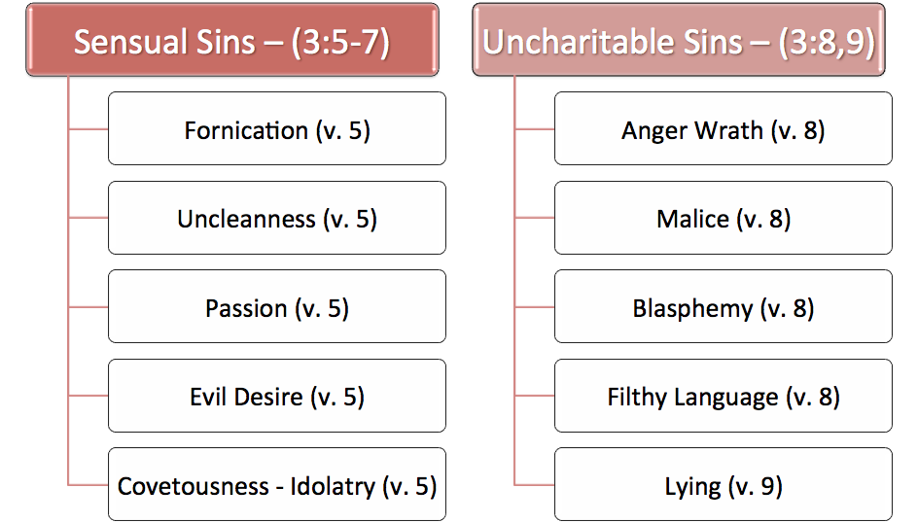
Since You Were Raised With Christ

Slide 21
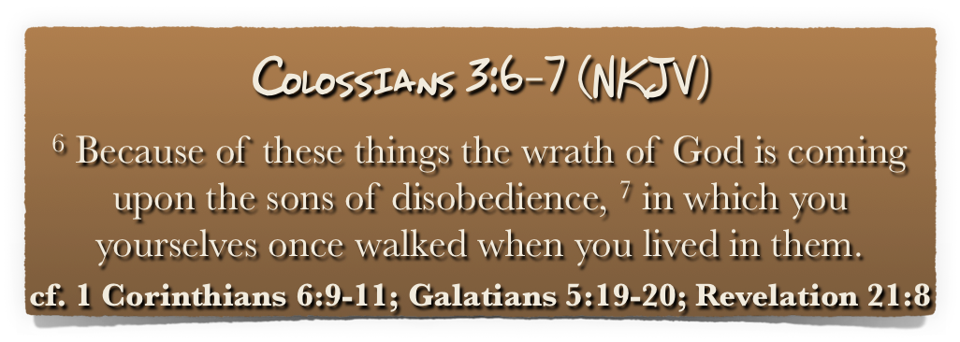
Since You Were Raised With Christ

Slide 22

Since You Were Raised With Christ
Colossians 3:10,11
They had been baptized into Christ thus they had put on the new man – (Col 2:11-13; Gal 3:27; 2 Cor 5:17; 1 Pet 1:22,23)
“Renewed in knowledge” – present passive participle – thus “being renewed in knowledge” [epignosis] – (Eph 4:23; 2 Cor 4:16; 2 Pet 2:1; 3:18)
According to the image of Him – (Gen 1:27; 2 Cor 5:17; Eph 4:24; 5:1; Rom 8:29)

Slide 23
Since You Were Raised With Christ
Colossians 3:12-15
Colossians 3:12–14 (NKJV)
¹² Therefore, as the elect of God, holy and beloved, put on tender mercies, kindness, humility, meekness, longsuffering; ¹³ bearing with one another, and forgiving one another, if anyone has a complaint against another; even as Christ forgave you, so you also must do. ¹⁴ But above all these things put on love, which is the bond of perfection.

Slide 24
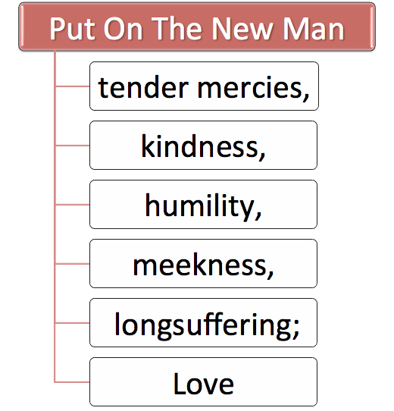
Since You Were Raised With Christ
Colossians 3:12-15
¹⁵ And let the peace of God rule in your hearts, to which also you were called in one body; and be thankful.

Slide 25
Since You Were Raised With Christ
Colossians 3:16-17
“Let the word of Christ dwell in you richly” – i.e. to allow oneself to be brought completely under its influence. (Ps 119:11; John 15:7)
“In all wisdom”– Wisdom receives the word of Christ – (Eph 5:17) - The word of Christ produces wisdom (Col. 1:9;2:3) - the word of Christ must be taught in wisdom – (Col 1:28)

Slide 26

Since You Were Raised With Christ
Colossians 3:16-17
I worship God in spirit & truth - (John 4:24)
We sing:
  To one another - teaching & admonishing
  The Lord
  Psalms, Hymns, Spiritual songs
  With grace in heart

Slide 27
Since You Were Raised With Christ
Colossians 3:16-17
I submit to Jesus’ authority in everything said & done - (3:17)
  Every word – every deed must be in submission to the authority of Christ – (2 John 9)
  “He is most likely to do his duty well who goes to it with a heart overflowing with gratitude to God for his mercies;” —Barnes' Notes on the New Testament – (Eph 5:20)

Slide 28
Colossians 3:1–4 (NKJV)
¹ If then you were raised with Christ, seek those things which are above, where Christ is, sitting at the right hand of God. ² Set your mind on things above, not on things on the earth. ³ For you died, and your life is hidden with Christ in God. ⁴ When Christ who is our life appears, then you also will appear with Him in glory.

Slide 29
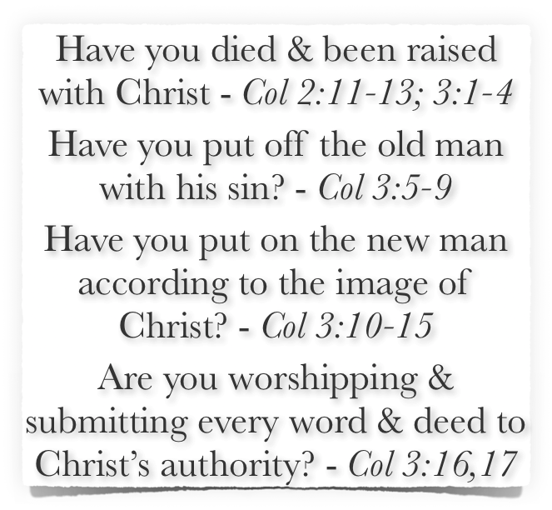
Since You Were Raised With Christ

Slide 30
Since You Were Raised With Christ
Does Jesus Christ “REALLY” have pre-eminence in your life?
Actions speak louder than words!

Slide 31
Don McClain
West 65th St. church of Christ - August 20,2006

Slide 32
Since You Were Raised With Christ
Charts by Don McClain
Prepared April 14,15, 2017 / Preached April 16, 2017
West 65th Street church of Christ / P.O. Box 190062 Little Rock AR 72219 / 501-568-1062
Prepared using Keynote / Email – donmcclain@sbcglobal.net
More Keynote, PPT & Audio Sermons:
http://w65stchurchofchrist.org/coc/sermons/

Slide 33
Romans 6:1–11 (NKJV)
¹ What shall we say then? Shall we continue in sin that grace may abound? ² Certainly not! How shall we who died to sin live any longer in it? ³ Or do you not know that as many of us as were baptized into Christ Jesus were baptized into His death? ⁴ Therefore we were buried with Him through baptism into death, that just as Christ was raised from the dead by the glory of the Father, even so we also should walk in newness of life.

Slide 34
Romans 6:1–11 (NKJV)
⁵ For if we have been united together in the likeness of His death, certainly we also shall be in the likeness of His resurrection, ⁶ knowing this, that our old man was crucified with Him, that the body of sin might be done away with, that we should no longer be slaves of sin. ⁷ For he who has died has been freed from sin. ⁸ Now if we died with Christ, we believe that we shall also live with Him,

Slide 35
Romans 6:1–11 (NKJV)
⁹ knowing that Christ, having been raised from the dead, dies no more. Death no longer has dominion over Him. ¹⁰ For the death that He died, He died to sin once for all; but the life that He lives, He lives to God. ¹¹ Likewise you also, reckon yourselves to be dead indeed to sin, but alive to God in Christ Jesus our Lord.

