Slide 1
Walking By Faith
The Law of
Exclusion
Genesis 6:8-7:7
Hebrews 7:11-14
Leviticus 10:1,2
1 Chronicles 13:7-12; 15:2

Slide 2
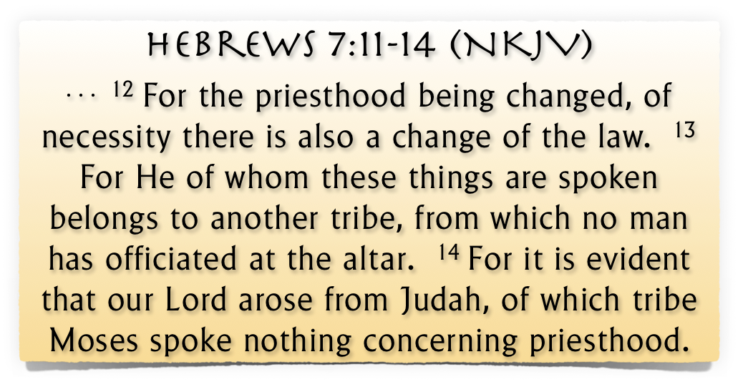
The Law of Exclusion

Slide 3
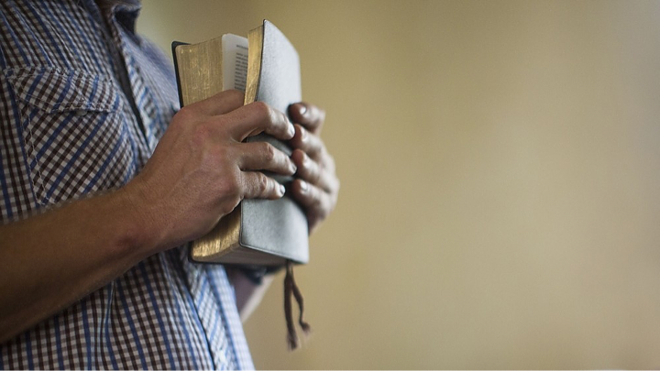
The Law of Exclusion
Cannot ADD to or SUBTRACT From God’s Word
1 Peter 4:11 (NKJV)
¹¹ If anyone speaks, let him speak as the oracles of God. …

Slide 4
The Law of Exclusion
Cannot ADD to or SUBTRACT From God’s Word
Deuteronomy 4:2 (NKJV)
² You shall not add to the word which I command you, nor take from it, that you may keep the commandments of the Lord your God which I command you.

Slide 5
The Law of Exclusion
Cannot ADD to or SUBTRACT From God’s Word
Deuteronomy 12:32 (NKJV)
³² “Whatever I command you, be careful to observe it; you shall not add to it nor take away from it.

Slide 6
The Law of Exclusion
Cannot ADD to or SUBTRACT From God’s Word
Joshua 1:7 (NKJV)
⁷ Only be strong and very courageous, that you may observe to do according to all the law which Moses My servant commanded you; do not turn from it to the right hand or to the left, that you may prosper wherever you go.

Slide 7
The Law of Exclusion
Cannot ADD to or SUBTRACT From God’s Word
Proverbs 30:6 (NKJV)
⁶ Do not add to His words, Lest He rebuke you, and you be found a liar.

Slide 8
The Law of Exclusion
Cannot ADD to or SUBTRACT From God’s Word
1 Corinthians 4:6 (NKJV)
⁶ Now these things, brethren, I have figuratively transferred to myself and Apollos for your sakes, that you may learn in us not to think beyond what is written, that none of you may be puffed up on behalf of one against the other.

Slide 9
The Law of Exclusion
Cannot ADD to or SUBTRACT From God’s Word
Revelation 22:18–19 (NKJV)
¹⁸ For I testify to everyone who hears the words of the prophecy of this book: If anyone adds to these things, God will add to him the plagues that are written in this book;

Slide 10
The Law of Exclusion
Cannot ADD to or SUBTRACT From God’s Word
Revelation 22:18–19 (NKJV)
¹⁹ and if anyone takes away from the words of the book of this prophecy, God shall take away his part from the Book of Life, from the holy city, and from the things which are written in this book.

Slide 11
Comprehensive Nature of The New Testament Scriptures
Fully Instructs - 2 Tim 3:16,17
Cannot Be Transgressed – 2 John 9
The totality of information revealed regarding any act of righteousness forms the pattern for that act – 2 Tim 1:13; 3:16,17; 2 Pet 1:3;
Understandable – Eph 3:3-5

Slide 12
Comprehensive Nature of The New Testament Scriptures
We cannot know the mind of God except through revelation
1 Cor 2:10, 11,14
Eph 3:3-5
Isaiah 55:8,9
Faith comes by hearing the word of CHRIST
God has revealed everything He wants us to know & do –
2 Pet 1:3;
2 Tim 3:16,17
Jude 3
ROMANS 10:17
Walking by faith means walking by what God has said
2 Cor. 5:7; 1 Cor. 4:6; Gal. 1:6-9

Slide 13
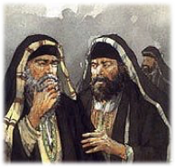
From Heaven or Men?
From Heaven
Mt. 21:23-27
1 John 4:4-6
Gal. 1:6-9
Col. 2:6-10
2 Thess. 2:15
From Men
Mt. 15:1-9
1 Cor. 4:6
Gal. 1:10-17
Col. 2:8
2 Thess. 2:2-4
Walking by faith means walking by what God has said
2 Cor. 5:7; 1 Cor. 4:6; Gal. 1:6-9

Slide 14
Exclusive & Inclusive
Heb 11:7 By faith Noah, being divinely warned of things not yet seen, moved with godly fear, prepared an ark for the saving of his household,
²²Thus Noah did; according to all that God commanded him, so he did. . . . 7:5 ⁵And Noah did according to all that the Lord commanded him.
Specific authority:
Gopher wood (14)
Compartments (14)
450’ Long (15)
75’ Wide (15)
45’ Tall (15)
1 Window & Door (16)
3 Stories (16)
Generic & Specific:
Build an ark of gopher wood
Expedients
Tools & Size of material dependent upon specific need
Liberty:
Source and means of transporting materials
Don McClain
W. 65th St church of Christ - 9/16/2007

Slide 15
Exclusive & Inclusive
Heb 11:7 By faith Noah, being divinely warned of things not yet seen, moved with godly fear, prepared an ark for the saving of his household,
²²Thus Noah did; according to all that God commanded him, so he did. . . . 7:5 ⁵And Noah did according to all that the Lord commanded him.
Authorized
Excluded / Unauthorized
Another door
Different wood
Different size
Additional boats
Incidental
Tools
Scaffolds
Help
Build An Ark of Gopher Wood
Don McClain
W. 65th St church of Christ - 9/16/2007

Slide 16
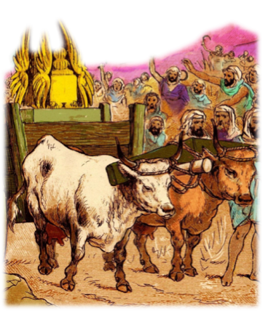
Exclusive & Inclusive
The method of moving the ark of the covenant was specified, thus excluding any other method
Consulted with every leader – (1 Chron 13:1) but forgot to consult God’s word (1 Chron 15:13)
The Ox Cart was unauthorized –NOT an expedient -
Was not specifically condemned – but was condemned because the method was specified!

Slide 17
Exclusive & Inclusive
The method of moving the ark of the covenant was specified, thus excluding any other method
When God specifies - we CANNOT substitute. (1 Chron 13:5-8)
David’s best attempt to serve God according to his own thinking dishonored God instead of honoring Him - (Lev 10:1-4; 1 Chron 15:2,13; Isa 55:6-9; Hos 14:9; Col. 3:17)

Slide 18
Exclusive & Inclusive
The method of moving the ark of the covenant was specified, thus excluding any other method
When God specifies - we CANNOT substitute. (1 Chron 13:5-8)
Nadab and Abihu – (Lev. 10:1,2)
Moses – (Num 20:8-24)
King Saul – (1 Sam. 13 & 15)
Jeroboam – (1 Kings 12:25-33)
Uzziah – (2 Chr. 26:16-23)

Slide 19
Exclusive & Inclusive
The method of moving the ark of the covenant was specified, thus excluding any other method
When God specifies - we CANNOT substitute. (1 Chron 13:5-8)
We must remember that any substitute for what God specifies is evil, regardless of intent (cf Num 20:8,11; Matt 7:21-23; 2 Jn 9,10; Dt 4:2; 12:32; Jos 1:7; Pro 30:6; Rev 22:18,19).

Slide 20
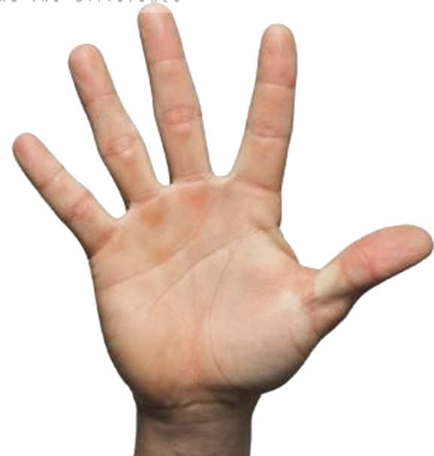
Making Application
Believe
Repent
3
2
4
Confess
1
Luke 8:11; Rom. 10:17
John 8:24; Heb 11:6
Luke 13:3,5; Acts 17:30
Mat. 10:32,33; Rom 10:9
Acts 2:38; 1 Pet 3:21
Hear
5
Be Baptized

Slide 21
Making Application
The organization of the church - Acts 14:23; 20:14,28; Phili 1:1; 1 Tim 3:1-8; etc.
The work of the church - (evangelism - 1 Thes. 1:8; edification - Eph. 4:11-16; Benevolence - Acts 11:29)
Worship of the church - (Praying - Acts 4:23-31; L.S. - Acts 20:7; Giving - 1 Cor. 16:1,2; Preaching - Acts 20:7; Singing - Eph 5:19; Col. 3:16)

Slide 22
Conclusion
What is OUR attitude towards the need to establish authority for all that we do?
Is the NT the ONLY source for our faith, teaching & practice?
If we add to or take away from the teaching of the NT, are we walking by faith?
If we do only those things we know are authorized in the NT, how confident can we be that we are doing what is right?

Slide 24
Walking By Faith
The Law of
Exclusion
Charts by Don McClain
Prepared April 7,8, 2017 / Preached April 9, 2017
West 65th Street church of Christ / P.O. Box 190062 Little Rock AR 72219 / 501-568-1062
Prepared using Keynote / Email – donmcclain@sbcglobal.net
More Keynote, PPT & Audio Sermons:
http://w65stchurchofchrist.org/coc/sermons/

Slide 25
2 Chronicles 26:16–21 (NKJV)
¹⁶ But when he was strong his heart was lifted up, to his destruction, for he transgressed against the Lord his God by entering the temple of the Lord to burn incense on the altar of incense. ¹⁷ So Azariah the priest went in after him, and with him were eighty priests of the Lord—valiant men.

Slide 26
2 Chronicles 26:16–21 (NKJV)
¹⁸ And they withstood King Uzziah, and said to him, “It is not for you, Uzziah, to burn incense to the Lord, but for the priests, the sons of Aaron, who are consecrated to burn incense. Get out of the sanctuary, for you have trespassed! You shall have no honor from the Lord God.” ¹⁹ Then Uzziah became furious; and he had a censer in his hand to burn incense. And while he was angry with the priests, leprosy broke out on his forehead, before the priests in the house of the Lord, beside the incense altar.

Slide 27
2 Chronicles 26:16–21 (NKJV)
²⁰ And Azariah the chief priest and all the priests looked at him, and there, on his forehead, he was leprous; so they thrust him out of that place. Indeed he also hurried to get out, because the Lord had struck him. ²¹ King Uzziah was a leper until the day of his death. He dwelt in an isolated house, because he was a leper; for he was cut off from the house of the Lord. Then Jotham his son was over the king’s house, judging the people of the land.

