Slide 1
Uncertain Sounds
For if the trumpet makes an uncertain sound, who will prepare for battle? ⁹ So likewise you, unless you utter by the tongue words easy to understand, how will it be known what is spoken? ~ 1 Corinthians 14:8,9

Slide 2
1 Corinthians 14:6–12 (NKJV)
⁶ But now, brethren, if I come to you speaking with tongues, what shall I profit you unless I speak to you either by revelation, by knowledge, by prophesying, or by teaching? ⁷ Even things without life, whether flute or harp, when they make a sound, unless they make a distinction in the sounds, how will it be known what is piped or played? ⁸ For if the trumpet makes an uncertain sound, who will prepare for battle?

Slide 3
1 Corinthians 14:6–12 (NKJV)
⁹ So likewise you, unless you utter by the tongue words easy to understand, how will it be known what is spoken? For you will be speaking into the air. ¹⁰ There are, it may be, so many kinds of languages in the world, and none of them is without significance. ¹¹ Therefore, if I do not know the meaning of the language, I shall be a foreigner to him who speaks, and he who speaks will be a foreigner to me. ¹² Even so you, since you are zealous for spiritual gifts, let it be for the edification of the church that you seek to excel.

Slide 4
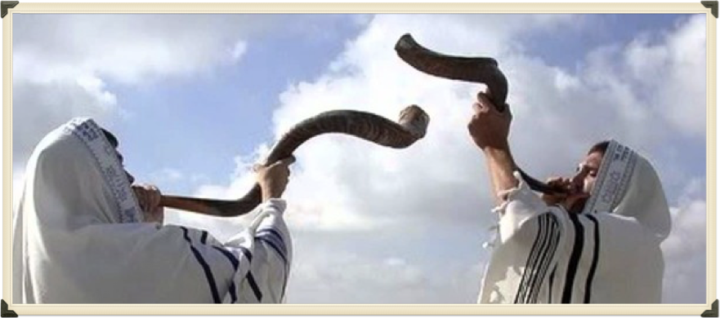
“Uncertain Sounds …”
⁹ So likewise you, unless you utter by the tongue words easy to understand, how will it be known what is spoken? For you will be speaking into the air.

Slide 5
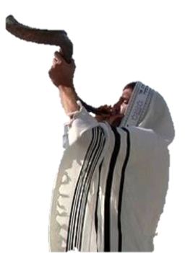
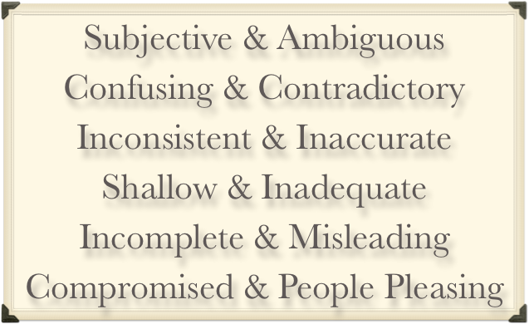
“Uncertain Sounds …”

Slide 6
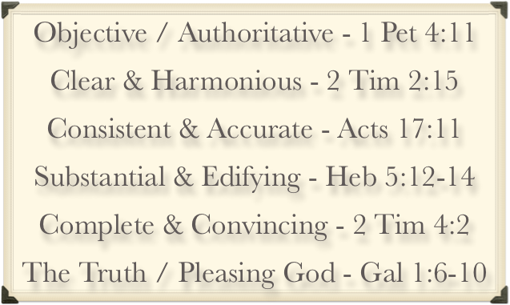
“Uncertain Sounds …”

Slide 7
“Uncertain Sounds …”
“That the Bible puts a very high premium on truth is indisputable. But sadly, the church today has largely downplayed and abandoned truth, content to follow the spirit of the age. That spirit is comprised of postmodernism, relativism, emotionalism and subjectivism. Truth cannot flourish in such poisoned soil.”
Truth Watch —- by Bill Muehlenberg
(Review of “THE TRUTH WAR” by John MacArthur)

Slide 8
“Uncertain Sounds …”
John 18:37–38 (NKJV)
³⁷ Pilate therefore said to Him, “Are You a king then?” Jesus answered, “You say rightly that I am a king. For this cause I was born, and for this cause I have come into the world, that I should bear witness to the truth. Everyone who is of the truth hears My voice.” ³⁸ Pilate said to Him, “What is truth?” …

Slide 9
“Uncertain Sounds …”
John 8:31–32 (NKJV)
31 Then Jesus said to those Jews who believed Him, “If you abide in My word, you are My disciples indeed. 32 And you shall know the truth, and the truth shall make you free.”

Slide 10
“Uncertain Sounds …”
John 8:46–47 (NKJV)
⁴⁶ Which of you convicts Me of sin? And if I tell the truth, why do you not believe Me? ⁴⁷ He who is of God hears God’s words; therefore you do not hear, because you are not of God.”

Slide 11
“Uncertain Sounds …”
John 17:17–19 (NKJV)
¹⁷ Sanctify them by Your truth. Your word is truth. ¹⁸ As You sent Me into the world, I also have sent them into the world. ¹⁹ And for their sakes I sanctify Myself, that they also may be sanctified by the truth.

Slide 12
“Uncertain Sounds …”
Psalm 119:160 (NKJV)
¹⁶⁰ The entirety of Your word is truth, And every one of Your righteous judgments endures forever.

Slide 13
“Uncertain Sounds …”
Ephesians 4:11–15 (NKJV)
¹¹ And He Himself gave some to be apostles, some prophets, some evangelists, and some pastors and teachers, ¹² for the equipping of the saints for the work of ministry, for the edifying of the body of Christ, ¹³ till we all come to the unity of the faith and of the knowledge of the Son of God, to a perfect man, to the measure of the stature of the fullness of Christ; ¹⁴ that we should no longer be children, tossed to and fro and carried about with every wind of doctrine, by the trickery of men, in the cunning craftiness of deceitful plotting, ¹⁵ but, speaking the truth in love, may grow up in all things into Him who is the head—Christ—

Slide 14
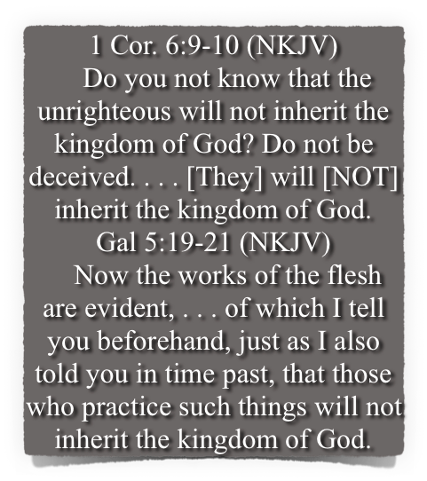
“Uncertain Sounds …”
Fornicators,
Idolaters,
Adulterers,
Homosexuals,
Sodomites,
Thieves,
Covetous,
Drunkards,
Revilers,
Extortioners,
Unclean,
Lewdness,
Sorcery,
Hatred,
Contentions,
Jealousies,
Outbursts Of Wrath,
Selfish Ambitions,
Dissensions,
Heresies,
Envy,
Murders,
Revelries,
And The Like;
1 Cor. 6:9-10;
Gal 5:19-21

Slide 15
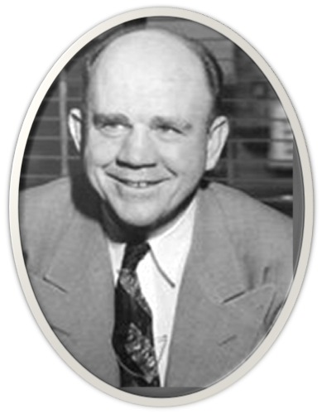
“Uncertain Sounds …”
“Do A Christian's Sins Damn His Soul?”
"We take the position that a Christian's sins do not damn his soul. The way a Christian lives, what he says, his character, his conduct, or his attitude toward other people have nothing whatsoever to do with the salvation of his soul…..all the sins a Christian may commit from idolatry to murder would not put his soul in any danger!"

Slide 16
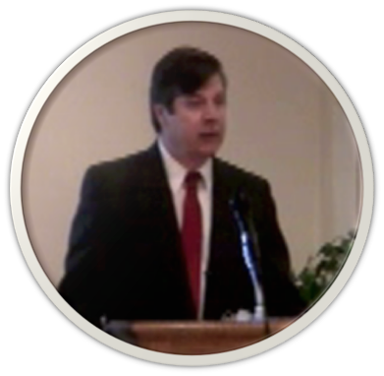
“Uncertain Sounds …”
“His second question is ‘is an elect and regenerated Christian saved while committing a homosexual act?’
“Yes he is”
(Steven Garrett - Garrett / Gentry debate - 6:54 of first affirmative speech Friday)

Slide 17
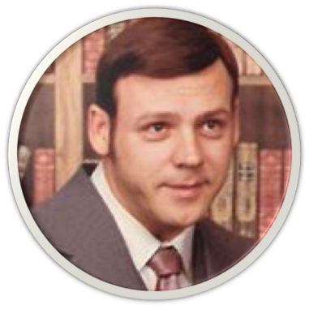
“Uncertain Sounds …”
“Repent does not mean sorry for sin,or turn from sin, or turn from anything to be saved” …
“You here (sic) this in many church’s on Sunday and on many radio church services, Preachers telling you to be saved you have to turn from sin or stop what you are doing before God will save you, which is a curse message.”
Jim Blev (Jim Blevins)
CHURCH of CHRIST FACEBOOK (Group) May 24, 2017

Slide 18
“Uncertain Sounds …”
“Repent does not mean sorry for sin,or turn from sin, or turn from anything to be saved” …
“So is it possible for a saved child to walk after the sins of the flesh and still be saved? Yes that is just what he is saying.” (a ref, Rom. 8:1)
Jim Blev (Jim Blevins)
CHURCH of CHRIST FACEBOOK (Group) May 27, 2017

Slide 19
“Uncertain Sounds …”
Sin separates one from God - Isa. 59,1,2
Sin will keep one out of heaven unless they repent - “Those who practice such things will not inherit the kingdom of God.” 1 Co 6:11; Gal. 5:21
Repentance - (a change of mind that results in a change in actions) - cf. Ezekiel 18:21-32
“Except you repent you will perish” - Lk 13:3,5
“God commands all men everywhere to repent …” Acts 17:30,31;
God’s will is that you repent - 2 Pet 3:9

Slide 20
“Uncertain Sounds …”
ONLY ONE (Universal) CHURCH (ecclesia)
“I will build my church” - Mat 16:18
“The Lord added to the church daily those who were being saved.” Acts 2:47; (cf. vs. 36-42)
“head over all things to the church, ²³ which is His body, the fullness of Him who fills all in all.” Ep 1:22,23; cf. 2:16; Col 1:18.
“There is one body” - Eph 4:4; cf. Rom. 12:5
Many LOCAL churches belonging to CHRIST - believers in various locales who follow Jesus - Rom. 16:16; Rev 2-3; etc. (Cor. Col. Eph. Phil …)

Slide 21
“Uncertain Sounds …”
Worship - John 4:24;
The Lord’s supper - Acts 20:7
Praying together - Acts 4:23-31
Singing together - Eph 5:19; Col. 3:16
Teaching, edifying each other - Acts 20:7
Giving - 1 Cor. 16:1,2; 2 Cor. 8,9
Organization - Phili. 1:1
Elders - 1 Tim 3:1-7; Tit. 1:5-9
Deacons - 1 Tim 3:8-13

Slide 22
“Uncertain Sounds …”
Just be good? - (passage?)
Nothing? - (passage?)
Faith ONLY - (Passage? James 2:24!)
Sinners prayer? - (passage?)
Ask Jesus to come into your heart? - (passage?)

Slide 23
“Uncertain Sounds …”
The Principle - (By Grace Through Faith)
Genesis 6; Joshua 6; Ephesians 2:8-10
God Speaks
Man Believes
Man Submits
God Saves

Slide 24
“Uncertain Sounds …”
3
4
Hear
2
Repent
1
Confess
Luke 8:11; Rom. 10:13-17
John 8:24; Heb 11:6
Luke 13:3,5; Acts 17:30
Mat. 10:32,33; Rom 10:9
Acts 2:38; 1 Pet 3:21
Believe
Be Baptized
5

Slide 25
“Uncertain Sounds …”
God said it -
That settles It -
I Need To Believe It!
Truth Is Objective, Consistent & Knowable

Slide 26
“Uncertain Sounds …”
We MUST Hold To The CERTAIN SOUND of Scripture In Every Area!
(2 Tim 1:13)

Slide 27
“Uncertain Sounds …”
The truth has been made available so that we can be free from sin – John 8:32
God wants you to come to a knowledge of the truth that you might be saved – 1 Tim 2:4; 2 Pet 3:9
Please – hear the truth – believe the truth – & by your faith, confess the LORD Jesus as the Christ, repent & be baptized – obey the truth and purify your soul – Mark 16:16; Acts 2:38; 22:16; 1 Pet 1:22

Slide 29
Uncertain Sounds
For if the trumpet makes an uncertain sound, who will prepare for battle? ⁹ So likewise you, unless you utter by the tongue words easy to understand, how will it be known what is spoken? ~ 1 Corinthians 14:8,9
Charts by Don McClain / Preached May 28, 2017
West 65th Street church of Christ P.O. Box 190062 / Little Rock AR 72219 /
501-568-1062 / Email – donmcclain@sbcglobal.net
Prepared using Keynote 2014 – More PPT & Audio Sermons:
http://w65stchurchofchrist.org/coc/

Slide 30
1 Thessalonians 2:13–16 (NKJV)
¹³ For this reason we also thank God without ceasing, because when you received the word of God which you heard from us, you welcomed it not as the word of men, but as it is in truth, the word of God, which also effectively works in you who believe. ¹⁴ For you, brethren, became imitators of the churches of God which are in Judea in Christ Jesus. For you also suffered the same things from your own countrymen, just as they did from the Judeans,

Slide 31
1 Thessalonians 2:13–16 (NKJV)
¹⁵ who killed both the Lord Jesus and their own prophets, and have persecuted us; and they do not please God and are contrary to all men, ¹⁶ forbidding us to speak to the Gentiles that they may be saved, so as always to fill up the measure of their sins; but wrath has come upon them to the uttermost.

