Slide 1
For Good
Titus 2:14 (NKJV)
¹⁴ who gave Himself for us, that He might redeem us from every lawless deed and purify for Himself His own special people, zealous for good works.

Slide 2
Biggest Problem Facing The Lord’s Church Today?
#Post Modernism?
#Materialism? (philosophical or practical)
#Rank Ungodliness?

Slide 3
Biggest Problem Facing The Lord’s Church Today?
#Division?
#False Doctrine?
#Worldliness?
#Complacency?

Slide 4
Redeemed To WORK!
¹¹ For the grace of God that brings salvation has appeared to all men, ¹² teaching us that, denying ungodliness and worldly lusts, we should live soberly, righteously, and godly in the present age,

Slide 5
Redeemed To WORK!
¹³ looking for the blessed hope and glorious appearing of our great God and Savior Jesus Christ, ¹⁴ who gave Himself for us, that He might redeem us from every lawless deed

Slide 6
Redeemed To WORK!
and purify for Himself His own special people, zealous for good works. ¹⁵ Speak these things, exhort, and rebuke with all authority. Let no one despise you.

Slide 7
Zealous To DO GOOD
¹⁸ But it is good to be zealous in a good thing always, and not only when I am present with you.

Slide 8
Zealous To HELP
¹ Now concerning the ministering to the saints,… ² for I know your willingness, about which I boast of you to the Macedonians, that Achaia was ready a year ago; and your zeal has stirred up the majority.

Slide 9
Zealous To REPENT
¹⁹ As many as I love, I rebuke and chasten. Therefore be zealous and repent.

Slide 10
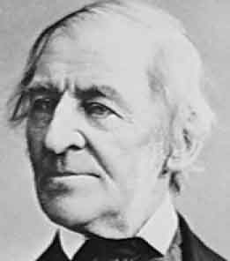
Defining ZEAL
“Nothing great was ever achieved without enthusiasm” –
R.W. Emerson

Slide 11
Defining ZEAL - “to strive after something.” - TDNT
Strong's Number: <G2205> Original Word: ζῆλος, zēlos
1. “zeal, ardor in embracing, pursuing, defending anything”: 2 Corinthians 12:11; 9:2; κατα ζηλος, as respects zeal (in maintaining religion), Philippians 3:6; with the genitive of the object, “zeal in behalf of, for” a person or thing, John 2:17 from Psalm 68:10 (Psalm 69:10); Romans 10:2 . . . —
Thayer's Greek-English Lexicon

Slide 12
Defining ZEAL - “to strive after something.” - TDNT
25.77 ζηλωτήςª, οῦ m: one who is deeply committed to something and therefore zealous—‘enthusiast, zealous person.’ ζηλωτὴς ὑπάρχων τοῦ θεοῦ καθὼς πάντες ὑμεῖς ἐστε σήμερον ‘being deeply committed to God even as all of you are today’ Ac 22:3.
Louw, J. P., & Nida, E. A. (1996). Greek-English lexicon of the New Testament: based on semantic domains (electronic ed. of the 2nd edition., Vol. 1, p. 297). New York: United Bible Societies.

Slide 13
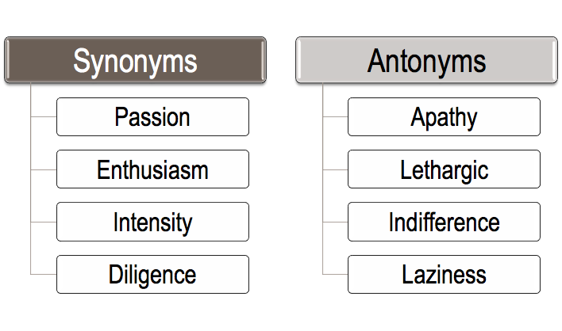
Defining ZEAL - “to strive after something.” - TDNT
noun - fervor for a person, cause, or object; eager desire or endeavor; enthusiastic diligence; ardor.

Slide 14
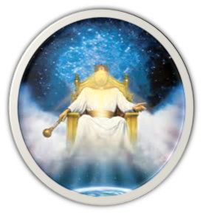
ZEAL Can Be GOOD or BAD
Where Is Our Zeal Directed?
Col. 3:1-3
1 John 2:15-17
Eccl. 1:1
Matt. 6:19-34
2 Cor. 4:18

Slide 15
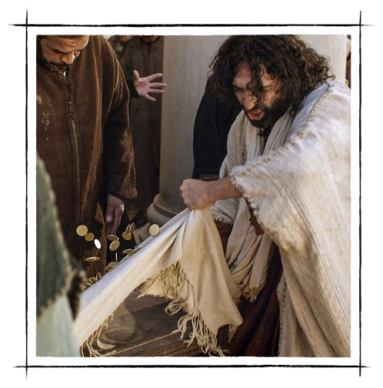
ZEAL Can Be GOOD or BAD
Zeal is a good thing when grounded on truth & directed toward godly ends – Jno. 2:17 (Psa. 69:9); Gal. 4:17-18.
Misplaced zeal is not good & can be deadly:

Slide 16
ZEAL Can Be GOOD or BAD
CBS NEWS - a snake-handling Kentucky pastor who appeared on the National Geographic television reality show "Snake Salvation" died after being bitten by a snake.
Jamie Coots was handling a rattlesnake at his Full Gospel Tabernacle in Jesus Name Church in Middlesboro when he was bitten on the hand Saturday night, February 15, 2014.

Slide 17
ZEAL Can Be GOOD or BAD
Zeal without Knowledge – Rom. 10:1-3; Acts 22:3-5; Phil. 3:6; 1 Tim. 1:13.
Zeal that is Selfish & Self-serving – 1 Tim. 6:9-11; Rom. 12:11.
Zeal for the Traditions of Men – Mat. 15:7-9; Gal. 1:14; Col. 2:8
Religious zeal for error – Rom. 16:18; Gal. 4:17; 2 Tim 2:17.

Slide 18
ZEAL Can Be GOOD or BAD
Zeal without Knowledge – Rom. 10:1-3; Acts 22:3-5; Phil. 3:6; 1 Tim. 1:13.
Zeal that is Selfish & Self-serving – 1 Tim. 6:9-11; Rom. 12:11.
Zeal for the Traditions of Men – Mat. 15:7-9; Gal. 1:14; Col. 2:8
Religious zeal for error – Rom. 16:18; Gal. 4:17; 2 Tim 2:17.
Atheism
Islam
Pentecostalism
Calvinism
Monergism
Premillennialism
Transmillennialism
Institutionalism

Slide 19
Let Us Be Zealous For Good Works
Bible Study – 2 Tim 2:15; 2 Pet. 2:2; Ps. 119:97-104
Obeying the gospel - Acts 22:16; 2 Cor 6:2
Spiritual Growth – 2 Pet. 1:5-12.
Service to God – Mark 12:29-31; Mat. 6:33,
Serving The Needs of Brethren – Rom. 12:9-17; 2 Cor. 9:2; 1 Pet. 1:22; 4:8; James 5:16; Heb. 10:24,25
Defeating Sin & Error – 2 Cor. 7:11; Mat. 5:30; John 2:17; Acts 17:16
Evangelism – Mark 16:15; Acts 8:4; 1 Thes 1:7,8

Slide 20
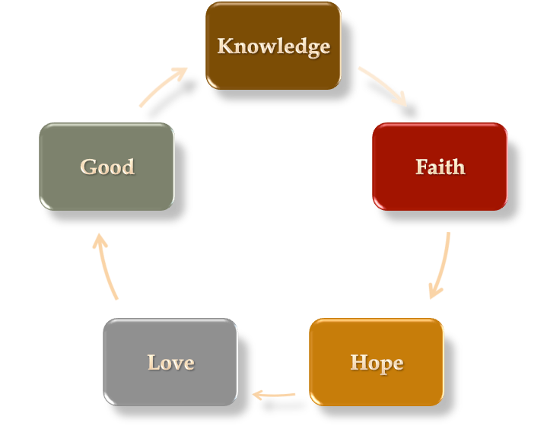
Let Us Be Zealous For Good Works

Slide 21
Let Us Be Zealous For Good Works
Where Is Our Zeal Directed?
Col. 3:1-3
1 John 2:15-17
Eccl. 1:1
Matt. 6:19-34
2 Cor. 4:18

Slide 23
For Good
Charts by Don McClain
Prepared March 17,18, 2017 / Preached March 19, 2017
West 65th Street church of Christ / P.O. Box 190062 / Little Rock AR 72219
501-568-1062 / 501-749-6928 / Email – donmcclain@sbcglobal.net
Prepared w/ Keynote More lessons: http://w65stchurchofchrist.org/coc/sermons/

Slide 24
2 Peter 3:10–18 (NKJV)
¹⁰ But the day of the Lord will come as a thief in the night, in which the heavens will pass away with a great noise, and the elements will melt with fervent heat; both the earth and the works that are in it will be burned up. ¹¹ Therefore, since all these things will be dissolved, what manner of persons ought you to be in holy conduct and godliness, ¹² looking for and hastening the coming of the day of God, because of which the heavens will be dissolved, being on fire, and the elements will melt with fervent heat?

Slide 25
2 Peter 3:10–18 (NKJV)
¹³ Nevertheless we, according to His promise, look for new heavens and a new earth in which righteousness dwells. ¹⁴ Therefore, beloved, looking forward to these things, be diligent to be found by Him in peace, without spot and blameless; ¹⁵ and consider that the longsuffering of our Lord is salvation—as also our beloved brother Paul, according to the wisdom given to him, has written to you,

Slide 26
2 Peter 3:10–18 (NKJV)
¹⁶ as also in all his epistles, speaking in them of these things, in which are some things hard to understand, which untaught and unstable people twist to their own destruction, as they do also the rest of the Scriptures. ¹⁷ You therefore, beloved, since you know this beforehand, beware lest you also fall from your own steadfastness, being led away with the error of the wicked; ¹⁸ but grow in the grace and knowledge of our Lord and Savior Jesus Christ. To Him be the glory both now and forever. Amen.

