Slide 1
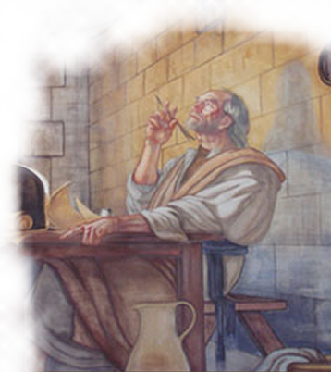
The Faith & Love of The Christians In Colosse
Notes:
I. THE CITY OF COLOSSE
A. LOCATION
1. 100 miles E of Ephesus in Asia Minor (consult map)
2. Very close to Hierapolis and Laodicea - cf. Co 4:13,16
B. DISTINCTION
1. Hierapolis was a place known for health, pleasure, relaxation
2. Laodicea was known for commercial trade and politics
3. Colosse, however, was simply a small town
C. PEOPLE
1. It was a pagan city, with a strong intermingling of Jews
2. In 62 B.C., there were 11,000 Jewish "freedmen" in the tri-city area
3. This helps us to understand the nature of some of the problems that arose within the church (problems of both pagan and Jewish origin)

Slide 2
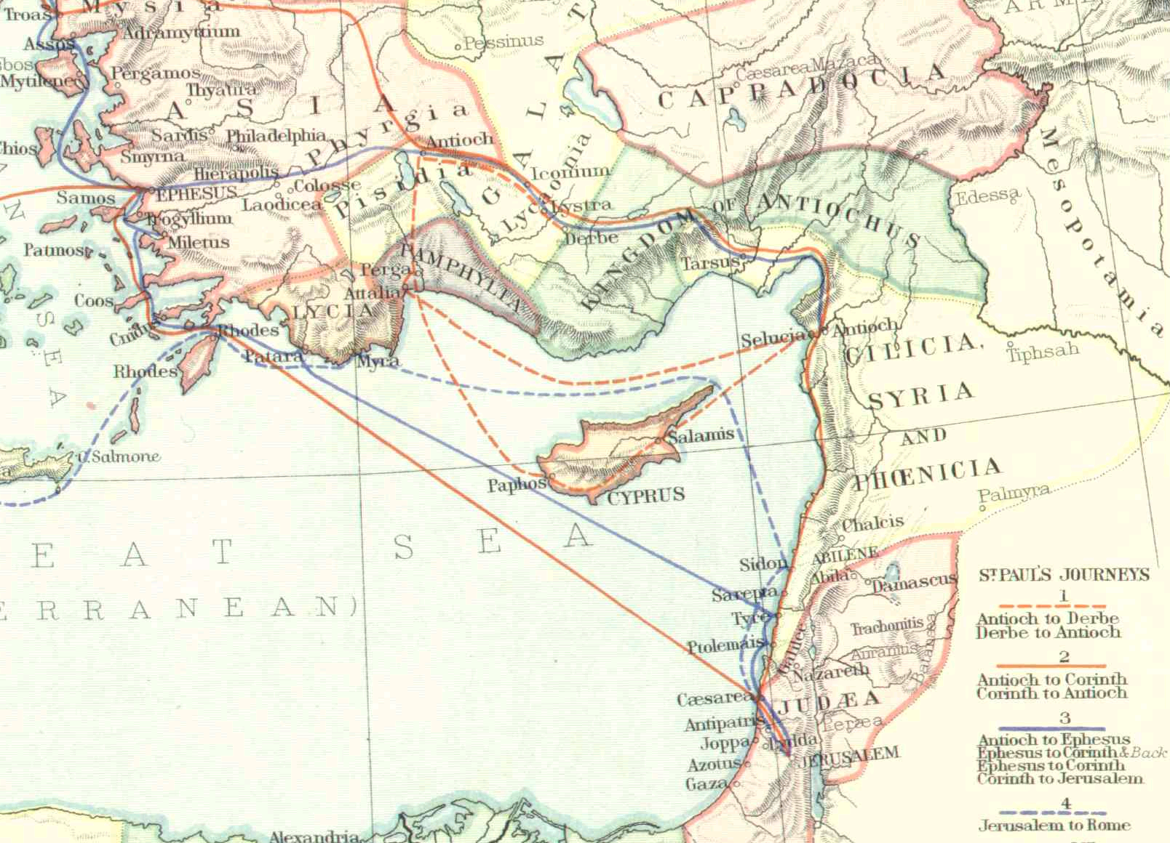
LOCATION
1. 100 miles E of Ephesus in Asia Minor
2. Very close to Hierapolis and Laodicea - cf. Co 4:13,16

Slide 3
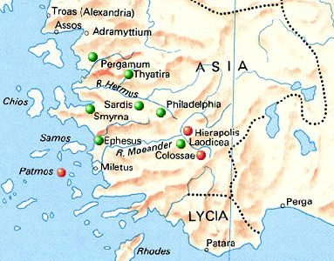
DISTINCTION
1. Hierapolis was a place known for health, pleasure, relaxation
2. Laodicea was known for commercial trade and politics
3. Colosse, however, was simply a small town

Slide 4
The Faith & Love of The Christians In Colosse
The City Of Colosse
People
It was a pagan city, with a strong intermingling of Jews
In 62 B.C., there were 11,000 Jewish "freedmen" in the tri-city area
This helps us to understand the nature of some of the problems that arose within the church (problems of both pagan and Jewish origin)
Notes:
II. THE CHURCH AT COLOSSE
A. ESTABLISHMENT
1. We are not sure when the church began, for the scriptures do not say
2. It is likely that Paul himself did not start it
a. He had not seen them in person –
Co 2:1 ¹For I want you to know what a great conflict I have for you and those in Laodicea, and for as many as have not seen my face in the flesh,
b. Rather, he had simply heard of their faith –
Co 1:4 ⁴since we heard of your faith in Christ Jesus
3. It is possible that it was started by Epaphras
a. From what Paul writes in
Co 1:4-8 ⁵because of the hope which is laid up for you in heaven, of which you heard before in the word of the truth of the gospel, ⁶which has come to you, as it has also in all the world, and is bringing forth fruit, as it is also among you since the day you heard and knew the grace of God in truth; ⁷as you also learned from Epaphras, our dear fellow servant, who is a faithful minister of Christ on your behalf,
b. Who evidently also had some contact with those in Hierapolis and Laodicea –
Co 4:12-13 ¹²Epaphras, who is one of you, a bondservant of Christ, greets you, always laboring fervently for you in prayers, that you may stand perfect and complete in all the will of God. ¹³For I bear him witness that he has a great zeal for you, and those who are in Laodicea, and those in Hierapolis.

Slide 5
The Faith & Love of The Christians In Colosse
The Epistle
The Purpose:
To warn the brethren at Colosse
To direct their attention to Jesus Christ
The Theme:
Jesus Christ: The pre-eminent and all-sufficient Savior

Slide 6
The Faith & Love of The Christians In Colosse
Colossians 1:1-8 (NKJV) ¹ Paul, an apostle of Jesus Christ by the will of God, and Timothy our brother, ² To the saints and faithful brethren in Christ who are in Colosse: Grace to you and peace from God our Father and the Lord Jesus Christ.

Slide 7
The Faith & Love of The Christians In Colosse
Colossians 1:1-8 (NKJV) ³ We give thanks to the God and Father of our Lord Jesus Christ, praying always for you, ⁴ since we heard of your faith in Christ Jesus and of your love for all the saints; ⁵ because of the hope which is laid up for you in heaven,

Slide 8
The Faith & Love of The Christians In Colosse
Colossians 1:1-8 (NKJV) of which you heard before in the word of the truth of the gospel, ⁶ which has come to you, as it has also in all the world, and is bringing forth fruit, as it is also among you since the day you heard and knew the grace of God in truth;

Slide 9
The Faith & Love of The Christians In Colosse
Colossians 1:1-8 (NKJV) ⁷ as you also learned from Epaphras, our dear fellow servant, who is a faithful minister of Christ on your behalf, ⁸ who also declared to us your love in the Spirit.

Slide 10
The Faith & Love of The Christians In Colosse
Salutation (vv. 1-2)
Sent From
Paul an apostle of Jesus Christ by the will of God & Timothy
Sent To Colossians Who Were:
Saints – (Separation)
Faithful – (Commitment)
Brethren – (Family)
In Christ – (Sphere)

Slide 11
The Faith & Love of The Christians In Colosse
Salutation (vv. 1-2)
Grace to You – (2b)
Free and unmerited favor – (Eph 2:8; Titus 2:11,12)
And Peace – (2b)
Tranquility, wholeness, and well being. (3:15; Phili 4:7)
Results from grace -
From God our Father – (2b)
Christians are born into the family of God and are to imitate Him – (Ehp 5:1).

Slide 12
The Faith & Love of The Christians In Colosse
Reputation (vv. 3-4)
Worthy of Thanksgiving -
Paul gave God thanks for them – (3)
Paul prayed for them – (3)
Worthy of Commendation
Paul had heard of their faith in Christ – (4; 2:5-7)
Paul had heard of their love for all the saints– (4; cf 1 Thes 4:9-10; Gal 5:6)

Slide 13
The Faith & Love of The Christians In Colosse
Motivation (vss 5-8)
Because Of The Hope Which Is Laid Up For You In Heaven– (5)
Their hope was the basis of their faith and love – i.e. God’s promises motivated them to faithful service -
This is the hope that they were careful not to be moved away from – (1:23)

Slide 14
The Faith & Love of The Christians In Colosse
Source of Their Fruit (vss 5-8)
How They Gained Their Faith, Love and Hope– (5-7)
They HEARD “the word of the truth of the gospel” – (Rom 10:14-17; 1 Cor 1:18,21; Eph 1:13)
This gospel was bringing forth fruit among them and throughout the world – (vs. 6; Ro 10:18; Jn 15:8; Gal 5:22,23)
Notes:
A. THE GOSPEL, WHICH SPEAKS OF THE HOPE LAID UP IN HEAVEN, HAD PRODUCED FRUIT IN THEIR LIVES
1. Not only in THEIR lives, but throughout the whole world (1:6)
Co 1:23 ²³if indeed you continue in the faith, grounded and steadfast, and are not moved away from the hope of the gospel which you heard, which was preached to every creature under heaven, of which I, Paul, became a minister.
2. We have seen the kind of fruit being born by the gospel:
a. Faith in Jesus
b. Love for the brethren
3. In bearing such fruit, they proved that they were truly disciples of Jesus! –
Jn 15:8 ⁸“By this My Father is glorified, that you bear much fruit; so you will be My disciples. ⁹“As the Father loved Me, I also have loved you; abide in My love. ¹⁰“If you keep My commandments, you will abide in My love, just as I have kept My Father’s commandments and abide in His love.

Slide 15
The Faith & Love of The Christians In Colosse
Source of Their Fruit (vss 5-8)
How They Gained Their Faith, Love and Hope– (5-7)
They had heard and had come to understand “the grace of God in truth” through Epaphras – (6b,7; 2 Pet 1:3)
Those who truly understand the grace of God will more likely respond in grateful service to God – “love in the Spirit!” (1 Thes 2:13; 2 Pet 3:18)
Notes:
A. THE GOSPEL, WHICH SPEAKS OF THE HOPE LAID UP IN HEAVEN, HAD B. WHAT WAS THE KEY TO BEARING SUCH FRUIT?
1. Notice that they had been bearing fruit "since the day you heard and knew the grace of God in truth" (1:6)
2. By knowing (understanding, NAS) the grace of God, they were properly motivated to bear fruit
3. So it is today, those who truly understand the grace of God will more likely respond in grateful service to God!
C. WHAT IS "THE GRACE OF GOD" WHICH MOTIVATES ONE TO BEAR FRUIT?
1. Simply put, it is the "unmerited favor" which God has shown us through Jesus Christ!
2. We can summarize this grace of God by defining several key terms:
a. CONDEMNATION - Being guilty of sin, we stand condemned in the sight of God and in danger of everlasting death – Ro 3:23; 6:23
b. ALIENATION - Being guilty of sin, we also find ourselves separated from God – Isa 59:1-2
c. PROPITIATION - but in love and mercy, God sent Jesus to be our sacrifice for sins to appease God's just and righteous anger –
1 Jn 4:9-10 ⁹In this the love of God was manifested toward us, that God has sent His only begotten Son into the world, that we might live through Him. ¹⁰In this is love, not that we loved God, but that He loved us and sent His Son to be the propitiation for our sins.
d. JUSTIFICATION - by responding in obedient faith, we can be justified (declared not guilty) by virtue of Jesus' sacrifice in our stead –
Ro 3:21-26 ²¹But now the righteousness of God apart from the law is revealed, being witnessed by the Law and the Prophets, ²²even the righteousness of God, through faith in Jesus Christ, to all and on all who believe. For there is no difference; ²³for all have sinned and fall short of the glory of God, ²⁴being justified freely by His grace through the redemption that is in Christ Jesus, ²⁵whom God set forth as a propitiation by His blood, through faith, to demonstrate His righteousness, because in His forbearance God had passed over the sins that were previously committed, ²⁶to demonstrate at the present time His righteousness, that He might be just and the justifier of the one who has faith in Jesus.
e. RECONCILIATION - Free from the guilt of sin, we can now be reconciled with God through Christ Jesus our Lord –
2 Co 5:17-20 ¹⁷Therefore, if anyone is in Christ, he is a new creation; old things have passed away; behold, all things have become new. ¹⁸Now all things are of God, who has reconciled us to Himself through Jesus Christ, and has given us the ministry of reconciliation, ¹⁹that is, that God was in Christ reconciling the world to Himself, not imputing their trespasses to them, and has committed to us the word of reconciliation. ²⁰Now then, we are ambassadors for Christ, as though God were pleading through us: we implore you on Christ’s behalf, be reconciled to God.
f. SANCTIFICATION - By virtue of Christ's death, we may also be "set apart" in service to the glory of God –
Ro 6:17-18, 20-22 ²⁰For when you were slaves of sin, you were free in regard to righteousness. ²¹What fruit did you have then in the things of which you are now ashamed? For the end of those things is death. ²²But now having been set free from sin, and having become slaves of God, you have your fruit to holiness, and the end, everlasting life.
3. The more one understands these concepts and their implications, the more likely they will also bear fruit!

Slide 16
The Faith & Love of The Christians In Colosse
The church at Colosse had admirable qualities, which we do well to emulate...
Do we have faith in Jesus?
Do we love the brethren?
Do we have the hope of eternal life?
Have you accepted the word of the truth of the gospel,
That you may bring forth fruit unto God??

