Slide 1
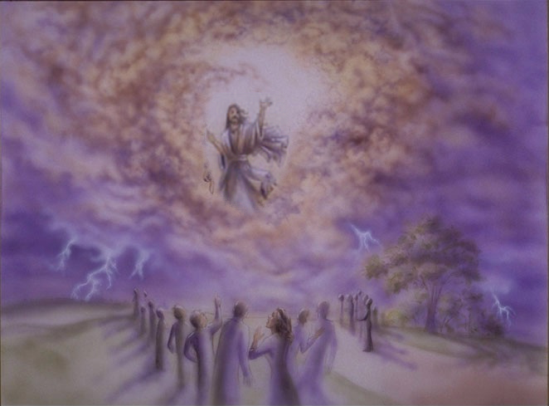
When Jesus Returns
Eschatology
A millennial?
Pre millennial?
Post millennial?

Slide 2
When Jesus Returns
Rapture out of the world living saints leaving behind the unrighteous . . .???
Expose and defeat a person called the Antichrist????
Eschatology
Begin a seven year period called the great tribulation???
Establish a material kingdom centered in Jerusalem & reign for a literal 1,000 years???
Restoration of National Israel???

Slide 3
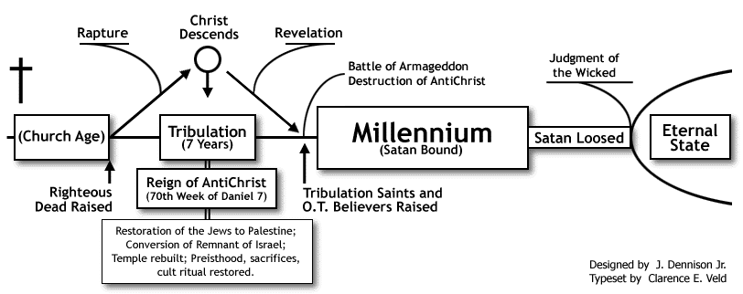
Pre millennialism
http://www.blueletterbible.org/faq/dispre.html

Slide 5
Pre millennialism
Based Upon God’s Failure
Dispensationalism / Premillennialism
Christ at His first advent offered the Jewish nation an earthly political kingdom . . . Because the Jewish nation rejected the Christ, this kingdom offer was retracted and the earthly, political, re-established Davidic kingdom was postponed until the future Jewish millennium. Between the withdrawal of the kingdom offer and the future millennial establishment of the kingdom was inserted the church age, a parenthesis in God's prophesied program for Israel and the nations. The present age and the present reign of Christ have no direct relationship to the Davidic covenant or to Messianic prophecy.
Notes:
Luke 1:32 (NKJV)
He will be great, and will be called the Son of the Highest; and the Lord God will give Him the throne of His father David.

Slide 6
Pre millennialism
Based Upon God’s Failure
God Gave Prophecies & Promises That Were NOT Fulfilled!
Seed Promise – Genesis 3:16; 12:3; 22:18; Galatians 3:16
Land Promise – Gen 15:17-21; 17:1-8; Joshua 21:43-45
Kingdom Promise – Isaiah 9:6; Dan 2:44; Colossians 1:13;Revelation 1:5,6; 5:9,10
“Because Israel Rejected Jesus As King God Changed His Plan!”
They Tried To Force Him To Become King – John 6:15; 18:36; Eph 3:9-11
They Were Looking For What The Millennialist Are Looking For Now – Luke 2:25-28; Mk 15:43; John 12:12,13

Slide 7
Pre millennialism
Based Upon Figurative Passages
Figurative Passages Are True – i.e. – They represent Something That Is Indeed Real – But They Are Yet Representative – Not To Be Understood As Literally Fulfilled By Being The Actual Thing Stated!
The Bible uses MANY figures of speech –
Revelation is a book of signs and symbols – Rev. 1:1
Millennialist Literalize Figurative Language & Makes Literal Language Figurative!
Revelation compared to the epistles -(Rev 20 & 1 Cor. 15)
Misapplying prophetic language & rejecting divinely inspired interpretation – Dan 2:44; Mark 9:1

Slide 8
When Jesus Returns
Biblical Descriptions Of Jesus’ Return -
With noise – shout, voice of the archangel & the trumpet of God - 1 Thess. 4:16
With His holy angels - Matt. 25:31; 2 Thess. 1:7-8
Suddenly and unexpected - 1 Thess. 5:1-4; 2 Pet. 3:10; Rev. 22:20
Visibly - Acts 1:9-11; Rev. 1:7 “and every eye will see Him” -

Slide 9
When Jesus Returns
Things That Will Occur When Jesus Returns
Simultaneously raise ALL the dead on the LAST DAY - John 5:28,29; 6:39,40,54; 11:24
Judge The World on the last day - Ac 17:30-31; - Mat 25:31-32; 2 Cor 5:10; Rev. 20:12; Rom. 2:16; John 12:48
Glorify Saints - Col. 3:4; Phil. 3:20-21; 1 Cor. 15:51-52; Rev. 22:14; Matt. 25:46
Punish wicked - 2 Thess. 1:7-9 - Matt. 25:41,46; Rev. 20:10; Rev 21:8
Destroy present order and establish new heavens and new earth - 2 Pet. 3:10-13; Heb. 11:13-16; Rev. 22:14
Deliver Kingdom to Father - 1 Cor. 15:23-28

Slide 10
When Jesus Returns
Eschatology
A millennial?
Pre millennial?
Post millennial?

Slide 11
When Jesus Returns
Eschatology
The Basis of Millennialism
How We Should Approach Scripture
Biblical Descriptions of Jesus’ Return Leaves No Place For Millennialism
Things That The Bible Says Will Occur When Jesus Returns Leaves No Place For Millennialism

Slide 12
When Jesus Returns
Eschatology
Jesus Is Returning
Will Judge The World - John 12:48
Will Reward The Obedient & Exact Vengeance Upon The Disobedience – 2 Thes 1:7-9
Destroy The World – 2 Peter 3:9-14
ARE YOU READY??

