Slide 1




Notes:
Series On Godliness
Essentials
To Living
A Godly
Life

Slide 2


1 Tim 4:7-8 (NKJV)
⁷ But reject profane and old wives' fables, and exercise yourself toward godliness. ⁸ For bodily exercise profits a little, but godliness is profitable for all things, having promise of the life that now is and of that which is to come.

Slide 3

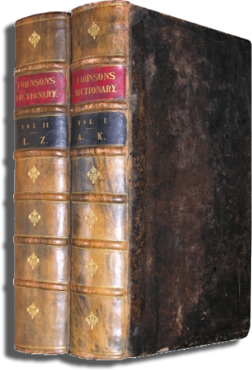
Thayer: “Reverence. Respect; in the Bible everywhere piety towards God.”
W.E. Vine: “That piety which, characterized by a Godward attitude, does that which is well pleasing to Him.”

Slide 4





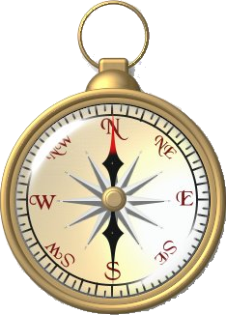

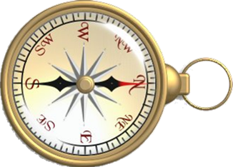






Slide 5



Knowledge –
Faith –
Hope -
Love –
2 Peter 1:3

Slide 6

Creator – Ps. 95:6; 1 Pet.4:19
Omnipotent – Rev.19:6; Acts 26:8
Omnipresent – Jer. 23:23; Ps.23:4
Omniscient – Prov 15:3; Heb 4:13
All-wise – Rom. 11:33; 1 Cor. 1:25
Holy – 1 Peter 1:15,16; 1 Thes 4:3-7
Impartial - Acts 10:34; 1 Pet. 1:17
Love – John 3:16; 1 John 4:8,19; 5:3
Jealous – Ex. 20:5; 34:14; Mt. 4:10
Good, Severe – Ro.11:22, Heb.12:28
Notes:
Faith In God Requires A Knowledge of God
Tritheism
Tritheism is the teaching that the Godhead is really three separate beings forming three separate gods. This erring view is often misplaced by the cults for the doctrine of the Trinity which states that there is but one God in three persons: Father, Son, and Holy Spirit. The doctrine of the trinity is, by definition, monothestic. That is, it is a doctrine that affirms that there is only one God in all the universe.
Tritheism has taken different forms throughout the centuries. In the early church the Christians were accused of being tritheists by those who either refused to understand or could not understand the doctrine of the Trinity. In the late 11th century a Catholic monk of Compiègne in France, Roscelin considered the three Divine Persons as three independent beings and that it could be said they were three gods. He maintained that God the Father and God the Holy Ghost would have become incarnate with God the Son unless there were three gods.
Present day Mormonism is tritheistic -- but with a twist. Mormonism teaches that there are many God's in the universe but they serve and worship only one of them. The godhead for earth is to them really three separate gods: the Father, the Son, and the Holy Ghost. The Father used to be a man on another world who brought one of his wives with him to this world - they both have bodies of flesh and bones. The son is a second god who was literally begotten between god the father and his goddess wife. The holy ghost is a third god. Therefore, in reality, Mormonism is polytheistic with a tritheistic emphasis.
Of course, tritheism clearly contradicts the teaching of the Bible regarding monotheism.
“You are My witnesses,” declares the Lord, “And My servant whom I have chosen, In order that you may know and believe Me, And understand that I am He. Before Me there was no God formed, And there will be none after Me," (Isaiah 43:10).
“Thus says the Lord, the King of Israel And his Redeemer, the Lord of hosts: ‘I am the first and I am the last, And there is no God besides Me," (Isaiah 44:6).
‘Do not tremble and do not be afraid; Have I not long since announced it to you and declared it? And you are My witnesses. Is there any God besides Me, Or is there any other Rock? I know of none,’” (Isaiah 44:8).

Slide 7

Who He Is – John 1:1,2; 17:5
  Son of God – Mat 17:5; Jn 3:16
  Savior – 1 John 4:14
  Head – Eph 1:22,23; Col 1:18
  King – 1 Tim 6:15; Rev 19:16
  Lord – Acts 2:36; Phili 2:9-11
What He Has Done For Us – Phili 2:5-11; Heb 2:9-18
What He Is Doing For Us –
  Priest – Heb 8:1
  Mediator – Heb 8:6
2 Cor. 5:10 (NKJV)
¹⁰ For we must all appear before the judgment seat of Christ, that each one may receive the things done in the body, according to what he has done, whether good or bad.
Notes:
Faith In Christ

Slide 8
2 Peter 1:2-7 (NKJV)
. . . ³ as His divine power has given to us all things that pertain to life and godliness, through the knowledge of Him who called us by glory and virtue, ⁴ by which have been given to us exceedingly great and precious promises, that through these you may be partakers of the divine nature, having escaped the corruption that is in the world through lust.
Notes:
Faith – Rom 10:17
Hope – Titus 1:2

Slide 9
epichorēgēsate, from which come the English words “chorus,” “choreograph,” and “choreography.” . . . the word came to be used of one who provides for or supports others or supplies something for them in abundance.
A believer is to “furnish, supply, or support” his life with these virtues. —Bible Knowledge Commentary
2 Peter 1:2-7 (NKJV)
⁵ But also for this very reason, giving all diligence, add to your faith virtue, to virtue knowledge, ⁶ to knowledge self-control, to self-control perseverance, to perseverance godliness, ⁷ to godliness brotherly kindness, and to brotherly kindness love.
Faith Is Essential!
Notes:
Faith – Rom 10:17
Hope – Titus 1:2

Slide 10




Wrong Ideas
“Faith that saves is a miraculous gift” (a perversion of Eph 2:8)
“Evidence? – I don’t need evidence – I know what I feel and what I’ve experienced!” – (a perversion of 2 Cor 5:7)
Faith
Facts,
Conditions & Promises

Slide 11



Romans 10:17
Fact
Witness
Testimony
Confirmation
John 20:30,31
Notes:
Romans 10:17; John 20:30,31

Slide 12

Titus 1:2 (NKJV) ² . . . which God, who cannot lie, promised before time began,
Phili 1:20 (NKJV) ²⁰ according to my earnest expectation and hope that in nothing I shall be ashamed, but with all boldness, as always, so now also Christ will be magnified in my body, whether by life or by death.
1 John 3:3 (NKJV) ³ And everyone who has this hope in Him purifies himself, just as He is pure.
Notes:
Hope Of Eternal Life

Slide 13

The bond of perfection - Col. 3:14
And now abide faith, hope, love, these three; but the greatest of these is love. - 1 Cor 13:13 (NKJV) –
Must Love God Supremely – Mark 12:29-31; John 14:15,23; 1 John 5:1-3
Love God’s Word - Ps 119:97-104
God is love – Those who possess a Godward attitude – will seek to love as He loves – 1 John 5:1; 1 Pet 1:22; 1 John 4:20
Notes:
Above All These Things Put On Love

Slide 14
2 Timothy 2:15 (NKJV)
¹⁵ Be diligent to present yourself approved to God, a worker who does not need to be ashamed, rightly dividing the word of truth.
Notes:
Above All These Things Put On Love

Slide 15
Strengthen your faith through Bible study & application of God’s word to everyday life –
The greater our knowledge and faithful obedience – the stronger our hope -
The stronger our hope – the better equipped we are to persevere, overcome temptations, remain pure & influence others!!

Slide 16
Even though we have all knowledge, faith and hope – we are nothing without love – (1 Cor 13:1-8)
Love is a choice – and must be developed, (1 John 3:23)

Slide 17
Knowledge –
Faith –
Hope -
Love –
2 Peter 1:3
Notes:
Godliness is all about becoming like Jesus!

Slide 18

2 Peter 1:3

Slide 19

1 Tim 4:7-8 (NKJV)
⁷ But reject profane and old wives' fables, and exercise yourself toward godliness. ⁸ For bodily exercise profits a little, but godliness is profitable for all things, having promise of the life that now is and of that which is to come.
Notes:
Live The Best Life NOW -
Enjoy Life Eternal With God

Slide 20
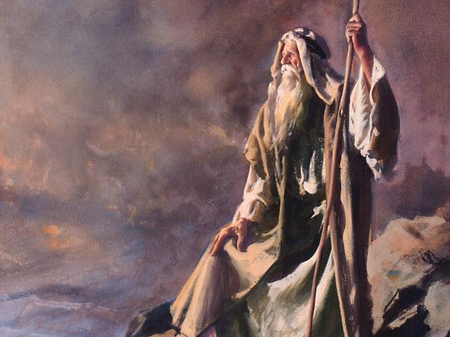

Notes:
I set before you
Life and death –
Choose life
Deut 30:15-19

