Slide 1
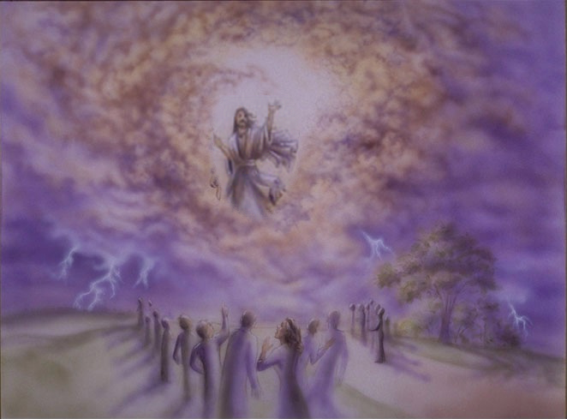
When Jesus Returns
Eschatology
A millennial?
Pre millennial?
Post millennial?

Slide 2
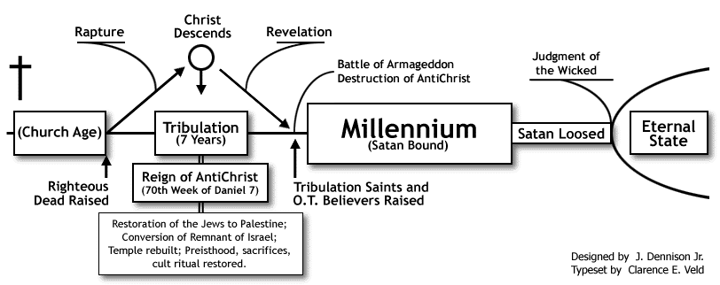
Pre millennialism
http://www.blueletterbible.org/faq/dispre.html

Slide 3
Should We Be Looking For A Future “GREAT Tribulation”
On Earth?

Slide 4
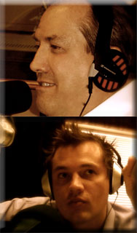
Hizbullah undertakes massive exercise as warning to Israel
Hamas setting stage for West Bank seizure
Thousands of Palestinians apply for Israeli citizenship seeking to escape life under the Palestinian Authority
EU seeks mediating role in Mideast conflict - looking to develop Mediterranean Union – (Revived Roman Empire?)
Britain 'No Longer Christian,' Says Influential Liberal Think Tank
The Gog/Magog War - Russia suspends arms treaty
Apostate Christianity - Senate Panel Probes 6 Top Televangelists
Increase in Knowledge/New Technologies - Poll finds nearly 80 percent of U.S. adults go online
Genetic Modification - the path to becoming superhuman
U.K. Kids Get RFID Chips In School Uniforms
Indonesia Sentences 41 Christians To Five Years Imprisonment for praying that Muslims "come to know Christ"
Bibles banned from 2008 Olympic village
POLITICS & RELIGION-IRVING BAXTER
“Bible prophecy is being fulfilled right NOW” November 9, 2007
Many Are WRONGFULLY Applying Fulfilled Prophecies To Current Events
November 07, 2007

Slide 5
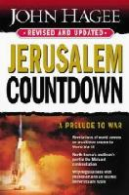
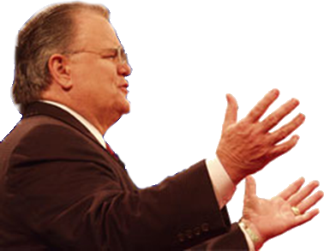
The Signs - Wars - Famine - Plague & Disease - Earthquakes - Traffic Accidents - Rapid Transport - Knowledge - Violence - The Occult - Gospel Preached -
The Antichrist - The Mark - Great Tribulation - The Rapture - Armageddon

Slide 6
A Future “GREAT” Tribulation?
If Not In These Passages – Then Not In The Bible
Proposed Proof Text:
Daniel 9:27
Matthew 24
Revelation 6-18

Slide 7
A Future “GREAT” Tribulation?
Abomination of Desolation Daniel 9:24-27; 12:11
Daniel 9:23-27 (NKJV) ²⁴ "Seventy weeks are determined For your people and for your holy city, To finish the transgression, To make an end of sins, To make reconciliation for iniquity, To bring in everlasting righteousness, To seal up vision and prophecy, And to anoint the Most Holy.

Slide 8
A Future “GREAT” Tribulation?
Abomination of Desolation Daniel 9:24-27; 12:11
Daniel 9:23-27 (NKJV) ²⁵ "Know therefore and understand, That from the going forth of the command To restore and build Jerusalem Until Messiah the Prince, There shall be seven weeks and sixty-two weeks; The street shall be built again, and the wall, Even in troublesome times.

Slide 9
A Future “GREAT” Tribulation?
Abomination of Desolation Daniel 9:24-27; 12:11
Daniel 9:23-27 (NKJV) ²⁶ "And after the sixty-two weeks Messiah shall be cut off, but not for Himself; And the people of the prince who is to come Shall destroy the city and the sanctuary. The end of it shall be with a flood, And till the end of the war desolations are determined.

Slide 10
A Future “GREAT” Tribulation?
Abomination of Desolation Daniel 9:24-27; 12:11
Daniel 9:23-27 (NKJV) ²⁷ Then he shall confirm a covenant with many for one week; But in the middle of the week He shall bring an end to sacrifice and offering. And on the wing of abominations shall be one who makes desolate, Even until the consummation, which is determined, Is poured out on the desolate.“

Slide 11
A Future “GREAT” Tribulation?
The Seventy Seven’s – Daniel 9:24-27
7 sevens
City rebuilt by 432 BC
Covenant confirmed
Cut Off
62 sevens
1 seven
69 sevens to Messiah
End to sacrifice & offering - 30 AD /
Abomination of Desolation
70 AD / Fall of Rome – 476 AD
Cyrus’ Proclamation 539 BC. Ezra 1:1-4; Isaiah 44:28;45:13
Artaxerxes – 457 BC.
Artaxerxes second decree – 444,445 BC.

Slide 12
A Future “GREAT” Tribulation?
Abomination of Desolation Daniel 9:24-27; 12:11
Matthew 24:15 (NKJV) ¹⁵ "Therefore when you see the 'abomination of desolation,' spoken of by Daniel the prophet, standing in the holy place" (whoever reads, let him understand),
Mark 13:14 (NKJV) ¹⁴ "So when you see the 'abomination of desolation,' spoken of by Daniel the prophet, standing where it ought not" (let the reader understand), "then let those who are in Judea flee to the mountains.
Luke 21:20-22 (NKJV) ²⁰ "But when you see Jerusalem surrounded by armies, then know that its desolation is near. ²¹ Then let those who are in Judea flee to the mountains, let those who are in the midst of her depart, and let not those who are in the country enter her. ²² For these are the days of vengeance, that all things which are written may be fulfilled.

Slide 13
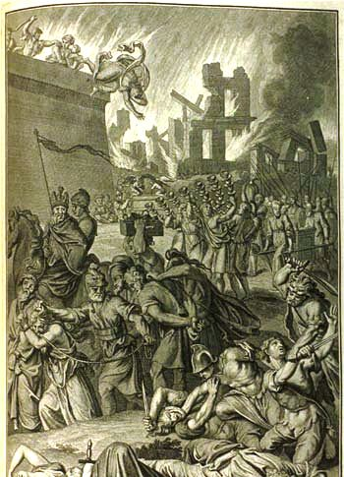
A Future “GREAT” Tribulation?
Abomination of Desolation Daniel 9:24-27; 12:11
Matthew 23:33-38 (NKJV) ³³ Serpents, brood of vipers! How can you escape the condemnation of hell? ³⁴ Therefore, indeed, I send you prophets, wise men, and scribes: some of them you will kill and crucify, and some of them you will scourge in your synagogues and persecute from city to city,

Slide 14
A Future “GREAT” Tribulation?
Abomination of Desolation Daniel 9:24-27; 12:11
Matthew 23:33-38 (NKJV) ³⁵ that on you may come all the righteous blood shed on the earth, from the blood of righteous Abel to the blood of Zechariah, son of Berechiah, whom you murdered between the temple and the altar. ³⁶ Assuredly, I say to you, all these things will come upon this generation.

Slide 15
A Future “GREAT” Tribulation?
Abomination of Desolation Daniel 9:24-27; 12:11
Matthew 23:33-38 (NKJV) ³⁷ "O Jerusalem, Jerusalem, the one who kills the prophets and stones those who are sent to her! How often I wanted to gather your children together, as a hen gathers her chicks under her wings, but you were not willing! ³⁸ See! Your house is left to you desolate; . . .

Slide 16
A Future “GREAT” Tribulation?
The Great Tribulation of Matthew 24
Matthew 24:34 (NKJV) ³⁴ Assuredly, I say to you, this generation will by no means pass away till all these things take place.

Slide 17
A Future “GREAT” Tribulation?
The Great Tribulation of Matthew 24
WE ARE THE GENERATION (JESUS) WAS TALKING ABOUT! I say that because, unmistakably, for the first time in history, all the signs are coming together at an accelerating rate"
(Hal Lindsey, The 1980's: Countdown To Armageddon, p. 162).

Slide 18
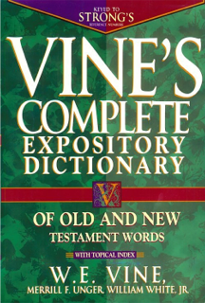
A Future “GREAT” Tribulation?
The Great Tribulation of Matthew 24
Generation - γενεά, genea - Strong‘s: <G1074> Noun
Usage Notes: . . . that which has been begotten, a family; or successive members of a genealogy, Matt. 1:17, or of a race of people, possessed of similar characteristics, pursuits, etc., . . .of the whole multitude of men living at the same time, Matt. 24:34; Mark 13:30; Luke 1:48; Luke 21:32; Phil. 2:15, and especially of those of the Jewish race living at the same period, Matt. 11:16, etc. Transferred from people to the time in which they lived, the word came to mean "an age," i.e., a period ordinarily occupied by each successive generation, say, of thirty or forty years, Acts 14:16; Acts 15:21; Eph. 3:5; Col. 1:26; see also, e.g., Gen. 15:16.

Slide 19
A Future “GREAT” Tribulation?
The Great Tribulation of Matthew 24
Mark 8:12 (NKJV) ¹² But He sighed deeply in His spirit, and said, "Why does this generation seek a sign? Assuredly, I say to you, no sign shall be given to this generation."
“This Generation”

Slide 20
A Future “GREAT” Tribulation?
The Great Tribulation of Matthew 24
Luke 11:50-51 (NKJV) ⁵⁰ that the blood of all the prophets which was shed from the foundation of the world may be required of this generation, ⁵¹ from the blood of Abel to the blood of Zechariah who perished between the altar and the temple. Yes, I say to you, it shall be required of this generation.
“This Generation”

Slide 21
A Future “GREAT” Tribulation?
The Great Tribulation of Matthew 24
Luke 17:25 (NKJV) ²⁵ But first He must suffer many things and be rejected by this generation.
“This Generation”

Slide 22
A Future “GREAT” Tribulation?
The Great Tribulation of Matthew 24
Occurred During The Generation Then Living!
Matthew 24:33-34 (NKJV) ³³ So you also, when you see all these things, know that it is near--at the doors! ³⁴ Assuredly, I say to you, this generation will by no means pass away till all these things take place.
Mark 13:29-30 (NKJV) ²⁹ So you also, when you see these things happening, know that it is near--at the doors! ³⁰ Assuredly, I say to you, this generation will by no means pass away till all these things take place.
Luke 21:31-32 (NKJV) ³¹ So you also, when you see these things happening, know that the kingdom of God is near. ³² Assuredly, I say to you, this generation will by no means pass away till all things take place.

Slide 23
A Future “GREAT” Tribulation?
The Great Tribulation of Matthew 24
Examining The Signs!
“You” - 2,4,9,15,20,23,25,26,33
“False Christ” 5 (Acts 5:36, Theudas, 8:9, Simon)
“Wars, rumors, Natural Disasters & persecution, Betrayal” 6-13

Slide 24
A Future “GREAT” Tribulation?
The Great Tribulation of Matthew 24
Examining The Signs!
Wars & Rumors of Wars
(Tacitus, The Histories, 1:2).
“The history on which I am entering is that of a period rich in disasters, terrible with battles, torn by civil struggles, horrible even in peace. Four emperors fell by the sword; there were three civil wars, more foreign wars, and often both at the same time.”

Slide 25
A Future “GREAT” Tribulation?
The Great Tribulation of Matthew 24
Examining The Signs!
Famines
(Josephus - Antiquities, 20:2:5).
"Now her coming was of very great advantage to the people of Jerusalem; for whereas a famine did oppress them at that time, and many people died for want of what was necessary to produce food withal, queen Helena sent some of her servants to Alexandria with money to buy a great quantity of corn, and others to Cyprus, to bring a cargo of dried figs"

Slide 26
A Future “GREAT” Tribulation?
The Great Tribulation of Matthew 24
Examining The Signs!
Pestilences
(Tacitus, The Annals of Imperial Rome, 12:43)
"Many prodigies occurred during the year. Ominous birds took their seat on the Capitol; houses were overturned by repeated shocks of earthquake, and, as the panic spread, the weak were trampled underfoot in the trepidation of the crowd. A shortage of corn, again, and the famine which resulted, were construed as a supernatural warning."

Slide 27
A Future “GREAT” Tribulation?
The Great Tribulation of Matthew 24
Examining The Signs!
Earthquakes
J. Marcellus Kik (An Eschatology Of Victory, p. 93).
"And as to earthquakes, many are mentioned by writers during a period just previous to 70 A.D. There were earthquakes in Crete, Smyrna, Miletus, Chios, Samos, Laodicea, Hierapolis, Colosse, Campania, Rome, and Judea. It is interesting to note that the city of Pompeii was much damaged by an earthquake occurring on February 5, 63 A.D."

Slide 28
A Future “GREAT” Tribulation?
The Great Tribulation of Matthew 24
Examining The Signs!
“You” - 2,4,9,15,20,23,25,26,33
“False Christ” 5 (Acts 5:36, Theudas, 8:9, Simon)
“Wars, rumors, Natural Disasters & persecution, Betrayal” 6-13
“Gospel of the kingdom preached” 14 (Col 1:6,23)
“Abomination of Desolation” 15 – (Dan. 9:27; 12:11; Luke 20-24)

Slide 29
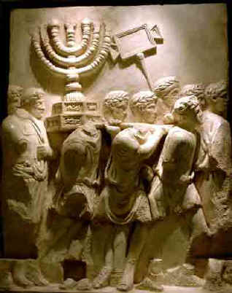
A Future “GREAT” Tribulation?
The Great Tribulation of Matthew 24
Examining The Signs!
Abomination of Desolation
Jesus gave the Olivet discourse in about 30 A.D.; Jerusalem was destroyed by Titus, the Roman General, in 70 A.D.

Slide 30
A Future “GREAT” Tribulation?
The Great Tribulation of Matthew 24
Examining The Signs!
Abomination of Desolation
(Josephus - The Wars Of The Jews, 4:3:10).
"Agnus stood in the midst of them, and casting his eyes frequently at the temple, and having a flood of tears in his eyes he said, 'Certainly, it had been good for me to die before I had seen the house of God full of so many abominations, or these sacred places that ought not to be trodden upon at random, filled with the feet of these bloodshedding villains'"

Slide 31
A Future “GREAT” Tribulation?
The Great Tribulation of Matthew 24
Examining The Signs!
“You” - 2,4,9,15,20,23,25,26,33
“False Christ” 5 (Acts 5:36, Theudas, 8:9, Simon)
“Wars, rumors, Natural Disasters & persecution, Betrayal” 6-13
“Gospel of the kingdom preached” 14 (Col 1:6,23)
“Abomination of Desolation” 15 – (Dan. 9:27; 12:11; Luke 20-24)
“A local tribulation” 16-28

Slide 32
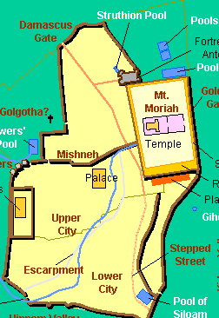
A Future “GREAT” Tribulation?
The Great Tribulation of Matthew 24
Examining The Signs!
A Local Tribulation!
Those in Judea flee . . . (16)
On the house top . . . (17)
In the field . . . (18)
The pregnant . . . (19)
Pray that your flight may not be in the winter or on the Sabbath . . . (20)
Was Escapable

Slide 33
A Future “GREAT” Tribulation?
The Great Tribulation of Matthew 24
Examining The Signs!
“You” - 2,4,9,15,20,23,25,26,33
“False Christ” 5 (Acts 5:36, Theudas, 8:9, Simon)
“Wars, rumors, Natural Disasters & persecution, Betrayal” 6-13
“Gospel of the kingdom preached” 14 (Col 1:6,23)
“Abomination of Desolation” 15 – (Dan. 9:27; 12:11; Luke 20-24)
“A local tribulation” 16-28
“Judgment upon National Israel” 27-35 (23:34-38)

Slide 34
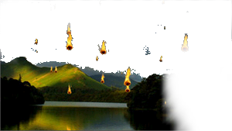
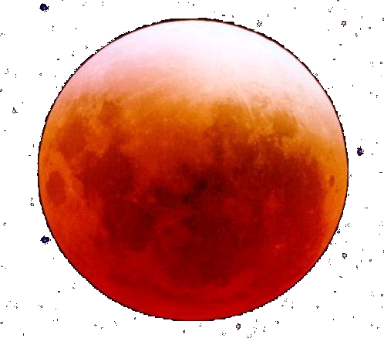
A Future “GREAT” Tribulation?
The Great Tribulation of Matthew 24
Examining The Signs!
Apocryphal Language Describing Judgment upon National Israel
Babylon (Isa. 13:10, 13)
Edom (Isa. 34:4-6)
The Peoples (Isa. 51:5-6)
Judah (Jer. 4:1-6, 23-28)
Egypt (Ezek. 32:7-8)
The Nations (Joel 3:15-16)
Nineveh (Nah. 1:1-5)
Israel (Amos 8:1-2, 9)

Slide 35
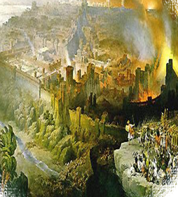
A Future “GREAT” Tribulation?
The Great Tribulation of Matthew 24
Examining The Signs!
Over 1 million Jews died in the destruction of Jerusalem – thousands more were killed outside of the city and in other cities in Judea – over 97,000 were carried away captive . . .

Slide 36
A Future “GREAT” Tribulation?
The Great Tribulation of Matthew 24
Occurred During The Generation Then Living!
Matthew 24:33-34 (NKJV) ³³ So you also, when you see all these things, know that it is near--at the doors! ³⁴ Assuredly, I say to you, this generation will by no means pass away till all these things take place.
Mark 13:29-30 (NKJV) ²⁹ So you also, when you see these things happening, know that it is near--at the doors! ³⁰ Assuredly, I say to you, this generation will by no means pass away till all these things take place.
Luke 21:31-32 (NKJV) ³¹ So you also, when you see these things happening, know that the kingdom of God is near. ³² Assuredly, I say to you, this generation will by no means pass away till all things take place.

Slide 37
A Future “GREAT” Tribulation?
The Great Tribulation of Revelation 6-18
“Shortly Take Place”
Revelation 1:1 (NKJV) ¹ The Revelation of Jesus Christ, which God gave Him to show His servants--things which must shortly take place. And He sent and signified it by His angel to His servant John,

Slide 38
A Future “GREAT” Tribulation?
The Great Tribulation of Revelation 6-18
“Time Is Near”
Revelation 1:3 (NKJV) ³ Blessed is he who reads and those who hear the words of this prophecy, and keep those things which are written in it; for the time is near.

Slide 39
A Future “GREAT” Tribulation?
The Great Tribulation of Revelation 6-18
“Time Is Near”
Revelation 1:19 (NKJV) ¹⁹ Write the things which you have seen, and the things which are, and the things which will take place after this.

Slide 40
A Future “GREAT” Tribulation?
The Great Tribulation of Revelation 6-18
“Shortly Take Place”
Revelation 22:6 (NKJV) ⁶ Then he said to me, "These words are faithful and true." And the Lord God of the holy prophets sent His angel to show His servants the things which must shortly take place.

Slide 41
A Future “GREAT” Tribulation?
The Great Tribulation of Revelation 6-18
“Time Is At Hand”
Revelation 22:10 (NKJV)
¹⁰ And he said to me, "Do not seal the words of the prophecy of this book, for the time is at hand.

Slide 42
A Future “GREAT” Tribulation?
The Great Tribulation of Revelation 6-18
“Tribulation - THEN”
Revelation 1:9 (NKJV) ⁹ I, John, both your brother and companion in the tribulation and kingdom and patience of Jesus Christ, was on the island that is called Patmos for the word of God and for the testimony of Jesus Christ.

Slide 43
A Future “GREAT” Tribulation?
The Great Tribulation of Revelation 6-18
1. Written PRIMARILY for the encouragement and edification of Christians living in his own time.
2. Written largely in symbolic language, . . . must strive to be certain interpretation agrees with the context of the book AS WELL as with the rest of the Bible!
3. Uses Old Testament terminology with New Testament meaning . . . .over 400 allusions to the Old Testament are made in Revelation.
4. Must seek to grasp the vision or series of visions as a whole without pressing the details of each symbol.
5. Understand the difficult passages in the light of clearer passages. Make all interpretations consistent with the teaching of the whole Bible.
“Tribulation - THEN”

Slide 44
Should We Be Looking For A Future “GREAT Tribulation”
On Earth?
NO!!

Slide 45
A Future “GREAT” Tribulation?
These Passages Do Not Teach A Future Period of “Great Tribulation” On The Earth!
Proposed Proof Text:
Daniel 9:27
Matthew 24
Revelation 6-18

Slide 46
A Future “GREAT” Tribulation?
The Bible Does Teach That Those Who Do Not Obey The Gospel Will Suffer Great Tribulation!!
2 Thessalonians 1:6-9 (NKJV) ⁶ since it is a righteous thing with God to repay with tribulation those who trouble you, ⁷ and to give you who are troubled rest with us when the Lord Jesus is revealed from heaven with His mighty angels, ⁸ in flaming fire taking vengeance on those who do not know God, and on those who do not obey the gospel of our Lord Jesus Christ. ⁹ These shall be punished with everlasting destruction from the presence of the Lord and from the glory of His power,

