Slide 1
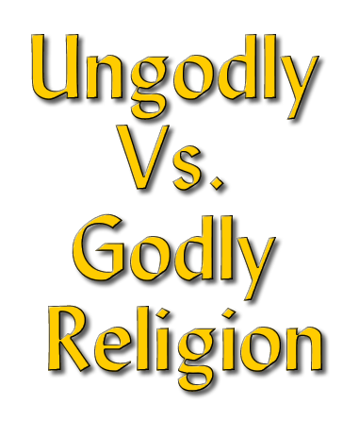
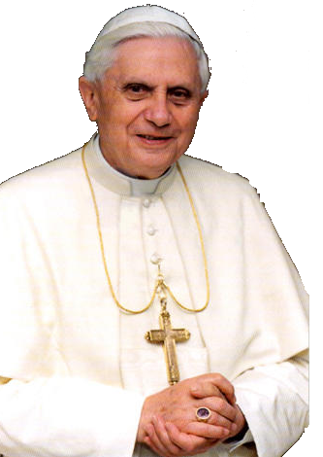
Notes:
Series On Godliness
Essentials
To Living
A Godly
Life

Slide 2
1 Tim 4:7-8 (NKJV)
⁷ But reject profane and old wives' fables, and exercise yourself toward godliness. ⁸ For bodily exercise profits a little, but godliness is profitable for all things, having promise of the life that now is and of that which is to come.

Slide 3
Godly Vs. Ungodly
W.E. Vine: “That piety which, characterized by a Godward attitude, does that which is well pleasing to Him.”
Ungodly = Not-godly - God is not the primary object when making decisions.
Notes:
Godly Vs. Ungodly

Slide 4
Godly
Religion
Family
Social
Pleasure
GOD
Godly Vs. Ungodly
Desire –
To please God!
Learning -
& Doing -
What God Wants
Godly Religion Is Revealed & Authorized Religion!
John 4:24
Notes:
Godly Vs. Ungodly
Desire – To please God!

Slide 5
UNgodly
Religion
Family
Social
Pleasure
GOD
Godly Vs. Ungodly
Desire –
Self Interest!
Rules & Actions Determined by men
Focus Is On
Temporal & Social
Desires
Notes:
Godly Vs. Ungodly
Desire – To please God!

Slide 7
NOT-GODLY
GODLY
Matthew 15:7-9 Doctrine of Men
2Tim.3:1-5; Jude 4 Immoral Conduct
2 Cor. 11:2-4 Another Jesus
Colossians 2:8 Men’s Philosophy

Slide 8
“Supposing that godliness is a way of gain” – I Timothy 6:5
Some love preeminence - 3 John 9, Jude 16
Some love “the praise of men more than the praise of God” – John 12:43

Slide 9
Bible Reveals 2 Kinds of Religion
NOT-GODLY
GODLY
Matthew 15:7-9 Doctrine of Men
2Tim.3:1-5; Jude 4 Immoral Conduct
2 Cor. 11:2-4 Another Jesus
Colossians 2:8 Men’s Philosophy
2 Tim. 3:16 - 4:4 Scripture
Titus 2:11-12 Deny Ungodliness
1 Tim. 3:16 – 4:2 Myst. of Godliness
Colossians 2:9-10

Slide 10
What Kind of CHURCH will be Preferred by the --
GODLY
NOT-GODLY
Goals?
Eph. 4:12-16
Numbers
Doctrine?
2 John 9
Pleasing Men
Discipline?
2 Thess. 3:6
“As You Are”
Worship?
Heb. 12:28
“Feel Good”
Preacher?
1 Cor. 2:1-5
Entertaining
Activities?
Col.3:17
Secular

Slide 11
The Social Gospel
“The social gospel is about causes, not Christ; agendas, not Alpha and Omega; politics, not the Prince of Peace; more of this world and less of the next one. It’s a subtle, but effective, means of distracting evangelicals from their paramount calling, which is about conversion, not political convictions” – Cal Thomas

Slide 12
What Kind of Church are You Seeking?
The church of YOUR choice?
OR
The church of GOD’S choice?
God’s choice can only be determined by a study of scripture. - Isaiah 55:8-9

Slide 14
Knowledge –
Faith –
Hope -
Love –

Slide 15
Creator – Ps. 95:6; 1 Pet.4:19
Omnipotent – Rev.19:6; Acts 26:8
Omnipresent – Jer. 23:23; Ps.23:4
Omniscient – Prov 15:3; Heb 4:13
All-wise – Rom. 11:33; 1 Cor. 1:25
Holy – 1 Peter 1:15,16; 1 Thes 4:3-7
Impartial - Acts 10:34; 1 Pet. 1:17
Love – John 3:16; 1 John 4:8,19; 5:3
Jealous – Ex. 20:5; 34:14; Mt. 4:10
Good, Severe – Ro.11:22, Heb.12:28
Notes:
Faith In God Requires A Knowledge of God
Tritheism
Tritheism is the teaching that the Godhead is really three separate beings forming three separate gods. This erring view is often misplaced by the cults for the doctrine of the Trinity which states that there is but one God in three persons: Father, Son, and Holy Spirit. The doctrine of the trinity is, by definition, monothestic. That is, it is a doctrine that affirms that there is only one God in all the universe. Tritheism has taken different forms throughout the centuries. In the early church the Christians were accused of being tritheists by those who either refused to understand or could not understand the doctrine of the Trinity. In the late 11th century a Catholic monk of Compiègne in France, Roscelin considered the three Divine Persons as three independent beings and that it could be said they were three gods. He maintained that God the Father and God the Holy Ghost would have become incarnate with God the Son unless there were three gods. Present day Mormonism is tritheistic -- but with a twist. Mormonism teaches that there are many God's in the universe but they serve and worship only one of them. The godhead for earth is to them really three separate gods: the Father, the Son, and the Holy Ghost. The Father used to be a man on another world who brought one of his wives with him to this world - they both have bodies of flesh and bones. The son is a second god who was literally begotten between god the father and his goddess wife. The holy ghost is a third god. Therefore, in reality, Mormonism is polytheistic with a tritheistic emphasis. Of course, tritheism clearly contradicts the teaching of the Bible regarding monotheism.
“You are My witnesses,” declares the Lord, “And My servant whom I have chosen, In order that you may know and believe Me, And understand that I am He. Before Me there was no God formed, And there will be none after Me," (Isaiah 43:10).
“Thus says the Lord, the King of Israel And his Redeemer, the Lord of hosts: ‘I am the first and I am the last, And there is no God besides Me," (Isaiah 44:6).
‘Do not tremble and do not be afraid; Have I not long since announced it to you and declared it? And you are My witnesses. Is there any God besides Me, Or is there any other Rock? I know of none,’” (Isaiah 44:8).

Slide 16
John 8:24 (NKJV) ²⁴ Therefore I said to you that you will die in your sins; for if you do not believe that I am He, you will die in your sins."
Acts 2:36 (NKJV) ³⁶ "Therefore let all the house of Israel know assuredly that God has made this Jesus, whom you crucified, both Lord and Christ."
Luke 6:46 (NKJV) ⁴⁶ "But why do you call Me 'Lord, Lord,' and do not do the things which I say?
Notes:
Faith In Christ

Slide 17
Who He Is – John 1:1,2; 17:5
Son of God – Mat 17:5; Jn 3:16
Savior – 1 John 4:14
Head – Eph 1:22,23; Col 1:18
King – 1 Tim 6:15; Rev 19:16
Lord – Acts 2:36; Phili 2:9-11
What He Has Done For Us – Phili 2:5-11; Heb 2:9-18
What He Is Doing For Us –
Priest – Heb 8:1
Mediator – Heb 8:6
2 Cor. 5:10 (NKJV)
¹⁰ For we must all appear before the judgment seat of Christ, that each one may receive the things done in the body, according to what he has done, whether good or bad.
Notes:
Faith In Christ

Slide 18
Titus 1:2 (NKJV) ² . . . which God, who cannot lie, promised before time began,
Phili 1:20 (NKJV) ²⁰ according to my earnest expectation and hope that in nothing I shall be ashamed, but with all boldness, as always, so now also Christ will be magnified in my body, whether by life or by death.
1 John 3:3 (NKJV) ³ And everyone who has this hope in Him purifies himself, just as He is pure.
Notes:
Hope Of Eternal Life

Slide 19
The bond of perfection - Col. 3:14
And now abide faith, hope, love, these three; but the greatest of these is love. - 1 Cor 13:13 (NKJV) –
Must Love God Supremely – Mark 12:29-31; John 14:15,23; 1 John 5:1-3
Love God’s Word - Ps 119:97-104
God is love – Those who possess a Godward attitude – will seek to love as He loves – 1 John 5:1; 1 Pet 1:22; 1 John 4:20
Notes:
Above All These Things Put On Love

Slide 20
2 Peter 1:2-4 (NKJV)
² Grace and peace be multiplied to you in the knowledge of God and of Jesus our Lord, ³ as His divine power has given to us all things that pertain to life and godliness, through the knowledge of Him who called us by glory and virtue, ⁴ by which have been given to us exceedingly great and precious promises, that through these you may be partakers of the divine nature, having escaped the corruption that is in the world through lust.
Notes:
Above All These Things Put On Love

Slide 21
Knowledge –
Faith –
Hope -
Love –

Slide 22
1 Tim 4:7-8 (NKJV)
⁷ But reject profane and old wives' fables, and exercise yourself toward godliness. ⁸ For bodily exercise profits a little, but godliness is profitable for all things, having promise of the life that now is and of that which is to come.
Notes:
Live The Best Life NOW -
Enjoy Life Eternal With God

Slide 23
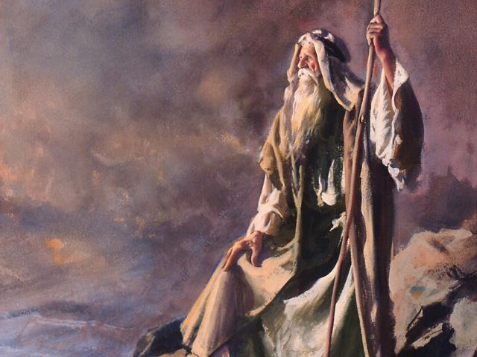
Notes:
I set before you
Life and death –
Choose life
Deut 30:15-19

Slide 25
Ungodly Vs. Godly Religion

