Slide 1
“Be Strong In The Lord And In The Power Of His Might”
Ephesians 6:10-24

Slide 2
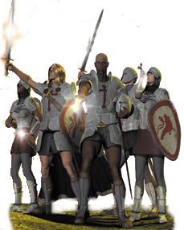
“Be Strong In The Lord And In The Power Of His Might”
We Are At War:
A Spiritual war – A battle that is waged in the minds of men! -
Internally – the war with sin, self deception, pride, selfishness, doubt, discouragement, etc.
Externally – we are at war with false doctrine, false religion, ungodliness, immorality, negativity, etc. –

Slide 3
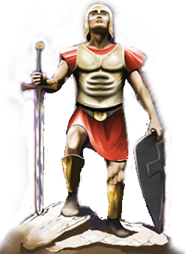
The Weapons Of Our Warfare
Ephesians 6:10-20 (NKJV) ¹⁰ Finally, my brethren, be strong in the Lord and in the power of His might. ¹¹ Put on the whole armor of God, that you may be able to stand against the wiles of the devil. ¹² For we do not wrestle against flesh and blood, but against principalities, against powers, against the rulers of the darkness of this age, against spiritual hosts of wickedness in the heavenly places.

Slide 4
The Weapons Of Our Warfare
Ephesians 6:10-20 (NKJV) ¹³ Therefore take up the whole armor of God, that you may be able to withstand in the evil day, and having done all, to stand. ¹⁴ Stand therefore, having girded your waist with truth, having put on the breastplate of righteousness, ¹⁵ and having shod your feet with the preparation of the gospel of peace;

Slide 5
The Weapons Of Our Warfare
Ephesians 6:10-20 (NKJV) ¹⁶ above all, taking the shield of faith with which you will be able to quench all the fiery darts of the wicked one. ¹⁷ And take the helmet of salvation, and the sword of the Spirit, which is the word of God; ¹⁸ praying always with all prayer and supplication in the Spirit, being watchful to this end with all perseverance and supplication for all the saints--

Slide 6
The Weapons Of Our Warfare
Ephesians 6:10-20 (NKJV) ¹⁹ and for me, that utterance may be given to me, that I may open my mouth boldly to make known the mystery of the gospel, ²⁰ for which I am an ambassador in chains; that in it I may speak boldly, as I ought to speak.

Slide 7
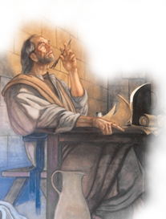
“Be Strong In The Lord And In The Power Of His Might”
Where true strength is found – (In the Lord) – Eph. 6:10; cf. Phili 4:13
The source of strength – (The power of His might) – Eph 6:10; 2 Cor. 12:9-10
Our responsibility in acquiring this strength – (Put on the whole armor of God) – Eph. 6:11; Rom. 13:12
Why we need God’s strength – (We do not wrestle against flesh and blood . . . ) - Eph. 6:12-13; 2 Cor. 2:11; John 8:44

Slide 8
2 Cor. 10:4 (NKJV) ⁴ For the weapons of our warfare are not carnal but mighty in God for pulling down strongholds,

Slide 9
“Having girded your waist with truth” (14)
“Having put on the breastplate of righteousness” (14)
“Having shod your feet with the preparation of the gospel of peace;” (15)
Stand therefore,

Slide 10
“Above all, taking the shield of faith with which you will be able to quench all the fiery darts of the wicked one” (15)
“And take the helmet of salvation,” (17)
“Take . . . the sword of the Spirit, which is the word of God (17)
Stand therefore,

Slide 11
“Praying always with all prayer and supplication in the Spirit, being watchful to this end with all perseverance and supplication for all the saints ” (18-20)
Necessary in putting on the armor – Expresses our dependence upon God.
Stand therefore,

Slide 12
“Be Strong In The Lord And In The Power Of His Might”
Our strength is found only in the Lord
The Lord provides us with what we need to stand
We must put on the whole armor of God if we are going to be able to stand
We face an enemy that we cannot defeat with our own power
We need to understand the desperation of our warfare

Slide 13
Spiritual Reality –
Moral Uprightness –
Preparedness –
Absolute Trust
Assurance of Hope –
The Word of God –
Dependency Upon God -

Slide 14
“Be Strong In The Lord And In The Power Of His Might”
Ephesians 6:10-24

