Slide 1
Dealing With Worldliness
Television, Movies, Music, Internet & Video Games
Notes:
Oh Be Careful Little Eyes What You See
I'm sure all or most of us know that song. It was one of my favorites when I was little and still is today. It goes on to say Oh be careful little ears what you hear; little mouth what you say; little hands what you do; and feet where you go.
As much as I loved that song and the actions to it, I never really took it seriously until several years ago. Or maybe I should say I never really understood it until then.
The song makes perfect sense! First we need to be careful what we see and hear and then what we do and where we go. If we can do the first two we won't have to worry about the rest. I believe everything which enters our minds either through our eyes or ears will influence us and eventually determine what we do with our mouths, hands and feet.
The most crucial thing we must do as Christians is to purify our minds. We must get rid of ALL negative or worldly influences in our lives if we want to move on to perfection. Jesus said in Matthew 5:29, "And if thy right eye offend thee, pluck it out, and cast it from thee..."
Many people disagree with me when I say this includes television, radio and fiction books. They say as long as we're not influenced by them.

Slide 4
Television, Movies, Music, Internet & Video Games
Matthew 6:22-23 (NKJV) ²² "The lamp of the body is the eye. If therefore your eye is good, your whole body will be full of light. ²³ But if your eye is bad, your whole body will be full of darkness. If therefore the light that is in you is darkness, how great is that darkness!

Slide 5
Television, Movies, Music, Internet & Video Games
We Are Influenced By What We See & Hear
Avenues of sins (1 Jno. 2:15-17)
The Devil is out to destroy us (1 Pet. 5:8)
Our Thoughts affect who and what we are (Prov. 23:7)
Influenced by our surroundings (Psalm 51:5; 1 Cor. 15:33)
Should detest sin (2 Pet. 2:7-8)
Ought to blush at wrongdoing (Jer. 8:12)
Possible to become desensitized to sin (Psa. 1:1-2)
Take heed lest we fall (1 Cor. 10:12).

Slide 6
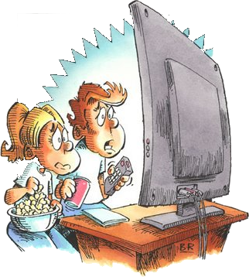
Television, Movies, Music, Internet & Video Games
TV
Can be a waste of time
Can control us – (can effect how we learn, what we deem as important, what we believe)
Networks have goals
Money
Philosophy (mostly immoral, ungodly, worldly, & atheistic)
Filled With Filth

Slide 7
Television, Movies, Music, Internet & Video Games
TV
Illicit sex as fun and liberating and having no consequences,
Language, immodesty, violence
Criminals as heroes fighting a corrupt establishment,
Unruly kids as sources of wisdom whose only need is to be freed from their stupid elders,
Anyone who talks about God as either a hypocrite or a dangerous maniac,

Slide 8
Television, Movies, Music, Internet & Video Games
Movies
What do the ratings mean?
http://www.mpaa.org/FlmRat_Ratings.asp
Notes:
I have seen G rated movies that I would not want my children to see –
I have seen PG movies that has such a sexual undertone that that a Christian shouldn’t enjoy it.
I have seen PG 13 movies that were good moral movies – but most of them glorify fornication and has bad language.
I have seen some good rated R movies – but again most of them have bad language and glorifies fornication, adultery and homosexuality.

Slide 9
Television, Movies, Music, Internet & Video Games
Movies
Most movies glorify fornication, contains nudity, filthy language, violence, are anti family, and many push the homosexual agenda, etc.
www.screenit.com

Slide 10
Television, Movies, Music, Internet & Video Games
Music
Much of Music
Glorifies fornication and adultery –
Advocates violence –
Contains filthy language –
Honors immoral practices –
Glorifies drinking alcohol and drug use –
Ridicules godliness -
Cradle of Filth

Slide 11
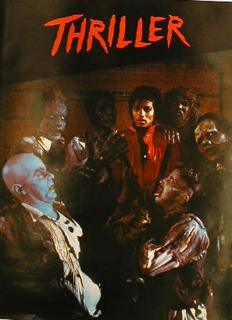
Television, Movies, Music, Internet & Video Games
Music
Music Videos
Promotes Lewdness, (dancing, clothing, behavior) – Violence – Drinking – Drug Use – Fornication – Filthy Language . . . Even Satanism.
Country, Pop, Rock, Heavy Metal, Rap . . .

Slide 12
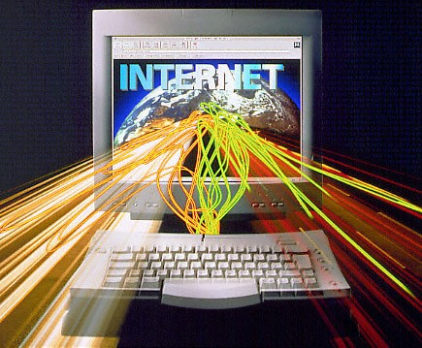
Television, Movies, Music, Internet & Video Games
Internet
An amazing tool that can be used for much good – just like TV and radio.
As with any TOOL – can be misused.
Many Temptations and worldly advice - U-Tube – Pornography – Violence – Scams – Viruses – Music and Movie Piracy.

Slide 13
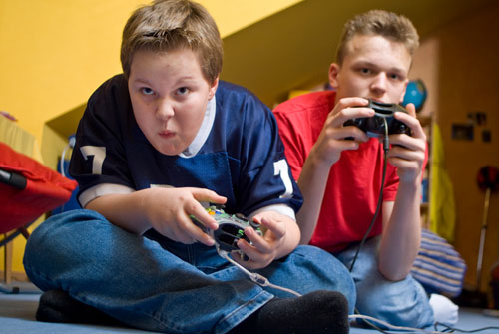
Television, Movies, Music, Internet & Video Games
Video Games
Many games harmless in and of themselves –
Can be addictive – Can be a waste of time –
Some games contain sexual content -
Some games promote violence –
Bad language -

Slide 14
Television, Movies, Music, Internet & Video Games
Can Destroy Families
Worldly influences –
Adultery, insubordination, divorce –
Rebellious children – fornication –
Alcohol and drug use – Violence & lewdness –
Steals time from God & family

Slide 15
Television, Movies, Music, Internet & Video Games
1 Corinthians 15:33-34 (NKJV) ³³ Do not be deceived: "Evil company corrupts good habits." ³⁴ Awake to righteousness, and do not sin; for some do not have the knowledge of God. I speak this to your shame.

Slide 16
Television, Movies, Music, Internet & Video Games
We Are Influenced By What We See & Hear
Avenues of sins (1 Jno. 2:15-17)
The Devil is out to destroy us (1 Pet. 5:8)
Our Thoughts affect who and what we are (Prov. 23:7)
Influenced by our surroundings (Psalm 51:5; 1 Cor. 15:33)
Should detest sin (2 Pet. 2:7-8)
Ought to blush at wrongdoing (Jer. 8:12)
Possible to become desensitized to sin (Psa. 1:1-2)
Take heed lest we fall (1 Cor. 10:12).

