Slide 1
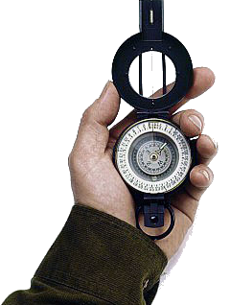
Walking By Faith
2 Corinthians 5:7

Slide 2
Walking By Faith
How To Establish Our Faith

Slide 3
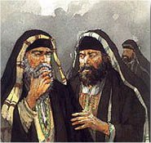
Walking By Faith
From Heaven or Men?
Matthew 21:25-26
Only Two Possible Sources
From Heaven
Mt. 21:23-27
1 John 4:4-6
Gal. 1:6-9
Col. 2:6-10
2 Thess. 2:15
From Men
Mt. 15:1-9
1 Cor. 4:6
Gal. 1:10-17
Col. 2:8
2 Thess. 2:2-4
Notes:
1 John 4:4-6 (NKJV) ⁴ You are of God, little children, and have overcome them, because He who is in you is greater than he who is in the world. ⁵ They are of the world. Therefore they speak as of the world, and the world hears them. ⁶ We are of God. He who knows God hears us; he who is not of God does not hear us. By this we know the spirit of truth and the spirit of error.

Slide 4
Walking By Faith
From Heaven or Men?
The Comprehensive Nature of The New Testament Scriptures
Understandable – Eph 3:3-5
Sufficiently Instructs - 2 Tim 3:16,17
Cannot Be Transgressed – 2 John 9
The totality of information revealed regarding any act of righteousness forms the pattern for that act – 2 Tim 1:13; 3:16,17; 2 Pet 1:3;
Matthew 21:23-27

Slide 5
Walking By Faith
Establishing Our Faith
The compilation of all references to the subject under consideration, including direct statements, approved actions, and necessary implications.
When all the evidence is compiled and sifted through using the laws of communication, including contextual considerations, then the true meaning and the current application can be arrived at.
God has used the basic laws of communication to reveal His will to us.
Notes:
Hermeneutics – The Science of Interpretation
The Inductive Method

Slide 6
Walking By Faith
Establishing Our Faith
Biography’s -
Novels -
Rules of a game –
Establishing Legal precedent –
Blue Prints in Construction –
Text Books –
God has used the basic laws of communication to reveal His will to us.
Notes:
Hermeneutics – The Science of Interpretation
The Inductive Method

Slide 7
Walking By Faith
Establishing Our Faith
God has used the basic laws of communication to reveal His will to us.
“The reader who comes to terms with an author and grasps his propositions and reasoning shares the author’s mind. In fact, the whole process of interpretation is directed toward a meeting of minds through the medium of language.” (How To Read A Book; Adler & Van Doren, Pg 153)
Notes:
Hermeneutics – The Science of Interpretation
The Inductive Method

Slide 8
Walking By Faith
Establishing Our Faith
God has used the basic laws of communication to reveal His will to us.
Direct Command or Statement. (Must Examine Context)
Approved Apostolic Example. (Observation of Approved Activity of first Century Christians).
Necessary Implication. (a logical and unavoidable conclusion drawn from statements or propositions).
Notes:
Don’t think that if God had spoken in nothing but direct statements or commands that unity would exist -
Baptism – Mark 16:16; Acts 2:38; 1 Peter 3:21
There is but one body, one faith – Ep. 4:4,5
Women to keep silent in the church – 1 Cor. 14:34; 1 Tim. 2:11,12
Fellowship halls (eating and entertainment halls)? 1 Cor 11:22,34

Slide 9
Walking By Faith
Establishing Our Faith
Don’t think that if God had spoken in nothing but direct statements or commands that unity would exist
Baptism – Mark 16:16; Acts 2:38; 1 Peter 3:21
There is but one body, one faith – Ep. 4:4,5
Women to keep silent in the church – 1 Cor. 14:34; 1 Tim. 2:11,12
Fellowship halls (recreation and entertainment halls)? 1 Cor 11:22,34
Notes:
Don’t think that if God had spoken in nothing but direct statements or commands that unity would exist -
Baptism – Mark 16:16; Acts 2:38; 1 Peter 3:21
There is but one body, one faith – Ep. 4:4,5
Women to keep silent in the church – 1 Cor. 14:34; 1 Tim. 2:11,12
Fellowship halls (eating and entertainment halls)? 1 Cor 11:22,34

Slide 10
Walking By Faith
Establishing Our Faith
Understanding Approved Examples Essential to Understanding and Abiding in God’s Divine Will.
1 Corinthians 11:1 (NKJV) ¹ Imitate me, just as I also imitate Christ.
Notes:
Don’t think that if God had spoken in nothing but direct statements or commands that unity would exist -
Baptism – Mark 16:16; Acts 2:38; 1 Peter 3:21
There is but one body, one faith – Ep. 4:4,5
Women to keep silent in the church – 1 Cor. 14:34; 1 Tim. 2:11,12
Fellowship halls (eating and entertainment halls)? 1 Cor 11:22,34

Slide 11
Walking By Faith
Establishing Our Faith
Understanding Approved Examples Essential to Understanding and Abiding in God’s Divine Will.
Philippians 3:17 (NKJV) ¹⁷ Brethren, join in following my example, and note those who so walk, as you have us for a pattern.
Notes:
Don’t think that if God had spoken in nothing but direct statements or commands that unity would exist -
Baptism – Mark 16:16; Acts 2:38; 1 Peter 3:21
There is but one body, one faith – Ep. 4:4,5
Women to keep silent in the church – 1 Cor. 14:34; 1 Tim. 2:11,12
Fellowship halls (eating and entertainment halls)? 1 Cor 11:22,34

Slide 12
Walking By Faith
Establishing Our Faith
Understanding Approved Examples Essential to Understanding and Abiding in God’s Divine Will.
Philippians 4:9 (NKJV) ⁹ The things which you learned and received and heard and saw in me, these do, and the God of peace will be with you.
Notes:
Don’t think that if God had spoken in nothing but direct statements or commands that unity would exist -
Baptism – Mark 16:16; Acts 2:38; 1 Peter 3:21
There is but one body, one faith – Ep. 4:4,5
Women to keep silent in the church – 1 Cor. 14:34; 1 Tim. 2:11,12
Fellowship halls (eating and entertainment halls)? 1 Cor 11:22,34

Slide 13
Walking By Faith
Establishing Our Faith
Direct statements often contain unavoidable conclusions although not directly stated.
Jesus in reassuring John the Baptist - (Mt. 11:3-5)
Jesus and the resurrection of the dead - (Mt. 22:31-33; Lk. 20:37-40)
Jesus about the humanity and deity of the Messiah -(Mt. 22:41-46)
Preaching the man involves preaching the plan - (Acts 8:35-36)
Notes:
Don’t think that if God had spoken in nothing but direct statements or commands that unity would exist -
Baptism – Mark 16:16; Acts 2:38; 1 Peter 3:21
There is but one body, one faith – Ep. 4:4,5
Women to keep silent in the church – 1 Cor. 14:34; 1 Tim. 2:11,12
Fellowship halls (eating and entertainment halls)? 1 Cor 11:22,34

Slide 14
Walking By Faith
Establishing Our Faith
Direct Statement – The elements of the Lord’s Supper – Jesus took bread, . . . 27Then He took the cup, (Luke 22:18 Fruit of the vine)
Example – When to observe the Lord’s supper - Upon the first day of the week - Acts 20:7
Implication – Frequency of observance – Every first day – “When the disciples came together to break bread” – Acts 20:7; (Ex 20:10)
Notes:
Don’t think that if God had spoken in nothing but direct statements or commands that unity would exist -
Baptism – Mark 16:16; Acts 2:38; 1 Peter 3:21
There is but one body, one faith – Ep. 4:4,5
Women to keep silent in the church – 1 Cor. 14:34; 1 Tim. 2:11,12
Fellowship halls (eating and entertainment halls)? 1 Cor 11:22,34

Slide 15
Walking By Faith
Establishing Our Faith
Jesus used these principles to establish His teachings as authoritative on the subject of divorce – Mat. 19:4-6
Example – Made them male and female - (Gen. 1:27)
Direct statement – Man shall leave and cleave & be one flesh – (Gen. 2:24)
Implication – God joined – (cf Mal 2:14) Necessary Inference - What God has joined together, let not man separate!” (Mat. 19:6)
Notes:
Don’t think that if God had spoken in nothing but direct statements or commands that unity would exist -
Baptism – Mark 16:16; Acts 2:38; 1 Peter 3:21
There is but one body, one faith – Ep. 4:4,5
Women to keep silent in the church – 1 Cor. 14:34; 1 Tim. 2:11,12
Fellowship halls (eating and entertainment halls)? 1 Cor 11:22,34

Slide 16
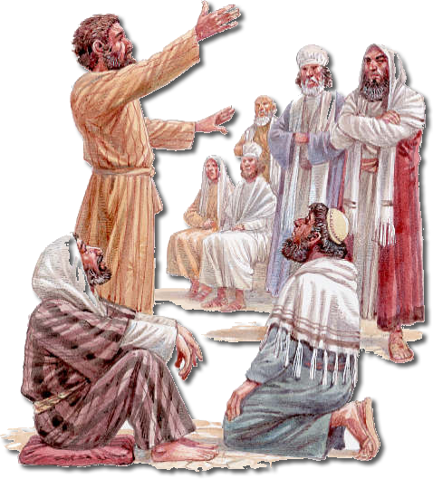
Walking By Faith
Establishing Our Faith
The apostles used these principles to establish the truth on the subject of circumcision – (Acts 15:7-19)
James - appealed to direct statements. vs. 14-19
Paul - referenced how God exemplified His will. v. 12
Peter - argued by the implications of what God did. vs. 7-11; (cf. Acts 10,11)
Notes:
Don’t think that if God had spoken in nothing but direct statements or commands that unity would exist -
Baptism – Mark 16:16; Acts 2:38; 1 Peter 3:21
There is but one body, one faith – Ep. 4:4,5
Women to keep silent in the church – 1 Cor. 14:34; 1 Tim. 2:11,12
Fellowship halls (eating and entertainment halls)? 1 Cor 11:22,34

Slide 17
Walking By Faith
Establishing Our Faith
The importance of establishing Divine authority for ALL we do!!
The NT is the ONLY source of Divine authority -
Must follow the inductive method of Bible study -
What is your attitude towards the need to establish authority for all that you do?
Do you desire to study the Word of God and follow it?
God has used the basic laws of communication to reveal His will to us.
Notes:
We must recognize the importance of establishing Divine authority for ALL we do!!
The Bible – (specifically the NT), is the ONLY source from whence Divine authority can be established
By compiling all references to the subject under consideration and by using the basic laws of communication, including contextual considerations, then the true meaning and the current application can be arrived at.
What is your attitude towards the need to establish authority for all that you do?

