Slide 1
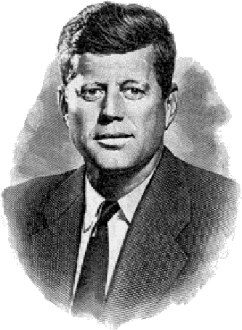
Ask Not . . .
“Ask not what your country can do for you. Ask what you can do for your country.”
John F. Kennedy Inaugural speech - January 20, 1961:
Notes:
Idea from Gerald Sutton Email

Slide 2
Ask Not . . .
NOT – BUT – construction . . . Jn 6:27; Mat 6:19,20; 1 Pet 3:3,4
We should be aware of – receptive of – and grateful for the many blessings various relationships provide us!
But it is MORE blessed to give than to receive! – Acts 20:35

Slide 3
Ask Not . . .
Matthew 16:24-25 (NKJV) ²⁴ Then Jesus said to His disciples, "If anyone desires to come after Me, let him deny himself, and take up his cross, and follow Me. ²⁵ For whoever desires to save his life will lose it, but whoever loses his life for My sake will find it.

Slide 4
Ask Not . . .
Galatians 2:20 (NKJV) ²⁰ I have been crucified with Christ; it is no longer I who live, but Christ lives in me; and the life which I now live in the flesh I live by faith in the Son of God, who loved me and gave Himself for me.

Slide 5
Ask Not . . .
1 Corinthians 13:4-8 (NKJV) ⁴ Love suffers long and is kind; love does not envy; love does not parade itself, is not puffed up; ⁵ does not behave rudely, does not seek its own, is not provoked, thinks no evil; ⁶ does not rejoice in iniquity, but rejoices in the truth; ⁷ bears all things, believes all things, hopes all things, endures all things. ⁸ Love never fails.

Slide 6
Ask Not . . .
Philippians 2:1-4 (NKJV) ¹ Therefore if there is any consolation in Christ, if any comfort of love, if any fellowship of the Spirit, if any affection and mercy, ² fulfill my joy by being like-minded, having the same love, being of one accord, of one mind. ³ Let nothing be done through selfish ambition or conceit, but in lowliness of mind let each esteem others better than himself. ⁴ Let each of you look out not only for his own interests, but also for the interests of others.

Slide 7
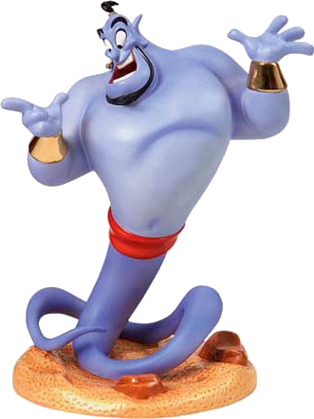
Ask Not . . . Regarding God
"What can God do for “ME?”
God, to many, is like a Santa Claus or genie.
God is many people's ultimate emergency plan.
Many ONLY think of God when they are in need of something from Him.

Slide 8
Ask Not . . . Regarding God
ASK - "What Can I Do For God?”
Because of who God is – Acts 17:24-31;
Because of what God has done – Jn 3:16; Rom 5:8, 1 Jn 4:9,10,19
Because of who I am and what I have done – Ps. 8:4; Rom 3:23
Because of what God requires – Ecc. 12:13; Jn 4:24; 8:24; 14:21; Rom. 12:1-3
Because of what God will do – Ecc 12:14; 2 Cor 5:10

Slide 9
Ask Not...Regarding the Gospel
"What Can The Gospel Do For Me?”
The Gospel brings us the message of peace we can have with God and the spiritual blessings we can have in Christ – Rom. 10:15; Eph 3:6
The POWER of God unto salvation! – Rom. 1:16; 1 Cor 4:15
Many abuse the gospel as a means of gain – 1 Tim 6:5; 2 Pet 2:3
With all blessings come great responsibility – Ps. 8:4; Rom 3:23

Slide 10
Ask Not...Regarding the Gospel
Ask - "What Can I Do For The Gospel?”
Believe & obey it! – Mark 16:16;
Preach it – Mark 16:15; Acts 8:4; 1 Cor 9:16; Eph 6:19
NOT hinder it – Luke 11:52; 1 Cor 9:12; Phili 1:27
Preserve its purity – Gal 1:6-9;
Must defend it – Phili 1:17; Jude 1:3; 1 The 2:2
Suffer for it – 2 Tim 1:8; Phile 1:13

Slide 11
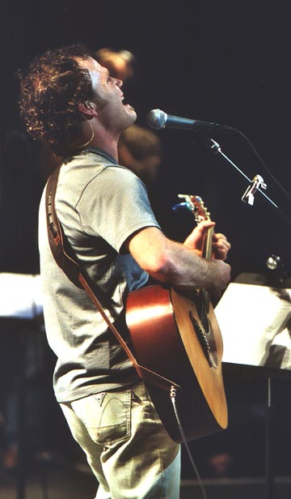
Ask Not...Regarding the Church
"What Can The Church Do For Me?”
To provide edification, support, encouragement, discipline, – Eph 4:11-15; Heb 10:24; 2 Thes 3:6-15
Many however expect the church to provide:
Entertainment –
Recreation –
Child care -
Relief for social ills –
Constant attention to ME

Slide 12
Ask Not...Regarding the Church
Ask "What Can I Do For The Church?”
Give what you can give – 1 Cor 16:1,2
Provide what you can supply, – (praying, leading, teaching, serving, etc.) - Eph 4:16; 1 Cor 12:14-27; Rom 12:4-8
Let your light shine – Mat 5:13-16; Phili 2:15-16
Not hindering by murmuring, complaining, gossiping and ungodly living – Phili 2:17; 1 Tim 6:1; Tit 6:1

Slide 13
Ask Not . . .
What God can do for you – but what you can do for God
What the gospel can do for you – but what you can do for the gospel -
What the church can do for you – but what you can do for the church

