Slide 1
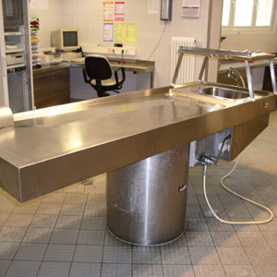
The Autopsy of A Dead
Faith
Why Perform Autopsies?
What Benefits Do The Living Get From An Autopsy?
How To Resurrect A Dead Faith?

Slide 2
The Autopsy of A Dead Faith
What Is A Dead Faith?
DEAD – “applies literally to what is deprived of vital force but is used figuratively of anything that has lost any attribute (as energy, activity, radiance) suggesting life” – (Merriam Webster)

Slide 3
The Autopsy of A Dead Faith
What Is A Dead Faith?
James 2:17 (NKJV) ¹⁷ Thus also faith by itself, if it does not have works, is dead.
James 2:20 (NKJV) ²⁰ But do you want to know, O foolish man, that faith without works is dead?
James 2:26 (NKJV) ²⁶ For as the body without the spirit is dead, so faith without works is dead also.

Slide 4
The Autopsy of A Dead Faith
What Is A Dead Faith?
A Dead Faith Is A Faith That Does Not Obey God
Cannot save – James 2:14,24
Has no compassion – James 2:15,16
Has no fruit – James 2:18-20
Has no fellowship with God – James 2:19, 21-23
Rejects the people of God – James 2:25; 3 John 1:9-11

Slide 5
The Autopsy of A Dead Faith
What Is A Dead Faith?
A Dead Faith Is A Faith That Does Not Obey God
Does not obey the gospel – Mark 16:16; Rom 10:16
Does not walk in the light – 1 John 1:5-7
Transgresses and does not abide in the doctrine of Christ – 2 John 1:9
Cannot please God – Heb 11:6

Slide 6
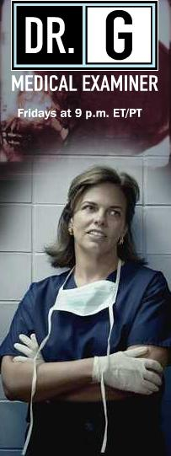
The Autopsy of A Dead Faith
Why Faith Dies?
A diminished respect for God and His word – Prov. 1:7; Ps. 112:1; Heb 4:1
Malnourishment - Rom. 10:17; Hos. 4:6; 1 Pet. 2:1,2
Ungodly attitudes – (pride, selfishness, worldliness, etc) - 1 Sam 15:17; 3 John 9,10; 2 Tim. 4:10
Bitterness – Eph. 4:31; Heb. 12:15
Indifference - Mat 24:12; Rev. 3:15-19
Neglect – Heb 2:3; 4:11; Mat. 25:24-26
Notes:
Let all bitterness—Πασα πικρια. It is astonishing that any who profess the Christian name should indulge bitterness of spirit. Those who are censorious, who are unmerciful to the failings of others, who have fixed a certain standard by which they measure all persons in all circumstances, and unchristian every one that does not come up to this standard, these have the bitterness against which the apostle speaks. In the last century there was a compound medicine, made up from a variety of drastic acrid drugs and ardent spirits, which was called Hiera Picra, ἱερα πικρα, the holy bitter; this medicine was administered in a multitude of cases, where it did immense evil, and perhaps in scarcely any case did it do good. It has ever appeared to me to furnish a proper epithet for the disposition mentioned above, the holy bitter; for the religiously censorious act under the pretense of superior sanctity. I have known such persons do much evil in a Christian society, but never knew an instance of their doing any good.—Adam Clarke's Commentary

Slide 7
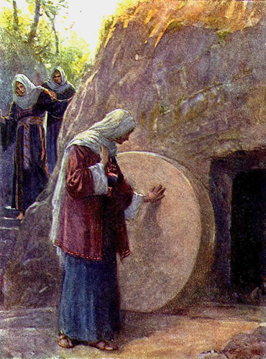
The Autopsy of A Dead Faith
Resurrecting A Dead Faith
Attend services and Bible classes – Heb. 10:24,25; Eph. 4:11-16; Rom 10:17
Read & study your Bible on your own – Acts 17:11,12; 1 Pet. 2:2
Be doers of the word and not hearers only – James 1:21-25
Pray – Luke 18:1; 1 Thes 5:17
Strengthen what you have – Rev 3:2,3; 2 Pet. 1:5-11; Jude 1:20
Serve – Rom. 12:1,2; James 2:15-17
Notes:
Let all bitterness—Πασα πικρια. It is astonishing that any who profess the Christian name should indulge bitterness of spirit. Those who are censorious, who are unmerciful to the failings of others, who have fixed a certain standard by which they measure all persons in all circumstances, and unchristian every one that does not come up to this standard, these have the bitterness against which the apostle speaks. In the last century there was a compound medicine, made up from a variety of drastic acrid drugs and ardent spirits, which was called Hiera Picra, ἱερα πικρα, the holy bitter; this medicine was administered in a multitude of cases, where it did immense evil, and perhaps in scarcely any case did it do good. It has ever appeared to me to furnish a proper epithet for the disposition mentioned above, the holy bitter; for the religiously censorious act under the pretense of superior sanctity. I have known such persons do much evil in a Christian society, but never knew an instance of their doing any good.—Adam Clarke's Commentary

Slide 8
The Autopsy of A Dead Faith
Resurrecting A Dead Faith
2 Corinthians 13:5 (NKJV) ⁵ Examine yourselves as to whether you are in the faith. Test yourselves. Do you not know yourselves, that Jesus Christ is in you?--unless indeed you are disqualified.
Notes:
Let all bitterness—Πασα πικρια. It is astonishing that any who profess the Christian name should indulge bitterness of spirit. Those who are censorious, who are unmerciful to the failings of others, who have fixed a certain standard by which they measure all persons in all circumstances, and unchristian every one that does not come up to this standard, these have the bitterness against which the apostle speaks. In the last century there was a compound medicine, made up from a variety of drastic acrid drugs and ardent spirits, which was called Hiera Picra, ἱερα πικρα, the holy bitter; this medicine was administered in a multitude of cases, where it did immense evil, and perhaps in scarcely any case did it do good. It has ever appeared to me to furnish a proper epithet for the disposition mentioned above, the holy bitter; for the religiously censorious act under the pretense of superior sanctity. I have known such persons do much evil in a Christian society, but never knew an instance of their doing any good.—Adam Clarke's Commentary

Slide 9
The Autopsy of A Dead
Faith
We Need A Living Faith!
Stay Away From Anything That Could Weaken & Kill Our Faith!
Be Diligent To Strengthen Your Faith!

