Slide 1
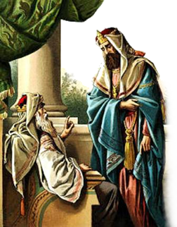
“The Lord has chosen you to build a house for the sanctuary”
1 Chronicles 28:1-10

Slide 2
David's Charge To Solomon
David’s calling – 1 Chron. 28:1-4
God chooses Solomon to build the temple – 1 Chron. 28,5,6
Continued blessings conditional – 1 Chron. 28:7-10

Slide 3
David's Charge To Solomon
1 Chronicles 28:7-10 (NKJV)
⁷ Moreover I will establish his kingdom forever, if he is steadfast to observe My commandments and My judgments, as it is this day.' ⁸ Now therefore, in the sight of all Israel, the assembly of the Lord, and in the hearing of our God, be careful to seek out all the commandments of the Lord your God, that you may possess this good land, and leave it as an inheritance for your children after you forever.

Slide 4
David's Charge To Solomon
1 Chronicles 28:7-10 (NKJV)
⁹ "As for you, my son Solomon, know the God of your father, and serve Him with a loyal heart and with a willing mind; for the Lord searches all hearts and understands all the intent of the thoughts. If you seek Him, He will be found by you; but if you forsake Him, He will cast you off forever. ¹⁰ Consider now, for the Lord has chosen you to build a house for the sanctuary; be strong, and do it."

Slide 5
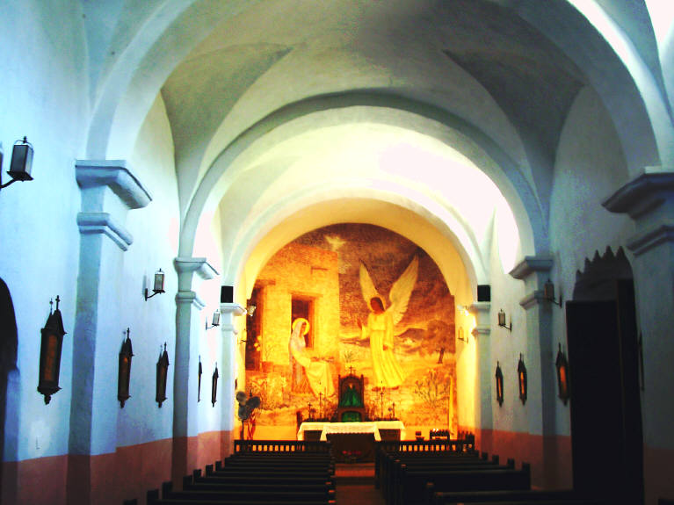
Building A Place For God To Dwell
Are you building a place for God to dwell?:
Personally?
Collectively?
God does not dwell in temples made with hands – Acts 7:48; 17:24
Our bodies are spoken of as being a temple for God – 1 Cor. 6:19; 1 John 4:15,16
The church is the temple of God – 1 Cor. 3:16; Eph 2:22;

Slide 6
Building A Place For God To Dwell
Determined Obedience
Steadfast – RV Constant
Original Word: ‏חָזַק‎, ḥāzaq
Usage Notes: "to be strong, strengthen, harden, take hold of." This verb is found 290 times in the Old Testament.
—Vine's Expository Dictionary of Old and New Testament Words
“⁷ . . . if he is steadfast to observe My commandments and My judgments,“

Slide 7
Building A Place For God To Dwell
Determined Obedience
Solomon was to OBEY the Law of Moses – 1 Kings 2:1-4
We too are under law – Mat 17:5; Luke 6:46;
Law of faith – Rom 3:27
Law of the Spirit – Rom 8:2
Law of Christ – Gal. 6:2
Law of Liberty – James 1:25
“⁷ . . . if he is steadfast to observe My commandments and My judgments,“

Slide 8
Building A Place For God To Dwell
Determined Obedience
To enter the kingdom – Mat 7:21-23; Rom 6:16,17; Jn 3:5
To receive the Holy Spirit – Acts 2:38; 5:32; 1 Cor 6:17-20
To obtain eternal salvation – Heb. 5:8.9; Luke 6:46; Phili 2:12; Rev 22:14;
Condemned if disobedient – Rom. 2:5-11; 2 Thes 1:7-9
“⁷ . . . if he is steadfast to observe My commandments and My judgments,“

Slide 9
Building A Place For God To Dwell
Seeking All of God’s Will
Need to learn and follow ALL of Jesus’ teaching – Jn 6:27; 2 Jn 1:9
“All things that I have commanded you” Mat. 28:20
“. . . Him you shall hear in all things, whatever He says to you.” Acts 3:22
“. . . he will keep My word; and My Father will love him, and We will come to him and make Our home with him.” John 14:23
⁸ . . . be careful to seek out all the commandments of the Lord your God, that you may possess this good land, and leave it as an inheritance for your children after you forever.

Slide 10
Building A Place For God To Dwell
Loyal & Willing Service
Cannot have divided loyalties– Mat 6:24; Luke 16:13
Serving God must be our top priority – Mat 6:33; Mark 12:29-31
We must have a willing attitude – John 7:17; 2 Cor 8:3,12
⁹ "As for you, my son Solomon, know the God of your father, and serve Him with a loyal heart and with a willing mind;

Slide 11
Building A Place For God To Dwell
Sincerity & Honesty
There is NOTHING hidden from our Omniscient God– Heb 4:13; Rev. 2:23; Psalm 139:1-12
Our obedience and service MUST be from the heart – Rom 6:16-19
Must bring even our thoughts under obedience to Christ – 2 Cor. 10:5
Our actions proceed from the heart – Mat 12:34,35; 15:18,19
⁹ “. . . for the Lord searches all hearts and understands all the intent of the thoughts.”

Slide 12
Building A Place For God To Dwell
Promise & Warning
Seek and you will find – Mat 7:7,8; James 4:8-10
We need to seek the Lord while we have opportunity – Isa. 55:6,7
We must seek with “all our heart” – Jer. 29:13
The Lord is with you while you are with Him – 2 Chr. 15:2
But if we forsake Him, He will cast us off – Heb 10:26-39
⁹ “. . . If you seek Him, He will be found by you; but if you forsake Him, He will cast you off forever.”

Slide 13
Building A Place For God To Dwell
Determined Obedience?
Seeking All of God’s Will?
Loyal & Willing Service?
With Sincerity & Honesty?
Are you seeking God – or have you forsaken Him?
Are you building a place for God to dwell?:
Personally?
Collectively?

