Slide 1

Five Ways
We Can Encourage Others

Slide 2

Five Ways We Can Encourage Others
Colossians 2:1-3 (NKJV)
¹ For I want you to know what a great conflict I have for you and those in Laodicea, and for as many as have not seen my face in the flesh, ² that their hearts may be encouraged, being knit together in love, and attaining to all riches of the full assurance of understanding, to the knowledge of the mystery of God, both of the Father and of Christ, ³ in whom are hidden all the treasures of wisdom and knowledge.

Slide 3

Five Ways We Can Encourage Others
Encourage
(n) Paraklēsis – (v) parakaleō
Lit. -“to call to one’s side, call for, summon”:
“to admonish, exhort”: —“to beg, entreat, beseech” —“to console, to encourage and strengthen by consolation, to comfort,” - it combines the ideas of exhorting and comforting and encouraging . . .
—Thayer's Greek-English Lexicon

Slide 4
Five Ways We Can Encourage Others
Encourage
1 a: to inspire with courage, spirit, or hope : hearten - b: to attempt to persuade : urge
2: to spur on : stimulate
3: to give help or patronage to : foster
(Merriam Webster)

Slide 5

Five Ways We Can Encourage Others
Why We Need Encouragement?
Life’s Experience Demands…
Courage
Confidence
Hope
Interdependence!

Slide 6

Five Ways We Can Encourage Others
The Source of Our Encouragement
The Father, Jesus and Holy Spirit – 2 Cor. 1:3-7; 2 Thes. 2:16; Acts 9:31
The Scriptures – Rom 15:4; Heb 13:22
One another – Phile 1:7; Heb 10:24,25

Slide 7
Five Ways We Can Encourage Others
The Example of Barnabas:
Acts 4:36-37 (NKJV)
³⁶ And Joses, who was also named Barnabas by the apostles (which is translated Son of Encouragement), a Levite of the country of Cyprus, ³⁷ having land, sold it, and brought the money and laid it at the apostles' feet.

Slide 8
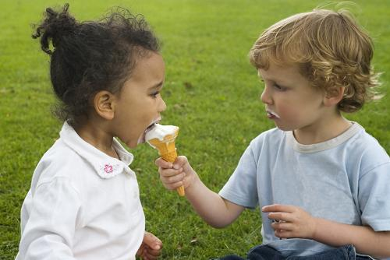
Five Ways We Can Encourage Others
I Will Encourage Others By Practicing Good Stewardship
Like Barnabas – Acts 4:36-37
Difference between ownership and stewardship – Mat 25:14-30; 1 Pet. 4:11; Rom 12:1,2
God does not ask us to give what we do not have – Acts 3:6
Applies to both physical and spiritual needs – Acts 20:35; Gal 6:1

Slide 9
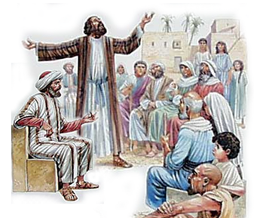
Five Ways We Can Encourage Others
I Will Encourage Others By Believing In Them
Barnabas defended Paul as a new Christian – Acts 9:26-27
It is not always easy to see the good in others – Acts 9:1,36; Luke 14:3-6
Love believes “all things” – 1 Cor. 13:7; Heb 10:24,25

Slide 10
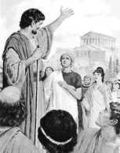
Five Ways We Can Encourage Others
I Will Encourage Others By Helping Them Grow
Barnabas Sent as far as Antioch – Acts 11:22-24
  “Saw the grace of God and was glad” – Rejoiced over what they had – saw their potential . . .
  Encouraged them – to have resolution and faith – cf. Phili 4:4-13
  Qualified – Good man, full of Holy Spirit, full of faith

Slide 11
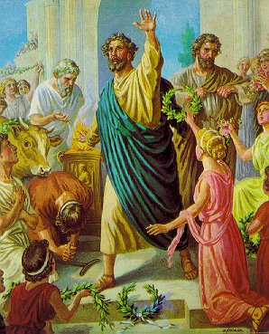
Five Ways We Can Encourage Others
I Will Encourage Others By Providing Opportunities
Barnabas sought out Saul – Acts 11:25,26; 12:25; 13:2,7,43,46,50
  Barnabas & Saul – Acts 12:25; 13:2,7
  Paul & Barnabas – Acts 13:9,13,16, 43,46,50
Barnabas helped Paul to become a leader – Some are jealous of others who have greater potential than they.

Slide 12

Five Ways We Can Encourage Others
I Will Encourage Others By Giving Second Chances
Barnabas wants to give John Mark another chance – Acts 15:35-39
  John Mark had left them on an earlier journey – Acts 13:13
  Paul insisted that Mark not be allowed to go – Acts 15:38
  Paul and Barnabas separate– Acts 15:39
Paul later commends Mark – Col. 4:10; 2 Tim 4:11; Phile. 1:24; (cf. 1 Pet 5:13)

Slide 13
Five Ways We Can Encourage Others
I will encourage others:
By practicing good stewardship –
By extending friendship –
By building them up –
By providing opportunities –
By giving them second chances -

