Slide 1
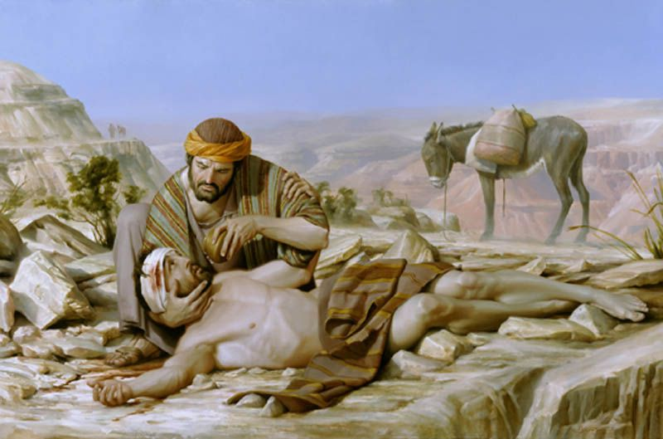
“Go and Learn What This Means”
Matthew 9:9-13

Slide 2
Go and Learn What This Means
Matthew 9:9-13 (NKJV) ⁹ As Jesus passed on from there, He saw a man named Matthew sitting at the tax office. And He said to him, "Follow Me." So he arose and followed Him. ¹⁰ Now it happened, as Jesus sat at the table in the house, that behold, many tax collectors and sinners came and sat down with Him and His disciples. ¹¹ And when the Pharisees saw it, they said to His disciples, . . .

Slide 3
Go and Learn What This Means
Matthew 9:9-13 (NKJV) . . . "Why does your Teacher eat with tax collectors and sinners?" ¹² When Jesus heard that, He said to them, "Those who are well have no need of a physician, but those who are sick. ¹³ But go and learn what this means: 'I desire mercy and not sacrifice.' For I did not come to call the righteous, but sinners, to repentance."

Slide 4
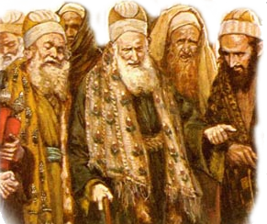
Go and Learn What This Means
The Pharisees’ question - "Why does your Teacher eat with tax collectors and sinners?"
Response - Who is in need of a physician?
Have we learned the importance of mercy?

Slide 5
Go and Learn What This Means
Correct actions are important – Mat 7:21-23; Heb 8:5
But – what good are correct actions without correct attitudes? – Hos 6:6; Mic 6:6-8;
Can one please God without being fair, merciful, and humble?

Slide 6
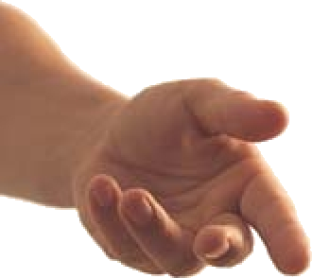
Go and Learn What This Means
Mercy – ἔλεος, eleos—
"is the outward manifestation of pity; it assumes need on the part of him who receives it, . . . It is used (a) of God, who is rich in mercy, Eph. 2:4, and who has provided salvation for all men, Titus 3:5, — Vine's Expository Dictionary of Old and New Testament Words

Slide 7
Go and Learn What This Means
Something that is required of us – Mal. 6:6-8
One of the beatitudes – Mat 5:7
A weightier matter of the Law – Mat 23:23
Involved in how we will be judged – Luke 6:35-38; James 2:13
A product of love – Luke 10:25-37; Eph. 2:4,5

Slide 8
Go and Learn What This Means
Forgiveness flows out of mercy
and mercy flows out of love!
Rom 5:8
Eph 2:4-6
Titus 3:3-5
Fellowship
Forgiveness
Mercy
Love

Slide 9
Go and Learn What This Means
Mercy In Action
Meeting Physical Needs - Mat 25:34-40
Meeting Spiritual Needs –Prov. 14:21; Rom. 15:1; Gal 6:1,2; Jude 1:22,23
Pitying the lost –
Rebuking sin
Praying for others
Preaching the gospel

Slide 10
Go and Learn What This Means
Blessed are the merciful - Matt. 5:7
God requires mercy - Matt 9:13
Therefore be merciful - Luke 6:27-38
“for with the measure you use, it will be measured back to you!”

