Slide 1
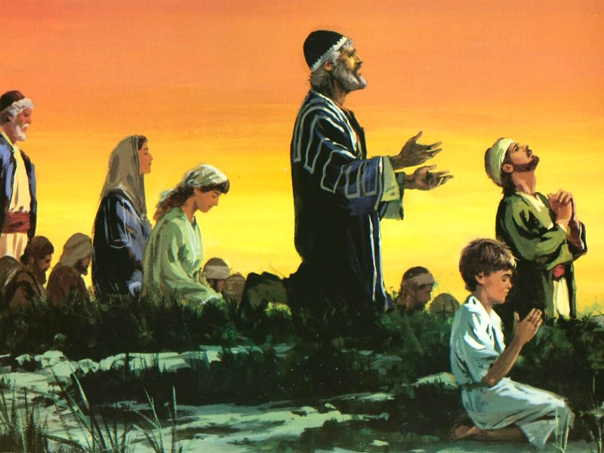
I Sat Where They Sat
Ezekiel 3:15

Slide 2
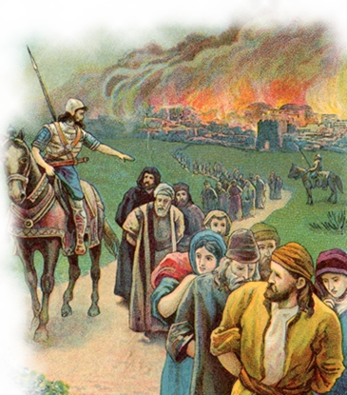
I Sat Where They Sat
Ezekiel’s ministry began “in the fourth month on the fifth day” of “the fifth year of the exile of King Jehoiachin” (1:1-2).
Jehoiachin became King December 598 b.c. (2 Kings 24:1-12).
Jehoiachin was captured three months later by Nebuchadnezzar and deported to Babylon (597 B.C.).
The fifth year of Jehoiachin’s exile was 593 b.c., and the fourth month was the month Tammuz.
Ezekiel is at this time Sent To Rebellious Judah – 1:28-3:14

Slide 3
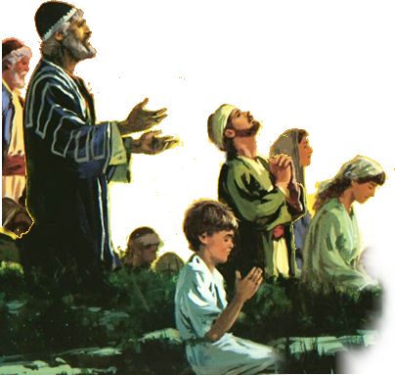
I Sat Where They Sat
Ezekiel 3:15 (KJV)
¹⁵ Then I came to them of the captivity at Telabib, that dwelt by the river of Chebar, and I sat where they sat, and remained there astonished among them seven days.

Slide 4
I Sat Where They Sat
How To Better Meet The Needs of Others . . .
Notes:
James 1:27 (NKJV) ²⁷ Pure and undefiled religion before God and the Father is this: to visit orphans and widows in their trouble, and to keep oneself unspotted from the world.
Leviticus 19:32 (NKJV) ³² 'You shall rise before the gray headed and honor the presence of an old man, and fear your God: I am the Lord.
1 Timothy 4:12 (NKJV) ¹² Let no one despise your youth, but be an example to the believers in word, in conduct, in love, in spirit, in faith, in purity.

Slide 5
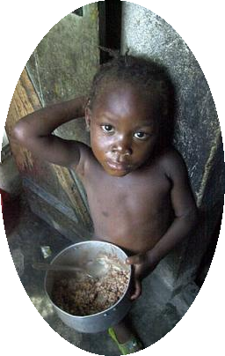
I Sat Where They Sat
The Well Off Sitting Where The Unfortunate Sit
The Poor – Gal. 2:10; James 2:2-5, 15:16

Slide 6
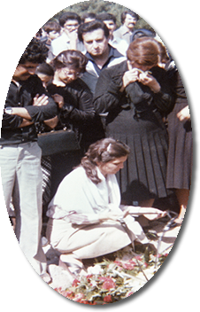
I Sat Where They Sat
The Well Off Sitting Where The Unfortunate Sit
The Poor – Gal. 2:10; James 2:2-5, 15:16
The Mourning – John 11:19, 33-36; Rom 13:15;

Slide 7
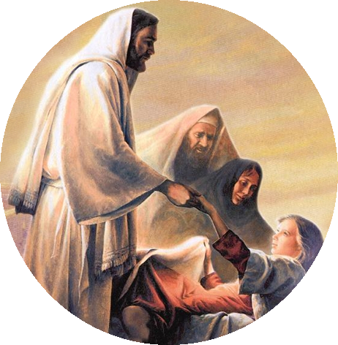
I Sat Where They Sat
The Well Off Sitting Where The Unfortunate Sit
The Poor – Gal. 2:10; James 2:2-5, 15:16
The Mourning – John 11:19, 33-36; Rom 13:15;
The Sick & Disabled – Mat 14:14

Slide 8
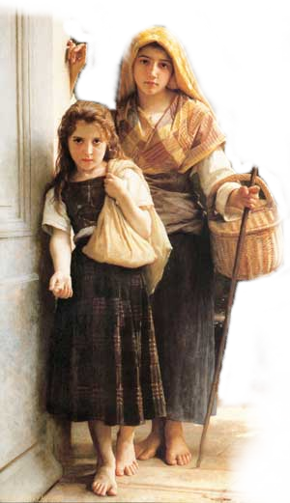
I Sat Where They Sat
The Well Off Sitting Where The Unfortunate Sit
The Poor – Gal. 2:10; James 2:2-5, 15,16
The Mourning – John 11:19, 33-36; Rom 13:15;
The Sick & Disabled – Mat 14:14
The Hurting – James 1:27; Heb 13:3; Rom 12:15; 1 Cor 12:26
Notes:
James 1:27 (NKJV) ²⁷ Pure and undefiled religion before God and the Father is this: to visit orphans and widows in their trouble, and to keep oneself unspotted from the world.
Leviticus 19:32 (NKJV) ³² 'You shall rise before the gray headed and honor the presence of an old man, and fear your God: I am the Lord.
1 Timothy 4:12 (NKJV) ¹² Let no one despise your youth, but be an example to the believers in word, in conduct, in love, in spirit, in faith, in purity.

Slide 9
I Sat Where They Sat
Spouses Sitting
Where their spouse Sits
The Need For Understanding – 1 Pet 3:1-6
The Gender Gap –
Acceptance of Roles -
Relationships Are Strengthened By Communication – 1 Cor 2:11

Slide 10
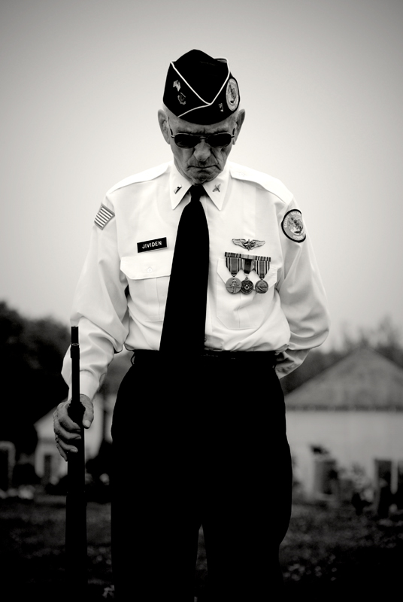
I Sat Where They Sat
The Younger Sitting Where The Older Sit
The Need For Respect – Lev 19:32; Prov 20:29
Should appreciate The Many Battles They Have Fought – 1 Kings 20:11
Should Learn From Them– Prov 20:29; Titus 2:2-6
Should Utilize Their Knowledge & Skill – Psalm 92:14
Notes:
A Case For God

Slide 11
I Sat Where They Sat
The Older Sitting
Where Younger Sit
Consider their Difficulties – 2 Tim 2:22
Should Help Them Prepare To Fight Their Own Battles – 1 Sam 17:33; Eph 6:4; Titus 2:4-6; Psalm 71:17,18

Slide 12
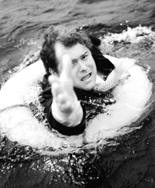
I Sat Where They Sat
The Saved Sitting
Where The Lost Sit
The Lostness of The Lost – Eph 2:11,12; Mat 25:46
We Have All Sinned – Rom 3:3-11,23
What If No one Had Shared The Gospel With You? – Ezekiel 3:16-21
Do You Care? – Jno 3:16

Slide 13
I Sat Where They Sat
The Need For Understanding . . .
The Well Off Sitting Where The Unfortunate Sit –
Spouses Sitting Where their spouse Sits –
The Younger Sitting Where The Older Sit -
The Older Sitting Where Younger Sit -
The Saved Sitting Where The Lost Sit -
Notes:
James 1:27 (NKJV) ²⁷ Pure and undefiled religion before God and the Father is this: to visit orphans and widows in their trouble, and to keep oneself unspotted from the world.
Leviticus 19:32 (NKJV) ³² 'You shall rise before the gray headed and honor the presence of an old man, and fear your God: I am the Lord.
1 Timothy 4:12 (NKJV) ¹² Let no one despise your youth, but be an example to the believers in word, in conduct, in love, in spirit, in faith, in purity.

Slide 14
I Sat Where They Sat
The Need For Understanding . . .
Are we doing unto others as we would have them do unto us?
Are we concerned about helping one another get to heaven?
Do we care that billions of people alive today will be in hell Forever?
Where Are You Sitting?
Notes:
James 1:27 (NKJV) ²⁷ Pure and undefiled religion before God and the Father is this: to visit orphans and widows in their trouble, and to keep oneself unspotted from the world.
Leviticus 19:32 (NKJV) ³² 'You shall rise before the gray headed and honor the presence of an old man, and fear your God: I am the Lord.
1 Timothy 4:12 (NKJV) ¹² Let no one despise your youth, but be an example to the believers in word, in conduct, in love, in spirit, in faith, in purity.

