Slide 1
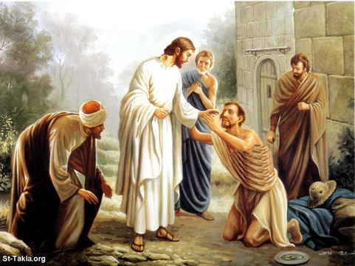
“I Was Blind But Now I See”
John 9:1-41

Slide 2
“I Was Blind But Now I See”
Miracle
Vine's Expository Dictionary of Old and New Testament Words
Usage Number: 1 - Strong's Number: <G1411>
Original Word: δύναμις, dynamis
Usage Notes: "power, inherent ability," is used of works of a supernatural origin and character, such as could not be produced by natural agents and means.
Usage Number: 2 - Strong's Number: <G4592>
Original Word: σημεῖον, sēmeion
Usage Notes: "a sign, mark, token" (akin to sēmainō, "to give a sign;" sema, "a sign"), is used of "miracles" and wonders as signs of Divine authority;
MIRACLES

Slide 3
“I Was Blind But Now I See”
Power over the laws of nature – (Turned water into wine, calmed the tempest, and walked on the sea - Jn. 2: 1-11; Mk. 4: 35-41; 6: 47-50; Feeding of the five thousand - Mk. 6: 37-44).
Power over the demonic Realm – (Cast them out - Mk. 1: 23-27; 5: 1-13, Matt. 12: 22, 23).
Power over diseases and infirmities –(Peter's wife - Mk. 1: 30, 31; healed "every sickness and disease among the people" - Matt. 9: 35; Restored sight to the blind (Matt. 9: 27-31; John 9)
Power over death – (Jesus raised Jairus' daughter, the widow's son, and Lazarus from the dead (Mk. 5: 22-24; 35-43; Lk. 7: 11-17; Jn. 11: 34-46).
MIRACLES
Notes:
1. turning water into wine John 2:1 2. many healings luke 1:32 3. Cleansing a Leper Matt 8:1 4. Healing roman centurians slave Matt 8:5 5. Healing Peter's mother in law Matt 8:14 6. Calming the storm Matt 8:23 7:driving out deamons near the tombs Matt 8:28 8. Healing a paralytic Matt 9:1 9. Healing the woman with the issue of blood Matt 9 20 10. Raising Jairus' daughter from dead matt 9 23 11. Healing two blind men Matt 9 27 12. Healing a demon posessed mute man matt 12 10 13. Healing a man with a paralyzed hand matt 12 22 14. feeding the 5000 matt 14 15 15. Walking on water matt 14 22 16. Healing the gentile mother's daughter matt 15 21 17. feeding 4000 matt 15 32 18. healing the epileptic boy matt 17 14 19. cursing the fig tree matt 21 18 20. healing demon poss man in the synagogue mark 1 23 21. healing the deaf mute mark 7:31 22. healing the blind man at Bethesda Mark 8:22 23. healing the blind at Jericho mark 10:46 24. a miraculous catch of fish luke 5:4 25. A widow's son raised to life Luke 7:11 26. Healing a disabled woman Luke 13:11 27. Healing a man with edema Luke 14:1 28. healing 10 lepers Luke 17:1 29. Healing Malchus's ear luke 22:50 30. Healing an officials son John 4:46 31. Healing the lame man at the Bethesda pool Lu 5:1 32. Healing a man born blind John 9:1 33. Raising Lazerus from the dead Luke 11:38 34. A second miraculous catch of fish Luke 21:1

Slide 4
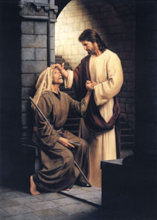
“I Was Blind But Now I See”
The Context
In John 6 - Jesus fed 5000 and then said He was the Bread of Life (John 6:35).
In John 7 – He claims to be the source of living water (John 6:37,38)
In John 8 - He claims to be the Light of the World (John 8:12).
John 8:48-59 – The Jews understood His claims and wanted to kill Him.
In John 9 - He provides physical and spiritual light to a blind man thus providing confirmation of His claims.
Notes:
1. turning water into wine John 2:1 2. many healings luke 1:32 3. Cleansing a Leper Matt 8:1 4. Healing roman centurians slave Matt 8:5 5. Healing Peter's mother in law Matt 8:14 6. Calming the storm Matt 8:23 7:driving out deamons near the tombs Matt 8:28 8. Healing a paralytic Matt 9:1 9. Healing the woman with the issue of blood Matt 9 20 10. Raising Jairus' daughter from dead matt 9 23 11. Healing two blind men Matt 9 27 12. Healing a demon posessed mute man matt 12 10 13. Healing a man with a paralyzed hand matt 12 22 14. feeding the 5000 matt 14 15 15. Walking on water matt 14 22 16. Healing the gentile mother's daughter matt 15 21 17. feeding 4000 matt 15 32 18. healing the epileptic boy matt 17 14 19. cursing the fig tree matt 21 18 20. healing demon poss man in the synagogue mark 1 23 21. healing the deaf mute mark 7:31 22. healing the blind man at Bethesda Mark 8:22 23. healing the blind at Jericho mark 10:46 24. a miraculous catch of fish luke 5:4 25. A widow's son raised to life Luke 7:11 26. Healing a disabled woman Luke 13:11 27. Healing a man with edema Luke 14:1 28. healing 10 lepers Luke 17:1 29. Healing Malchus's ear luke 22:50 30. Healing an officials son John 4:46 31. Healing the lame man at the Bethesda pool Lu 5:1 32. Healing a man born blind John 9:1 33. Raising Lazerus from the dead Luke 11:38 34. A second miraculous catch of fish Luke 21:1

Slide 5
“I Was Blind But Now I See”
In the OT it is God himself who is associated with the giving of sight - (Exodus 4:11, Psalm 146:8).
A Messianic Sign - (Isaiah 29:18, 35:5, 42:7)
“Since the world began it has been unheard of that anyone opened the eyes of one who was born blind" (John 9:32).
Notes:
1. turning water into wine John 2:1 2. many healings luke 1:32 3. Cleansing a Leper Matt 8:1 4. Healing roman centurians slave Matt 8:5 5. Healing Peter's mother in law Matt 8:14 6. Calming the storm Matt 8:23 7:driving out deamons near the tombs Matt 8:28 8. Healing a paralytic Matt 9:1 9. Healing the woman with the issue of blood Matt 9 20 10. Raising Jairus' daughter from dead matt 9 23 11. Healing two blind men Matt 9 27 12. Healing a demon posessed mute man matt 12 10 13. Healing a man with a paralyzed hand matt 12 22 14. feeding the 5000 matt 14 15 15. Walking on water matt 14 22 16. Healing the gentile mother's daughter matt 15 21 17. feeding 4000 matt 15 32 18. healing the epileptic boy matt 17 14 19. cursing the fig tree matt 21 18 20. healing demon poss man in the synagogue mark 1 23 21. healing the deaf mute mark 7:31 22. healing the blind man at Bethesda Mark 8:22 23. healing the blind at Jericho mark 10:46 24. a miraculous catch of fish luke 5:4 25. A widow's son raised to life Luke 7:11 26. Healing a disabled woman Luke 13:11 27. Healing a man with edema Luke 14:1 28. healing 10 lepers Luke 17:1 29. Healing Malchus's ear luke 22:50 30. Healing an officials son John 4:46 31. Healing the lame man at the Bethesda pool Lu 5:1 32. Healing a man born blind John 9:1 33. Raising Lazerus from the dead Luke 11:38 34. A second miraculous catch of fish Luke 21:1

Slide 6
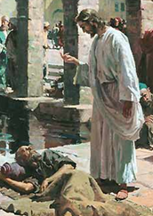
“I Was Blind But Now I See”
The Disciples' question regarding the Blind Man - (9:1-2)
The Lord's answer regarding the Blind Man - (9:3-5)
The Healing Effect of An Obedient Faith - (9:6-7,15)
The People's Reaction - (9:8-12)
The man and the Pharisees - (13-17)
The Jews and the parents - (18-23)
The man and the Jews - (24-34)
The faith of the man - (35-38)
The function of Jesus - (39-41)
Notes:
1. turning water into wine John 2:1 2. many healings luke 1:32 3. Cleansing a Leper Matt 8:1 4. Healing roman centurians slave Matt 8:5 5. Healing Peter's mother in law Matt 8:14 6. Calming the storm Matt 8:23 7:driving out deamons near the tombs Matt 8:28 8. Healing a paralytic Matt 9:1 9. Healing the woman with the issue of blood Matt 9 20 10. Raising Jairus' daughter from dead matt 9 23 11. Healing two blind men Matt 9 27 12. Healing a demon posessed mute man matt 12 10 13. Healing a man with a paralyzed hand matt 12 22 14. feeding the 5000 matt 14 15 15. Walking on water matt 14 22 16. Healing the gentile mother's daughter matt 15 21 17. feeding 4000 matt 15 32 18. healing the epileptic boy matt 17 14 19. cursing the fig tree matt 21 18 20. healing demon poss man in the synagogue mark 1 23 21. healing the deaf mute mark 7:31 22. healing the blind man at Bethesda Mark 8:22 23. healing the blind at Jericho mark 10:46 24. a miraculous catch of fish luke 5:4 25. A widow's son raised to life Luke 7:11 26. Healing a disabled woman Luke 13:11 27. Healing a man with edema Luke 14:1 28. healing 10 lepers Luke 17:1 29. Healing Malchus's ear luke 22:50 30. Healing an officials son John 4:46 31. Healing the lame man at the Bethesda pool Lu 5:1 32. Healing a man born blind John 9:1 33. Raising Lazerus from the dead Luke 11:38 34. A second miraculous catch of fish Luke 21:1

Slide 7
“I Was Blind But Now I See”
Man is born a blank slate and with free will that God may be glorified – (1-3)
We too need to be working while opportunity lasts – (4,5; cf. Mat. 5:13-16)
Salvation is from God through Christ – but we must respond with an obedient faith – (6,7)
Not everyone will believe – (8-12)
Some will be antagonistic – (13-34)
Jesus brings division – (9,16,34)
Some will not follow Jesus because they fear men – (18-23)
The main obstacle to faith in Jesus is not insufficient evidence, but rather unwillingness to bow to God – (35-41)

Slide 8
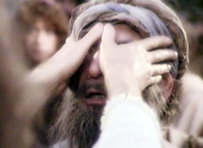
“I Was Blind But Now I See”
Do you recognize your need for Jesus?
Will you believe and obey Him that you may be saved from your sins?
Will you worship and serve Him?
Or will you close your mind and heart to the truth and be lost?

