Slide 2
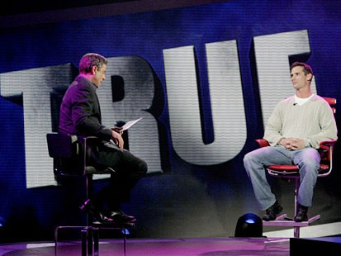
THE MOMENT OF TRUTH will put participants to the test -- the lie detector test -- to reveal whether or not they are telling the truth for a chance to win half a million dollars. The challenge is simple: answer 21 increasingly personal questions honestly, as determined by a polygraph, and win up to $500,000. This is the only game show where participants know both the questions and the answers before they begin to play. What deep dark secret will someone divulge for hundreds of thousands of dollars?

Slide 3
“How much commitment do we have to the truth about ourselves? For all our talk about loving the truth, do we really desire to see all that God sees when He examines our hearts? There will be no redemption for those unwilling to face reality.”
– Gary Henry (WordPoints 1/27/08)

Slide 4
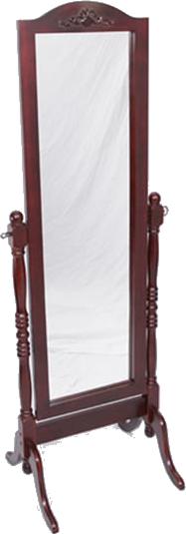
The Moment Of Truth
James 1:21-25 (NKJV) ²¹ Therefore lay aside all filthiness and overflow of wickedness, and receive with meekness the implanted word, which is able to save your souls. ²² But be doers of the word, and not hearers only, deceiving yourselves. ²³ For if anyone is a hearer of the word and not a doer, he is like a man observing his natural face in a mirror; ²⁴ for he observes himself, goes away, and immediately forgets what kind of man he was. ²⁵ But he who looks into the perfect law of liberty and continues in it, and is not a forgetful hearer but a doer of the work, this one will be blessed in what he does.

Slide 5
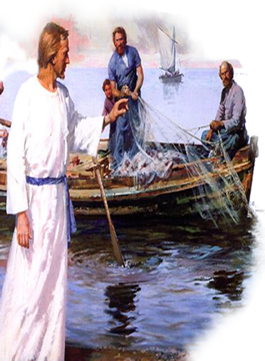
The Moment Of Truth
Luke 9:23-26 (NKJV) ²³ Then He said to them all, "If anyone desires to come after Me, let him deny himself, and take up his cross daily, and follow Me. ²⁴ For whoever desires to save his life will lose it, but whoever loses his life for My sake will save it.

Slide 6
The Moment Of Truth
Luke 9:23-26 (NKJV) ²⁵ For what profit is it to a man if he gains the whole world, and is himself destroyed or lost? ²⁶ For whoever is ashamed of Me and My words, of him the Son of Man will be ashamed when He comes in His own glory, and in His Father's, and of the holy angels.

Slide 7
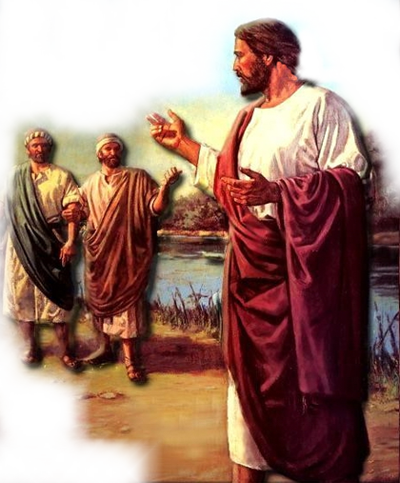
The Moment Of Truth
"If Anyone Desires To Come After Me,"
1. Do You Really Want To Go To Heaven?
2. If you continue on your present course – will you be in heaven?
3. Do You TRULY Desire to Pursue Jesus & be like Him?
4. Are You So Desperate to Follow Jesus, That You Will Do WHATEVER He Ask You To Do?

Slide 8
The Moment Of Truth
" Let Him Deny Himself,"
5. Have you denied yourself “the pleasures of sin?” (Luke 13:3,5; Heb 11:25)
6. Have you given the Lord everything you have? (Luke 14:25-33; 18:18-23)
7. Are you willing to deny yourself comfort & pleasure to follow Jesus? (Luke 9:57-62)

Slide 9
The Moment Of Truth
" Let Him Deny Himself,"
8. If you miss a worship service – it is because you have no other choice – (Even if you are out of town) - (True or False) _____
9. If you miss a Bible class it is because you have no other choice - (True or False) _____
10. You are glad whenever it is time to assemble with the saints - (True or False) _____

Slide 10
The Moment Of Truth
" Let Him Deny Himself,"
11. How much time do you take each week to study your Bible? _____ A) None? B) Only at our Bible Studies? C) In addition to our Bible studies – 1 Hour or less? D) More than one hour – but not every day? E) I try to study every day – and usually I do?

Slide 11
The Moment Of Truth
" Let Him Deny Himself,"
12. How many people have you talked to this past week about the Bible? _____ A) None? B) One? C) Two to Five? D) More than Five?
13. How many people have you invited to worship services this year? _____ A) None? B) One? C) Two to Five? D) Six to Ten? E) More than Ten?
14. I am truly concerned about those around me who are lost (True or False) _____

Slide 12
The Moment Of Truth
" Let Him Deny Himself,"
15. Is your pride standing in the way of reconciliation with another person? (Mat 5:23,24; 18:15-17; Rom 14:15; 1 Cor 8:12,13)
16. Do you get angry when someone offers you some constructive criticism?
YES NO
YES NO

Slide 13
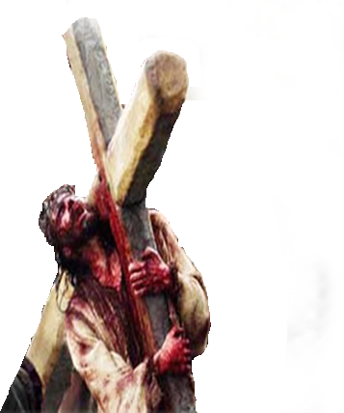
The Moment Of Truth
" And Take Up His Cross Daily,"
17. Do you feel “put out” when you are asked to do something for the church? (Teach a class, Send cards, call the sick, lead worship, etc.)
18. When you are mistreated, ignored, or ridiculed by another –are you as patient as you ought to be?
YES NO
YES NO

Slide 14
The Moment Of Truth
"And Follow Me”
19. Are you doing all you can to promote the unity and growth of the Lord’s church? (Eph 4:11-16)
20. Are you submissive to God’s appointed authorities (Government; Elders; Parents; Husband . . .)? (Heb 13:17)
YES NO
YES NO

Slide 15
The Moment Of Truth
"And Follow Me”
21. Can you honestly say that you are putting the Lord First in your life? (Matthew 6:19-24;33; Mark 12:29-31; Col 3:1,2)
YES NO

Slide 16
The Moment Of Truth
Conclusion
1. Do you want to go to heaven?
Are you absolutely sure that is where you are headed?
Do you believe and have you confessed that Jesus is the Christ, the Son of God?
Have you from the heart repented toward God?
Have you been baptized for the remission of your sins?
Since your baptism have you been living the Christian life?

Slide 17
The Moment Of Truth
Conclusion
Are you ready just as you are to meet Christ?

