Slide 1
Rightly Dividing The Word
Contrasting The Old Testament With The New Testament

Slide 2
Rightly Dividing The Word
The need to correctly understand the scriptures – (Eph 5:19)
MUST recognize the two main divisions of the Bible - “The OLD & NEW Testaments.
What are some of the differences between the Old & New Covenants
2 Timothy 2:15 (NKJV) ¹⁵ Be diligent to present yourself approved to God, a worker who does not need to be ashamed, rightly dividing the word of truth.

Slide 3
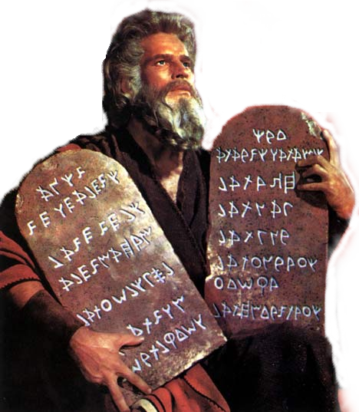
Rightly Dividing The Word
The Old & New Testaments Contrasted
In Description
Law Giver - Officers & Tabernacle
Power
Blessings & Promises
Purpose
Effective Time Period

Slide 4
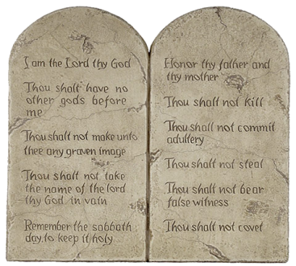
The Old & New Testaments Contrasted
In Description
Old
New
Old – Heb 8:13; 2 Cor 3:14 | New – Heb. 8:8; 9:15
First – Heb 8:7; 9:1 | Second – Heb 8:7
Law of works – Ro. 3:19-28: 4:2,3 | A law of Faith & Liberty - Rom 3:27; Js 1:22
Was only a type, shadow, or copy – Heb. 10:1; 8:4-7 | The real thing -(not a shadow) – Heb 10:1; Col 2:17
Letter which kills – ministers death, & condemnation – 2 Cor. 3:6,7,9 | The Spirit which gives life, ministration of righteousness – 2 Cor. 3:6,7,9

Slide 5
The Old & New Testaments Contrasted
Old
New
Law Giver - Officers & Tabernacle
Delivered by Moses – revealed by angels – Heb 2:2; Gal 3:19 | Delivered by the SON of GOD –Mat. 17:5; Heb. 1:1,2
Earthly priest Animal sacrifices –(manifesting its imperfections) – Heb 7:23,27,28 | Heavenly priest, Divine sacrifice – (manifesting its imperfections) – Heb. 8:4; Heb. 9:24
Earthly tabernacle “pitched by man” – Exodus 25:8; Heb 9:1-3 | Heavenly – “Lord pitched tabernacle” Heb. 8:2

Slide 6
The Old & New Testaments Contrasted
In Its Power
Old
New
Weak and unprofitable – Heb 7:18 | Strong – reaching within the veil – Heb 7:17,19; 6:19
Made nothing perfect – Heb 7:19 | Makes all things perfect – Heb. 10:14
Could NOT take away sin – Heb. 10:4,11 | Sins remembered NO MORE – Heb 8:12; 10:17; 1 John 1:7
Could not justify man – Gal. 3:11; 5:4 | It can justify ALL men – Gal 3:24
Could not make alive – Gal. 3:21 | Law of the Spirit of Life – Rom. 8:2
Written on tables of stone – Deut 9:10; 2 Cor. 3:7, | Written in heart – 2 Cor. 3:3; Heb 8:10
It was with glory – 2 Cor. 3:11 | Was more glorious – 2 Cor, 3:8-11

Slide 7
The Old & New Testaments Contrasted
In Blessings & Promises
Old
New
Rewards were carnal & temporal – Heb 9:9,10 | Consist of better promises – Heb 8:6
Presented a discouraging and imperfect hope – Heb 7:19; Rom 7 | It brings a better hope – Heb 7:19; Rom 8:9-11,18
Could NOT take away sins – Heb 10:11 | Can take away all sins – Heb 8:12; 10:17
Did NOT fully reveal the way to eternal life – Heb. 9:8 | Way to eternal life FULLY revealed – Heb 9:15; Tit 1:2
Those who continue in it are severed from Christ – Gal. 5:4 | Creates joint heirs with Christ – Romans 8:17

Slide 8
The Old & New Testaments Contrasted
In Purpose
Old
New
Added because of transgressions, till the seed come – Gal 3:19 | Revealed the seed – Christ – Gal 3:16; Heb 9:15
Given To the House of Israel – Lev. 1:1,2; Mal. 4:4; Ps 147:19,20 | Given to ALL NATIONS – Mat. 28:18-20;Mark 16:15; Acts 10:34,35; Col 1:5,23
A schoolmaster – Gal. 3:24; Rom 3:2 | The faith, therefore no longer in need of the schoolmaster - Gal 3:19

Slide 9
The Old & New Testaments Contrasted
In Effective Time Period
Old
New
Lasted until Christ – Gal 3:19 | Given by Christ to last till the end of time – Heb 13:20; Rev 14:6
Done away in Christ – 2 Cor. 3:13,14 | Was created new in Christ – Hebrews 8:13; 12:24
Abolished in the flesh of Christ – Ep. 2:14,15 | Brought to light His resurrection – Rom 1:4; Rev 1:18
Nailed to the cross of Christ – Col. 2:14 | From the cross universally promulgated, - Mt 28:18-20; Mk 16:16; Acts 2:36; Col 1:23
Blotted out – Col. 2:14,16; Hebrews 7:18; 8:13; 10:9 | An eternal covenant – Heb 13:20

Slide 10
Rightly Dividing The Word
The Old & New Testaments Contrasted
In Description
Law Giver - Officers & Tabernacle
Power
Blessings & Promises
Purpose
Effective Time Period

Slide 11
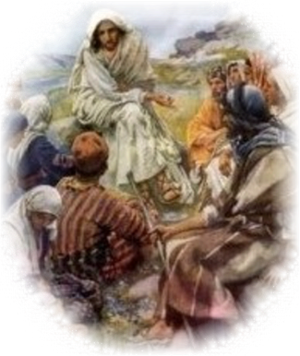
Rightly Dividing The Word
The Old & New Testaments Contrasted
Hebrews 1:1-2 (NKJV) ¹ God, who at various times and in various ways spoke in time past to the fathers by the prophets, ² has in these last days spoken to us by His Son, whom He has appointed heir of all things, through whom also He made the worlds;

