Slide 1
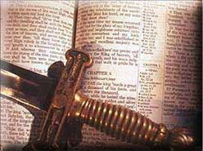
Our Common Salvation
Jude 1:3

Slide 2
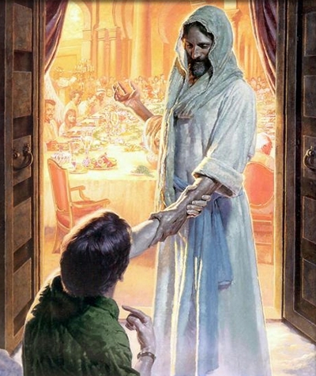
Our Common Salvation
The Nature of Our Common Salvation (1)
The Blessings of Our Common Salvation (2)
The Duty To Defend Our Common Salvation (3)
A Grave Threat To Our Common Salvation (4)

Slide 3
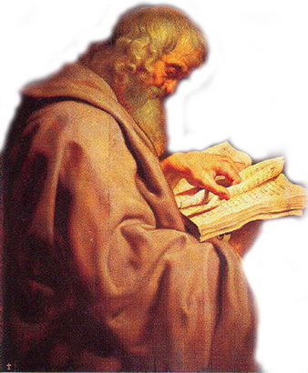
Our Common Salvation
Jude 1:1-7 (NKJV) ¹ Jude, a bondservant of Jesus Christ, and brother of James, To those who are called, sanctified by God the Father, and preserved in Jesus Christ: ² Mercy, peace, and love be multiplied to you. ³ Beloved, while I was very diligent to write to you concerning our common salvation, . . .

Slide 4
Our Common Salvation
Jude 1:1-7 (NKJV) . . . I found it necessary to write to you exhorting you to contend earnestly for the faith which was once for all delivered to the saints. ⁴ For certain men have crept in unnoticed, who long ago were marked out for this condemnation, ungodly men, who turn the grace of our God into lewdness and deny the only Lord God and our Lord Jesus Christ.

Slide 5
Our Common Salvation
Jude 1:1-7 (NKJV) ⁵ But I want to remind you, though you once knew this, that the Lord, having saved the people out of the land of Egypt, afterward destroyed those who did not believe. ⁶ And the angels who did not keep their proper domain, but left their own abode, He has reserved in everlasting chains under darkness for the judgment of the great day;

Slide 6
Our Common Salvation
Jude 1:1-7 (NKJV) ⁷ as Sodom and Gomorrah, and the cities around them in a similar manner to these, having given themselves over to sexual immorality and gone after strange flesh, are set forth as an example, suffering the vengeance of eternal fire.

Slide 7
Our Common Salvation
The Nature of Our Common Salvation (1)
We Are “Called” –
By or through the gospel – (2 Thes 2:13-14; Gal 1:6-9)
Unto a “holy calling”- (2 Tim 1:9)
To walk worthy of our calling – (Eph 4:1-6)
To make our calling & election sure – (2 Pet 1:5-11)

Slide 8
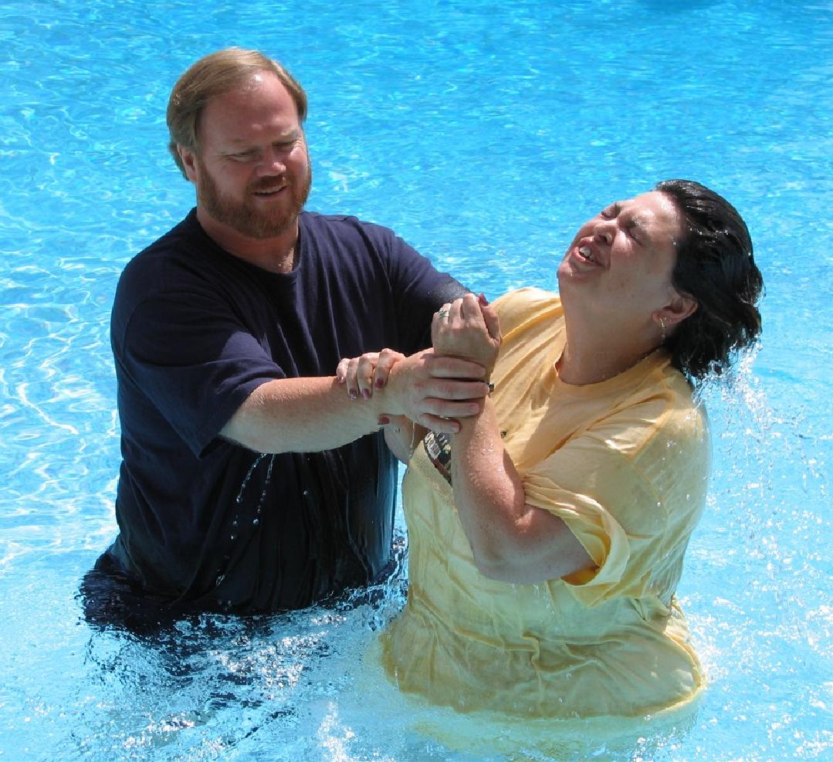
Our Common Salvation
The Nature of Our Common Salvation (1)
"Sanctified" By God The Father
The word “Sanctified” (ἁγιάζω)- hagiazō - from <G40> (hagios); to make holy, i.e. (ceremony) purify or consecrate; (mentally) to venerate :- hallow, be holy, sanctify.—Strong's
“To set apart for a special purpose” – 1 Cor 6:11; Rom 15:16; John 17:17; Eph 5:26; 1 Thes 5:23

Slide 9
Our Common Salvation
The Nature of Our Common Salvation (1)
"Preserved" In Jesus Christ
Guarded from loss or injury – (cf John 10:27-29)
“Kept by the power of God through faith” – (1 Pet 1:5; Heb 3:12-14; 1 Cor 10:1-13)
Does NOT exclude personal responsibility - (Jude 1:5-7, 21; 2 Pet 1:5-11; John 15:1-10; Rev 2:10; 2 Pet 2:20-22)

Slide 10
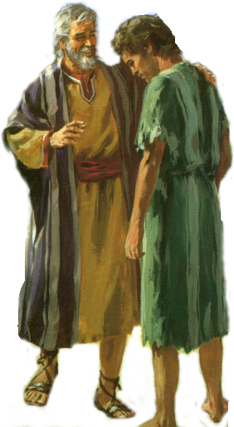
Our Common Salvation
The Blessings of Our Common Salvation (2)
" Mercy, peace, and love be multiplied to you.”
“Mercy-in the pardon of all their sins and acceptance with God; peace-with God, with their fellow-men, in their own consciences, and in the prospect of death; and love-to God, to the brethren, to all the world. What blessings are there which these do not include?”—Barnes' Notes on the New Testament
Notes:
God’s mercy can sustain them in times of difficulty (Heb. 4:16); His peace can give a subtle calmness when evil abounds (Rom. 15:13; Phil. 4:7); and His love can protect and assure believers in the face of peril (Rom. 5:5; 1 John 4:12, 15-16).—Bible Knowledge Commentary

Slide 11
Our Common Salvation
The Blessings of Our Common Salvation (2)
" Mercy, peace, and love be multiplied to you.”
God’s mercy can sustain us in times of difficulty (Heb. 4:16)
His peace can give a subtle calmness when evil abounds (Rom. 15:13; Phil. 4:7)
His love can protect and assure believers in the face of peril (Rom. 5:5; 8:35-39).
Notes:
God’s mercy can sustain them in times of difficulty (Heb. 4:16); His peace can give a subtle calmness when evil abounds (Rom. 15:13; Phil. 4:7); and His love can protect and assure believers in the face of peril (Rom. 5:5; 1 John 4:12, 15-16).—Bible Knowledge Commentary

Slide 12
Our Common Salvation
Our Duty To Defend It (3)
“Wishing to write of the more pleasant theme of salvation, Jude was forced by his concern to write on an urgent and abhorrent theme. Circumstances had arisen that demanded immediate action, thus presenting an emergency situation. Jude addressed himself to a recognized problem, and exhorted the believers to respond with positive determination.”—Bible Knowledge Commentary
Jude’s intended purpose
Notes:
God’s mercy can sustain them in times of difficulty (Heb. 4:16); His peace can give a subtle calmness when evil abounds (Rom. 15:13; Phil. 4:7); and His love can protect and assure believers in the face of peril (Rom. 5:5; 1 John 4:12, 15-16).—Bible Knowledge Commentary

Slide 13
Our Common Salvation
Our Duty To Defend It (3)
“ἐπαγωνίζομαι, epagōnizomai - - - signifies "to contend about a thing, as a combatant" (epi, "upon or about," intensive, agōn, "a contest"), "to contend earnestly," Jude 1:3. The word "earnestly" is added to convey the intensive force of the preposition.”
—(Vine's Expository Dictionary of Old and New Testament Words ).
Jude’s intended purpose
The necessary Instruction – “Contend Earnestly”
Notes:
God’s mercy can sustain them in times of difficulty (Heb. 4:16); His peace can give a subtle calmness when evil abounds (Rom. 15:13; Phil. 4:7); and His love can protect and assure believers in the face of peril (Rom. 5:5; 1 John 4:12, 15-16).—Bible Knowledge Commentary

Slide 14
Our Common Salvation
Our Duty To Defend It (3)
“The system of religion revealed in the gospel. It is called faith, because that is the cardinal virtue in the system, and because all depends on that. The rule here will require that we should contend in this manner for all truth.”
- Barnes' Notes on the New Testament
Jude’s intended purpose
The necessary Instruction – “Contend Earnestly”
“For The Faith”
Notes:
God’s mercy can sustain them in times of difficulty (Heb. 4:16); His peace can give a subtle calmness when evil abounds (Rom. 15:13; Phil. 4:7); and His love can protect and assure believers in the face of peril (Rom. 5:5; 1 John 4:12, 15-16).—Bible Knowledge Commentary

Slide 15
Our Common Salvation
Our Duty To Defend It (3)
The delivering of this faith to the saints here referred to is evidently that made by revelation, or the system of truth which God has made known in his word. Everything which He has revealed, we are to defend as true. . . . —Barnes' Notes on the New Testament
Jude’s intended purpose
The necessary Instruction – “Contend Earnestly”
“For The Faith”
“Once For All Delivered”
Notes:
God’s mercy can sustain them in times of difficulty (Heb. 4:16); His peace can give a subtle calmness when evil abounds (Rom. 15:13; Phil. 4:7); and His love can protect and assure believers in the face of peril (Rom. 5:5; 1 John 4:12, 15-16).—Bible Knowledge Commentary

Slide 16
Our Common Salvation
Our Duty To Defend It (3)
Once For All - The Faith is complete and does not need to be revised or amended –
Delivered – The faith is entirely sufficient to provide the man of God with everything to be complete before God – (2 Tim 3:16,17)
To the saints – The faith is not the exclusive possession of a special few – but for all Christians.
Jude’s intended purpose
The necessary Instruction – “Contend Earnestly”
“For The Faith”
“Once For All Delivered”

Slide 17
Our Common Salvation
A Grave Threat - (4)
The Secrecy of False Teachers - – (2 Pet 2:1-3)
The Condemnation of False Teachers – (2 Pet 2:12-17)
What These False Teachers were doing - – (2 Peter 2:18-19; )
Jude 1:4 (NKJV) ⁴ For certain men have crept in unnoticed, who long ago were marked out for this condemnation, ungodly men, who turn the grace of our God into lewdness and deny the only Lord God and our Lord Jesus Christ.
Notes:
Jeremiah 9:3 (NKJV) ³ "And like their bow they have bent their tongues for lies. They are not valiant for the truth on the earth. For they proceed from evil to evil, And they do not know Me," says the Lord.

Slide 18
Our Common Salvation
A common Savior (1 Cor 8:6)
A common necessity of submitting to him (John 14:6; Acts 4:12; Luke 6:46),
A common body into which the saved are gathered (John 10:16; 11:52; Eph 4:4; 5:26).
A Common Means of Entrance – [Faith, Repentance, Confession, Baptism] – John 8:24; Rom 10:9,10; Acts 2:38; Gal 3:26,27]
Notes:
Greek Word: κοινός
Transliteration: koinos
Phonetic Pronunciation:koy-nos'
Root: probably from <G4862>
Cross Reference: TDNT - 3:789,447
Part of Speech: adj
Vine's Words: Defile, Defilement, Unclean, Unholy
Usage Notes:
English Words used in KJV:
common 7 unclean 3 defiled 1 unholy 1 [Total Count: 12]
probably from <G4862> (sun); common, i.e. (litin) shared by all or several, or (cerimonial) profane :- common, defiled, unclean, unholy.
—Strong's Talking Greek & Hebrew Dictionary

