Slide 1
Scripture Reading
Isaiah 6:1-7 (NKJV) ¹ In the year that King Uzziah died, I saw the Lord sitting on a throne, high and lifted up, and the train of His robe filled the temple. ² Above it stood seraphim; each one had six wings: with two he covered his face, with two he covered his feet, and with two he flew. ³ And one cried to another and said: "Holy, holy, holy is the Lord of hosts; The whole earth is full of His glory!"

Slide 2
Scripture Reading
Isaiah 6:1-7 (NKJV) ⁴ And the posts of the door were shaken by the voice of him who cried out, and the house was filled with smoke. ⁵ So I said: "Woe is me, for I am undone! Because I am a man of unclean lips, And I dwell in the midst of a people of unclean lips; For my eyes have seen the King, The Lord of hosts”

Slide 3
Scripture Reading
Isaiah 6:1-7 (NKJV) ⁶ Then one of the seraphim flew to me, having in his hand a live coal which he had taken with the tongs from the altar. ⁷ And he touched my mouth with it, and said: "Behold, this has touched your lips; Your iniquity is taken away, And your sin purged.”

Slide 4
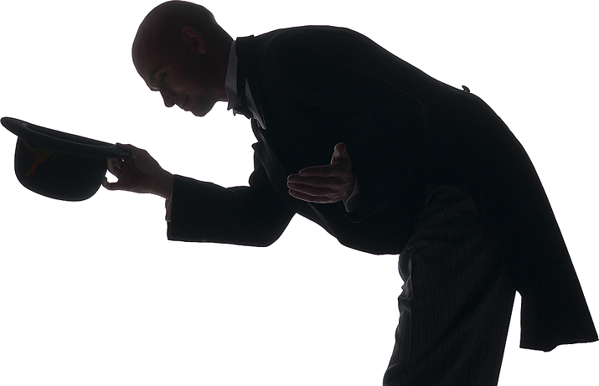
Paying Our Respects

Slide 5
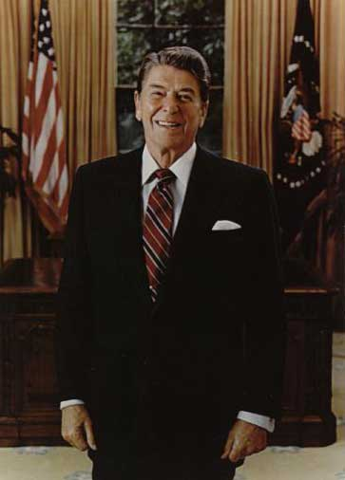
Paying Our Respects
“My father, Ronald Reagan, held the presidency in such honor and reverence that he was never in the Oval Office without a coat and tie.” - Michael Reagan
“He never took off his tie and jacket inside the Oval Office in deference to the Presidency of the United States. Nor did anyone else walk into the Oval Office without a coat and tie on because we followed our leader in deference to the Presidency. “ - Ken Duberstein
Notes:
Kenneth M. Duberstein (born April 21, 1944) served as U.S. President Ronald Reagan's White House Chief of Staff from 1988 to 1989.

Slide 6
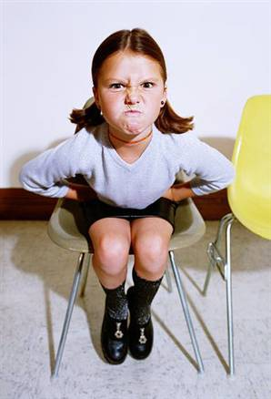
Paying Our Respects
Over the last 2-3 generations of Americans, the degree of respect for God, various God ordained institutions, and others in general has dwindled.
Christians need to understand the importance of respect.

Slide 7
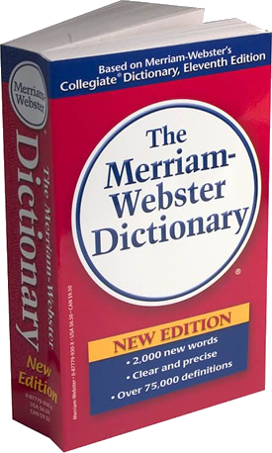
Paying Our Respects
Webster’s – “To feel or show deferential regard for: ESTEEM; deferential regard; the state of being regarded with deference or esteem; willingness to show consideration or appreciation.”
In the Bible – “Honor; esteem, especially of the highest degree; to prize; to revere; to value.” See: Romans 13:7 & 1 Peter 2:17.
Notes:
My father, Ronald Reagan, held the presidency in such honor and reverence that he was never in the Oval Office without a coat and tie. Reagan, Michael "Ronald Reagan always wore his coat and tie in Oval Office". Human Events. Sep 4, 1998. FindArticles.com. 25 Jul. 2008. http://findarticles.com/p/articles/mi_qa3827/is_199809/ai_n8811977
But I would also tell you that he never took off his tie and jacket inside the Oval Office in deference to the Presidency of the United States.
Nor did anyone else walk into the Oval Office without a coat and tie on because we followed our leader in deference to the Presidency.
He used to say that the Oval Office was not his office, but he was the temporary custodian of the Oval Office.
Ken Duberstein

Slide 8
Paying Our Respects
“A respectful, submissive disposition of mind arising from affection and esteem, from a sense of superiority in the person reverenced. We reverence the house of God, the worship of God, the attributes, the commands… and we ought to demonstrate our reverence by our overt acts. (M’Clintock and Strong)

Slide 9
Paying Our Respects
“Honor to Whom Honor”
The King/Government - (Romans 13:7)
Wives their husbands - (Ephesians 5:33)
Husbands their wives - (1 Peter 3:6-7)
Slaves their masters - (1 Timothy 6:1)
Church their elders - (1 Timothy 5:17)
Children their parents – (Ephesians 6:2 )
The aged – (Leviticus 19:32)
All people - (1 Peter 2:17)
Honor God – (1 Timothy 1:17)

Slide 10
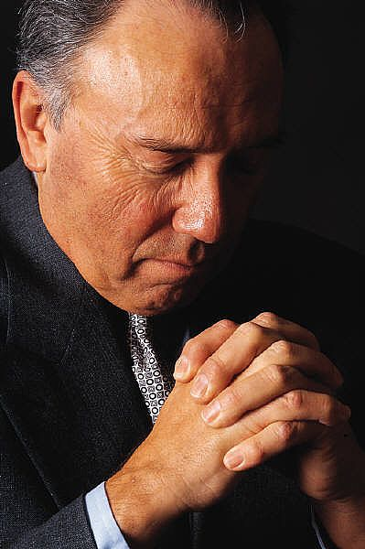
Paying Our Respects
Honoring God In Our Worship
Worship - προσκυνέω, proskyneō
Usage Notes: "to make obeisance, do reverence to" (from pros, "towards," and kuneo, "to kiss"), is the most frequent word rendered "to worship." It is used of an act of homage or reverence
—Vine's Expository Dictionary of Old and New Testament Words

Slide 11
Paying Our Respects
Honoring God In Our Worship
“the man bowed down his head and worshiped the Lord. And he said, “Blessed be the Lord God…” Genesis 24:26
“he worshiped the Lord bowing himself to the earth.” - Genesis 24:52, Ex. 12:27

Slide 12
Paying Our Respects
Honoring God In Our Worship
Leviticus 10:3 (NKJV) ³ And Moses said to Aaron, "This is what the Lord spoke, saying: 'By those who come near Me I must be regarded as holy; And before all the people I must be glorified.' " So Aaron held his peace.

Slide 13
Paying Our Respects
Honoring God In Our Worship
Psalms 89:7 (NKJV) ⁷ God is greatly to be feared in the assembly of the saints, And to be held in reverence by all those around Him.

Slide 14
Paying Our Respects
Honoring God In Our Worship
Ecclesiastes 5:1-7 (NKJV) ¹ Walk prudently when you go to the house of God; and draw near to hear rather than to give the sacrifice of fools, for they do not know that they do evil.

Slide 15
Paying Our Respects
Honoring God In Our Worship
Isaiah 66:2 (NKJV) ² For all those things My hand has made, And all those things exist," Says the Lord. "But on this one will I look: On him who is poor and of a contrite spirit, And who trembles at My word.

Slide 16
Paying Our Respects
Honoring God In Our Worship
Hebrews 12:28-29 (NKJV) ²⁸ Therefore, since we are receiving a kingdom which cannot be shaken, let us have grace, by which we may serve God acceptably with reverence and godly fear. ²⁹ For our God is a consuming fire.

Slide 17
Paying Our Respects
Honoring God In Our Worship
1 Corinthians 14:40 (NKJV) ⁴⁰ Let all things be done decently and in order.

Slide 18
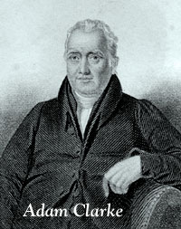
Paying Our Respects
Honoring God In Our Worship
Let all things be done decently—Ευσχημονως· In their proper forms; with becoming reverence; according to their dignity and importance, Every thing in the Church of God should be conducted with gravity and composure, suitable to the importance of the things, the infinite dignity of the object of worship, and the necessity of the souls in behalf of which those religious ordinances are instituted.
—Adam Clarke's Commentary

Slide 19
Paying Our Respects
Honoring God In Our Worship
Spirit & Truth . . . (John 4:24)
Saturday Night . . .
Getting Ready to Worship . . .
Time of Arrival . . .
At the Building . . . .
Preparation . . .
During the worship service . . .
Application . . . .

Slide 20
Paying Our Respects
“Honor to Whom Honor”
The King/Government - (Romans 13:7)
Wives their husbands - (Ephesians 5:33)
Husbands their wives - (1 Peter 3:6-7)
Slaves their masters - (1 Timothy 6:1)
Church their elders - (1 Timothy 5:17)
Children their parents – (Ephesians 6:2 )
The aged – (Leviticus 19:32)
All people - (1 Peter 2:17)
Honor God – (1 Timothy 1:17)

Slide 21
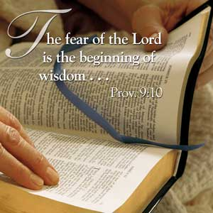
H
ave You Shown Proper Reverence For God This Morning?

