Slide 1
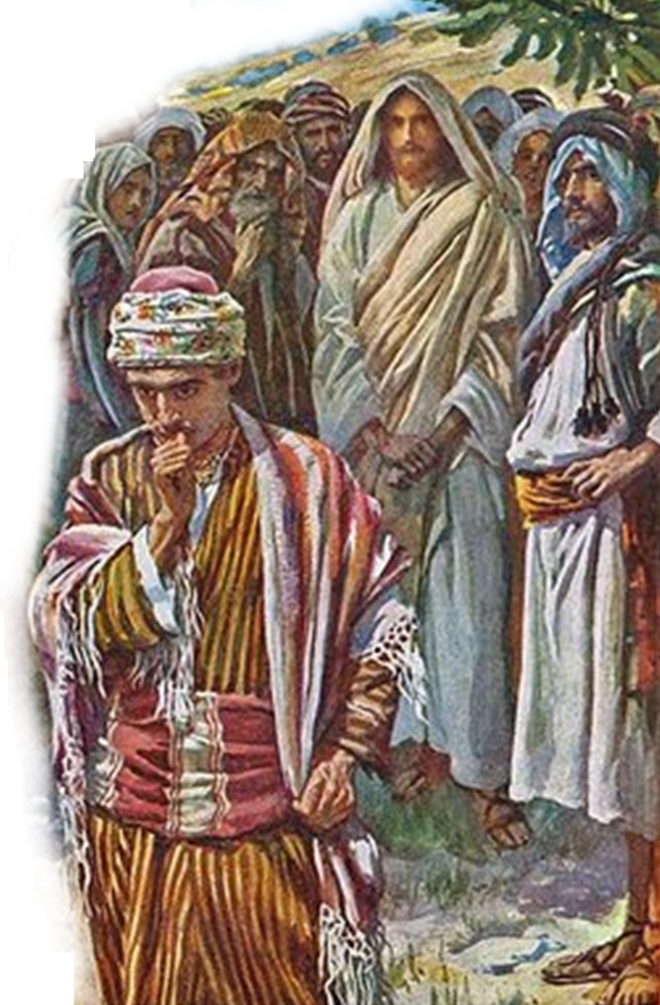
“What Shall I Do To Inherit Eternal Life?”
The Rich Young Ruler
Matthew 19:16-22
Mark 10:17-22
Luke 18:18-23

Slide 2
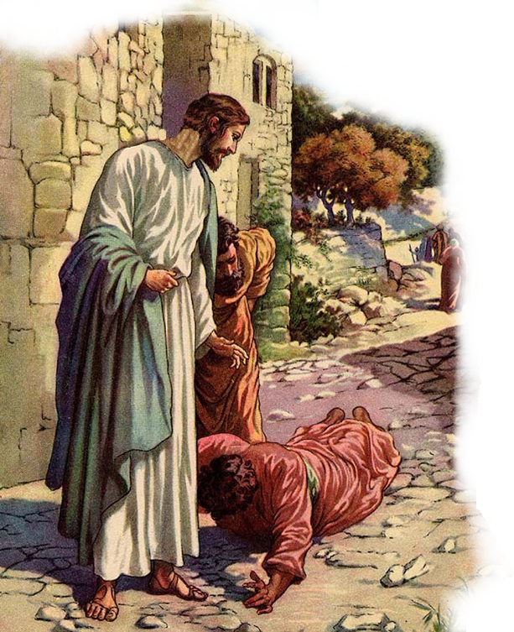
“What Shall I Do To Inherit Eternal Life?”
The Rich Young Ruler
The context in which the incident is found – (Mat. 19; Mark 10; Luke 18)
The inquirer –
A ruler - Luke 18:18
A young man – Mat. 19:22 –
A rich man - Luke 18:23 –
An earnest man – Mark 10:17

Slide 3
“What Shall I Do To Inherit Eternal Life?”
Went To The Right Person
“Good teacher . . .”- demonstrates his high opinion of Jesus as a teacher. (cf. John 3:2)
Jesus is the source of life –
Living water – (John 4:10, 14 25,26; 7:37-39)
Bread of life – (John 6:35,51;
Gave the words of life - (John 6:63,68; 12:44-50; Heb 1:1,2)
Notes:
Verse 17. Why callest thou me good? Why do you give to me a title that belongs only to God? You suppose me to be only a man. Yet you give me an appellation that belongs only to God. It is improper to use titles in this manner. As you Jews use them, they are unmeaning. And though the title may apply to me, yet you did not intend to use it in the sense in which it is proper, as denoting infinite perfection, or Divinity; but you intended to use it as a complimentary or a flattering title, applied to me as if I were a mere man-a title which belongs only to God. The intention, the habit of using mere titles, and applying as compliment terms belonging only to God, is wrong, Christ did not intend here to disclaim Divinity, or to say anything about his own character; but simply to reprove the intention and habit of the young man-a most severe reproof of a foolish habit of compliment and flattery, and seeking pompous title. —Barnes' Notes on the New Testament
Why callest thou me good?—Or, Why dost thou question me concerning that good thing? τι με ερωτας περι του αγαθου. This important reading is found in BDL, three others, the Coptic, Sahidic, Armenian, Ethiopic, latter Syriac, Vulgate, Saxon, all the Itala but one, Origen, Eusebius, Cyril, Dionysius Areop., Antiochus, Novatian, Jerome, Augustin, and Juvencus. Erasmus, Grotius, Mill, and Bengel approve of this reading. This authority appears so decisive to Griesbach that he has received this reading into the text of his second edition, which in the first he had interlined. And instead of, None is good but the one God, he goes on to read, on nearly the same respectable authorities, εις εϝιν ο αγαθος. There is one who is good. Let it be observed also that, in the 16th verse, instead of διδασκαλε αγαθε, good teacher, διδασκαλε only is read by BDL, one other, one Evangelistarium, the Ethiopic, three of the Itala, Origen, and Hilary. The whole passage therefore may be read thus: O teacher! what good thing shall I do that I may have eternal life? And he said unto him, Why dost thou question me concerning that good thing? There is one that is good. (Or he who is good is one). But If thou art willing to enter into that life, keep the commandments. This passage, as it stood in the common editions, has been considered by some writers as an incontrovertible proof against the Divinity or Godhead of Christ. A very learned person, in his note on this place, thus concludes concerning it: "Therefore our Savior cannot be GOD: and the notion of, I know not what, a trinity in unity, THREE Gods in ONE, is here proved beyond all controversy, by the unequivocal declaration of JESUS CHRIST HIMSELF, to be ERRONEOUS and IMPOSSIBLE." Not so. One of the greatest critics in Europe, not at all partial to the Godhead of Christ, has admitted the above readings into his text, on evidence which he judged to be unexceptionable. If they be the true readings, they destroy the whole doctrine built on this text; and indeed the utmost that the enemies of the trinitarian doctrine can now expect from their formidable opponents, concerning this text, is to leave it neuter.
—Adam Clarke's Commentary

Slide 4
“What Shall I Do To Inherit Eternal Life?”
Went To The Right Person
“Why do you call Me good? No one is good but One, that is, God.”- Denoting infinite perfection, Divinity; (Mat 23:6-10)
Jesus not denying His Deity – but affirming it - (John 1:1,2; 8:58; 13:13; 17:5; Phili 2:5-10; Col. 1:15-18)
Jesus was good – Jn 8:46; 14:30; 2 Cor 5:21; Heb 4:15; 7:26; 1 Pet 2:21,22
Notes:
Verse 17. Why callest thou me good? Why do you give to me a title that belongs only to God? You suppose me to be only a man. Yet you give me an appellation that belongs only to God. It is improper to use titles in this manner. As you Jews use them, they are unmeaning. And though the title may apply to me, yet you did not intend to use it in the sense in which it is proper, as denoting infinite perfection, or Divinity; but you intended to use it as a complimentary or a flattering title, applied to me as if I were a mere man-a title which belongs only to God. The intention, the habit of using mere titles, and applying as compliment terms belonging only to God, is wrong, Christ did not intend here to disclaim Divinity, or to say anything about his own character; but simply to reprove the intention and habit of the young man-a most severe reproof of a foolish habit of compliment and flattery, and seeking pompous title. —Barnes' Notes on the New Testament
Why callest thou me good?—Or, Why dost thou question me concerning that good thing? τι με ερωτας περι του αγαθου. This important reading is found in BDL, three others, the Coptic, Sahidic, Armenian, Ethiopic, latter Syriac, Vulgate, Saxon, all the Itala but one, Origen, Eusebius, Cyril, Dionysius Areop., Antiochus, Novatian, Jerome, Augustin, and Juvencus. Erasmus, Grotius, Mill, and Bengel approve of this reading. This authority appears so decisive to Griesbach that he has received this reading into the text of his second edition, which in the first he had interlined. And instead of, None is good but the one God, he goes on to read, on nearly the same respectable authorities, εις εϝιν ο αγαθος. There is one who is good. Let it be observed also that, in the 16th verse, instead of διδασκαλε αγαθε, good teacher, διδασκαλε only is read by BDL, one other, one Evangelistarium, the Ethiopic, three of the Itala, Origen, and Hilary. The whole passage therefore may be read thus: O teacher! what good thing shall I do that I may have eternal life? And he said unto him, Why dost thou question me concerning that good thing? There is one that is good. (Or he who is good is one). But If thou art willing to enter into that life, keep the commandments. This passage, as it stood in the common editions, has been considered by some writers as an incontrovertible proof against the Divinity or Godhead of Christ. A very learned person, in his note on this place, thus concludes concerning it: "Therefore our Savior cannot be GOD: and the notion of, I know not what, a trinity in unity, THREE Gods in ONE, is here proved beyond all controversy, by the unequivocal declaration of JESUS CHRIST HIMSELF, to be ERRONEOUS and IMPOSSIBLE." Not so. One of the greatest critics in Europe, not at all partial to the Godhead of Christ, has admitted the above readings into his text, on evidence which he judged to be unexceptionable. If they be the true readings, they destroy the whole doctrine built on this text; and indeed the utmost that the enemies of the trinitarian doctrine can now expect from their formidable opponents, concerning this text, is to leave it neuter.
—Adam Clarke's Commentary

Slide 5
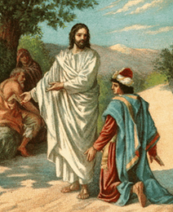
“What Shall I Do To Inherit Eternal Life?”
Asked The Right Question
The Most Important Question One Could Ask – (Acts 2:37; 9:6; 16:30)
Recognized that there was more than this present life – (Luke 10:25; Mark 10:30; Mat 25:46; Rom 2:7; 6:22,23; Tit 1:2; 1 John 5:21; 1 Cor. 15:19)
How interested are you in eternal life?

Slide 6
“What Shall I Do To Inherit Eternal Life?”
Received The Right Answer
“You know the commandments . . .” – (required for one living under the OT) - (Gal. 3:10-13)
The Law exposes and convicts men of their sin – (Rom 3:20; 7:7-9)
Was mistaken about his own righteousness - (Acts 13:39; Rom 3:9,19,23; Gal. 3:22)

Slide 7
“What Shall I Do To Inherit Eternal Life?”
Was Lacking One Thing
All it takes is one sin to make one guilty before God – (James 2:10; Gal. 3:10)
Jesus knew his one area of weakness – (Luke 12:15-21)
Jesus requires self denial and total commitment - (Mark 10:21; Luke 9:23-26; 14:26,27; John 12:25,26)

Slide 8
“What Shall I Do To Inherit Eternal Life?”
Was Unwilling To Comply
Not a shortage of Jesus’ love for him – (Mark 10:21)
Love causes one to tell others the truth about what they must do – even if it is not what they want to hear - (Mark 10:21,22)
Unwilling to pay the price – (Luke 14:26-33; Mat 14:44-46)

Slide 9
“What Shall I Do To Inherit Eternal Life?”
The Rich Young Ruler
Went to the right person
Asked the right question
Received the right answer
Was lacking one thing
Was unwilling to comply

Slide 10
“What Shall I Do To Inherit Eternal Life?”
What About You?
Will you go to the right source?
Will seek the right answer?
Will you comply?
Will you give Jesus your all?

