Slide 1
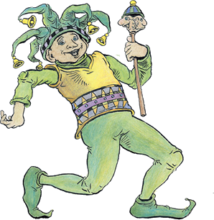
Some Fools of The Bible

Slide 2
Some Fools of The Bible
Unger's Bible Dictionary, p. 375
FOOL. Represented by a large number of Heb. and Gk. words. The word is used in Scripture with respect to moral more than to intellectual deficiencies. The “fool” is not so much one lacking in mental powers, as one who misuses them; not one who does not reason, but reasons wrongly . . .

Slide 3
Some Fools of The Bible
Unger's Bible Dictionary, p. 375
. . . In Scripture the “fool” primarily is the person who casts off the fear of God and thinks and acts as if he could safely disregard the eternal principles of God’s righteousness (Psalm 14:1; Proverbs 14:9; Jeremiah 17:11; etc.). Yet in many passages, especially in Proverbs, the term has its ordinary use and denotes one who is rash, senseless, or unreasonable.

Slide 4
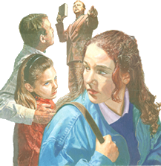
Some Fools of The Bible
The Unbelieving Fool
Psalms 14:1 (NKJV) ¹ To the Chief Musician. A Psalm of David. The fool has said in his heart, "There is no God." They are corrupt, They have done abominable works, There is none who does good.

Slide 5
Some Fools of The Bible
The Unbelieving Fool
Those who are atheist & agnostics
Those who are NOT Christians – John 8:24; Rev 21:8
True believers are obedient to Jesus – Luke 6:46; Gal 3:1

Slide 6
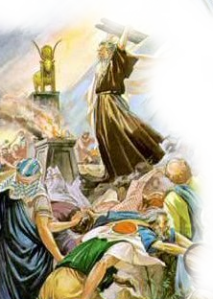
Some Fools of The Bible
The Idolatrous Fool
Romans 1:21-23 (NKJV) ²¹ because, although they knew God, they did not glorify Him as God, nor were thankful, but became futile in their thoughts, and their foolish hearts were darkened. ²² Professing to be wise, they became fools, ²³ and changed the glory of the incorruptible God into an image made like corruptible man--and birds and four-footed animals and creeping things.

Slide 7
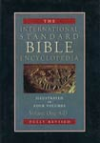
Some Fools of The Bible
The Idolatrous Fool
. . . idolatry came to mean, not only the giving to any creature or human creation the honor or devotion which belonged to God alone, but the giving to any human desire a precedence over God's will (1Co_10:14; Gal_5:20; Col_3:5; 1Pe_4:3).

Slide 8
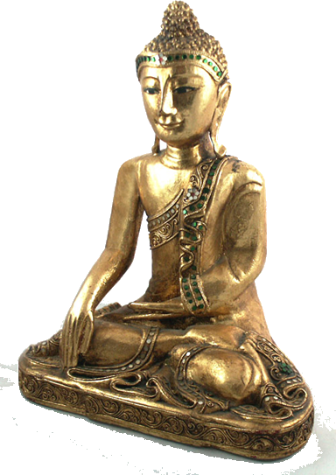
Some Fools of The Bible
The Idolatrous Fool
Eastern Religions –
Humanism -
Catholicism –
Money, Sports, Entertainment, Politics, Possessions
Many Unscriptural Religious Practices -

Slide 9
Some Fools of The Bible
The Immoral Fool
Proverbs 7:21-22 (NKJV) ²¹ With her enticing speech she caused him to yield, With her flattering lips she seduced him. ²² Immediately he went after her, as an ox goes to the slaughter, Or as a fool to the correction of the stocks,

Slide 10
Some Fools of The Bible
The Immoral Fool
Proverbs 6:32-33 (NKJV) ³² Whoever commits adultery with a woman lacks understanding; He who does so destroys his own soul. ³³ Wounds and dishonor he will get, And his reproach will not be wiped away.

Slide 11
Some Fools of The Bible
The Immoral Fool
1 Corinthians 6:9-10 (NKJV) ⁹ Do you not know that the unrighteous will not inherit the kingdom of God? Do not be deceived. Neither fornicators, nor idolaters, nor adulterers, nor homosexuals, nor sodomites, ¹⁰ nor thieves, nor covetous, nor drunkards, nor revilers, nor extortioners will inherit the kingdom of God.

Slide 12
Some Fools of The Bible
The Immoral Fool
Revelation 21:8 (NKJV) ⁸ But the cowardly, unbelieving, abominable, murderers, sexually immoral, sorcerers, idolaters, and all liars shall have their part in the lake which burns with fire and brimstone, which is the second death."

Slide 13
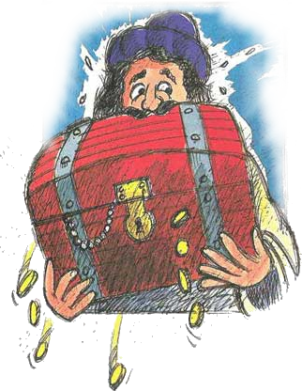
Some Fools of The Bible
The Materialistic Fool
Luke 12:13-21 (NKJV) ^{. . . 15} And He said to them, "Take heed and beware of covetousness, for one's life does not consist in the abundance of the things he possesses." ¹⁶ Then He spoke a parable to them, saying:

Slide 14
Some Fools of The Bible
The Materialistic Fool
Luke 12:13-21 (NKJV) "The ground of a certain rich man yielded plentifully. ¹⁷ And he thought within himself, saying, 'What shall I do, since I have no room to store my crops?' ¹⁸ So he said, 'I will do this:

Slide 15
Some Fools of The Bible
The Materialistic Fool
Luke 12:13-21 (NKJV) “I will pull down my barns and build greater, and there I will store all my crops and my goods. ¹⁹ And I will say to my soul, "Soul, you have many goods laid up for many years; take your ease; eat, drink, and be merry." ‘

Slide 16
Some Fools of The Bible
The Materialistic Fool
Luke 12:13-21 (NKJV) “²⁰ But God said to him, 'Fool! This night your soul will be required of you; then whose will those things be which you have provided?' ²¹ So is he who lays up treasure for himself, and is not rich toward God.”

Slide 17
Some Fools of The Bible
The Materialistic Fool
We must lay our treasures up in heaven – Mat. 6:19-21
We must build our lives upon a lasting foundation – Mat 7:24-27
What is the eternal value of the things that you are pursuing?

Slide 18
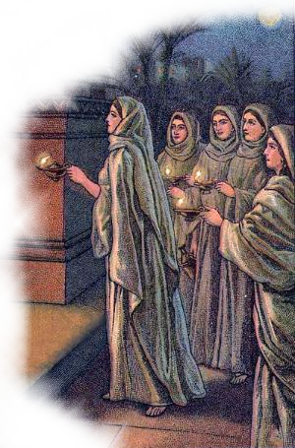
Some Fools of The Bible
The Unprepared Fool
Matthew 25:1-13 (NKJV) ¹ "Then the kingdom of heaven shall be likened to ten virgins who took their lamps and went out to meet the bridegroom. ² Now five of them were wise, and five were foolish. ³ Those who were foolish took their lamps and took no oil with them,

Slide 19
Some Fools of The Bible
The Unprepared Fool
Matthew 25:1-13 (NKJV) ⁴ but the wise took oil in their vessels with their lamps. ⁵ But while the bridegroom was delayed, they all slumbered and slept. ⁶ And at midnight a cry was heard: 'Behold, the bridegroom is coming; go out to meet him!'

Slide 20
Some Fools of The Bible
The Unprepared Fool
Matthew 25:1-13 (NKJV) ⁷ Then all those virgins arose and trimmed their lamps. ⁸ And the foolish said to the wise, 'Give us some of your oil, for our lamps are going out.' ⁹ But the wise answered, saying, 'No, lest there should not be enough for us and you; but go rather to those who sell, and buy for yourselves.’

Slide 21
Some Fools of The Bible
The Unprepared Fool
Matthew 25:1-13 (NKJV) ¹⁰ And while they went to buy, the bridegroom came, and those who were ready went in with him to the wedding; and the door was shut. ¹¹ Afterward the other virgins came also, saying, 'Lord, Lord, open to us!'

Slide 22
Some Fools of The Bible
The Unprepared Fool
Matthew 25:1-13 (NKJV) ¹² But he answered and said, 'Assuredly, I say to you, I do not know you.' ¹³ Watch therefore, for you know neither the day nor the hour in which the Son of Man is coming.

Slide 23
Some Fools of The Bible
The Unprepared Fool
Heaven is a prepared place for a prepared people – (John 14:1-6; 2 Tim 4:6-8; Rev 16:15)
We do not know when the Lord is coming - (2 Pet 3:10; Rev 3:3)
Are You Prepared To Meet The Lord?– (Mk 16:16; 2 Thes. 1:7-9)

Slide 24
Some Fools of The Bible
The Unbelieving Fool
The Idolatrous Fool
The Immoral Fool
The Materialistic Fool
The Unprepared Fool

Slide 25
Some Fools of The Bible
Ephesians 5:15-17 (NKJV)
¹⁵ See then that you walk circumspectly, not as fools but as wise, ¹⁶ redeeming the time, because the days are evil. ¹⁷ Therefore do not be unwise, but understand what the will of the Lord is.

