Slide 1
“That Is What I Was Told”

Slide 2
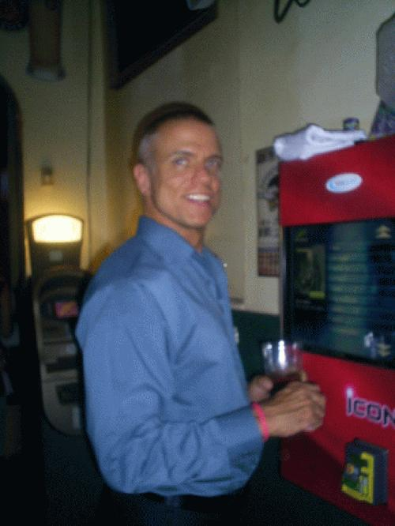
“That Is What I Was Told”
Tetelestai Church in Pittsburgh, PA - "Be Ye Holy, even as I have been Ye holy! Thus saith the lord thy God!", as pastor Rick Knapp would proclaim . . . this guy teaches (and convinced me) you can commit mass murder then still go to heaven. . . . In any case, . . . I think his teaching did the most damage. Their web site: http://www.tetelestai.org.”
George Sodini Age 48. Pittsburgh, Pennsylvania US
http://georgesodini.com/20090804.htm

Slide 3
“That Is What I Was Told”
August 3, 2009: “I took off today, Monday, and tomorrow to practice my routine and make sure it is well polished. I need to work out every detail, there is only one shot. Also I need to be completely immersed into something before I can be successful. I haven't had a drink since Friday at about 2:30. Total effort needed. Tomorrow is the big day. . . .”
George Sodini Age 48. Pittsburgh, Pennsylvania US
http://georgesodini.com/20090804.htm

Slide 4
“That Is What I Was Told”
August 3, 2009: “Maybe soon, I will see God and Jesus. At least that is what I was told. Eternal life does NOT depend on works. If it did, we will all be in hell. Christ paid for EVERY sin, so how can I or you be judged BY GOD for a sin when the penalty was ALREADY paid. People judge but that does not matter. I was reading the Bible and The Integrity of God beginning yesterday, because soon I will see them.”
George Sodini Age 48. Pittsburgh, Pennsylvania US
http://georgesodini.com/20090804.htm

Slide 5
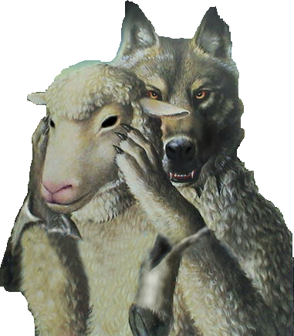
“That Is What I Was Told”
“The serpent deceived me and I ate” – Gen. 3:13
The old prophet – 1 Kings 13:11-24
The false prophets of Israel – Jer. 23:13,14
The scribes & Pharisees – Mat 5:43
The Judaizing Teachers – Acts 15:1,2,5,24

Slide 6
“That Is What I Was Told”
“We are born with a sin nature”– Ezek. 18:2-4; 20,21; Mat. 18:2-5
“Salvation is by grace alone, by faith alone, through Christ alone” – Eph 2:8,9; Titus 2:11,12; James 2:14-24;
“Baptism has nothing to do with one’s salvation” – Mark 16:16; Acts 2:38; Rom 6:3-6; 1 Pet 3:21
“Once you’re saved you’re always saved” – 1 Cor. 10:1-12; Gal. 5:1-4; 2 Pet. 2:20-22

Slide 7
“That Is What I Was Told”
“Jesus is coming back to earth to reign 1,000 years”– Rev 20:1-6; 1:5,9; Col. 1:13; 1 Cor. 15:20-26
“Those who are saved should speak in tongues” – Acts 2; Acts 10:46; 19:6; 1 Cor. 13:8-13; 14
“We can’t understand the Bible” – Acts 8:31; Eph. 3:3-5; 5:17; Rom 10:17; 1 Pet. 2:2; 2 Tim 2:15
“God will not condemn the lost to an eternity of torment” – 2 Thes. 1:7-9; Mark 9:43-48; Mat. 25:41,46

Slide 8
“That Is What I Was Told”
“One church is as good as another” – Mat 16:18; Acts 2:47; Eph. 2:16-20; 4:4; 5:23; Rev. 2,3
“We can worship God any way we want – as long as we are sincere” – John 4:24; Lev. 10:1,2; 1 Sam. 13:8-14; Heb 12:28,29
“We need to bait people with food and fun to teach them the gospel”– John 6:44,45; Rom 1:16;
“The church can do anything the individual can do”– 1 Tim 5:16; Eph 4:28; 1 Tim. 3:15

Slide 9
“That Is What I Was Told”
1 Timothy 4:1-2 (NKJV) ¹ Now the Spirit expressly says that in latter times some will depart from the faith, giving heed to deceiving spirits and doctrines of demons, ² speaking lies in hypocrisy, having their own conscience seared with a hot iron,

Slide 10
“That Is What I Was Told”
2 Timothy 4:2-4 (NKJV) ³ For the time will come when they will not endure sound doctrine, but according to their own desires, because they have itching ears, they will heap up for themselves teachers; ⁴ and they will turn their ears away from the truth, and be turned aside to fables.

Slide 11
“That Is What I Was Told”
Acts 17:11 (NKJV) ¹¹ These were more fair-minded than those in Thessalonica, in that they received the word with all readiness, and searched the Scriptures daily to find out whether these things were so.

