Slide 1
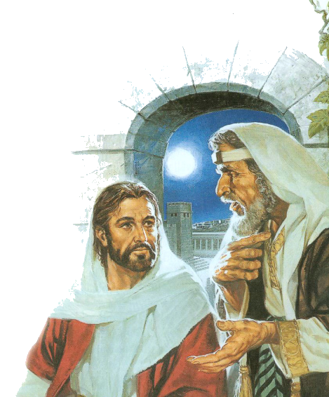
The Basic Fundamentals Of Discipleship
Luke 9:23-26

Slide 2
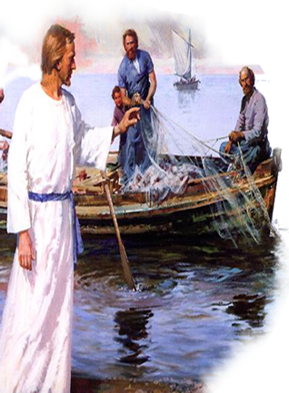
The Basic Fundamentals Of Discipleship
Desire –
Self Denial –
Sacrifice –
Following Jesus –
Losing Your Own Life -

Slide 3
The Basic Fundamentals Of Discipleship
Luke 9:23-26 (NKJV) ²³ Then He said to them all, "If anyone desires to come after Me, let him deny himself, and take up his cross daily, and follow Me. ²⁴ For whoever desires to save his life will lose it, but whoever loses his life for My sake will save it.

Slide 4
The Basic Fundamentals Of Discipleship
Luke 9:23-26 (NKJV) ²⁵ For what profit is it to a man if he gains the whole world, and is himself destroyed or lost? ²⁶ For whoever is ashamed of Me and My words, of him the Son of Man will be ashamed when He comes in His own glory, and in His Father's, and of the holy angels.

Slide 5
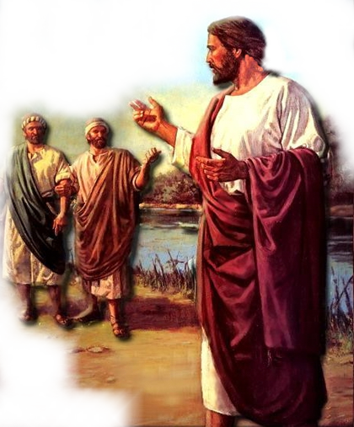
The Basic Fundamentals Of Discipleship
"If Anyone Desires To Come After Me,"
This Text Is Dealing With Salvation – (John 14:6; Acts 4:12)
This Statement Implies Free Will – (Is 55:1-3; Matt 11:28; 1 Tim 2:4)
This Statement Implies Action – (Rev 22:17; 1 Thes 1:5-8; Mat 7:13,14)

Slide 6
The Basic Fundamentals Of Discipleship
" Let Him Deny Himself,"
The Gospel Is A Call For Self-denial – (Phili 3:7-11; Mt 16:22-24 ; Mk 8:34)
It is not a call for self-fulfillment – (Col 3:5; Rom 8:12-14; 2 Cor. 5:15; Mat 7:13,14)
Jesus’ Teaching Is Opposed To Modern Evangelicalism . . .

Slide 7
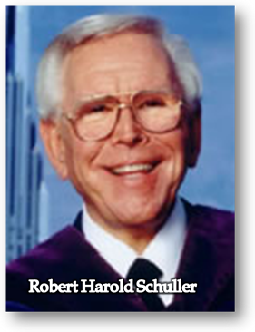
The Basic Fundamentals Of Discipleship
"It is precisely at this point that classical theology has erred in its insistence that theology be God-centered and not man-centered, . . . This master plan of God is designed around the deepest needs of human beings. . . Self-dignity, self-respect, self-worth, self-esteem, the pearl of great price is genuine self-respect and self-esteem, . . .”

Slide 8
The Basic Fundamentals Of Discipleship
“. . . God needs you and me to help create a society of self-esteeming people. . . . God's ultimate objective is to turn you and me into self-confident persons, . . .Once a person believes he's an unworthy sinner, it is doubtful if he can really honestly accept the saving grace God offers in Christ,"

Slide 9
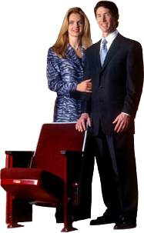
The Basic Fundamentals Of Discipleship
Joel Osteen's brand of the prosperity gospel
http://www.youtube.com/watch?v=di9-PebV634&NR=1

Slide 10
The Basic Fundamentals Of Discipleship
“Because He paid the price, we have the right to live in total victory, not partial victory, to where we have a good family, we have good health, but we constantly struggle in our finances. – That’s not total victory. If God did it for us in one area, He can do it for you in another area. Get a vision for it. . . . He paid the price so we can be totally free, . . . free from poverty, and lack, free from low self esteem . . .”
Joel Osteen's brand of the prosperity gospel

Slide 11
The Basic Fundamentals Of Discipleship
" Let Him Deny Himself,"
Luke 14:25-33 (NKJV) ²⁵ Now great multitudes went with Him. And He turned and said to them, ²⁶ "If anyone comes to Me and does not hate his father and mother, wife and children, brothers and sisters, yes, and his own life also, he cannot be My disciple.

Slide 12
The Basic Fundamentals Of Discipleship
" Let Him Deny Himself,"
Luke 14:25-33 (NKJV) ²⁷ And whoever does not bear his cross and come after Me cannot be My disciple. . . . ³³ So likewise, whoever of you does not forsake all that he has cannot be My disciple.

Slide 13
The Basic Fundamentals Of Discipleship
" Let Him Deny Himself,"
Matthew 10:34-39 (NKJV) ³⁴ "Do not think that I came to bring peace on earth. I did not come to bring peace but a sword. ³⁵ For I have come to 'set a man against his father, a daughter against her mother, and a daughter-in-law against her mother-in-law';

Slide 14
The Basic Fundamentals Of Discipleship
" Let Him Deny Himself,"
Matthew 10:34-39 (NKJV) ³⁶ and 'a man's enemies will be those of his own household.' ³⁷ He who loves father or mother more than Me is not worthy of Me. And he who loves son or daughter more than Me is not worthy of Me.

Slide 15
The Basic Fundamentals Of Discipleship
" Let Him Deny Himself,"
Matthew 10:34-39 (NKJV) ³⁸ And he who does not take his cross and follow after Me is not worthy of Me. ³⁹ He who finds his life will lose it, and he who loses his life for My sake will find it.

Slide 16
The Basic Fundamentals Of Discipleship
" And Take Up His Cross Daily,"
Some Have The Wrong Idea About This – (My mother-n-Law; My job; My Boss; . . .)
This Statement Implies Persecution and death – (Mat 5 :10-12; 10:38; 16:24; Mk 8:34; 10:21; John 15:19-21; 19:17; Acts 14:22; 2 Tim 3:12)
Jesus Is Stipulating The Extent of Your Desperation & Devotion – (Heb 11:32-38)

Slide 17
The Basic Fundamentals Of Discipleship
"And Follow Me”
Literally, "Let him be following Me."
Travel The Same Road of Obedience – (Phili 2:5-8; Heb 5:8,9; Mat 7:21-23; John 14:21; 15:9,10)
It's all about submission. - (It's a life pattern of self-denial, cross-bearing, bearing the reproach of Christ and loyal obedience)

Slide 18
The Basic Fundamentals Of Discipleship
Luke 9:23-26 (NKJV) ²³ Then He said to them all, "If anyone desires to come after Me, let him deny himself, and take up his cross daily, and follow Me. ²⁴ For whoever desires to save his life will lose it, but whoever loses his life for My sake will save it.

Slide 19
The Basic Fundamentals Of Discipleship
Luke 9:23-26 (NKJV) ²⁵ For what profit is it to a man if he gains the whole world, and is himself destroyed or lost? ²⁶ For whoever is ashamed of Me and My words, of him the Son of Man will be ashamed when He comes in His own glory, and in His Father's, and of the holy angels.

Slide 20
The Basic Fundamentals Of Discipleship
Desire –
Self Denial –
Sacrifice –
Following Jesus –
Losing Your Own Life -

