Slide 1
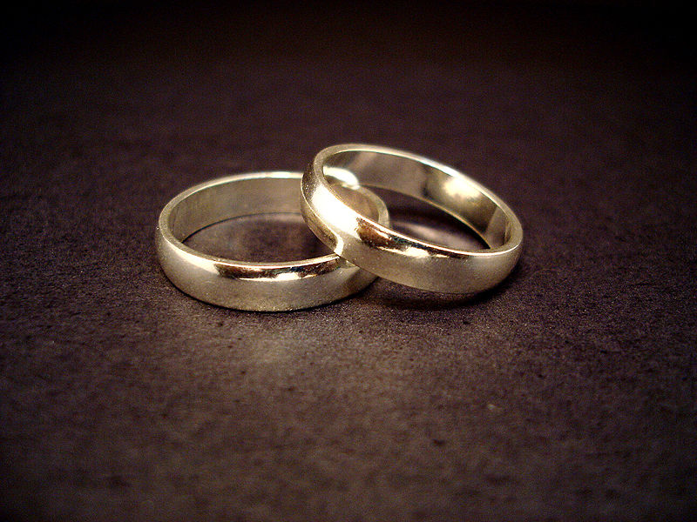
THE
Love Dare

Slide 2
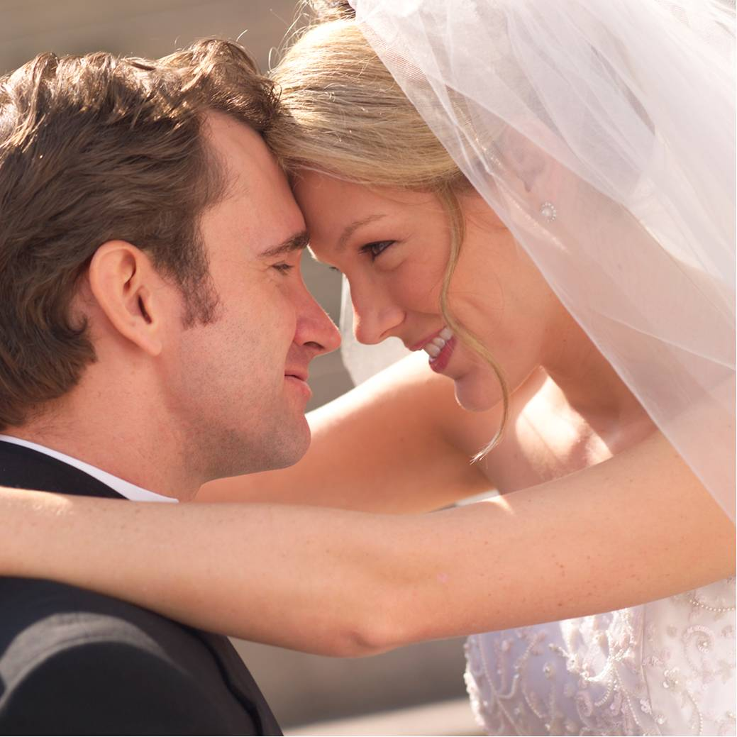
The Love Dare
Eros--Sensual love. Not used in New Testament.
Stergein—Natural love – natural affection.
Phileo- Friendly love - More nearly represents tender affection.
Agapao— “Love which is awakened by a sense of value in an object which causes one to prize it . . . It is a love of esteem and approbation” (Weust). Act of the will – not emotion - (Mt. 5:43-48; Mk 12:29-31; Jn. 3:16; 1 Cor 13)

Slide 3
The Love Dare
God designed marriage for our good –
If we are teachable – we will learn to do the ONE thing that is most important in marriage – LOVE!
Requires humility, desire and courage!
Love is a command thus a choice – instead of following our heart – we must LEAD it!

Slide 4
The Love Dare
1 Corinthians 13:4-8 (NKJV) ⁴ Love suffers long and is kind; love does not envy; love does not parade itself, is not puffed up; ⁵ does not behave rudely, does not seek its own, is not provoked, thinks no evil; ⁶ does not rejoice in iniquity, but rejoices in the truth; ⁷ bears all things, believes all things, hopes all things, endures all things. ⁸ Love never fails.

Slide 5
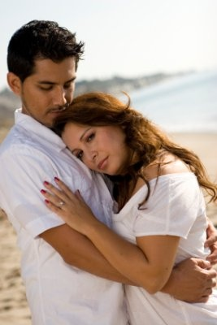
The Love Dare
Love Is Patient -
Ephesians 4:2 (NKJV) ² with all lowliness and gentleness, with longsuffering, bearing with one another in love,

Slide 6
The Love Dare
Love Is Patient -
Makrothumos - to be long-spirited, i.e. . . . To patiently endure. (Strong’s)
Patience is not quick to condemn –quick to anger – quick to give up – or quick to bail out –
Patience is choosing to respond to a negative situation in a positive way –(Prov 16:32)
Can your mate count on having a patient spouse to deal with?

Slide 7
The Love Dare
Love Is Kind
Ephesians 4:32 (NKJV) ³² And be kind to one another, tenderhearted, forgiving one another, just as God in Christ forgave you.

Slide 8
The Love Dare
Love Is Kind
Chrestos - to show oneself useful, i.e. act benevolently—(Strong's)
Gentleness – sensitive & tender – “truth in love” – not harsh.
Helpfulness – meeting the needs of the moment
Willingness – not obstinate, reluctant & stubborn – but cooperative & flexible.
Love in action – (Luke 10:25-37)
Where would you rate on kindness?

Slide 9
The Love Dare
Love Does Not Envy
Titus 3:3 (NKJV) ³ For we ourselves were also once foolish, disobedient, deceived, serving various lusts and pleasures, living in malice and envy, hateful and hating one another.

Slide 10
The Love Dare
Love Does Not Envy
Zelos - to have warmth of feeling for or against :- . . . (move with) envy, be jealous over, - (Strong‘s)
There is such a thing as justified jealousy – (Ex 34:14; Deut 4:24)
Envy is rooted in selfishness – and can infect a marriage.
Love celebrates the success of one’s mate and rejoices in their happiness & is supportive.
Are you envious of your mate?

Slide 11
The Love Dare
Love Does Not Parade Itself
2 Corinthians 10:18 (NKJV) ¹⁸ For not he who commends himself is approved, but whom the Lord commends.

Slide 12
The Love Dare
Love Does Not Parade Itself
Perpereuomai - From perperos, vainglorious, braggart – A.T. Robertson
(Barnes‘) - “This spirit proceeds from the idea of superiority over others; and is connected with a feeling of contempt or disregard for them.”—
Bragging Yields Bad Fruit – It is dishonoring and disrespectful!
Love doesn’t say “look at me” – but one rather exalts their mate above themselves – (Phili 2:3; Prov 27:2)

Slide 13
The Love Dare
Love Is Not Puffed Up
1 Peter 5:5 (NKJV) ⁵ Likewise you younger people, submit yourselves to your elders. Yes, all of you be submissive to one another, and be clothed with humility, for "God resists the proud, But gives grace to the humble."
Notes:
HONOR - We should treat our mate as someone special – Including each other in every important decision that we make -

Slide 14
The Love Dare
Love Is Not Puffed Up
Phusioō - in the primary sense of blowing; to inflate, i.e. (figurative) make proud (haughty) —(Strong's)
Love causes one to push aside pride and replace it with humility –
Love motivates the willingness to be sacrificial – (Phili 2:5-8), to work with their mate – cooperating with them and honoring them.
Do you show proper respect to your mate?
Notes:
HONOR - We should treat our mate as someone special – Including each other in every important decision that we make -

Slide 15
The Love Dare
Love Does Not Behave Rudely
Proverbs 18:13 (NKJV) ¹³ He who answers a matter before he hears it, It is folly and shame to him.

Slide 16
The Love Dare
Love Does Not Behave Rudely
Aschēmoneo - to act unbecomingly – (Thayer)
To be rude is to act in such a way as to embarrass our mate or irritate them, (sarcastic quips, poor table manners, loud and obnoxious behavior, etc) – things not done while dating.
Demonstrates a lack of respect -
How does your spouse feel about the way you speak and act around them?

Slide 17
The Love Dare
Love Does Not Seek Its Own
Philippians 2:3-4 (NKJV) ³ Let nothing be done through selfish ambition or conceit, but in lowliness of mind let each esteem others better than himself. ⁴ Let each of you look out not only for his own interests, but also for the interests of others.
Notes:
The distorted view of love in our culture is distorted fundamentally because it is focused on pleasing self –

Slide 18
The Love Dare
Love Does Not Seek Its Own
Seeketh not its own (ou zētei ta heautēs). Its own interests (1 Cor. 10:24, 33).—(A.T. Robertson)
Our decisions are motivated by either a love for God, our spouse, or ourselves.
Do you put your interests, wants and desires ahead of things needed and wanted by your spouse?
Does your mate see you as selfish?
Notes:
The distorted view of love in our culture is distorted fundamentally because it is focused on pleasing self –

Slide 19
The Love Dare
Love Is Not Provoked
James 1:19-20 (NKJV) ¹⁹ So then, my beloved brethren, let every man be swift to hear, slow to speak, slow to wrath; ²⁰ for the wrath of man does not produce the righteousness of God.

Slide 20
The Love Dare
Love Is Not Provoked
Paroxynō - primarily, "to sharpen" (akin to A, No. 2), is used metaphorically, signifying "to rouse to anger, to provoke," in the Passive Voice, in Acts 17:16, RV, "was provoked" (AV, "was stirred"); in 1 Cor. 13:5, RV, "is not provoked“ - —Vine's
Love is hard to offend and quick to forgive.

Slide 21
The Love Dare
Love Is Not Provoked
Indicates insecurity and stress – (Mat. 6:25-34)
Indicates bitterness – (Eph 4:31)
Indicates selfish lust – (James 4:1-3)
Indicates pride – (1 Tim 6:4)

Slide 22
The Love Dare
God designed marriage for our good –
If we are teachable – we will learn to do the ONE thing that is most important in marriage – LOVE!
Requires humility, desire and courage!
Love is a command thus a choice – instead of following our heart – we must LEAD it!

