Slide 1
Two Ways of Life
A Psalm of Wisdom

Slide 2
Two Ways of Life
(1) The way of the godly and their blessedness in contrast to the way of the ungodly (1:1-6).
(2) The way of the godly is set forth by way of a contrast: negatively, what the godly do not do (1:1), and positively, what the godly do (1:2).
(3) Then there is the contrast between the results of the two ways of life; the godly are stable and fruitful, but the ungodly are unstable and face sure judgment (1:3-6).

Slide 3
The Truly Blessed Person
What The Blessed Man Does Not Do (1)
“Walks not in the counsel of the ungodly” - (does not listen to their advice)
“Nor stands in the path of sinners” - (Does not linger where sinners are)
“Nor sits in the seat of the scornful” - (Does not join with those who ridicule godliness)

Slide 4
The Truly Blessed Person
What The Blessed Man Does Not Do (1)
From this retrogressive process, it is easy to see that people simply do not remain passive about God.
These verses pose a warning to us that little by little we can step out of the place of blessedness and into the place of misery and cursing.

Slide 5
The Truly Blessed Person
What The Blessed Man Does Not Do (1)
Ephesians 4:17-19 | Psalm 1:1
¹⁷ This I say therefore, and affirm together with the Lord, that you walk no longer just as the Gentiles also walk, in the futility of their mind, | who does not walk in the counsel of the wicked,
¹⁸ being darkened in their understanding, excluded from the life of God, because of the ignorance that is in them, because of the hardness of their heart; | Nor stand in the path of sinners,
¹⁹ and they, having become callous, have given themselves over to sensuality, for the practice of every kind of impurity with greediness. | Nor sit in the seat of scoffers!

Slide 6
The Truly Blessed Person
What The Blessed Man Does (2)
But – a contrasting coupling & conditional clause, “but if,”
His delight is in the law of the Lord, - to be mindful of, attentive to, . . . To keep, protect.
And in His law he meditates day and night - It is on his mind and in his heart at all times in every situation and area of life

Slide 7
The Truly Blessed Person
What The Blessed Man Becomes (3)
Grounded – mental, emotional, and spiritual stability
Nourished – transplanted where there is plenty of nutrients.
Fruitful – grows to be productive in the kingdom of God
Preserved – Even in adverse conditions
Prosperous – A successful life

Slide 8
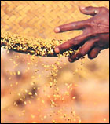
The Way of The Wicked
The Condition of the Wicked (4-5)
The ungodly are not so, - (a) The righteous are stable, fruitful, and will be rewarded. (b) The wicked are unstable, unfruitful, and will be judged.
But are like the chaff which the wind drives away - the debris separated from the grain or seed in threshing - it has no body or substance and is blown about by the wind, always unstable. It is that which is worthless, of no value.
Notes:
Chaff is the seed covering and the debris separated from the grain or seed in threshing. Unlike the grain or actual seed, it has no body or substance and is blown about by the wind, always unstable. It is that which is worthless, of no value.

Slide 9
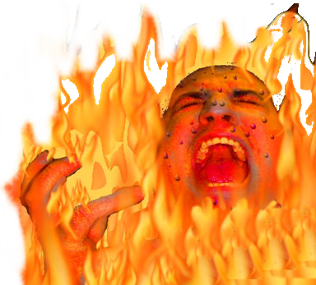
The Way of The Wicked
The End of the Wicked (4-5)
Therefore the ungodly shall not stand in the judgment, - They will not have the ability to withstand or endure the judgment of God
Nor sinners in the congregation of the righteous - will be excluded from the eternal blessings of God’s presence to be enjoyed by the righteous.
Notes:
Chaff is the seed covering and the debris separated from the grain or seed in threshing. Unlike the grain or actual seed, it has no body or substance and is blown about by the wind, always unstable. It is that which is worthless, of no value.

Slide 10
Two Ways of Life
The Final Contrast – (6)
For the Lord knows the way of the righteous, - Salvation in the day of judgment is equated with being known by the Lord (cf. Matt. 7:23)
But the way of the ungodly shall perish – Their way of life gains them nothing with God - Ultimately this means the lake of fire – (cf . Rev 21:8).

Slide 11
Two Ways of Life
(1) The way of the godly and their blessedness in contrast to the way of the ungodly (1:1-6).
(2) The way of the godly is set forth by way of a contrast: negatively, what the godly do not do (1:1), and positively, what the godly do (1:2).
(3) Then there is the contrast between the results of the two ways of life; the godly are stable and fruitful, but the ungodly are unstable and face sure judgment (1:3-6).

