Slide 1

Why I Am A Member Of The Church Of Christ!

Slide 2
Why I Am A Member Of The Church Of Christ
It Is Anti-Denominational -
The Standard It Uses –
The Message It Preaches –
The Worship Is Scriptural –
The Work Is Authorized -

Slide 3
Why I Am A Member Of The Church Of Christ
Defining
“The Church of Christ”
The
Definite Article / Singularity
Church
Ecclesia / Called Out
Mat 16:18; Acts 19:32; Rom 16:16
of
Possessive / Belonging To
Christ
Messiah / Savior / Lord / Jesus
Rom 16:16; 1 Cor 1:1
Mat 16:18; Acts 2:47; Eph 4:4
1 Cor 3:23; Gal 5:24

Slide 4



Why I Am A Member Of The Church Of Christ
Defining
“The Church of Christ”
“I will build MY CHURCH” Matt. 16:18
“there is ONE BODY” Eph. 4:4
“He is also head of the BODY, the CHURCH” Col. 1:18; Eph. 1:22-23
Notes:
“Church” In The
Universal Sense
All Christians everywhere.

Slide 5
Why I Am A Member Of The Church Of Christ
Defining
“The Church of Christ”
Description
Passage
Jesus
Relationship
“the church”
(Acts 8:3, etc.)
The One Who Calls
The Called Out
“the church of God”
(Acts 20:28)
Paid The Price
Purchased of God
“the body of Christ”
(1 Cor. 12:27)
Headship
Members
“the kingdom of God”
(Rom. 14:17)
Kingship
Citizens
“the family of God”
(1 Tim. 3:15)
Son
Children
“the temple of God”
(1 Cor. 3:16)
High Priest
Serve / Worship
“the church of the firstborn”
(Heb. 12:23)
Heir
Fellow Heirs
Notes:
Descriptions of “The Church” In The Universal Sense:

Slide 6

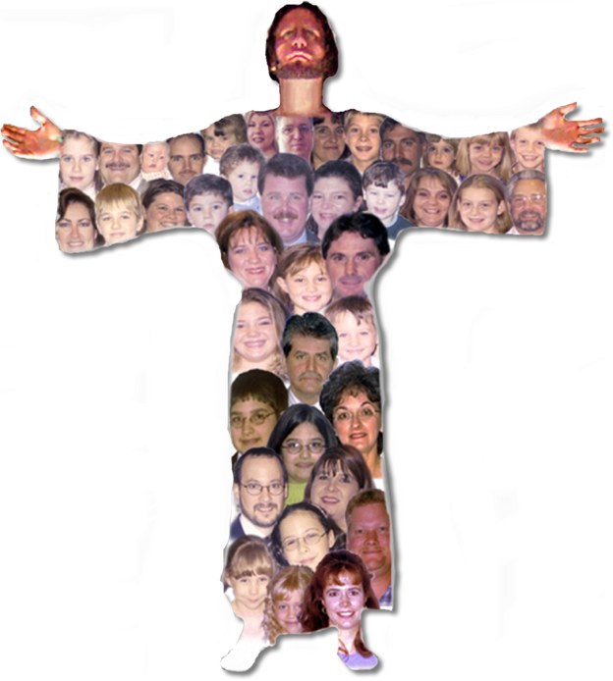

Why I Am A Member Of The Church Of Christ
Defining
“The Church of Christ”
Who agree to join together in fellowship (Acts 9:26).
Who worship in a common assembly – (1 Cor. 11:18)
Who work out of a common treasury – (1 Cor.16:1-3)
Who submit to a common oversight – (Acts 14:23; 20:28)
Notes:
“Church” In The
Universal Sense
All Christians everywhere.

Slide 7
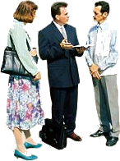
Why I Am A Member Of The Church Of Christ
Defining
“The Church of Christ”
“the church of God which is at Corinth” (1 Cor. 1:2)
“the church of the Thessalonians in God” (1 Thess. 1:1).
“the churches of Galatia” (1 Cor. 16:1).
“the churches of the saints” (1 Cor. 14:33).
“the churches of Christ” (Rom. 16:16).
“the churches” (Acts 8:3; 15:41, etc., etc.).
Notes:
Individual Christians banding Together

Slide 8
Why I Am A Member Of The Church Of Christ
It Is Anti-Denominational -
The Church Is The Saved – Acts 2:47; Ephe 5:23
Jesus Prayed For Unity – John 17:20-23
Paul Pleaded For Unity – 1 Cor. 1:10
The Church of Christ Submits To Christ – Ephe 5:23,24; 4:1-6; 1 Cor 4:17

Slide 9
Why I Am A Member Of The Church Of Christ
It Is Anti-Denominational -
Corn
Apple
Acorn

Slide 10
Why I Am A Member Of The Church Of Christ
It Is Anti-Denominational -
Methodist
Christian
Mennonite
Nazarene

Slide 11
Why I Am A Member Of The Church Of Christ
The Standard It Uses
Human Denominations Do Not Use “JUST” The Bible – (Confessions, Disciplines, Rules of Faith, Party Statements, etc.)
The Lord’s Church Uses ONLY The Bible As Its Guide In Faith, Teaching, Work, Worship & Organization. (2 Tim 3:16,17; 1 Pet 4:16; Col 3:17)

Slide 12
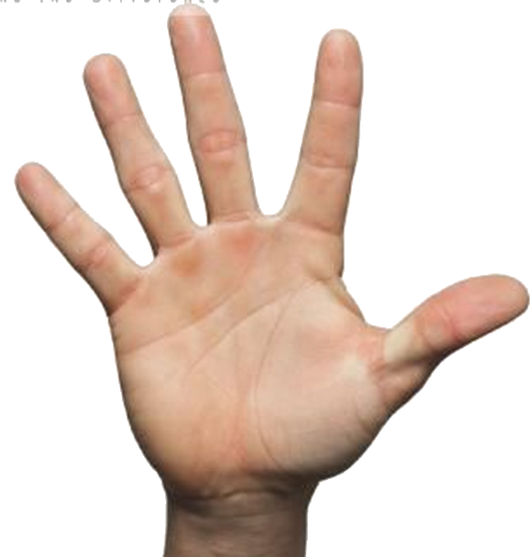
Why I Am A Member Of The Church Of Christ
The Message It Preaches
Repent
Confess
What A Person Must Do In Order To Be Saved In The Words of Inspired Men – (1 Peter 4:11)
The Alien Sinner - (John 8:24; Romans 10:9,10; Luke 13:3,5; Acts 17:30; Mark 16:15,16; Acts 2:38; 10:47; 22:16; Ro 6:3-6; 1 Pet 3:21)
The Christian – (Col. 1:23; Rev 2:10; Acts 8:18-24; 1 John 1:9)
Be Baptized
Believe
Hear

Slide 13
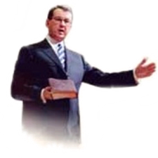
Why I Am A Member Of The Church Of Christ
The Message It Preaches
The Need To Live In Love & Purity – (Mark 12:29-31; Col. 3:1-14; 2 Cor 6:14-7:1; Ephe 5:1-18; 1 Pet 1:13-18)
The Need For Positive Divine Authority For Everything Believed, Taught & Practiced - (Mat 21:25; 1 Pet 4:11; Col. 3:17)
The Plea For Unity Upon What The Bible Says – (1 Cor 1:10; John 17:20-22; Ephe 4:1-6)

Slide 14
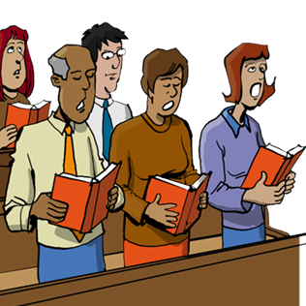
Why I Am A Member Of The Church Of Christ
The Worship Is Scriptural
The New Testament Reveals Five Acts of Worship
  Studying God’s Word - (Acts 20:7; Col 4:16)
  Singing – (Eph 5:19; Col. 3:16)
  Praying – (Acts 4:23-31; Eph 6:18)
  Giving – (1 Cor 16:1,2)
  Observing The Lord’s Supper– (Acts 20:7; 1 Cor 11:23-26)

Slide 15
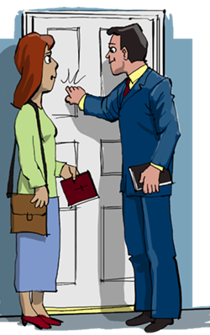
Why I Am A Member Of The Church Of Christ
The Work Is Authorized
Three Works of The Church
Evangelism (Acts 13:1-3)
Edification (Eph 4:11-16)
Benevolence (Ro 15:25-26)

Slide 16
Why I Am A Member Of The Church Of Christ
It Is Anti-Denominational -
The Standard It Uses –
The Message It Preaches –
The Worship Is Scriptural –
The Work Is Authorized -

