Slide 1
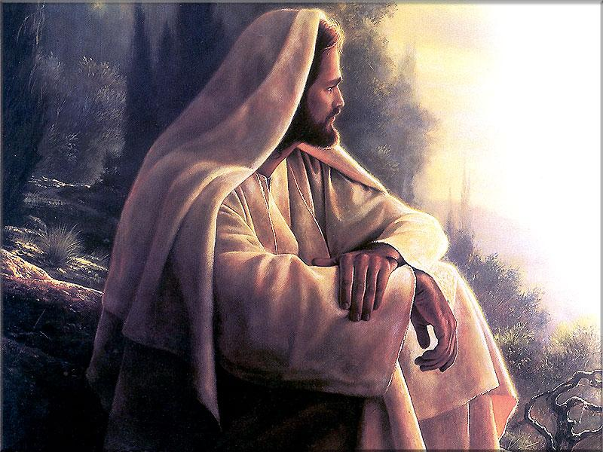
Why I Believe
Jesus Is The Christ, The Son of God

Slide 2
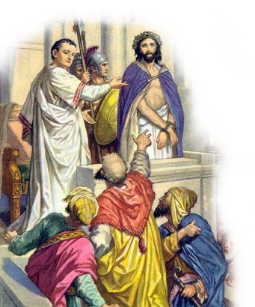
Why I Believe In Jesus
John 6:66-69 (NKJV) ⁶⁶ From that time many of His disciples went back and walked with Him no more. ⁶⁷ Then Jesus said to the twelve, "Do you also want to go away?" ⁶⁸ But Simon Peter answered Him, "Lord, to whom shall we go? You have the words of eternal life. ⁶⁹ Also we have come to believe and know that You are the Christ, the Son of the living God."

Slide 3
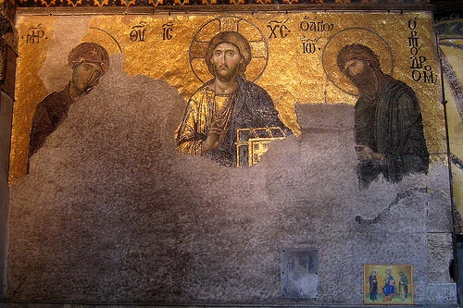
Why I Believe In Jesus
The Historical Jesus
There is MORE THAN ENOUGH historical evidence to prove Jesus existed
The Bible as historical evidence –
There is non-Biblical evidence -

Slide 4
Why I Believe In Jesus
The Historical Jesus
Dr. Gary Habermas, an American Christian apologist, theologian, and philosopher of religion, he writes that “approximately eighteen non-Christian, extra biblical sources mention more than one hundred facts, beliefs, and teachings from the life of Christ”
(Did Jesus Rise From The Dead? The Resurrection Debate, p. 43).

Slide 5
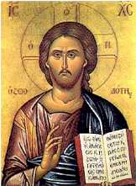
Why I Believe In Jesus
The Historical Jesus
Gaalyah Cornfield, Jewish scholar, -“Modern archaeology and scholarship have now established beyond all doubt that a man known as Jesus certainly did exist in history and that the criticism of the skeptics was ill founded … We are today able to assert beyond a shadow of a doubt that the historical Jesus existed” (The Historical Jesus, A Scholarly View of the Man and His World, pgs. 11-12).

Slide 6
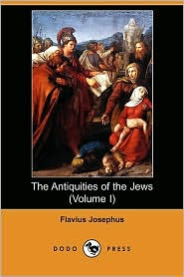
Why I Believe In Jesus
The Historical Jesus
Flavius Josephus, -
“He (Annas the Younger) convened a judicial session of the Sanhedrin and brought before it the brother of Jesus the so-called Christ -- James by name -- and some others, whom he charged with breaking the law and handed over to be stoned to death.” - (Antiquities 20.200)

Slide 7
Why I Believe In Jesus
The Historical Jesus
Flavius Josephus, - “Now, there was about this time Jesus, a wise man, if it be lawful to call him a man, for he was a doer of wonderful works, a teacher of such men as receive the truth with pleasure. He was the Christ. And when Pilate, at the suggestion of the principal men amongst us, had condemned him to the cross, those who loved him at the first did not forsake him, for he appeared to them alive again at the third day, as the divine prophets had foretold these and 10,000 other wonderful things concerning him. And the tribe of Christians, so named from him, is not extinct at this day.” - (Antiquities 18.63-64)

Slide 8
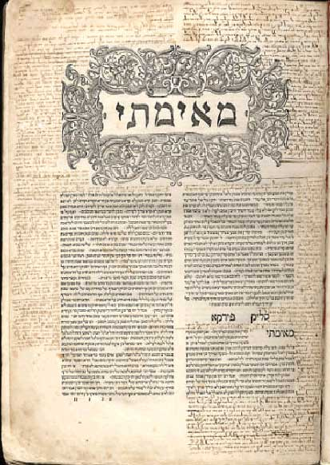
Why I Believe In Jesus
The Historical Jesus
The Talmud, -
On the eve of Passover Yeshua was hanged. For forty days before the execution a herald went forth and cried, "He is going to be stoned because he has practiced sorcery and enticed Israel to apostasy. Anyone who can say anything in his favor, let him come forward and plead on his behalf." But since nothing was brought forward in his favor he was hanged on the eve of Passover. - Sanhedrin 43a

Slide 9
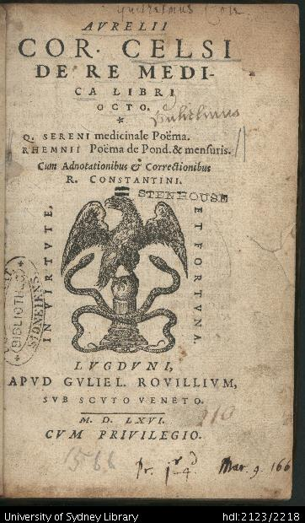
Why I Believe In Jesus
The Historical Jesus
Celsus, -
“"Jesus, they say, was sent to save sinners; was he not sent to help those who have kept themselves free from sin? They pretend that God will save the unjust man if he repents and humbles himself. The just man who has held steady from the cradle in the ways of virtue He will not look upon.” - (175 AD)
Notes:
[Jesus] of having "invented his birth from a virgin," and upbraids Him with being "born in a certain Jewish village, of a poor woman of the country, who gained her subsistence by spinning, and who was turned out of doors by her husband, a carpenter by trade, because she was convicted of adultery; that after being driven away by her husband, and wandering about for a time, she disgracefully gave birth to Jesus, an illegitimate child, who having hired himself out as a servant in Egypt on account of his poverty, and having there acquired some miraculous powers, on which the Egyptians greatly pride themselves, returned to his own country, highly elated on account of them, and by means of these proclaimed himself a God."...

Slide 10
Why I Believe In Jesus
The Historical Jesus
Cornelius Tacitus,,
Annals 15.44 - written in the 2nd century A.D.
But neither the aid of men, nor the emperor's bounty, nor propitiatory offerings to the gods, could remove the grim suspicion that the fire had been started by Nero's order. To put an end to this rumor, he shifted the charge on to others, and inflicted the most cruel tortures upon a group of people detested for their abominations, and popularly known as "Christians". . . .

Slide 11
Why I Believe In Jesus
The Historical Jesus
Cornelius Tacitus,,
Annals 15.44 - written in the 2nd century A.D.
. . . Their name came from one Christus, who was put to death in the principate of Tiberius by the Procurator Pontius Pilate. Though checked for a time, the destructive superstition broke out again, not in Judaea only, where its mischief began, but even in Rome, where every abominable and shameful iniquity, from all the world, pours in and finds a welcome.” - Annals 15.44

Slide 12
Why I Believe In Jesus
The Historical Jesus
Mara bar Serapion,
Letter to Son Serapion
“What advantage did the Athenians gain from putting Socrates to death? Famine and plague came upon them as a judgment for their crime. What advantage did the men of Samos gain from burning Pythagoras? In a moment their land was covered with sand. What advantage did the Jews gain from executing their wise king? It was just after that their kingdom was abolished. . . .

Slide 13
Why I Believe In Jesus
The Historical Jesus
Mara bar Serapion,
Letter to Son Serapion
. . . God justly avenged these three wise men: the Jews, ruined and driven from their land, live in complete dispersion. But Socrates did not die for good; he lived on in the teaching of Plato. Pythagoras did not die for good; he lived on in the statue of Hera. Nor did the wise king die for good; he lived on in the teaching which he had given.”

Slide 14
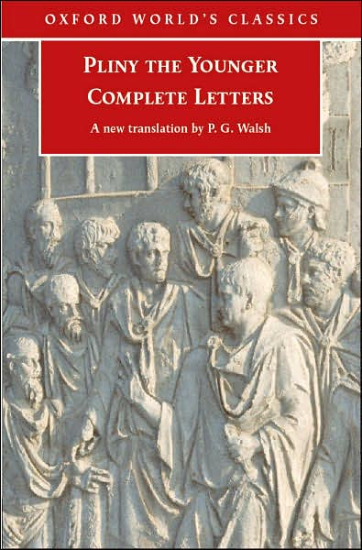
Why I Believe In Jesus
The Historical Jesus
Pliny the Younger,
Letters to Trajan
. . . But they declared that the sum of their guilt or error had amounted only to this, that on an appointed day they had been accustomed to meet before daybreak, and to recite a hymn antiphonally to Christ, as to a god, and to bind themselves by an oath, not for the commission of any crime but to abstain from theft, robbery, adultery and breach of faith and not to deny a deposit when it was claimed. . . ..

Slide 15
Why I Believe In Jesus
The Historical Jesus
Epitome from Church History of Agapius (Arabic)
“At this time there was a wise man who was called Jesus. And his conduct was good and he was known to be virtuous. And many from among the Jews and other nations became his disciples. Pilate condemned him to be crucified and to die. . . .”

Slide 16
Why I Believe In Jesus
The Historical Jesus
Epitome from Church History of Agapius (Arabic)
“. . . And those who had become his disciples did not abandon his discipleship. They reported that he had appeared to them three days after his crucifixion and that he was alive. Accordingly he was perhaps the Messiah concerning who the prophets have recounted wonders.”

Slide 17
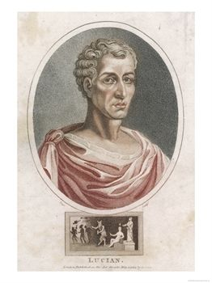
Why I Believe In Jesus
The Historical Jesus
Lucian,
the Greek satirist, AD 170
“The Christians, you know, worship a man to this day - the distinguished personage who introduced their novel rites, and was crucified on that account... You see, these misguided creatures start with the general conviction that they are immortal for all time, . . .”

Slide 18
Why I Believe In Jesus
The Historical Jesus
Lucian,
the Greek satirist, AD 170
“. . . which explains the contempt of death and voluntary self-devotion which are so common among them; and then it was impressed upon them by their original lawgiver that they are all brothers, from the moment that they are converted, and deny the gods of Greece, and worship the crucified sage, and live after his laws.”

Slide 19
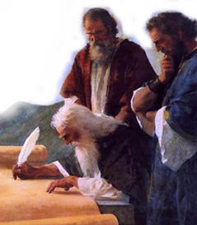
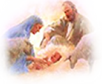
Why I Believe In Jesus
The Prophesied Jesus
Jesus said that the scriptures testified of Him – (John 5:39)
The Law was a tutor to bring us to Christ – (Gal. 3:24)
The OT scriptures produced faith in Christ for Timothy – (2 Tim. 3:15)
The prophets confirmed Jesus as the Messiah – (2 Pet. 1:16-21)

Slide 20
Why I Believe In Jesus
The Prophesied Jesus
The Lineage of the Messiah
Seed of woman (Gen. 3:15; Gal. 4:4).
Seed of Abram (Gen. 12:3; Gal. 3:16).
Tribe of Judah (Gen. 49:10; Heb. 7:14).
House of David (Isa. 11:1; Acts 13:23).
Divine in nature (Mic. 5:2; Jn. 1:1-2).
Equal to God (Zech. 13:7; Phil. 2:6).

Slide 21
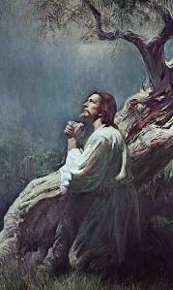
Why I Believe In Jesus
The Prophesied Jesus
Main Events in His Life
Announced by a harbinger (Mal. 3:1; Mt. 11:10)
Anointed prophet, priest, and king (Deut. 18:15-18; Zech. 6:13; Heb. 1:1; 5; Rev. 1:5)
Began work in Galilee (Isa. 9:1; Mt. 4:12)
Mission confirmed by miracles (Isa. 35:5; Acts 10:38)
Life of sorrows (Isa. 53:3; Mat 26:36ff; Acts 8:32)
Rejection by Jews (Isa. 53:1-3; Jn. 1:11)

Slide 22
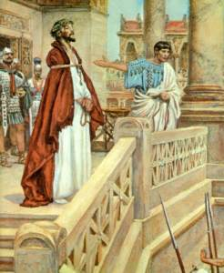
Why I Believe In Jesus
The Prophesied Jesus
Betrayal and Trial
Betrayed for 30 pieces of silver (Zech. 11:12; Mt. 27:3)
Unjustly tried (Isa. 53:8; Mat. 26:59-68; 27:22,23)
Demeanor during trial (Isa. 53:7; Mt. 26:62-63)
Suffering abuse (Isa. 50:6; Mt. 26:67)

Slide 23
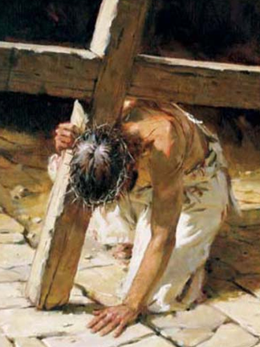
Why I Believe In Jesus
The Prophesied Jesus
Crucifixion, Burial, & Resurrection
Died for sins of others (Isa. 53:5)
Clothing divided (Ps. 22:18; Jn. 19:23)
Numbered with transgressors (Isa. 53:12; Jn. 19:17-18)
Buried with rich (Isa. 53:9; Jn. 19:39-42)
Resurrected (Isa. 53:10; Acts 2:29-32)
Ascended into heaven (Ps. 68:18; Eph. 4:8)

Slide 24
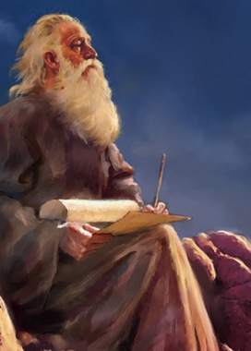
Why I Believe In Jesus
The Prophesied Jesus
The Weight of Fulfilled Prophecy
Jesus fulfilled approximately 330 prophecies -
The probability of any man fulfilling eight prophecies has been calculated as 1 in 10 to 17th power (100,000,000,000,000,000)!
The probability of fulfilling just 48 prophecies is one in 10 to 157th power! - Peter Stoner

Slide 25
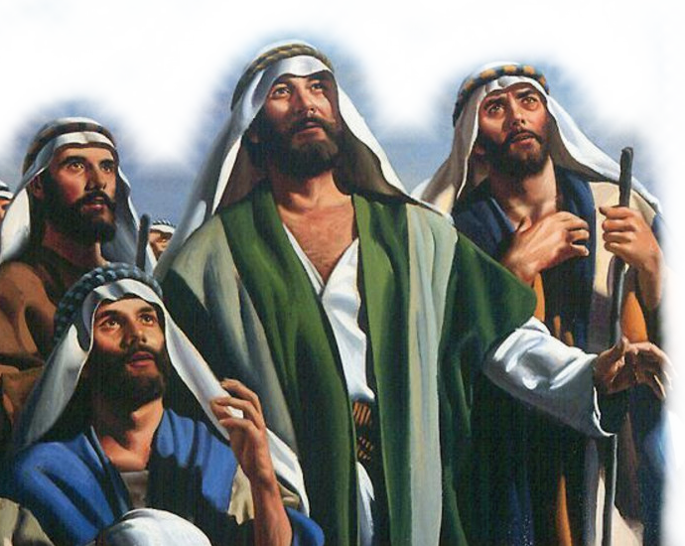
Why I Believe In Jesus
The Apostolic Witness
The apostles claimed to be eyewitnesses of His life & resurrection
Peter - Ac 10:39-42; 2 Pe 1:16-18
John – Jn 1:14; 1 Jn 1:1-3
Paul –Acts 22:6-10; 26:12-19
All of the apostles – Acts 1:1-4;
Over 500 others - 1 Cor. 15:3-8

Slide 26
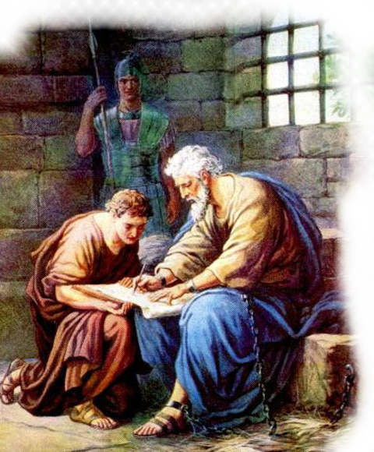
Why I Believe In Jesus
The Apostolic Witness
Significance
The apostles by their testimony force us to make a decision – 1 Cor 15:12-15; John 20:30,31
Were they eyewitnesses, or false witnesses? - 1Co 15:14-15; 2Pe 1:16-18
Why would men suffer extreme hardship, persecution, and martyrdom for a lie? 1 Cor. 15:18,19

Slide 27
Why I Believe In Jesus
The Apostolic Witness
Significance
Jesus is everything they claimed!
Jesus is the Son of God - Ro 1:4
Jesus is God in the flesh – John 1:1-3,14; Phili 2:5-10
He died for our sins – Mat. 26:28
Was resurrected and has all authority in heaven and earth - Mt 28:18; Ac 2:36

Slide 28
Why I Believe In Jesus
The Apostolic Witness
Significance
He went to prepare a place for us - Jn 14:2
He shall come again - Jn 14:3
No one can come to the Father but through Him - Jn 14:6
There will be a resurrection of the dead and ensuing judgment - Jn 5:28-29; 12:48

Slide 29
Why I Believe In Jesus
John 6:66-69 (NKJV) ⁶⁶ From that time many of His disciples went back and walked with Him no more. ⁶⁷ Then Jesus said to the twelve, "Do you also want to go away?" ⁶⁸ But Simon Peter answered Him, "Lord, to whom shall we go? You have the words of eternal life. ⁶⁹ Also we have come to believe and know that You are the Christ, the Son of the living God."

Slide 30
Why I Believe
Jesus Is The Christ, The Son of God
The Historical Jesus –
The Prophetic Witness –
The Apostolic Witness –
The Practical Evidence -

