Slide 1
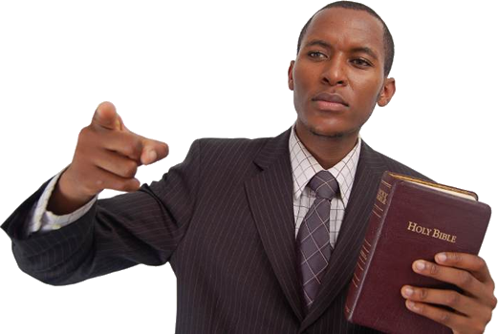
2 Timothy 3:1-4:5
Why Preach The Word?

Slide 2
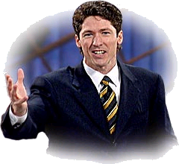
Why Preach The Word?
Much Of Modern Preaching
Is full of error –
Misuses Scripture -
Caters to people who do not care for God
Caters to people whose first love is themselves –

Slide 5
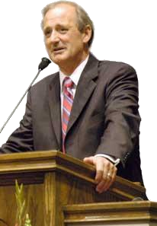
Why Preach The Word?
Our Preaching Must Be To Please God!
Therefore – our preaching must consist of that which God instructs –
Salvation and edification is not achieved by following modern marketing and management techniques

Slide 7
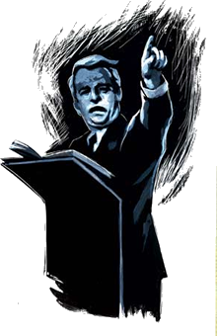
Why Preach The Word?
The Danger Of The Times – 2 Tim 3:1-9
ONLY the light of God’s word can bring light to this dark world – Ps 119:105,130; Prov 6:23; Eph 5:8-13
People are starving to death spiritually – and the ONLY thing that can help them is the word of God – Mat 4:4
Preach the word of God and let God give the increase – 1 Cor 3:6
¹ But know this, that in the last days perilous times will come:
Notes:
² For men will be lovers of themselves, lovers of money, boasters, proud, blasphemers, disobedient to parents, unthankful, unholy, ³ unloving, unforgiving, slanderers, without self-control, brutal, despisers of good, ⁴ traitors, headstrong, haughty, lovers of pleasure rather than lovers of God, ⁵ having a form of godliness but denying its power. And from such people turn away! ⁶ For of this sort are those who creep into households and make captives of gullible women loaded down with sins, led away by various lusts, ⁷ always learning and never able to come to the knowledge of the truth. ⁸ Now as Jannes and Jambres resisted Moses, so do these also resist the truth: men of corrupt minds, disapproved concerning the faith; ⁹ but they will progress no further, for their folly will be manifest to all, as theirs also was.

Slide 8
Why Preach The Word?
The Deception Of False Teachers – 2 Tim 3:10-13
Mysticism, Monergism, Calvinism, Premillennialism, Eccomunicalism, Pragmatism …
The example of Paul – 3:11-12; Acts 14:1-5; 17:1-9,16-18
False teachers and error must be exposed – Gal 1:5; Mat. 15:1-9; 23; Jude 1:3
Only the truth will set us free – John 8:32; 1 Cor. 1:18-24
¹³ But evil men and impostors will grow worse and worse, deceiving and being deceived.
Notes:
2 Timothy 3:10-13 (NKJV) ¹⁰ But you have carefully followed my doctrine, manner of life, purpose, faith, longsuffering, love, perseverance, ¹¹ persecutions, afflictions, which happened to me at Antioch, at Iconium, at Lystra--what persecutions I endured. And out of them all the Lord delivered me. ¹² Yes, and all who desire to live godly in Christ Jesus will suffer persecution. ¹³ But evil men and impostors will grow worse and worse, deceiving and being deceived.

Slide 9
Why Preach The Word?
The Dynamics Of The Scripture – 2 Tim 3:14-17
It has power – Gen. 1:1; Heb 11:3; 1:3; 4:12; Acts 20:32
It gives life – John 6:63; Psalm 19:7; 1 Peter 1:22,23; James 1:21
It is the mirror for the soul – James 1:25; Hebrews 4:12
It is eternal – Psalm 119:89; 1 Peter 1:24-25; Mark 13:31
It will accomplish its purpose – Isaiah 55:11; 2 Tim 3:16,17; 2 Pet 1:3
2 Tim 3:16-17 (NKJV) ¹⁶ All Scripture is given by inspiration of God, and is profitable . . .
Notes:
2 Timothy 3:14-17 (NKJV) ¹⁴ But you must continue in the things which you have learned and been assured of, knowing from whom you have learned them, ¹⁵ and that from childhood you have known the Holy Scriptures, which are able to make you wise for salvation through faith which is in Christ Jesus. ¹⁶ All Scripture is given by inspiration of God, and is profitable for doctrine, for reproof, for correction, for instruction in righteousness, ¹⁷ that the man of God may be complete, thoroughly equipped for every good work.

Slide 10
Why Preach The Word?
Demanded By God – 2 Tim 4:1-5
When should His word be preached? – “in season and out of season”
How should it be preached – “reprove, rebuke and exhort, with all longsuffering and teaching”
Why it should be preached – “For the time will come when they will not endure sound doctrine,”
2 Tim 4:1-2 (NKJV) ¹ I charge you therefore before God . . . ² Preach the word! . . .
Notes:
2 Timothy 4:1-5 (NKJV) ¹ I charge you therefore before God and the Lord Jesus Christ, who will judge the living and the dead at His appearing and His kingdom: ² Preach the word! Be ready in season and out of season. Convince, rebuke, exhort, with all longsuffering and teaching. ³ For the time will come when they will not endure sound doctrine, but according to their own desires, because they have itching ears, they will heap up for themselves teachers; ⁴ and they will turn their ears away from the truth, and be turned aside to fables. ⁵ But you be watchful in all things, endure afflictions, do the work of an evangelist, fulfill your ministry.

Slide 11
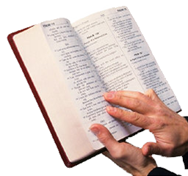
Why Preach The Word?
The Kind of Preaching That Pleases God!
The preachers task is to proclaim scripture and give the sense of it (Neh 8:8; 2 Tim 2:15; Acts 20:27)
The power of conversion is ONLY found in the word of God – (1 Pet 1:22,23; Heb 4:12; Rom 1:16; 1 Cor 1:18,21; 1 Tim 4:16)
The task of a faithful preacher revolves around the word of God – (Acts 6:3,4; 1 Tim 4:12-16)
Notes:
Why would a preacher proclaim the wisdom of men - - - or use the wisdom of men to guide them in what and how they should preach when they have the word of God?

Slide 12
Why Preach The Word?
The Kind of Preaching That Pleases God!
When the word of God is preached – the word of man is NOT –
When the word of God is preached – the ultimate authority is appealed to – NOT the authority of men!
When the word of God is preached – men learn what God says -
Notes:
The power of the Word is what the Holy Spirit uses to transform lives. If I only preached sermonettes, book reviews, entertaining stories, or simply rehashed the same message, God's Word wouldn't have an opportunity to work in your life or mine!!

Slide 13
Why Preach The Word?
The Danger Of The Times – 2 Tim 3:1-9
The Deception Of False Teachers – 2 Tim 3:10-13
The Dynamics Of The Scripture – 2 Tim 3:14-17
Demanded By God – 2 Tim 4:1-5
Notes:
2 Timothy 4:1-5 (NKJV) ¹ I charge you therefore before God and the Lord Jesus Christ, who will judge the living and the dead at His appearing and His kingdom: ² Preach the word! Be ready in season and out of season. Convince, rebuke, exhort, with all longsuffering and teaching. ³ For the time will come when they will not endure sound doctrine, but according to their own desires, because they have itching ears, they will heap up for themselves teachers; ⁴ and they will turn their ears away from the truth, and be turned aside to fables. ⁵ But you be watchful in all things, endure afflictions, do the work of an evangelist, fulfill your ministry.

Slide 15
Why Preach The Word?
2 Timothy 4:1-5 (NKJV)
. . . but according to their own desires, because they have itching ears, they will heap up for themselves teachers; ⁴ and they will turn their ears away from the truth, and be turned aside to fables. ⁵ But you be watchful in all things, endure afflictions, do the work of an evangelist, fulfill your ministry.

