Slide 1
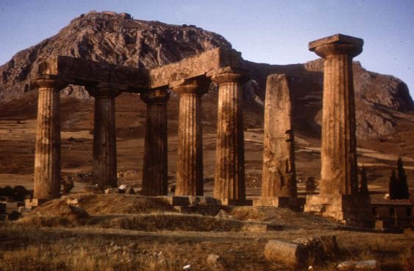
Called to Be Saints
Introduction To The First Epistle To The Church At Corinth

Slide 2
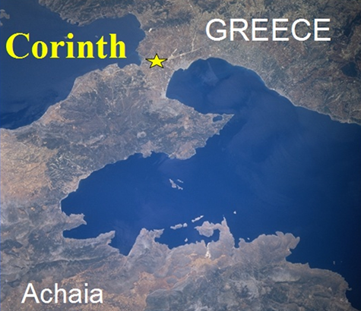
Corinth is located on an isthmus, the typical seaport town of its day.
Homosexuality, prostitution and idolatry all ran rampant— (likely over 1,000 prostitutes there)
"Corinthian," then and now, connotates moral laxity.

Slide 3
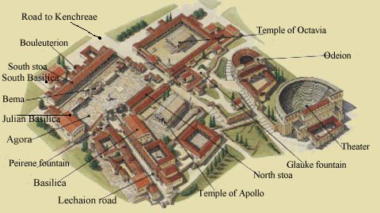
550 BC
Notes:
The “Odeion” was a small roofed theater where plays and various performances were given.
The Bema, or “judgment seat” – Acts 18:12-17 - Paul spent 18 months in the city before the Jews of the city charged him with breaking the law and brought him before Gallio at the city's place of judgment (bema). The mention of Gallio provides an anchor for New Testament chronology as we know from Roman sources that Gallio was proconsul of Achaia from June 51 to May 52. Standing on this platform, the proconsul dismissed the charges against Paul as a dispute of Jewish law and not of a criminal nature.
Temple of Apollo - The seven surviving monolithic Doric columns of the temple of Apollo. The temple is dated around 550 BC. It was built in the same place, where an older temple of Apollo existed in the years of Kypselidae, 100 years before.
Octavia’s Temple: The three surviving columns of the great temple built in memory of Octavia.
Acrocorinth. The Acropolis of Corinth. The summit is 1800 feet above sea level. Many shrines dedicated to female deities were built there, including the famous and wealthy temple of Aphrodite.

Slide 4
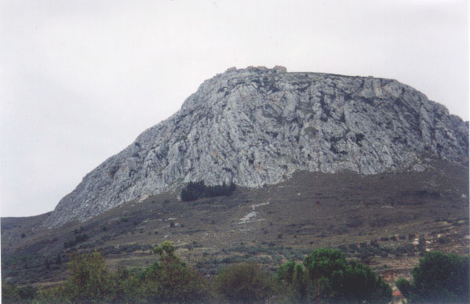
Acrocorinth. The Acropolis of Corinth.
The summit is 1800 feet above sea level. Many shrines dedicated to female deities were built there, including the famous and wealthy temple of Aphrodite.

Slide 5
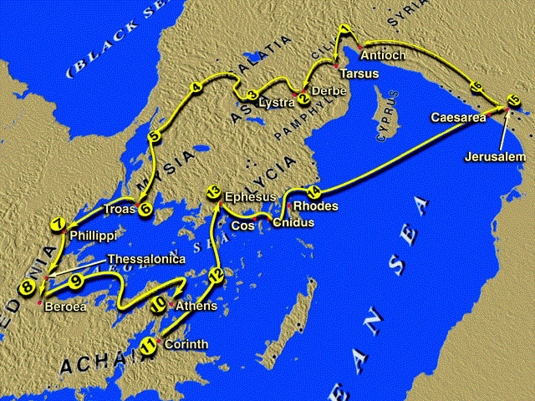
Paul’s Second Missionary Tour, A.D. 49-52

Slide 6
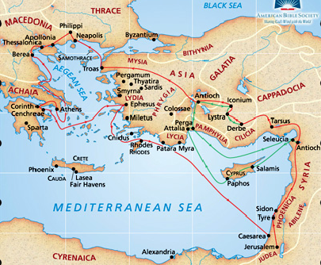
Beginning of the church recorded in Acts 18
First converts: Crispus and his household specifically mentioned, (Acts 18:8), but likely others were Christians first (Aquila and Priscilla, Justus, (Acts 18:1-7).
Stephanas and Fortunatus likely carried the letter.

Slide 7
Called to Be Saints
Paul’s First Stay
Paul spent 18 months in the city before the Jews of the city charged him with breaking the law and brought him before Gallio at the city's place of judgment (bema).
The mention of Gallio provides an anchor for NT chronology as we know from Roman sources that Gallio was proconsul of Achaia from June 51 to May 52.
The proconsul dismissed the charges against Paul as a dispute of Jewish law and not of a criminal nature.

Slide 8
Called to Be Saints
Paul’s Subsequent Ministry In Corinth
Paul addressed at least three letters to this church.
a. Ante-Corinthians (I Corinthians 5:9)
b. 1 Corinthians (1:1) – (54 or 55 AD)
c. 2 Corinthians (1:1) – (56 or 57 AD)
Paul visited Corinth at least twice after his initial visit.
a. Paul visited on the last leg of the third journey (Acts 20:1–3).
b. Yet, Paul calls this trip “the third time” (II Corinthians 12:14; 13:1).
Notes:
Paul visited Corinth at least twice after his initial visit.
a. Paul visited on the last leg of the third journey (Acts 20:1–3).
(1) This trip was not according to the original plan which may have been announced in missing “Ante-Corinthians” (II Corinthians 1:15– 16).
(2) This plan would have never been known were it not that Paul was charged with being indecisive and fickle (cf. I Corinthians 16:1–9; Acts 20:1–5).
b. Yet, Paul calls this trip “the third time” (II Corinthians 12:14; 13:1).
(1) It is not possible for II Corinthians to have been written later than during the third journey from Macedonia (Acts 20:2–3; cf. II Corinthians 8–9). Therefore, Paul must have made a trip to Corinth between the visits of 18:1 and 20:2.
(2) In that I Corinthians was written in the last year of Paul’s residence in Ephesus (16:7–8) and Acts 19:10 indicates that he was in the “school of Tyrannus” for two years, it seems most likely that Paul’s journey occurred at the end of that second year and that I Corinthians was written shortly after his return to Ephesus (Acts 19:21ff.).
c. Thus, the “second” trip recorded in Acts 20:1–3 is actually the “third time” of II Corinthians 12:14 and 13:1 (See: A Harmony of the Life of St. Paul by Frank J. Goodwin, pp. 94, 209–210).

Slide 9
Called to Be Saints
Purpose of Epistle
To deal with carnality –
To deal with Jew / Gentile problem –
To deal with the immorality problem –
To answer their questions –
To answer his critiques and false teachers –
To focus them on the resurrected Lord – Jesus Christ -

Slide 10
Called to Be Saints
Synopsis by Chapters
1- Greetings / Salutations; Divisions; God Makes Foolish the World’s Wisdom
2- Revelation of God’s Wisdom by the Spirit
3- Problem of Carnality; Foundation & Building the Temple of God
4- Stewardship & Apostleship
5- Problem of Individual Immorality & Congregational Arrogance

Slide 11
Called to Be Saints
Synopsis by Chapters
6- Problem of Litigation; Problem of Harlotry
7- Instructions on Marriage
8- Instructions on Meat Sacrificed to Idols
9- Rights of Apostles & Preachers
10- Israel’s Example: Flee Idolatry; Lawful vs. Expedient
11- Proper Subjection to Your Head; Problems relating to the Lord’s Supper

Slide 12
Called to Be Saints
Synopsis by Chapters
12- Purpose of Spiritual Gifts; One Body, Many Members
13- Superiority of Love
14- Proper Use of Spiritual Gifts
15- Resurrection of Christ; Resurrection of the Dead
16- Collection of Benevolent Funds; Acknowledgment of Individuals

Slide 13
Called to Be Saints
A Practical Study
The church at Corinth was far from being a perfect church –
The problems in Corinth are problems that still effect the church today.
The solutions to those problems are the same today as then -

Slide 15
Called to Be Saints
Charts by Don McClain
Prepared November 26-28, 2010
Preached November 28, 2010
West 65th Street church of Christ
P.O. Box 190062
Little Rock AR 72219
501-568-1062
Prepared using PPT 2010 –
Email – donmcclain@sbcglobal.net
More PPT & Audio Sermons:
http://w65stchurchofchrist.org/donmaccla/2010SermonPage.html
Note – Many of the transition effects used in this presentation are lost using PPT 2007 Viewer
To view transitions you can download PPT 2010 viewer:
http://www.microsoft.com/downloads/en/details.aspx?displaylang=en&FamilyID=cb9bf144-1076-4615-9951-294eeb832823

