Slide 1
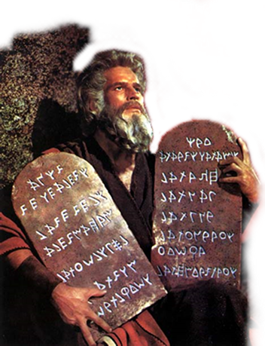
A study of The Law
“Remember
The Sabbath Day
And Keep It Holy”

Slide 2
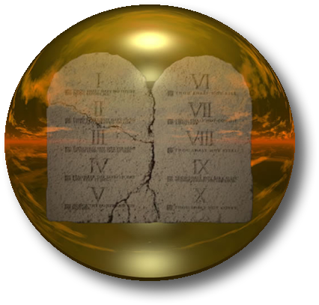
A study of The Law
That God Gave Through Moses
"A covenant is a binding contract between two parties, both of whom have obligations specified in the covenant." (Fee and Stuart. 150)
Israel
God’s chosen people
Separated from the world as a nation -
The Law
613 Commands
Toward God
Toward Others
National / Civil
God
You shall keep
(Exodus 19:5-6; 24:3-8; Deut. 5:1-3)
Notes:
To understand the laws themselves, we must understand the nature of this covenant. The New Testament (as well as the United States Constitution) provides for the separation of church and state (civil government) (Matthew 22:15-22; John 18:33-36). But Old Testament Israel was a theocracy; church and state were combined. The Law told them how to worship God (e.g., Leviticus chapters 1 - 7), but it also organized their armies for war (e.g., Numbers chapter 2).
Old Testament law was very different from our civil law today. Most modern nations have a huge body of law intended to regulate every conceivable civil issue. Thus, as society changes, new laws are enacted yearly. The Old Testament "do's" and "don'ts" (e.g., Leviticus 19:9-14) were laws by example. They were intended to teach principles that could be applied to parallel situations. Thus, the Law once given from God to Israel did not have to be amended as society changed.
The Law also contained what is called "case law." These were regulations that applied in certain situations (cases) (e.g., Deuteronomy 15:12-17).
It is very difficult for us to see why God gave Israel some of its laws. For example, Moses commanded, "You shall not boil a young goat in its mother's milk." (Deuteronomy 14:21) Why? you might ask. Historians tell us this was a heathen magical practice intended to increase the production of flocks. This was apparently a "for example" law prohibiting Israel from practicing magic as the superstitious pagans around them did (cf. Deuteronomy 18:9-12).

Slide 3
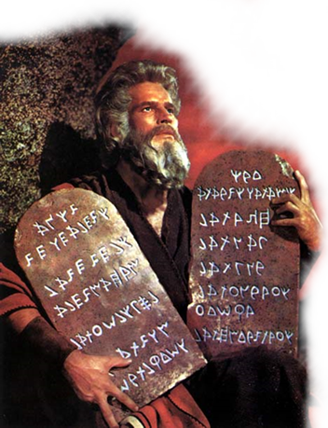
A study of The Law
That God Gave Through Moses
God's essential nature is unchanging and unchangeable (Malachi 3:6; James 1:17),
God's law is adapted to man's needs, therefore specific laws have changed in different dispensations (Gen. 6-9; 17:10; Exo 20; Mat. 17:1-5; Heb. 1:1,2; 7:12).
There are principles behind the law God gave through Moses which will help us understand God and how to please Him. (Rom. 15:4; Gal. 3:24; 2 Tim 3:15)

Slide 4
A study of The Law
Two Major Divisions
Love God
1. You shall have no other gods before Me.
Love Man
5. Honor your father and your mother.
2. You shall not make for yourself a carved image.
3. You shall not take the name of the Lord your God in vain.
4. Remember the Sabbath day, to keep it holy.
6. You shall not murder.
7. You shall not commit adultery.
8. You shall not steal.
9. You shall not bear false witness.
10. You shall not covet.
Exodus 20:1-17 Deuteronomy 5:1-22
Notes:
On Tuesday of the week Jesus was crucified, as the Master taught in the Temple, various Jewish politico-religious parties sent representatives to try to entrap Him in His words with difficult questions that they might find something to use against Him. After a delegation of Pharisees and Herodians (Politics does indeed make strange bed fellows) had failed (Matthew 22:15-22), and a group of Sadducees had been rebuffed (Matthew 22:23-33), the Pharisees held a pow wow and selected a lawyer to ask him a difficult question (Matthew 22:34-40; Mark 12:28-34). Having failed to entrap the Lord with specific debaters' questions, they tried a favorite legal trick. Throw out a question general enough and controversial enough that they would be able to use something He said as evidence against Him - a legal fishing trip. The Jews had codified the Mosaic covenant into a precise number of laws and endlessly debated which were the most important. They thought to embroil Jesus in their own disputes.
The question: Which is the most important law, the law which stands above all the rest? One might expect the Master to quote one of the Ten Commandments. No, He quoted Deuteronomy 6:4-5:
Hear, O Israel: The Lord our God, the Lord is one! 'You shall love the Lord your God with all your heart, with all your soul, and with all your strength.'
Then the Lord went beyond their question:
"'And the second is like it: 'You shall love your neighbor as yourself.'" (Matthew 22:39; Leviticus 19:18).
The scribe/lawyer, struck by the wisdom of the Master's reply, candidly acknowledged Jesus had spoken truly and even gave the reasons. There is only one God. To love Him with all our beings will lead us to obey with all our hearts His every command (Deuteronomy 10:12-13; John 14:15; 1 John 5:3). To love our neighbors as ourselves will cause us to fulfill every command involving our relationship with our fellow men (Romans 13:8-10; 1 John 3:16-18). The purpose of the law was to make Israel righteous in God's sight that they might live (Deuteronomy 6:24-25). Had they fully obeyed that law, the animal sacrifices of sin the law demanded, which brought only outward purity (Hebrews 9:13-14; 10:4), would have been unnecessary. Therefore, these two commandments are both the basis of the law and superior in importance to all animal sacrifices.
This lawyer's honest reply and correct understanding of the law rendered him close to being ready to enter the kingdom, where the true righteousness of God is to be found (Matthew 4:23; 5:20; Romans 14:17). These principles yet apply under the covenant of Christ. Above all else we must love God and our neighbors (Romans 13:8-10; 1 Corinthians 13:13;16:14; Galatians 5:14; Colossians 3:14; 1 Timothy 1:5-6; James 2:8; 1 Peter 4:8; 1 John 2:5; 4:8).
Thus, the law has two primary divisions: love God and love your neighbor. And the Ten Commandments are divided into these two categories. The first four commandments regulated the Jews' relationship with God. Commandments six through ten dealt with human to human relationships, (which had direct bearing on one’s relationship to God, D.M.). To keep the first four was to be godly. To keep the latter six was to be righteous (cf. Romans 1:18).

Slide 5
A study of The Law
“Remember The Sabbath Day”
Exodus 20:8-11 (NKJV)
⁸ "Remember the Sabbath day, to keep it holy. ⁹ Six days you shall labor and do all your work, ¹⁰ but the seventh day is the Sabbath of the LORD your God. In it you shall do no work: you, nor your son, nor your daughter, nor your male servant, nor your female servant, nor your cattle, nor your stranger who is within your gates.
Deuteronomy 5:12-15

Slide 6
A study of The Law
“Remember The Sabbath Day”
Exodus 20:8-11 (NKJV)
¹¹ For in six days the LORD made the heavens and the earth, the sea, and all that is in them, and rested the seventh day. Therefore the LORD blessed the Sabbath day and hallowed it.
Deuteronomy 5:12-15

Slide 7
A study of The Law
“Remember The Sabbath Day”
Sabbath
Vine’s - Verb - Strong's # <H7673> ‏שָׁבַת‎, shābat - "to rest, cease." - - - Noun - Strong's # <H7676> ‏שַׁבָּת‎, shabbāt - "the sabbath." The verb shābat is the root of shabbāt:
Smith’s Bible Dictionary - (Hebrew, shabbath). "A day of rest", from shabath, "to cease to do to," "to rest").
Notes:
Hebrew Strong's Number: 7673
Hebrew Word: ‏שָׁבַת‎
Transliteration: shābat
Phonetic Pronunciation:shaw-bath'
Root: a primitive root
Cross Reference: TWOT - 2323, 2323c
Part of Speech: v
Vine's Words: Cease (To)
Usage Notes:
English Words used in KJV:
cease 47 rest 11 away 3 fail 2 celebrate 1 misc 7 [Total Count: 71]
a primitive root; to repose, i.e. desist from exertion; used in many implication relations (causative, figurative or specific) :- (cause to, let, make to) cease, celebrate, cause (make) to fail, keep (sabbath), suffer to be lacking, leave, put away (down), (make to) rest, rid, still, take away.
— Strong's Talking Greek & Hebrew Dictionary

Slide 8
A study of The Law
“Remember The Sabbath Day”
The Sabbath is the seventh day of the week - (verse 14; cf. Exodus 20:10).
It is measured "from evening to evening," - i.e., sunset Friday to sunset Saturday - (Leviticus 23:32).
The Lord chose this day because He rested from His work of creation on the seventh day - (Exodus 20:11).
It was a weekly memorial of Israel's deliverance from Egypt - (Deut. 5:15).

Slide 9
A study of The Law
“Remember The Sabbath Day”
There were many other “Sabbaths” - (cf. Lev. 19:3; 26:2).
Connected with the five sacred festivals - e.g., the Passover, First-Fruits, etc. – (Lev. 23:7-8; 21; 24-25; 32; 39).
Every seventh year - The land was to lie uncultivated and all debts canceled - (Lev. 25:1-4),
Each fiftieth year – a Year of Jubilee – return to lands and families - (Lev. 25:8-13; Deut. 15:2).

Slide 10
A study of The Law
“Remember The Sabbath Day”
All servile labor was forbidden, - (whether of men, women, children, servants, strangers or beasts)
No fire could be kindled (Exodus 35:3),
No cooking was to be done (Exodus 16:5,23).
Everyone was to stay at home (Exodus 16:29).
Two lambs were to be offered to the Lord in the morning and two in the evening (Numbers 28:1-10).
The penalty for it's violation was death (Exodus 31:15-16; 35:2; Numbers 15:32-36).

Slide 11
A study of The Law
“Remember The Sabbath Day”
To Whom Was It Given?
What Was Its purpose?
What Was To Be Its Duration?
Its Relevance To Us?

Slide 12
“Remember The Sabbath Day”
To Whom Was It Given?
Exodus 16:23-30 (NKJV)
²³ Then he said to them, "This is what the LORD has said: 'Tomorrow is a Sabbath rest, a holy Sabbath to the LORD . . . ²⁹ See! For the LORD has given you the Sabbath; therefore He gives you on the sixth day bread for two days. Let every man remain in his place; let no man go out of his place on the seventh day." ³⁰ So the people rested on the seventh day.
Notes:
Exodus 16:29 (NKJV) ²⁹ See! For the LORD has given you the Sabbath; therefore He gives you on the sixth day bread for two days. Let every man remain in his place; let no man go out of his place on the seventh day."

Slide 13
“Remember The Sabbath Day”
To Whom Was It Given?
Nehemiah 9:14 (NKJV)
¹⁴ You made known to them Your holy Sabbath, And commanded them precepts, statutes and laws, By the hand of Moses Your servant.
(Which was not made known to others, and was peculiar to the Jewish nation, and a privilege granted to them, to have rest corporeal and spiritual, typical of the rest in Christ – John Gill)
Notes:
Of the commandments, that concerning the Sabbath is specially mentioned, and spoken of as a benefit bestowed by God upon the Israelites, as a proclamation of His holy Sabbath, inasmuch as the Israelites were on the Sabbath to share in the rest of God; see rem. on Exo_20:9-11. c.
Keil & Delitzsch
Neh 9:14 And madest known unto them thy holy sabbath,.... Which was not made known to others, and was peculiar to the Jewish nation, and a privilege granted to them, to have rest corporeal and spiritual, typical of the rest in Christ:
Yādaʿ in the intensive and causative stems is used to express a particular concept of revelation. God did not make Himself known by His name Jehovah to Abraham, Isaac, and Jacob. He did reveal that name to them, that He was the God of the covenant. — Vine's Expository Dictionary of Old and New Testament Words

Slide 14
“Remember The Sabbath Day”
To Whom Was It Given?
Ezekiel 20:10-12 (NKJV)
¹⁰ "Therefore I made them go out of the land of Egypt and brought them into the wilderness. ¹¹ And I gave them My statutes and showed them My judgments, 'which, if a man does, he shall live by them.' ¹² Moreover I also gave them My Sabbaths, to be a sign between them and Me, that they might know that I am the LORD who sanctifies them.
Notes:
to be a sign between me and them; of his being their God, and they being his people; of his favour and good will to them, and of the, obligations they were under to him; of his having separated and distinguished them from all other nations of the world; these sabbaths being only given to them as a memorial of their deliverance out of Egypt, and as a pledge of their entering into the land of rest; and of the future rest to be enjoyed by Christ, and in heaven, to all eternity; for these were shadows of things to come, Col_2:16;

Slide 15
“Remember The Sabbath Day”
What Was The Purpose?
A sign between God and Israel – after six days God ceased His labor - (Eze. 20:10-12; Ex. 30:13,17; cf. Gen 2:2)
Because God delivered Israel from Egypt – A memorial of that event – they were slaves – (Deut. 5:15)
Holy (Set apart) for them – To be a day of rest – to be set apart to the Lord - (Ex. 31:13-17; Mark 2:27).
Notes:
to be a sign between me and them; of his being their God, and they being his people; of his favour and good will to them, and of the, obligations they were under to him; of his having separated and distinguished them from all other nations of the world; these sabbaths being only given to them as a memorial of their deliverance out of Egypt, and as a pledge of their entering into the land of rest; and of the future rest to be enjoyed by Christ, and in heaven, to all eternity; for these were shadows of things to come, Col_2:16;

Slide 16
“Remember The Sabbath Day”
What Was The Purpose?
How could it be a sign between God and Israel if everyone since creation had the same sign?
How could it be a memorial of an event before that event occurred?

Slide 17
“Remember The Sabbath Day”
What Was Its Duration?
Exodus 31:16-17 (NKJV)
¹⁶ Therefore the children of Israel shall keep the Sabbath, to observe the Sabbath throughout their generations as a perpetual covenant. ¹⁷ It is a sign between Me and the children of Israel forever; for in six days the LORD made the heavens and the earth, and on the seventh day He rested and was refreshed.' "
Notes:
The Sabbath was given only to Israel.
Deuteronomy 5:15 - Israel (v1) was a slave in the land of Egypt, God brought them out and commanded them to keep the Sabbath day.
Exodus 31:13,16,17 - The Sabbath was a sign between God and Israel like circumcision was (Gen. 17; Rom. 4:11). How could it have been a sign between God and Israel if He had given the same law to other nations too? Would a ring be a sign of a man's special relationship with his wife, if he gave similar rings to many other women?

Slide 18
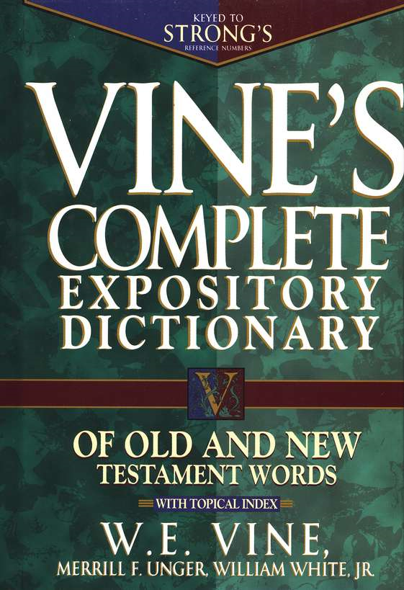
“Remember The Sabbath Day”
What Was Its Duration?
Perpetual - Forever <H5769> עוֹלָם‎, ʿôlām
“Eternity" in the sense of not being limited to the present
With the preposition 'ad, the word can mean "into the indefinite future"
In the largest number of its occurrences. . . with the preposition le. . . - "simple duration."

Slide 19
“Remember The Sabbath Day”
What Was Its Duration?
Exodus 27:21 (NKJV)
²¹ In the tabernacle of meeting, outside the veil which is before the Testimony, Aaron and his sons shall tend it from evening until morning before the LORD. It shall be a statute forever (עוֹלָם‎ ʿôlām)
to their generations on behalf of the children of Israel.
If these practices could cease though they were "forever," why cannot the Sabbath have ceased?

Slide 20
“Remember The Sabbath Day”
What Was Its Duration?
Exodus 40:15 (NKJV)
¹⁵ You shall anoint them, as you anointed their father, that they may minister to Me as priests; for their anointing shall surely be an everlasting (עוֹלָם‎ ʿôlām) priesthood throughout their generations."
If these practices could cease though they were "forever," why cannot the Sabbath have ceased?

Slide 21
“Remember The Sabbath Day”
What Was Its Duration?
The Passover - (Ex. 12:14);
Incense - (Ex. 30:8);
Feast days - (Lev. 23:14,21,31,41);
Animal sacrifices (Lev. 16:29-34; 6:19-23; 2 Chron. 2:4);
Levitical priesthood - (Ex. 40:15; 29:9,26-28; 28:40-43; Num. 25:13; Deut. 18:5);
Tabernacle worship - (Ex. 27:21; 30:8,17-21; Lev. 24:5-9);
Circumcision - (Gen. 17:9-14);
If these practices could cease though they were "forever," why cannot the Sabbath have ceased?

Slide 22
“Remember The Sabbath Day”
What Was Its Duration?
Exodus 31:16,17
to observe the Sabbath . . . as a perpetual (עוֹלָם‎, ʿôlām) covenant. - 31:16
a sign between Me and the children of Israel forever (עוֹלָם‎, ʿôlām) – 31:17
“throughout their generations”
31:16

Slide 23
“Remember The Sabbath Day”
What Was Its Duration?
Romans 14:5-6 (NKJV)
⁵ One person esteems one day above another; another esteems every day alike. Let each be fully convinced in his own mind. ⁶ He who observes the day, observes it to the Lord; and he who does not observe the day, to the Lord he does not observe it. He who eats, eats to the Lord, for he gives God thanks; and he who does not eat, to the Lord he does not eat, and gives God thanks.

Slide 24
“Remember The Sabbath Day”
What Was Its Duration?
Galatians 4:1-11 (NKJV)
. . . . ⁹ But now after you have known God, or rather are known by God, how is it that you turn again to the weak and beggarly elements, to which you desire again to be in bondage? ¹⁰ You observe days and months and seasons and years. ¹¹ I am afraid for you, lest I have labored for you in vain.

Slide 25
“Remember The Sabbath Day”
What Was Its Duration?
Colossians 2:14-17 (NKJV)
¹⁴ having wiped out the handwriting of requirements that was against us, which was contrary to us. And He has taken it out of the way, having nailed it to the cross. ¹⁵ Having disarmed principalities and powers, He made a public spectacle of them, triumphing over them in it. ¹⁶ So let no one judge you in food or in drink, or regarding a festival or a new moon or sabbaths, ¹⁷ which are a shadow of things to come, but the substance is of Christ.

Slide 26
“Remember The Sabbath Day”
What Was Its Duration?
Ephesians 2:14-18 (NKJV)
¹⁴ For He Himself is our peace, who has made both one, and has broken down the middle wall of separation, ¹⁵ having abolished in His flesh the enmity, that is, the law of commandments contained in ordinances, so as to create in Himself one new man from the two, thus making peace, ¹⁶ and that He might reconcile them both to God in one body through the cross, thereby putting to death the enmity.

Slide 27
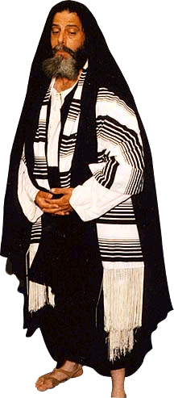
“Remember The Sabbath Day”
What Was Its Duration?
THE LAW

Slide 28
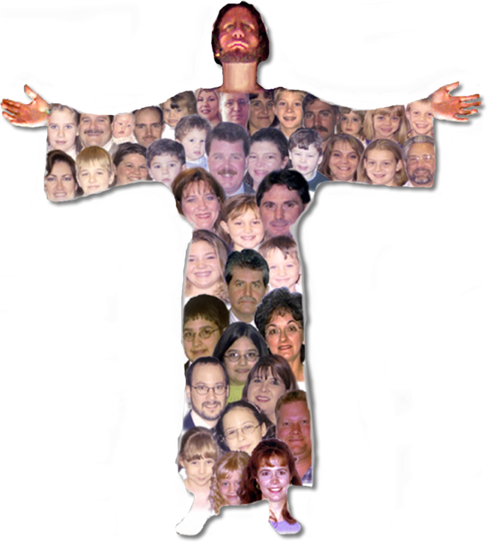
“Remember The Sabbath Day”
What Was Its Duration?
Ephesians 2:14-16 (NKJV)
¹⁴ For He Himself is our peace, who has made both one, and has broken down the middle wall of separation, ¹⁵ having abolished in His flesh the enmity, that is, the law of commandments contained in ordinances, so as to create in Himself one new man from the two, thus making peace, ¹⁶ and that He might reconcile them both to God in one body through the cross, thereby putting to death the enmity.

Slide 29
“Remember The Sabbath Day”
What Was Its Duration?
Christian
Spiritual Circumcision – Keep Law of Christ
Jews - Circumcision - Keep laws given to them
Gentiles - Uncircumcision – do not keep laws not given to them

Slide 30
“Remember The Sabbath Day”
What Was Its Relevance?
The value of worship – Mal 1:13; John 4:24; Acts 20:7
The value of work – Eccl. 9:10; Eph. 4:28
The value of rest – Mark 2:27;
What we have in Christ – Mat 11:28-30; Phili 4:6-9
Exodus 20:8-10 (NKJV)
"Remember the Sabbath day, to keep it holy.
[9] Six days you shall labor and do all your work,
[10] but the seventh day is the Sabbath of the Lord your God. In it you shall do no work

Slide 31
A study of The Law
“Remember The Sabbath Day”
To Whom Was It Given?
What Was Its purpose?
What Was To Be Its Duration?
Its Relevance To Us?

Slide 33
A study of The Law
That God Gave Through Moses
Charts by Don McClain
Prepared July 21-24, 2010
Preached July 25, 2010
West 65th Street church of Christ
P.O. Box 190062
Little Rock AR 72219
501-568-1062
Prepared using PPT 2010
Email – donmcclain@sbcglobal.net
More PPT & Audio Sermons:
http://w65stchurchofchrist.org/donmaccla/2010SermonPage.html
Note – Many of the transition effects used in this presentation may be lost using PPT 2007 Viewer
http://www.microsoft.com/downloads/details.aspx?FamilyID=cb9bf144-1076-4615-9951-294eeb832823&displaylang=en

