Slide 1
Justification Found Through The Gospel, Not The Law of Moses – 3:21-8:39
Romans 3:21-4:25
Lesson 4
The Righteousness of God –
Not By The Law - But In Christ

Slide 2
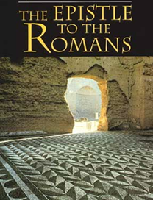
Lesson 4 – Romans 3:21-4:25
The Gospel – God’s Power To Save Man
The Gospel of Christ is the ONLY hope for sinful man – (1:16,17; 3:21-23)
The sinful condition of the whole world and its need for salvation – (1:18-3:20)
All are justified by faith apart from the law – (3:21 - 7:25)
In this study we will see the proposition stated and OT examples given – (3:21 - 4:25)

Slide 3
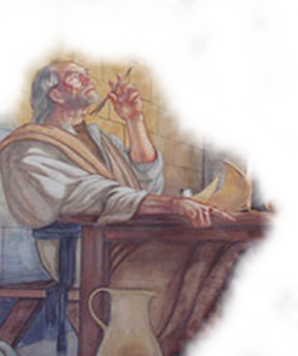
Lesson 4 – Romans 3:21-4:25
The Gospel – God’s Righteousness Revealed
The Proposition Stated - 3:21-31
The righteousness of God apart from the law is revealed (21)
Found ONLY through faith in Christ & is available to all (22)
All have sinned – therefore justification is by grace (23,24)
Made possible by the giving of God’s Son - Jesus (25-26)
The Law of Faith excludes boasting (27-31)
Notes:
Romans 3:21-31 (NKJV) ²¹ But now the righteousness of God apart from the law is revealed, being witnessed by the Law and the Prophets, ²² even the righteousness of God, through faith in Jesus Christ, to all and on all who believe. For there is no difference; ²³ for all have sinned and fall short of the glory of God, ²⁴ being justified freely by His grace through the redemption that is in Christ Jesus, ²⁵ whom God set forth as a propitiation by His blood, through faith, to demonstrate His righteousness, because in His forbearance God had passed over the sins that were previously committed, ²⁶ to demonstrate at the present time His righteousness, that He might be just and the justifier of the one who has faith in Jesus. ²⁷ Where is boasting then? It is excluded. By what law? Of works? No, but by the law of faith. ²⁸ Therefore we conclude that a man is justified by faith apart from the deeds of the law. ²⁹ Or is He the God of the Jews only? Is He not also the God of the Gentiles? Yes, of the Gentiles also, ³⁰ since there is one God who will justify the circumcised by faith and the uncircumcised through faith. ³¹ Do we then make void the law through faith? Certainly not! On the contrary, we establish the law.

Slide 4
Lesson 4 – Romans 3:21-4:25
The Gospel – God’s Righteousness Revealed
Old Testament Examples – 4:1-25
Abraham
What is discovered by examining the justification of the physical forefather of the Jews - (4:1; John 8:39)
Abraham was not justified by boastful works – (4:2; Eph. 2:8.9)
Abraham was not righteous because he deserved it – rather he “believed God” and was COUNTED as righteous – (4:3; Gen. 15:6; Gal. 3:6; James 2:23)

Slide 5
Lesson 4 – Romans 3:21-4:25
The Gospel – God’s Righteousness Revealed
Old Testament Examples – 4:1-25
Paul clearly defines the type of works under consideration - (4:4; 3:27,28; 9:32; 11:6; Gal. 3:10-12)
“Works” is not referring to humble submission to God’s stated will – (4:5; 6:16-18; Mt. 7:21-23)
The system by which men are justified depends on “forgiveness” not “merit”– (4:6-8; Ps. 32:1,2; Acts 2:38; Col 2:12-14)

Slide 6
Lesson 4 – Romans 3:21-4:25
The Gospel – God’s Righteousness Revealed
Old Testament Examples – 4:1-25
Can Gentiles receive this blessedness? (4:9; 3:29,30; 9:24; 10:12,13; 15:8-19; Gal. 3:14,26-28)
Abraham was counted as righteous before the giving of circumcision – (4:10-12,15; Gen. 15:6; 17:10)
Promise of righteousness not through the Law but through faith – (4:13-18; Gal. 3:16-29)
We must have the same kind of faith as Abraham – (4:12-18; John 8:39,40)

Slide 7
Lesson 4 – Romans 3:21-4:25
The Gospel – God’s Righteousness Revealed
Old Testament Examples – 4:1-25
Abraham’s Faith exemplified
Not weak – but strong – believing that with God the impossible is possible - (4:19,20)
Abraham was FULLY convinced that God was not only able to keep His promises – but that He would – (4:20-21; Gen. 18:14; Mat. 19:26; Luke 1:37; 2 Tim 1:12; Heb. 11:13)
Therefore it was accounted to Him for righteousness – (4:22)

Slide 8
Lesson 4 – Romans 3:21-4:25
The Gospel – God’s Righteousness Revealed
Old Testament Examples – 4:1-25
Recorded For Us
Men are “counted righteous” today by the same principle – if we believe on God who raised the Lord Jesus Christ from the dead - (4:23,24; Rom. 10:9-17; Mk 16:16; Acts 2:22-38)
Jesus died because of our sins and was raised for our justification – (4:25; 3:25; 5:6-8; 8:3; Is. 53:5,6,10-12; 2 Cor. 5:21; Gal. 1:4; 3:13)

Slide 9
Lesson 4 – Romans 3:21-4:25
The Gospel – God’s Righteousness Revealed
Old Testament Examples – 4:1-25
Romans 4:12 (NKJV)
and the father of circumcision to those who not only are of the circumcision, but who also walk in the steps of the faith which our father Abraham had while still uncircumcised.
Genesis 12:4
Hebrews 11:8
Genesis 15:6
Romans 4:1-4,12
Genesis 13:4
Hebrews 11:9
Genesis 22:3,12,16,18
James 2:21-25

Slide 10
God’s Means of Making Men Righteous Is Not By The Law – But Through The Gospel
Romans 1:16,17
¹⁶For I am not ashamed of the gospel, for it is the power of God for salvation to everyone who believes, to the Jew first and also to the Greek. ¹⁷For in it the righteousness of God is revealed from faith for faith, as it is written, "The righteous shall live by faith.“

Slide 12
Charts by Don McClain
Prepared February 13,14, 2010
Preached February 14, 2010
West 65th Street church of Christ
Little Rock AR 72209
501-568-1062
Prepared using PPT 2010 Beta
Email – donmcclain@sbcglobal.net
Note – Many of the transition effects used in this presentation are lost using PPT 2007 Viewer
To view transitions you can download Office 2010 Beta for free:
http://www.microsoft.com/office/2010/en/default.aspx

