Slide 1
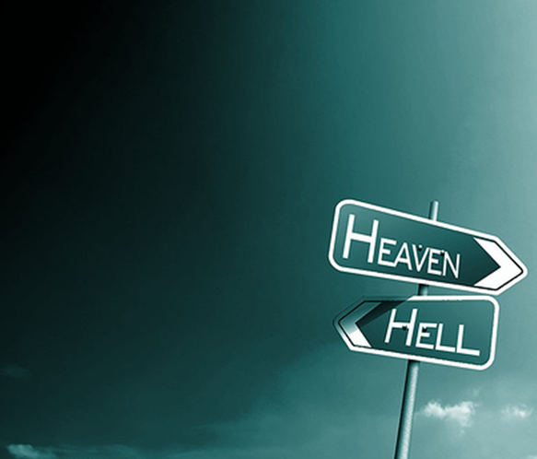
Decisions
Determine
Destiny

Slide 2
Decisions Determine Destiny
There is a choice you have to make, In everything you do. And you must always keep in mind, The choice you make makes you.
In the little booklet, Bits and Pieces,

Slide 3
Decisions Determine Destiny
Our lives are made of choices –
Some have little to no bearing on our destiny – (color of suit / dress, color of shoes, which restaurant for lunch, Mac or PC, Verizon or AT&T, etc. . . .)

Slide 4
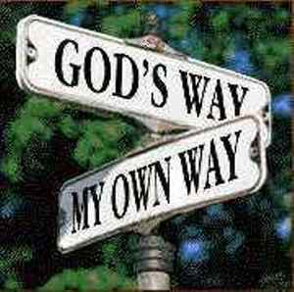
Decisions Determine Destiny
Many choices have far reaching and eternal consequences . . .
We are free to choose – but we are not free not to choose . . .
We are not free to choose the consequences of our choices . . .

Slide 5
Decisions Determine Destiny
Things that Should NOT Govern Our Decision Making –
Temporal Things -
Human Wisdom -
Tradition -
Feelings -

Slide 6
Decisions Determine Destiny
1 Kings 18:21 (NKJV) ²¹ And Elijah came to all the people, and said, "How long will you falter between two opinions? If the LORD is God, follow Him; but if Baal, follow him." But the people answered him not a word.

Slide 7
Decisions Determine Destiny
Joshua 24:14-15 (NKJV) ¹⁴ "Now therefore, fear the LORD, serve Him in sincerity and in truth, and put away the gods which your fathers served on the other side of the River and in Egypt. Serve the LORD! ¹⁵ And if it seems evil to you to serve the LORD, choose for yourselves this day whom you will serve, whether the gods which your fathers served that were on the other side of the River, or the gods of the Amorites, in whose land you dwell. But as for me and my house, we will serve the LORD."

Slide 8
Decisions Determine Destiny
Deuteronomy 30:15-20 (NKJV) ¹⁵ "See, I have set before you today life and good, death and evil, ¹⁶ in that I command you today to love the LORD your God, to walk in His ways, and to keep His commandments, His statutes, and His judgments, that you may live and multiply; and the LORD your God will bless you in the land which you go to possess. ¹⁷ But if your heart turns away so that you do not hear, and are drawn away, and worship other gods and serve them,
Notes:
1. Read: Deuteronomy 30:19, 20
2. About the Text:
1) For forty years the Israelites have been wandering in the wilderness.
2) For their disobedience, God decreed that every one above the age of twenty with the exception of Joshua and Caleb would die in the wilderness (Numbers 14:29-38).
3) Now, that generation had passed away. There was a new generation standing before Moses.
4) And his last act as their spiritual leader was to rehearse to them all the things of the law.
5) The book of Deuteronomy is the book in which Moses does this (Deuteronomy 5:1).
6) In chapter 30, Moses exhorts the Israelites to obey Jehovah.
7) He tells them that God’s commands are not hard to keep (Deuteronomy 30:11-14).
8) He then lays before them the decision (read Deuteronomy 30:15-20).

Slide 9
Decisions Determine Destiny
Deuteronomy 30:15-20 (NKJV) ¹⁸ I announce to you today that you shall surely perish; you shall not prolong your days in the land which you cross over the Jordan to go in and possess. ¹⁹ I call heaven and earth as witnesses today against you, that I have set before you life and death, blessing and cursing; therefore choose life, that both you and your descendants may live;

Slide 10
Decisions Determine Destiny
Deuteronomy 30:15-20 (NKJV) ²⁰ that you may love the LORD your God, that you may obey His voice, and that you may cling to Him, for He is your life and the length of your days; and that you may dwell in the land which the LORD swore to your fathers, to Abraham, Isaac, and Jacob, to give them."

Slide 11
Decisions Determine Destiny
Matthew 7:13-14 (NKJV) ¹³ "Enter by the narrow gate; for wide is the gate and broad is the way that leads to destruction, and there are many who go in by it. ¹⁴ Because narrow is the gate and difficult is the way which leads to life, and there are few who find it.

Slide 12
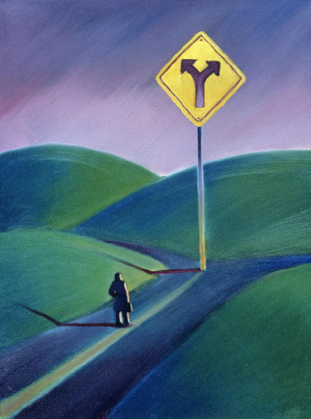
Decisions Determine Destiny
There Are But Two Ways
The Right Way OR The Wrong Way
The way to life - John 14:6; 8:32
The Gospel – Gal. 1:6-9; Rom 1:16
True Doctrine – 2 John 9; Acts 2:42
The one body – Acts 2:47; Eph. 4:5
The Standard – 2 Tim. 3:16; 4:2
Any other way - Acts 4:12
Any other gospel – Gal. 1:6-9
Any other doctrine – Mat. 15:7-9
Any other body – 1 Cor. 1:10-12
Any other Standard – Heb 13:9
Notes:
Ephesians 4:4-6 (NKJV) ⁴ There is one body and one Spirit, just as you were called in one hope of your calling; ⁵ one Lord, one faith, one baptism; ⁶ one God and Father of all, who is above all, and through all, and in you all.

Slide 13
Decisions Determine Destiny
There Are But Two Attitudes
Godly Attitude OR Ungodly Attitude
Matthew 5:3-10 (NKJV) ³ "Blessed are the poor in spirit, For theirs is the kingdom of heaven. ⁴ Blessed are those who mourn, For they shall be comforted. ⁵ Blessed are the meek, For they shall inherit the earth. ⁶ Blessed are those who hunger and thirst for righteousness, For they shall be filled. ⁷ Blessed are the merciful, For they shall obtain mercy. ⁸ Blessed are the pure in heart, For they shall see God. ⁹ Blessed are the peacemakers, For they shall be called sons of God. ¹⁰ Blessed are those who are persecuted for righteousness' sake, For theirs is the kingdom of heaven.
Notes:
Matthew 5:3-10 (NKJV) ³ "Blessed are the poor in spirit, For theirs is the kingdom of heaven. ⁴ Blessed are those who mourn, For they shall be comforted. ⁵ Blessed are the meek, For they shall inherit the earth. ⁶ Blessed are those who hunger and thirst for righteousness, For they shall be filled. ⁷ Blessed are the merciful, For they shall obtain mercy. ⁸ Blessed are the pure in heart, For they shall see God. ⁹ Blessed are the peacemakers, For they shall be called sons of God. ¹⁰ Blessed are those who are persecuted for righteousness' sake, For theirs is the kingdom of heaven.

Slide 14
Decisions Determine Destiny
There Are But Two Attitudes
Godly Attitude OR Ungodly Attitude
Humble –
Philippians 2:3-4 (NKJV) ³ Let nothing be done through selfish ambition or conceit, but in lowliness of mind let each esteem others better than himself. ⁴ Let each of you look out not only for his own interests, but also for the interests of others.
Notes:
Matthew 5:3-10 (NKJV) ³ "Blessed are the poor in spirit, For theirs is the kingdom of heaven. ⁴ Blessed are those who mourn, For they shall be comforted. ⁵ Blessed are the meek, For they shall inherit the earth. ⁶ Blessed are those who hunger and thirst for righteousness, For they shall be filled. ⁷ Blessed are the merciful, For they shall obtain mercy. ⁸ Blessed are the pure in heart, For they shall see God. ⁹ Blessed are the peacemakers, For they shall be called sons of God. ¹⁰ Blessed are those who are persecuted for righteousness' sake, For theirs is the kingdom of heaven.

Slide 15
Decisions Determine Destiny
There Are But Two Attitudes
Godly Attitude OR Ungodly Attitude
Humble –
Penitent -
2 Corinthians 7:10 (NKJV) ¹⁰ For godly sorrow produces repentance leading to salvation, not to be regretted; but the sorrow of the world produces death.
Notes:
Matthew 5:3-10 (NKJV) ³ "Blessed are the poor in spirit, For theirs is the kingdom of heaven. ⁴ Blessed are those who mourn, For they shall be comforted. ⁵ Blessed are the meek, For they shall inherit the earth. ⁶ Blessed are those who hunger and thirst for righteousness, For they shall be filled. ⁷ Blessed are the merciful, For they shall obtain mercy. ⁸ Blessed are the pure in heart, For they shall see God. ⁹ Blessed are the peacemakers, For they shall be called sons of God. ¹⁰ Blessed are those who are persecuted for righteousness' sake, For theirs is the kingdom of heaven.

Slide 16
Decisions Determine Destiny
There Are But Two Attitudes
Godly Attitude OR Ungodly Attitude
Humble –
Penitent -
Submissive –
James 4:7-8 (NKJV) ⁷ Therefore submit to God. Resist the devil and he will flee from you. ⁸ Draw near to God and He will draw near to you. Cleanse your hands, you sinners; and purify your hearts, you double-minded.
Notes:
Matthew 5:3-10 (NKJV) ³ "Blessed are the poor in spirit, For theirs is the kingdom of heaven. ⁴ Blessed are those who mourn, For they shall be comforted. ⁵ Blessed are the meek, For they shall inherit the earth. ⁶ Blessed are those who hunger and thirst for righteousness, For they shall be filled. ⁷ Blessed are the merciful, For they shall obtain mercy. ⁸ Blessed are the pure in heart, For they shall see God. ⁹ Blessed are the peacemakers, For they shall be called sons of God. ¹⁰ Blessed are those who are persecuted for righteousness' sake, For theirs is the kingdom of heaven.

Slide 17
Decisions Determine Destiny
There Are But Two Attitudes
Godly Attitude OR Ungodly Attitude
Humble –
Penitent -
Submissive –
Seekers of Truth –
Psalms 63:1 (NKJV) ¹ A Psalm of David when he was in the wilderness of Judah. O God, You are my God; Early will I seek You; My soul thirsts for You; My flesh longs for You In a dry and thirsty land Where there is no water.
Notes:
Matthew 5:3-10 (NKJV) ³ "Blessed are the poor in spirit, For theirs is the kingdom of heaven. ⁴ Blessed are those who mourn, For they shall be comforted. ⁵ Blessed are the meek, For they shall inherit the earth. ⁶ Blessed are those who hunger and thirst for righteousness, For they shall be filled. ⁷ Blessed are the merciful, For they shall obtain mercy. ⁸ Blessed are the pure in heart, For they shall see God. ⁹ Blessed are the peacemakers, For they shall be called sons of God. ¹⁰ Blessed are those who are persecuted for righteousness' sake, For theirs is the kingdom of heaven.

Slide 18
Decisions Determine Destiny
There Are But Two Attitudes
Godly Attitude OR Ungodly Attitude
Humble –
Penitent -
Submissive –
Seekers of Truth –
Loving –
Colossians 3:12-14 (NKJV) ¹² Therefore, as the elect of God, holy and beloved, put on tender mercies, kindness, humility, meekness, longsuffering; ¹³ bearing with one another, and forgiving one another, if anyone has a complaint against another; even as Christ forgave you, so you also must do. ¹⁴ But above all these things put on love, which is the bond of perfection.
Notes:
Matthew 5:3-10 (NKJV) ³ "Blessed are the poor in spirit, For theirs is the kingdom of heaven. ⁴ Blessed are those who mourn, For they shall be comforted. ⁵ Blessed are the meek, For they shall inherit the earth. ⁶ Blessed are those who hunger and thirst for righteousness, For they shall be filled. ⁷ Blessed are the merciful, For they shall obtain mercy. ⁸ Blessed are the pure in heart, For they shall see God. ⁹ Blessed are the peacemakers, For they shall be called sons of God. ¹⁰ Blessed are those who are persecuted for righteousness' sake, For theirs is the kingdom of heaven.

Slide 19
Decisions Determine Destiny
There Are But Two Attitudes
Godly Attitude OR Ungodly Attitude
Humble –
Penitent -
Submissive –
Seekers of Truth –
Loving –
Sincere –
James 4:8 (NKJV) ⁸ Draw near to God and He will draw near to you. Cleanse your hands, you sinners; and purify your hearts, you double-minded.
Notes:
Matthew 5:3-10 (NKJV) ³ "Blessed are the poor in spirit, For theirs is the kingdom of heaven. ⁴ Blessed are those who mourn, For they shall be comforted. ⁵ Blessed are the meek, For they shall inherit the earth. ⁶ Blessed are those who hunger and thirst for righteousness, For they shall be filled. ⁷ Blessed are the merciful, For they shall obtain mercy. ⁸ Blessed are the pure in heart, For they shall see God. ⁹ Blessed are the peacemakers, For they shall be called sons of God. ¹⁰ Blessed are those who are persecuted for righteousness' sake, For theirs is the kingdom of heaven.

Slide 20
Decisions Determine Destiny
There Are But Two Attitudes
Godly Attitude OR Ungodly Attitude
Humble –
Penitent -
Submissive –
Seekers of Truth –
Loving –
Sincere –
Peaceable –
James 3:17-18 (NKJV) ¹⁷ But the wisdom that is from above is first pure, then peaceable, gentle, willing to yield, full of mercy and good fruits, without partiality and without hypocrisy. ¹⁸ Now the fruit of righteousness is sown in peace by those who make peace.
Notes:
Matthew 5:3-10 (NKJV) ³ "Blessed are the poor in spirit, For theirs is the kingdom of heaven. ⁴ Blessed are those who mourn, For they shall be comforted. ⁵ Blessed are the meek, For they shall inherit the earth. ⁶ Blessed are those who hunger and thirst for righteousness, For they shall be filled. ⁷ Blessed are the merciful, For they shall obtain mercy. ⁸ Blessed are the pure in heart, For they shall see God. ⁹ Blessed are the peacemakers, For they shall be called sons of God. ¹⁰ Blessed are those who are persecuted for righteousness' sake, For theirs is the kingdom of heaven.

Slide 21
Decisions Determine Destiny
There Are But Two Attitudes
Godly Attitude OR Ungodly Attitude
Humble –
Penitent -
Submissive –
Seekers of Truth –
Loving –
Sincere –
Peaceable –
Patience -
Colossians 1:10-11 (NKJV) ¹⁰ that you may walk worthy of the Lord, fully pleasing Him, being fruitful in every good work and increasing in the knowledge of God; ¹¹ strengthened with all might, according to His glorious power, for all patience and longsuffering with joy;
Notes:
Matthew 5:3-10 (NKJV) ³ "Blessed are the poor in spirit, For theirs is the kingdom of heaven. ⁴ Blessed are those who mourn, For they shall be comforted. ⁵ Blessed are the meek, For they shall inherit the earth. ⁶ Blessed are those who hunger and thirst for righteousness, For they shall be filled. ⁷ Blessed are the merciful, For they shall obtain mercy. ⁸ Blessed are the pure in heart, For they shall see God. ⁹ Blessed are the peacemakers, For they shall be called sons of God. ¹⁰ Blessed are those who are persecuted for righteousness' sake, For theirs is the kingdom of heaven.

Slide 22
Decisions Determine Destiny
There Are But Two Responses
Obedience OR Rebellion
Obedience to the gospel – Rom. 10:16; 2 Thes 1:7-9; 1 Pet. 4:17
Acting with Divine authority – Col. 3:17; Mat. 21:25; 1 Chron. 15:13
Putting The Lord first in our lives – worshipping, giving; serving; working; - Mat. 6:33
Notes:
Ephesians 4:4-6 (NKJV) ⁴ There is one body and one Spirit, just as you were called in one hope of your calling; ⁵ one Lord, one faith, one baptism; ⁶ one God and Father of all, who is above all, and through all, and in you all.

Slide 23
Decisions Determine Destiny
Life on Earth
Hell
Heaven
Which Way Will You Choose?
Which Attitude Will You Choose?
Which Actions Will You Choose?

Slide 24
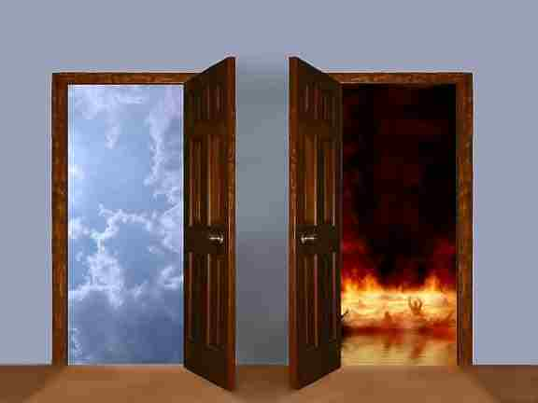
You are free to choose –
But you are not free not to choose!

Slide 26
Charts by Don McClain
Prepared March 5,6, 2010
Preached March 7, 2010
West 65th Street church of Christ
Little Rock AR 72209
501-568-1062
Prepared using PPT 2010 Beta
Email – donmcclain@sbcglobal.net
Note – Many of the transition effects used in this presentation are lost using PPT 2007 Viewer
To view transitions you can download Office 2010 Beta for free:
http://www.microsoft.com/office/2010/en/default.aspx

