Slide 1
Growing As A Christian
MOST
Feel a need to grow -
Have a desire to grow –
Acknowledge a need for assistance to grow

Slide 2
Growing As A Christian
The Need For Spiritual Growth
We are told to – 1 Pet. 2:2; 2 Pet. 3:18; 1 Thes. 4:1
The parable of the soils – Mat. 13: 3-17; 18-23
The need to be teachers – to be skilled in the word – to be able to discern between good and evil – Heb. 5:12-14
That we may be pleasing to God – Col. 1:9-12

Slide 3
Growing As A Christian
The Path To Spiritual Growth
Simple – Not elaborate or complex -
Nothing new – nothing amazing or mystical - mostly things we already know.
Difficult – No shortcuts - Takes time, great effort and patience.

Slide 4
Growing As A Christian
The Path To Spiritual Growth
Commitment –
Can’t be double minded - 1 Kings 18:21; Acts 11:23
Must choose with purpose - Jos. 24:15; Mat. 6:33
Must approach with diligence – Heb. 6:11; 2 Pet. 1:5,10

Slide 5
Growing As A Christian
The Path To Spiritual Growth
Bible Study –
Psalms 1:2-3 (NKJV) ² But his delight is in the law of the Lord, And in His law he meditates day and night. ³ He shall be like a tree Planted by the rivers of water, That brings forth its fruit in its season, Whose leaf also shall not wither; And whatever he does shall prosper.

Slide 6
Growing As A Christian
The Path To Spiritual Growth
Bible Study –
The only source of saving faith – Rom. 10:17
The only source of spiritual growth – Acts 20:30; 1 Cor. 14:1-5; 1 Pet. 2:2

Slide 7
Growing As A Christian
The Path To Spiritual Growth
Bible Study –
Requires regular & consistent study – Psa. 1:2; 119:97; Acts 17:11; 1 Tim. 4:13;
Must possess proper attitude - Acts 17:11; Mat 5:6; Psa. 119:16, 72,127,162; 2 Tim 2:15
Must apply what we learn - Jam 1:21-25; Mat 7:24-27

Slide 8
Growing As A Christian
The Path To Spiritual Growth
Bible Study Accomplishes –
Greater knowledge - (1 Pet. 3:16-18; 2 Tim. 3:16-17)
Gives Wisdom - (Psalm 19:7; 2 Tim. 3:15)
Discouragement from sin - (Psa. 119:11; Prov. 2:10,11)
Equips us for service - (Eph. 4:11-16; 2 Tim. 3:17)

Slide 9
Growing As A Christian
The Path To Spiritual Growth
Fervent Prayer -
Supplication
(Request – averting of evil)
Prayers
(Request – obtaining of good)
Intercession
(For others)
Thanks
(Gratitude for blessings

Slide 10
Growing As A Christian
The Path To Spiritual Growth
Fervent Prayer -
Power in prayer - (1 Pet. 3:12; James 1:5; 5:16)
Need for habitual prayer - (Psa. 55:16-17; Dan. 6:10; Luke 18:1; 1 Thess. 5:17)
Must be coupled with faith - (James 1:6; Mark 11:22-24)
According to God’s will – (1 John 5:14)

Slide 11
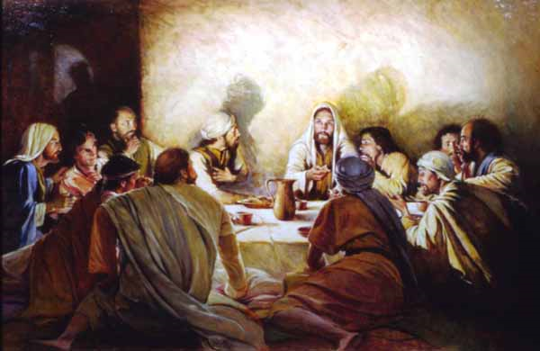
Growing As A Christian
The Path To Spiritual Growth
God-Centered Worship -
Deliberately God-focused - (Worship is about God and for God, affects content, mood, organization, and elements)
Worship takes effort - Easy to let minds wonder – be distracted – requires focus
Requires preparation – true worship is not accidental

Slide 12
Growing As A Christian
The Path To Spiritual Growth
God-Centered Worship -
Must be with reverence - (Lev. 10:3; Heb 12:28,29)
Must be from the heart and according to truth - (John 4:21-24; Col. 3:16,17)
What we are doing (singing, praying, hearing, thinking, examining) – 1 Cor. 14:40
Meaning of the Lord’s supper (body, blood, death)

Slide 13
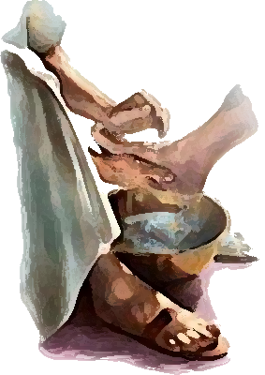
Growing As A Christian
The Path To Spiritual Growth
Service Prompted By Love
Obey God – (Mat. 22:36-40; Jn 14:15,21,24; 1 Jn 5:3)
By love serve one another - (Gal. 5:13; Mat. 22:39; Gal. 6:2; 1 Cor. 13:4-7; James 4:17; 2:15-17)
Weep & rejoice (Rom 12:15)
Restore (Gal. 6:1)
Encourage (Heb. 10:24)
Participate (Eph. 5:16)

Slide 14
Growing As A Christian
The Path To Spiritual Growth
Submit to those over you in the Lord – Heb. 13:17; Eph 4:11-16; 1 Thes 5:12,13;
Apostles & prophets – i.e., respect their writings – (Eph. 4:11; Acts 2:42)
Evangelists, pastors and teachers, - (2 Tim. 4:2; Acts 20:28; 1 Thes 5:12,13

Slide 15
Growing As A Christian
The Results of Spiritual Growth
Can resist falling – 2 Pet. 1:5-10
Can stand strong in the Lord – Eph. 6:10-18
Able to discern good from evil – Heb 5:14
Can help others overcome sin – Mat. 7:1-5; Gal. 6:1
Able to lead others to Christ – Acts 8:4; Heb. 5:12
Able to help others grow – 2 Tim. 2:2; Rom. 15:1,2
Able to bear fruit – Gal. 5:22,23; John 15:1-10
Victorious over death – HEAVEN – Rev. 2:10

Slide 16
Growing As A Christian
Spiritual growth is a divine requirement for every believer.
The Word of God is the divine provision for spiritual growth.

Slide 17
Growing As A Christian
Simple – Not elaborate or complex -
Nothing new – nothing amazing or mystical - mostly things we already know.
Difficult – No shortcuts - Takes time, great effort and patience.

Slide 18
Growing As A Christian
We never stay the same – we will either grow spiritually – or we will spiritually die!
Are you IN CHRIST? – Have you by faith repented – confessed – been baptized?
Are you growing in Christ?

Slide 20
Charts by Don McClain
Prepared January 13,14, 2010
Preached January 17, 2010
West 65th Street church of Christ
Little Rock AR 72209
501-568-1062
Email – donmcclain@sbcglobal.net

