Slide 1
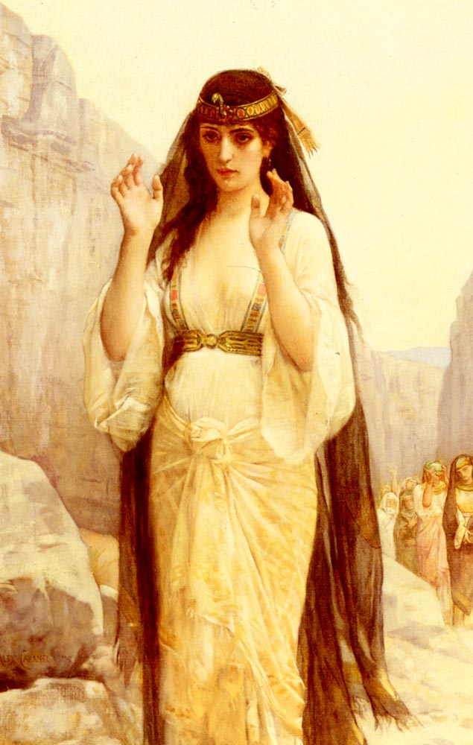
Lessons From
Jephthah’s Vow
Judges 11:1-40

Slide 2
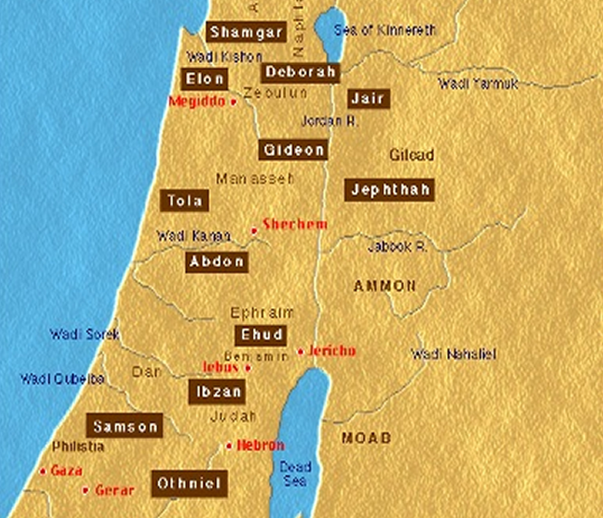
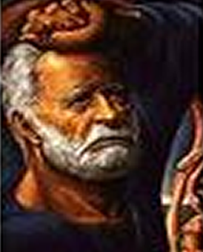
Lessons From Jephthah’s Vow
Who Was Jephthah?
A judge in Israel
Tribe of Manasseh
A Gileadite
Father – Gilead
Mother a prostitute
Rejected & cast out
(Judges 11:1-3).
Notes:
Jephthah's Character
It is unfortunate that he made the vow at all. However, unlike Gideon and others, God never appeared or spoke to him. In fact, God dealt with him much as he does with us—through law, experience and personal circumstance. Apparently, he needed the vow to bolster his faith, to secure God's favor however he could, though obviously God was with him (verse 29).
But Jephthah knew the law. He knew that God requires parley before battle to give the opponent a chance to surrender or retreat. He knew that vows are sacred promises to be kept (Numbers 30). He also knew the history of Israel's approach to the Promised Land and Moses' negotiations with the kings of Edom, Moab and the Amorites well enough to make a legal point in his own negotiations (Judges 11:15-27). Obviously, Jephthah knew that human sacrifice is a detestable and hated act to God (Leviticus 18:21; Deuteronomy 12:31).
Not only did Jephthah know it was wrong, the people of Gilead would also have abhorred the practice and were commanded to kill one who did it (Leviticus 20:2-5)! They—especially the priests—would never have been a party to it, nor would the maidens have commemorated it (the Hebrew word translated "lament" in Judges 11:40 is actually "praise," "commemorate" or "rehearse").
Nor was Jephthah an impetuous or rash person. His vow was spoken, not on the eve of battle, but on the march to it. Rather than leaping at the chance to command Gilead's army, he patiently negotiated for a more powerful position. He did not rush into battle with Ammon, but recruited and trained an army, negotiating with the enemy all the while. If he remained in character, his vow must have been well considered.
The vow itself has been misunderstood too. His vow is in two parts: whatever comes out of the house "shall surely be the LORD'S and I will offer it up as a burnt offering." Bullinger in the Companion Bible says: "The Hebrew Vav [translated ‘and' in the KJV/NKJV] is a connective particle, and is rendered in many different ways. It is also used as a disjunctive, and is often rendered ‘or' (or with a negative ‘nor')." So Bullinger concludes Jephthah vowed to dedicate to God whoever came out to meet him, or if it was an animal, to offer it as a burnt offering.
This agrees with Jephthah's character. He considered the scenario, decided a human being or an animal could fulfill it, and provided for both circumstances. Another factor is the term "burnt offering" (Hebrew olah), which has no connotation of fire or burning. It literally means "that which goes up," and implies total consumption (as one "consumed in his work") or complete surrender. Thus, even without changing the conjunction, the wording of the vow can technically mean that she was completely devoted to God.

Slide 3
Lessons From Jephthah’s Vow
Who Was Jephthah?
A mighty man of valor – vss. 1,6
Called by the elders of Gilead to be their commander – vss. 5-11
Acknowledged God’s power to deliver & rule – vss. 9,11
Offered treaty to Ammon according to the Law – vss. 12-14; cf. Deut 20:10-12
Very familiar with God delivering Israel from Egypt and bringing them into the land of promise – vss. 15-28
A man acknowledged by God to deliver Israel, zealous for God and Israel – vs. 29
Notes:
Jephthah's Character
It is unfortunate that he made the vow at all. However, unlike Gideon and others, God never appeared or spoke to him. In fact, God dealt with him much as he does with us—through law, experience and personal circumstance. Apparently, he needed the vow to bolster his faith, to secure God's favor however he could, though obviously God was with him (verse 29).
But Jephthah knew the law. He knew that God requires parley before battle to give the opponent a chance to surrender or retreat. He knew that vows are sacred promises to be kept (Numbers 30). He also knew the history of Israel's approach to the Promised Land and Moses' negotiations with the kings of Edom, Moab and the Amorites well enough to make a legal point in his own negotiations (Judges 11:15-27). Obviously, Jephthah knew that human sacrifice is a detestable and hated act to God (Leviticus 18:21; Deuteronomy 12:31).
Not only did Jephthah know it was wrong, the people of Gilead would also have abhorred the practice and were commanded to kill one who did it (Leviticus 20:2-5)! They—especially the priests—would never have been a party to it, nor would the maidens have commemorated it (the Hebrew word translated "lament" in Judges 11:40 is actually "praise," "commemorate" or "rehearse").
Nor was Jephthah an impetuous or rash person. His vow was spoken, not on the eve of battle, but on the march to it. Rather than leaping at the chance to command Gilead's army, he patiently negotiated for a more powerful position. He did not rush into battle with Ammon, but recruited and trained an army, negotiating with the enemy all the while. If he remained in character, his vow must have been well considered.
The vow itself has been misunderstood too. His vow is in two parts: whatever comes out of the house "shall surely be the LORD'S and I will offer it up as a burnt offering." Bullinger in the Companion Bible says: "The Hebrew Vav [translated ‘and' in the KJV/NKJV] is a connective particle, and is rendered in many different ways. It is also used as a disjunctive, and is often rendered ‘or' (or with a negative ‘nor')." So Bullinger concludes Jephthah vowed to dedicate to God whoever came out to meet him, or if it was an animal, to offer it as a burnt offering.
This agrees with Jephthah's character. He considered the scenario, decided a human being or an animal could fulfill it, and provided for both circumstances. Another factor is the term "burnt offering" (Hebrew olah), which has no connotation of fire or burning. It literally means "that which goes up," and implies total consumption (as one "consumed in his work") or complete surrender. Thus, even without changing the conjunction, the wording of the vow can technically mean that she was completely devoted to God.

Slide 4
Lessons From Jephthah’s Vow
Nature of His Vow?
Judges 11:30-31 (NKJV) ³⁰ And Jephthah made a vow to the LORD, and said, "If You will indeed deliver the people of Ammon into my hands, ³¹ then it will be that whatever comes out of the doors of my house to meet me, when I return in peace from the people of Ammon, shall surely be the LORD'S, and I will offer it up as a burnt offering."
Notes:
Jephthah's Character
It is unfortunate that he made the vow at all. However, unlike Gideon and others, God never appeared or spoke to him. In fact, God dealt with him much as he does with us—through law, experience and personal circumstance. Apparently, he needed the vow to bolster his faith, to secure God's favor however he could, though obviously God was with him (verse 29).
But Jephthah knew the law. He knew that God requires parley before battle to give the opponent a chance to surrender or retreat. He knew that vows are sacred promises to be kept (Numbers 30). He also knew the history of Israel's approach to the Promised Land and Moses' negotiations with the kings of Edom, Moab and the Amorites well enough to make a legal point in his own negotiations (Judges 11:15-27). Obviously, Jephthah knew that human sacrifice is a detestable and hated act to God (Leviticus 18:21; Deuteronomy 12:31).
Not only did Jephthah know it was wrong, the people of Gilead would also have abhorred the practice and were commanded to kill one who did it (Leviticus 20:2-5)! They—especially the priests—would never have been a party to it, nor would the maidens have commemorated it (the Hebrew word translated "lament" in Judges 11:40 is actually "praise," "commemorate" or "rehearse").
Nor was Jephthah an impetuous or rash person. His vow was spoken, not on the eve of battle, but on the march to it. Rather than leaping at the chance to command Gilead's army, he patiently negotiated for a more powerful position. He did not rush into battle with Ammon, but recruited and trained an army, negotiating with the enemy all the while. If he remained in character, his vow must have been well considered.
The vow itself has been misunderstood too. His vow is in two parts: whatever comes out of the house "shall surely be the LORD'S and I will offer it up as a burnt offering." Bullinger in the Companion Bible says: "The Hebrew Vav [translated ‘and' in the KJV/NKJV] is a connective particle, and is rendered in many different ways. It is also used as a disjunctive, and is often rendered ‘or' (or with a negative ‘nor')." So Bullinger concludes Jephthah vowed to dedicate to God whoever came out to meet him, or if it was an animal, to offer it as a burnt offering.
This agrees with Jephthah's character. He considered the scenario, decided a human being or an animal could fulfill it, and provided for both circumstances. Another factor is the term "burnt offering" (Hebrew olah), which has no connotation of fire or burning. It literally means "that which goes up," and implies total consumption (as one "consumed in his work") or complete surrender. Thus, even without changing the conjunction, the wording of the vow can technically mean that she was completely devoted to God.

Slide 5
Lessons From Jephthah’s Vow
Nature of His Vow?
Was not as rash as many think – expresses his dependence upon God for the victory as well as his earnest desire for the deliverance of his people – vss. 29-32
Man or animal? - Jephthah expected a person to meet him, - “out of the doors of my house” – vs. 31
Possible interpretations –
“or I have offered up for it--a burnt-offering” – [YLT]
“I will offer it up as a burnt offering” [NKJV] – i.e. “like a burnt offering”
Notes:
Judges 11:31 (YLT) ³¹ then it hath been, that which at all cometh out from the doors of my house to meet me in my turning back in peace from the Bene-Ammon--it hath been to Jehovah, or I have offered up for it--a burnt-offering.'

Slide 6
Lessons From Jephthah’s Vow
Nature of His Vow?
“The word עֹולָה does not involve the idea of burning, like our word burnt-offering, but simply that of going up upon the altar, or of complete surrender to the Lord. עֹולָה is a whole offering, as distinguished from the other sacrifices, of which only a part was given up to the Lord. When a virgin, therefore, was set apart as a spiritual עֹולָה, it followed, as a matter of course, that henceforth she belonged entirely to the Lord: that is to say, was to remain a virgin for the remainder of her days.”
Keil & Delitzsch Commentary on the Old Testament -
Johann (C.F.) Keil (1807-1888) & Franz Delitzsch (1813-1890)
Notes:
Auberlen's remarks upon this subject are very good. “The history of Jephthah's daughter,” he says, “would hardly have been thought worth preserving in the Scriptures if the maiden had been really offered in sacrifice; for, in that case, the event would have been reduced, at the best, into a mere family history, without any theocratic significance, though in truth it would rather have been an anti-theocratic abomination, according to Deu_12:31 (cf. Jdg_18:9; Lev_18:21; Lev_20:1-5). Jephthah's action would in that case have stood upon the same platform as the incest of Lot (Gen_19:30.), and would owe its adoption into the canon simply to genealogical considerations, or others of a similar kind. But the very opposite is the case here; and if, from the conclusion of the whole narrative in Jdg_11:39-40, the object of it is supposed to be simply to explain the origin of the feast that was held in honour of Jephthah's daughter, even this would tell against the ordinary view. In the eye of the law the whole thing would still remain an abomination, and the canonical Scriptures would not stoop to relate and beautify an institution so directly opposed to the law.”)

Slide 7
Lessons From Jephthah’s Vow
Nature of His Vow?
God granted His petition – vss. 32,33
Jephthah’s only child is the first to greet him – (emphasized in the text) – vs. 34
Jephthah grieves – (He expresses great sorrow & faithfulness to his vow) – vs. 35
Many suggest that he was grieving because he knew he had to kill her.
Others suggest that he grieved due to his posterity being cut off, and her hope of motherhood was dashed in that she was wholly given to the Lord which required perpetual virginity.
Notes:
Judges 11:31 (YLT) ³¹ then it hath been, that which at all cometh out from the doors of my house to meet me in my turning back in peace from the Bene-Ammon--it hath been to Jehovah, or I have offered up for it--a burnt-offering.'

Slide 8
Lessons From Jephthah’s Vow
Nature of His Vow?
His daughter’s reaction – she too expresses faith and devotion to God – (the victory was from God & encourages her father to keep his vow in view of what God had done in respect to it) - vss. 36,37
His daughter’s request – (to bewail her virginity in private) – vs. 38
Jephthah keeps his vow – He did what he promised - (she knew no man) – vs. 39
She was praised by the daughters of Israel – (expressing a perpetual honor by the nation upon her) – vs. 40
Notes:
Judges 11:31 (YLT) ³¹ then it hath been, that which at all cometh out from the doors of my house to meet me in my turning back in peace from the Bene-Ammon--it hath been to Jehovah, or I have offered up for it--a burnt-offering.'

Slide 9
Lessons From Jephthah’s Vow
Nature of His Vow?
He knew the law – God forbade human sacrifice – (Lev 18:21; Deut. 12:31; 20:2-5)
Human sacrifice was an abomination in the sight of God – (Jer. 7:31) -
Jehoshaphat & Jehoram withdrew from war when the king of the Moabites sacrificed his son as a burnt-offering upon the wall (2Ki 3:26-27)
He depended upon God’s help –
Called upon the Lord as a witness - (10)
Spirit of the Lord was upon him – (29)
Continued as judge – (12:1-7)
Notes:
Judges 11:31 (YLT) ³¹ then it hath been, that which at all cometh out from the doors of my house to meet me in my turning back in peace from the Bene-Ammon--it hath been to Jehovah, or I have offered up for it--a burnt-offering.'

Slide 10
Lessons From Jephthah’s Vow
Nature of His Vow?
There is no condemnation or negative assertion made of Jepthah’s vow –
The nation remembered this act as noble – (11:40)
Jephthah stands as a name of honor in the scriptures – (1 Sam. 12:11; Heb. 11:32)
Jephthah fulfilled his vow by giving his daughter to perpetual service in the Temple – (11:36-40)
Bewail my virginity with friends - (37)
Bewailed her virginity on mtns – (38)
She knew no man – (39)
Notes:
Judges 11:36-40 (NKJV) ³⁶ So she said to him, "My father, if you have given your word to the LORD, do to me according to what has gone out of your mouth, because the LORD has avenged you of your enemies, the people of Ammon." ³⁷ Then she said to her father, "Let this thing be done for me: let me alone for two months, that I may go and wander on the mountains and bewail my virginity, my friends and I." ³⁸ So he said, "Go." And he sent her away for two months; and she went with her friends, and bewailed her virginity on the mountains. ³⁹ And it was so at the end of two months that she returned to her father, and he carried out his vow with her which he had vowed. She knew no man. And it became a custom in Israel ⁴⁰ that the daughters of Israel went four days each year to lament the daughter of Jephthah the Gileadite.

Slide 11
Lessons From Jephthah’s Vow
Nature of His Vow?
(“Auberlen's remarks upon this subject are very good. “The history of Jephthah's daughter, . . . “would hardly have been thought worth preserving in the Scriptures if the maiden had been really offered in sacrifice; for, in that case, the event would have been reduced, at the best, into a mere family history, without any theocratic significance, though in truth it would rather have been an anti-theocratic abomination, according to Deu_12:31 (cf. Jdg_18:9; Lev_18:21; Lev_20:1-5). Jephthah's action would in that case have stood upon the same platform as the incest of Lot (Gen_19:30.), and would owe its adoption into the canon simply to genealogical considerations, or others of a similar kind.
Notes:
Auberlen's remarks upon this subject are very good. “The history of Jephthah's daughter,” he says, “would hardly have been thought worth preserving in the Scriptures if the maiden had been really offered in sacrifice; for, in that case, the event would have been reduced, at the best, into a mere family history, without any theocratic significance, though in truth it would rather have been an anti-theocratic abomination, according to Deu_12:31 (cf. Jdg_18:9; Lev_18:21; Lev_20:1-5). Jephthah's action would in that case have stood upon the same platform as the incest of Lot (Gen_19:30.), and would owe its adoption into the canon simply to genealogical considerations, or others of a similar kind. But the very opposite is the case here; and if, from the conclusion of the whole narrative in Jdg_11:39-40, the object of it is supposed to be simply to explain the origin of the feast that was held in honour of Jephthah's daughter, even this would tell against the ordinary view. In the eye of the law the whole thing would still remain an abomination, and the canonical Scriptures would not stoop to relate and beautify an institution so directly opposed to the law.”)

Slide 12
Lessons From Jephthah’s Vow
Nature of His Vow?
“But the very opposite is the case here; and if, from the conclusion of the whole narrative in Jdg_11:39-40, the object of it is supposed to be simply to explain the origin of the feast that was held in honour of Jephthah's daughter, even this would tell against the ordinary view. In the eye of the law the whole thing would still remain an abomination, and the canonical Scriptures would not stoop to relate and beautify an institution so directly opposed to the law.”)
From: Keil & Delitzsch Commentary on the Old Testament -
Johann (C.F.) Keil (1807-1888) & Franz Delitzsch (1813-1890)
Notes:
Auberlen's remarks upon this subject are very good. “The history of Jephthah's daughter,” he says, “would hardly have been thought worth preserving in the Scriptures if the maiden had been really offered in sacrifice; for, in that case, the event would have been reduced, at the best, into a mere family history, without any theocratic significance, though in truth it would rather have been an anti-theocratic abomination, according to Deu_12:31 (cf. Jdg_18:9; Lev_18:21; Lev_20:1-5). Jephthah's action would in that case have stood upon the same platform as the incest of Lot (Gen_19:30.), and would owe its adoption into the canon simply to genealogical considerations, or others of a similar kind. But the very opposite is the case here; and if, from the conclusion of the whole narrative in Jdg_11:39-40, the object of it is supposed to be simply to explain the origin of the feast that was held in honour of Jephthah's daughter, even this would tell against the ordinary view. In the eye of the law the whole thing would still remain an abomination, and the canonical Scriptures would not stoop to relate and beautify an institution so directly opposed to the law.”)

Slide 13
Lessons From Jephthah’s Vow
Making Some Applications
God can use anyone who will trust in Him – (11:1-11; Exo. 3:11; Judges; Acts 4:13; 1 Cor. 1:26)
We need to learn to trust and depend upon God – (11:12-33; Mat. 6:19-34; Rom. 8:28-39)
We must take our commitments to the Lord seriously – We must count the cost – (11:30-39; Luke 14:25-33; Eccl. 5:2-5; Mat. 5:33,37)
Our commitment to the Lord requires sacrifice and faithfulness – (11:30-39; Rom. 12:1-3; Phil. 2:1-5)

Slide 14
Lessons From Jephthah’s Vow
Making Some Applications
Faithfulness to the Lord must come before family – (11:35; Mark 12:28,29; Mat. 10:34-39)
Children - put the Lord first and submit to your parents, and encourage them to be faithful – (11:36-39; Eph. 6:1-3; Col. 3:20)
We need to weep with those who weep – (11:38; Rom. 12:15)
We need to remember those who have sacrificed so much for us – (11:39,40; 1 Cor. 11:24,25; Heb 12:1)

Slide 15
Lessons From Jephthah’s Vow
Conclusion
How great is your commitment to the Lord?
Discipleship in Christ begins and ends with sacrifice.
Vow today to consecrate your life to God, commit yourself to His commandments

Slide 17
Lessons From Jephthah’s Vow
Charts by Don McClain
Prepared December 21-24, 2010
Preached December 26, 2010
West 65th Street church of Christ
P.O. Box 190062
Little Rock AR 72219
501-568-1062
Prepared using PPT 2010 –
Email – donmcclain@sbcglobal.net
More PPT & Audio Sermons:
http://w65stchurchofchrist.org/donmaccla/2010SermonPage.html
Note – Many of the transition effects used in this presentation are lost using PPT 2007 Viewer
To view transitions you can download PPT 2010 viewer:
http://www.microsoft.com/downloads/en/details.aspx?displaylang=en&FamilyID=cb9bf144-1076-4615-9951-294eeb832823

