Slide 1
Drawing Nearer To God
Psalm 145:18
Psalm 73:28
Hebrews 10:19-25
James 4:7-10

Slide 2
Drawing Nearer To God
Are you desiring to draw nearer to God?
Are You Drawing Closer To Him Each Day?

Slide 3
Drawing Nearer To God
There Is A Difference Between “Knowing About God” And “Knowing God!”

Slide 4
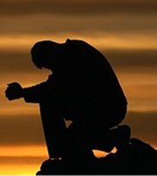
Drawing Nearer To God
Psalms 145:18-20 (NKJV) ¹⁸ The LORD is near to all who call upon Him, To all who call upon Him in truth. ¹⁹ He will fulfill the desire of those who fear Him; He also will hear their cry and save them. ²⁰ The LORD preserves all who love Him, But all the wicked He will destroy.

Slide 5
Drawing Nearer To God
Psalms 73:28 (NKJV) ²⁸ But it is good for me to draw near to God; I have put my trust in the Lord GOD, That I may declare all Your works.

Slide 6
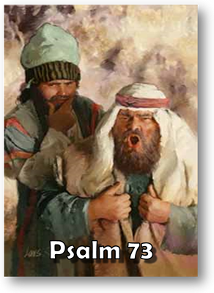
Drawing Nearer To God
Characteristics of Being Near To God
NOT:
Boastful pride – Ps. 73:3,6
Prosperity – Ps. 73:3,7,12
The absence of a troubled conscience – Ps. 73:4
The absence of trouble in their life – Ps. 73:5

Slide 7
Drawing Nearer To God
Characteristics of Being Near To God
NOT:
Scoffing and wicked speech – Ps. 73:8
Proud speech – Ps. 73:8,9
Joining with others who sin – Ps. 73:10
A lack of respect – Ps. 73:11
At ease – Ps. 73:12

Slide 8
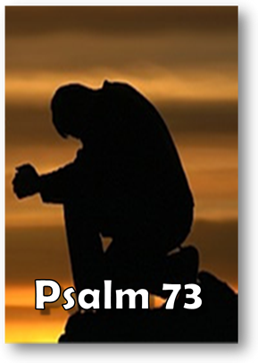
Drawing Nearer To God
Characteristics of Being Near To God
ARE:
Cleansed heart – Ps. 73:13
Washed hands – Ps. 73:13
Hardship – Ps. 73:14
Concerned about influence on others – Ps. 73:15
Understands the end of the wicked – Ps. 73:16-20, 27

Slide 9
Drawing Nearer To God
Characteristics of Being Near To God
ARE:
Penitent – Ps. 73:21,22
Trust in God – Ps. 73:23,28
Follows God’s word, trusting His promises – Ps. 73:24
Desires God above all things – Ps. 73:25
Doesn’t trust in self – Ps. 73:26
Tells others – Ps. 73:28

Slide 10
Drawing Nearer To God
How Do We DRAW Near To God
Hebrews 10:19-25 (NKJV) ¹⁹ Therefore, brethren, having boldness to enter the Holiest by the blood of Jesus, ²⁰ by a new and living way which He consecrated for us, through the veil, that is, His flesh, ²¹ and having a High Priest over the house of God,

Slide 11
Drawing Nearer To God
How Do We DRAW Near To God
Hebrews 10:19-25 (NKJV) ²² let us draw near with a true heart in full assurance of faith, having our hearts sprinkled from an evil conscience and our bodies washed with pure water. ²³ Let us hold fast the confession of our hope without wavering, for He who promised is faithful.

Slide 12
Drawing Nearer To God
How Do We DRAW Near To God
Hebrews 10:19-25 (NKJV) ²⁴ And let us consider one another in order to stir up love and good works, ²⁵ not forsaking the assembling of ourselves together, as is the manner of some, but exhorting one another, and so much the more as you see the Day approaching.

Slide 13
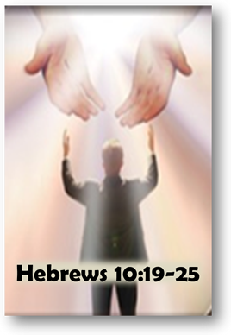
Drawing Nearer To God
How Do We DRAW Near To God
Knowing we can through Christ – Heb. 10:19-21; Jn 14:6
Need a true heart – Heb. 10:22; Ps. 119:2,10,34,58, 69,80,145; Eph. 6:5
Need full assurance of faith – Heb. 10:22; 6:11; 11:6; Jm. 1:6-9
Obey the gospel – Heb. 10:22; 1 Pet. 1:22,23; Acts 2:38; Col. 2:11-13; Tit. 3:5; 1 Pet. 3:21

Slide 14
Drawing Nearer To God
How Do We DRAW Near To God
Holding fast to the confession of our hope . . . – Heb. 10:23; 3:6,14; Rev 3:11; 2 Pet, 1:5-10
Considering one another – provoking to love and good works – Heb. 10:24; 2 Cor. 9:2
Attendance and participation – Heb. 10:25; Eph. 4:11-16
Exhorting one another – Heb. 10:25; 13:3; Rom. 12:3-13;
Notes:
Exhort
Usage Number: A-1
Part Of Speech: Verb
Strong's Number: <G3870>
Original Word: παρακαλέω, parakaleō
Usage Notes: primarily, "to call to a person" (para, "to the side," kaleō, "to call"), denotes (a) "to call on, entreat;" see BESEECH; (b) "to admonish, exhort, to urge" one to pursue some course of conduct (always prospective, looking to the future, in contrast to the meaning to comfort, which is retrospective, having to do with trial experienced), translated "exhort" in the RV of Phil. 4:2; 1 Thess. 4:10; Heb. 13:19, 22, for AV, "beseech;" in 1 Tim. 5:1, for AV, "intreat;" in 1 Thess. 5:11, for AV, "comfort;" "exhorted" in 2 Cor. 8:6; 2 Cor. 12:18, for AV, "desired;" in 1 Tim. 1:3, for AV, "besought." See BESEECH.
— Vine's Expository Dictionary of Old and New Testament Words

Slide 15
Drawing Nearer To God
How Do We DRAW Near To God
Submit To God –
Resist the devil –
Cleanse our hands –
Purify our hearts –
Humble ourselves and repent -
James 4:7-10 (NKJV) ⁷ Therefore submit to God. Resist the devil and he will flee from you. ⁸ Draw near to God and He will draw near to you. Cleanse your hands, you sinners; and purify your hearts, you double-minded. ⁹ Lament and mourn and weep! Let your laughter be turned to mourning and your joy to gloom. ¹⁰ Humble yourselves in the sight of the Lord, and He will lift you up.

Slide 16
Drawing Nearer To God
Am I being sincere? Is my heart fixed on Him and undivided?
Do I have unwavering confidence in God, His Son Jesus and His word?
Am I coming humbly, obeying God’s will - completely surrendering my will to His?
Is there any sin in my life I haven't dealt with?

Slide 17
Drawing Nearer To God
Psalms 145:18-20 (NKJV) ¹⁸ The LORD is near to all who call upon Him, To all who call upon Him in truth. ¹⁹ He will fulfill the desire of those who fear Him; He also will hear their cry and save them. ²⁰ The LORD preserves all who love Him, But all the wicked He will destroy.

Slide 18
Drawing Nearer To God
Is Your Current Direction Leading You Closer To God?

Slide 20
Charts by Don McClain
Prepared April 22-24, 2010; Preached April 25, 2010
West 65th Street church of Christ
P.O. Box 190062
Little Rock AR 72219
501-568-1062
Prepared using PPT 2010 Beta
Email – donmcclain@sbcglobal.net
Audio:
PPT:
Note – Many of the transition effects used in this presentation are lost using PPT 2007 Viewer
To view transitions you can download Office 2010 Beta for free:
http://www.microsoft.com/office/2010/en/default.aspx

