Slide 1
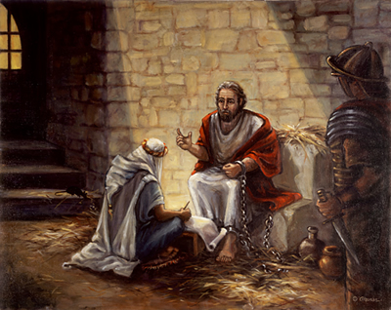
Set For The Defense of
The Gospel
Philippians 1:3-18

Slide 2
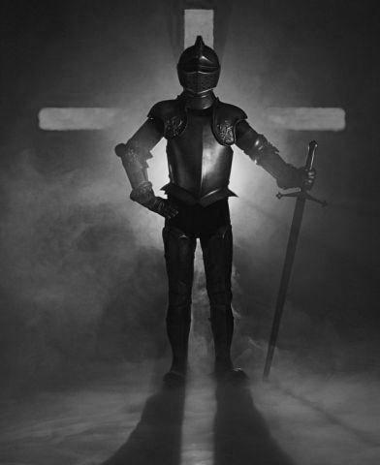
Set For The Defense of The Gospel
Is The Gospel Worth Defending?
Many do not see the need to defend the truth -
Many are unable to defend the truth –
Many are afraid of defending the truth –
Many believe that it is wrong to critique false doctrine –

Slide 3
Set For The Defense of The Gospel
Philippians 1:3-18 (NKJV)
³ I thank my God upon every remembrance of you, ⁴ always in every prayer of mine making request for you all with joy, ⁵ for your fellowship in the gospel from the first day until now, ⁶ being confident of this very thing, that He who has begun a good work in you will complete it until the day of Jesus Christ; ⁷ just as it is right for me to think this of you all, because I have you in my heart, . . .

Slide 4
Set For The Defense of The Gospel
Philippians 1:3-18 (NKJV)
. . . inasmuch as both in my chains and in the defense and confirmation of the gospel, you all are partakers with me of grace. ⁸ For God is my witness, how greatly I long for you all with the affection of Jesus Christ. ⁹ And this I pray, that your love may abound still more and more in knowledge and all discernment, ¹⁰ that you may approve the things that are excellent, that you may be sincere and without offense till the day of Christ,

Slide 5
Set For The Defense of The Gospel
Philippians 1:3-18 (NKJV)
¹¹ being filled with the fruits of righteousness which are by Jesus Christ, to the glory and praise of God. ¹² But I want you to know, brethren, that the things which happened to me have actually turned out for the furtherance of the gospel, ¹³ so that it has become evident to the whole palace guard, and to all the rest, that my chains are in Christ; ¹⁴ and most of the brethren in the Lord, having become confident by my chains, . . .

Slide 6
Set For The Defense of The Gospel
Philippians 1:3-18 (NKJV)
. . . are much more bold to speak the word without fear. ¹⁵ Some indeed preach Christ even from envy and strife, and some also from good will: ¹⁶ The former preach Christ from selfish ambition, not sincerely, supposing to add affliction to my chains; ¹⁷ but the latter out of love, knowing that I am appointed for the defense of the gospel. ¹⁸ What then? Only that in every way, whether in pretense or in truth, Christ is preached; and in this I rejoice, yes, and will rejoice.

Slide 7
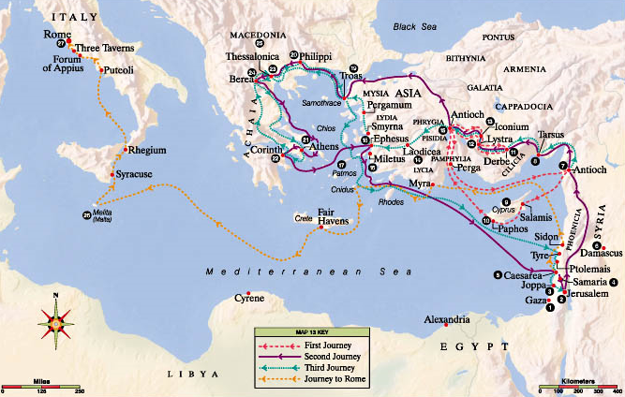
First - 1,400 miles
Second - 2,800 miles
Third - 2,700 miles
Fourth to Rome - 2,250
Approximate total - 9,150 miles

Slide 8
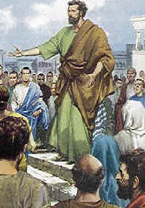
Set For The Defense of The Gospel
Paul As A Preacher
Paul’s conversion – 9:1-25 – (Immediately preached Christ . . . Confounded the Jews – receives his first death threat - 9:20-25)
Confronts Elymas the sorcerer – 13:4-12
Reasoning with the Jews - Use of the OT scriptures to prove that Jesus is the promised Messiah – Jews rejection & turning to the Gentiles – 13:13-52
Divided the city of Iconium – 14:1-7
Escapes stoning in Lystra to Derbe – 14:8-20

Slide 9
Set For The Defense of The Gospel
Paul As A Preacher
Controversy in Jerusalem – Acts 15:1-29
Imprisoned in Philippi – Acts 16:11-40
Trouble in Thessalonica – 17:1-9
Jews stir up those in Berea – 17:10-15
Paul in Athens – 17:16-34
Reasoning from the scriptures in Corinth – saying to the Jews “your blood be upon your own heads” – 18:1-17
Riot in Ephesus – Acts 19:1-41
Paul in Macedonia, Troas & Miletus – 20:1-38

Slide 10
Set For The Defense of The Gospel
Paul As A Preacher
His return to Jerusalem and arrest – 21:1-23:22
Paul before Felix – 23:23-24:27
Paul before Festus – appeals to Caesar – 25:1-12
Paul before Agrippa – 25:13-26:32
Paul goes to Rome – 27:1-28:31

Slide 11
Set For The Defense of The Gospel
Paul As A Preacher
Acts 9:29 (NKJV) ²⁹ And he spoke boldly in the name of the Lord Jesus and disputed against the Hellenists, but they attempted to kill him.

Slide 12
Set For The Defense of The Gospel
Paul As A Preacher
Acts 17:2-3 (NKJV) ² Then Paul, as his custom was, went in to them, and for three Sabbaths reasoned with them from the Scriptures, ³ explaining and demonstrating that the Christ had to suffer and rise again from the dead, and saying, "This Jesus whom I preach to you is the Christ."

Slide 13
Set For The Defense of The Gospel
Paul As A Preacher
Acts 17:16-17 (NKJV) ¹⁶ Now while Paul waited for them at Athens, his spirit was provoked within him when he saw that the city was given over to idols. ¹⁷ Therefore he reasoned in the synagogue with the Jews and with the Gentile worshipers, and in the marketplace daily with those who happened to be there.

Slide 14
Set For The Defense of The Gospel
Paul As A Preacher
Preached baptism in the name of Jesus - Acts 19:1-5
Didn’t hold anything back – proclaimed the whole council of God – Acts 22:17-32
Reasoned about righteousness, self control and the judgment to come before Felix – 24:25
Paul’s wise defense before Agrippa – 26:19-29
From prison – Phili 3:7-18

Slide 15
Set For The Defense of The Gospel
Paul As A Preacher
Warned that there would be those who would teach and receive error – Acts 20:29-31; 2 Tim. 4:3,4
Confronted immorality – 1 Cor. 5:1-13; 6:9-11; Gal. 5:19-21
Confronted false teachers, even calling names – Gal. 2:5; 5:7-12; 1 Tim. 1:19,20; 2 Tim. 2:18
Confronted those not walking worthy of the gospel – Gal. 2:11-14

Slide 16
Set For The Defense of The Gospel
Things Necessary
Love – Eph. 4:15
Knowledge – Heb. 5:12-14
Strength – Eph. 6:10-18
Confidence – Rom. 1:16; Phili 4:13
Courage – Josh. 1:5-9; 1 Cor. 16:13
Zeal – Titus 2:14

Slide 17
Set For The Defense of The Gospel
Our Mission – Our Charge
Mark 16:15-16 (NKJV) ¹⁵ And He said to them, "Go into all the world and preach the gospel to every creature. ¹⁶ He who believes and is baptized will be saved; but he who does not believe will be condemned.

Slide 18
Set For The Defense of The Gospel
Our Mission – Our Charge
Jude 1:3 (NKJV) ³ Beloved, while I was very diligent to write to you concerning our common salvation, I found it necessary to write to you exhorting you to contend earnestly for the faith which was once for all delivered to the saints.

Slide 19
Thoughts Of An Atheist
If I firmly believed, as millions say the do, that a knowledge and practice of Christianity in this life influenced destiny in another world, Christianity would be to me everything. I would cast aside earthly thoughts as vanities and earthly feelings as follies. Christianity would by my first waking thought and my last image before sleep sank me into unconsciousness. I would labor in its cause alone. I would take thought for tomorrow and eternity alone. Earthly consequences would never stay my hands nor seal my lips. I would esteem one soul gained for heaven worth a lifetime of effort. I would go forth and preach Christ to the world, and my theme would be, “What shall it profit a man if he gain the whole world and lose his own soul.”
Norman Grubb,1972 - Written by an Atheist

Slide 20
Are You Set For The Defense of
The Gospel
Philippians 1:3-18

Slide 22
Charts by Don McClain
Prepared March 25-27, 2010
Preached March 28, 2010
West 65th Street church of Christ
P.O. Box 190062
Little Rock AR 72209
501-568-1062
Prepared using PPT 2010 Beta
Email – donmcclain@sbcglobal.net
Note – Many of the transition effects used in this presentation are lost using PPT 2007 Viewer
To view transitions you can download Office 2010 Beta for free:
http://www.microsoft.com/office/2010/en/default.aspx

