Slide 1
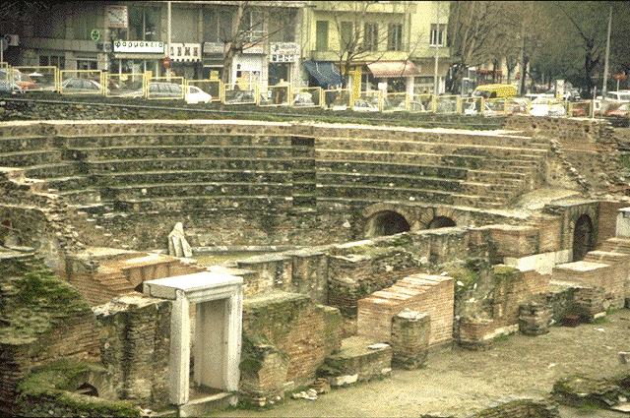
Thessalonica:
A Working Church

Slide 2
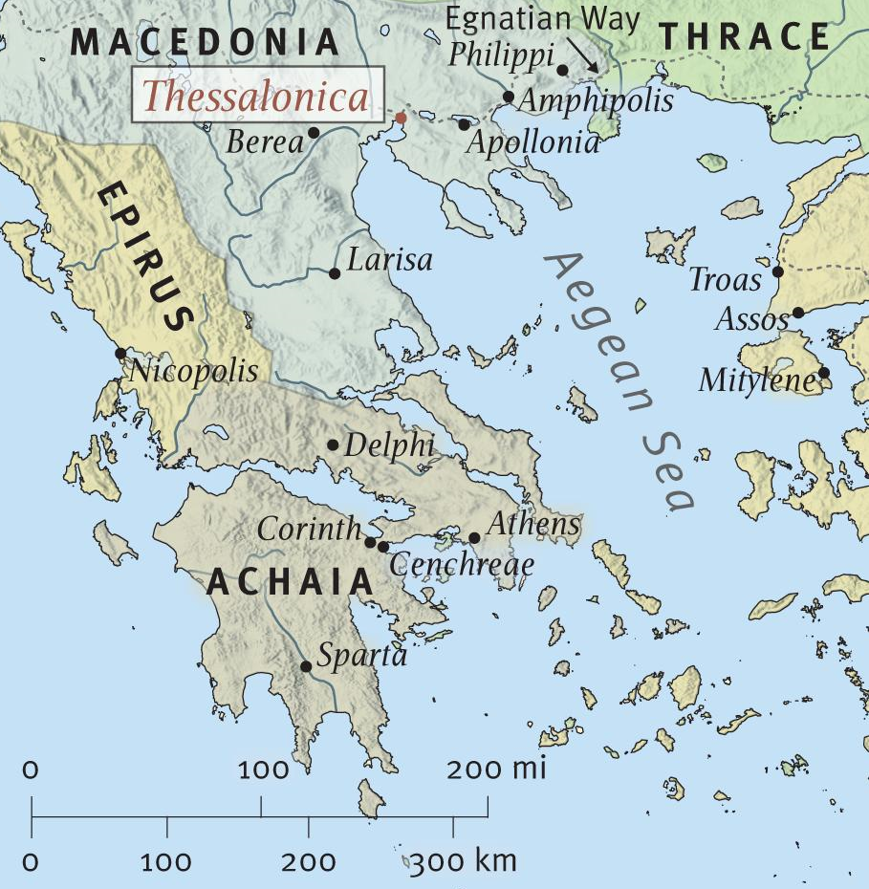
Thessalonica: A Working Church
Thessalonica is a seaport located at the head of the Themaic Gulf in Macedonia, and was on the well traveled Egnatian Way.
The largest city of Macedonia, with a population of ca. 200,000, The city was affectionately called the "mother of all Macedon."
It had been granted the status of a free city.

Slide 3
Thessalonica: A Working Church
A grossly immoral city (1:9).
Had a large Jewish population, who had their own synagogue (Acts 17:1).
1st Thessalonians was written by Paul from Corinth and sent by Timothy, who returned with good news of their faith (Acts 18:1,5; 1 Thessalonians 3:1-8).
The apostle penned the epistle in A.D. 52. (1st letter - perhaps the 1st book of New Testament).

Slide 4
Thessalonica: A Working Church
1 Thessalonians 1:2-10 (NKJV) ² We give thanks to God always for you all, making mention of you in our prayers, ³ remembering without ceasing your work of faith, labor of love, and patience of hope in our Lord Jesus Christ in the sight of our God and Father, ⁴ knowing, beloved brethren, your election by God.

Slide 5
Thessalonica: A Working Church
1 Thessalonians 1:2-10 (NKJV) ⁵ For our gospel did not come to you in word only, but also in power, and in the Holy Spirit and in much assurance, as you know what kind of men we were among you for your sake. ⁶ And you became followers of us and of the Lord, having received the word in much affliction, with joy of the Holy Spirit, ⁷ so that you became examples to all in Macedonia and Achaia who believe.

Slide 6
Thessalonica: A Working Church
1 Thessalonians 1:2-10 (NKJV) ⁸ For from you the word of the Lord has sounded forth, not only in Macedonia and Achaia, but also in every place. Your faith toward God has gone out, so that we do not need to say anything. ⁹ For they themselves declare concerning us what manner of entry we had to you, and how you turned to God from idols to serve the living and true God, ¹⁰ and to wait for His Son from heaven, whom He raised from the dead, even Jesus who delivers us from the wrath to come.

Slide 7
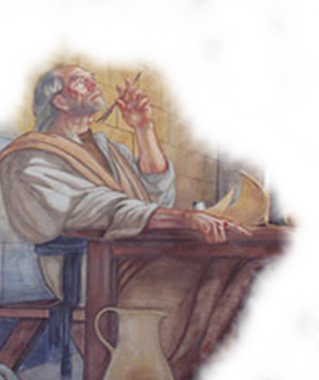
Thessalonica: A Working Church
Paul, Silas and Timothy came to Thessalonica after they had preached in Philippi on the apostle's second journey (Act 16:1-3; 17:1-2).
Paul preached to the Jews in their synagogue for three Sabbaths, proving that Jesus was Christ by appealing to the Old Testament prophets (Acts 17:2-3).
Paul probably stayed in Thessalonica at least several months - (Acts 17:3-4; 1 Thessalonians 1:9).

Slide 8
Thessalonica: A Working Church
The apostle preached boldly among them in the face of much opposition (2:2,14-16).
His work among them was as a father with his children (2:3-11), while they received his preaching as the word of God (2:13).
He was forced to leave due to Jewish persecution (Acts 17:5-10).
He was anxious about them, and desired to return, but was hindered by Satan (2:17-20).

Slide 9
Thessalonica: A Working Church
He sent back Timothy from Athens to find out about them (3:1-5).
Timothy brought back to Paul the comforting news of a faithful church who loved Paul (3:1-10; 1:3,8).
They were surrounded, however, by ungodliness and were being persecuted (2:14).

Slide 10
Thessalonica: A Working Church
They Were Workers
They were evangelistic – Not only locally but throughout the region - (1:8-10; cf. Acts 8:1-4).
They were benevolent - included in the "great collection" for the saints in Jerusalem (Rom. 15:26; Acts 20:4; 2 Cor. 8:1; 9:1-6).
They edified one another - (1 Thes. 5:11-14; cf. Eph. 4:12-16).

Slide 11
Thessalonica: A Working Church
The Working Conditions
Persecution – subjected to assault, civil prosecution and economic persecution - (Acts 17:4-9; 1 Thes. 2:14-16; 2 Thes 1:3-8; 3:2-8).
Poverty – Not as much in need as the saints in Jerusalem, but still spoken of as being in “deep poverty” - (Rom. 15:26; Acts 20:4; 2 Cor. 8:1-5; 9:1-6),

Slide 12
Thessalonica: A Working Church
What Prompts A Church To Work?
Because they had faith, love and hope – due to their reception of the word of God - (1 Thes. 1:5; Rom 10:17; 1 Thes 2:1-13).
Because they had the proper examples – the need for elders, deacons and preachers to do what it takes to set the proper example. - (1 Thes 1:6; 2:9-11; 2 Thes 3:7-9),
Notes:
What motivated these saints to such work, toil and endurance? What do we need to do to get God's people to work like that today in a land that is prosperous and which protects the free exercise of our religion?
The church in Thessalonica worked because they had faith, love and hope (1 Thes. 1:5). These spiritual treasures come by hearing the Word of God preached (Rom. 10:17). It cannot be preached with flattery or out of covetousness and have the desired results. It must be preached with simplicity, sincerity and sacrifice in order to succeed (1 Thes. 2:1-11). The Thessalonians received the Gospel as the authoritative message of Heaven (1 Thes. 2:13). Their hearts were open to its truth and molded by its power. The church would go to work today if the pulpits were sounding for the Word of God and not the words of men.
They worked because they had an example (1 Thes. 1:6). Paul, Silas and Timothy had demonstrated acceptable zeal for the Gospel (1 Thes. 2:9-11). They worked tirelessly. They loved the brethren unselfishly. They warned the brethren tenderly. Churches today are waxing cold because there are no elders, deacons and preachers willing to do what it takes to set the proper example. The flock will not go where the shepherds will not lead.
Thessalonica worked because their lives were transformed by repentance (1 Thes. 1:9). Paul says the Thessalonians "turned to God from idols to serve." Repentance is one fruit of the gospel (Matt. 12:41). It always results in a changed life with changed priorities (2 Cor. 7:10-11). We will not go to work for the Lord until we turn from our idols (Eph. 5:5).
Thessalonica worked because they had a heavenly goal (1 Thes. 1:10). Their toil, suffering and sacrifice were all put in perspective when viewed looking toward Glory. We would do well today to hold our cankered possessions up to heavens light and get a good look at the way things really are.
Will this congregation be a working church like the brethren at Thessalonica? It can be, but you will be the determining factor. What of your faith? Are there sins stealing your heart from God? Are you willing to be an example to others? These are the things that will make the difference.

Slide 13
Thessalonica: A Working Church
What Prompts A Church To Work?
Because their lives had been transformed by repentance – "turned to God from idols to serve the living and true God." - (1 Thes. 1:9; Luke 13:3,5; 2 Cor. 7:10,11; 8:5).
Because they had heaven as their goal – they were to wait for Jesus Who had saved them from wrath & comfort one another - (1 Thes 1:10; 4:13-5:11; 2 Thes 1:7-10)
Notes:
What motivated these saints to such work, toil and endurance? What do we need to do to get God's people to work like that today in a land that is prosperous and which protects the free exercise of our religion?
The church in Thessalonica worked because they had faith, love and hope (1 Thes. 1:5). These spiritual treasures come by hearing the Word of God preached (Rom. 10:17). It cannot be preached with flattery or out of covetousness and have the desired results. It must be preached with simplicity, sincerity and sacrifice in order to succeed (1 Thes. 2:1-11). The Thessalonians received the Gospel as the authoritative message of Heaven (1 Thes. 2:13). Their hearts were open to its truth and molded by its power. The church would go to work today if the pulpits were sounding for the Word of God and not the words of men.
They worked because they had an example (1 Thes. 1:6). Paul, Silas and Timothy had demonstrated acceptable zeal for the Gospel (1 Thes. 2:9-11). They worked tirelessly. They loved the brethren unselfishly. They warned the brethren tenderly. Churches today are waxing cold because there are no elders, deacons and preachers willing to do what it takes to set the proper example. The flock will not go where the shepherds will not lead.
Thessalonica worked because their lives were transformed by repentance (1 Thes. 1:9). Paul says the Thessalonians "turned to God from idols to serve." Repentance is one fruit of the gospel (Matt. 12:41). It always results in a changed life with changed priorities (2 Cor. 7:10-11). We will not go to work for the Lord until we turn from our idols (Eph. 5:5).
Thessalonica worked because they had a heavenly goal (1 Thes. 1:10). Their toil, suffering and sacrifice were all put in perspective when viewed looking toward Glory. We would do well today to hold our cankered possessions up to heavens light and get a good look at the way things really are.
Will this congregation be a working church like the brethren at Thessalonica? It can be, but you will be the determining factor. What of your faith? Are there sins stealing your heart from God? Are you willing to be an example to others? These are the things that will make the difference.

Slide 14
Thessalonica: A Working Church
What About Us?
What of our “work of faith, labor of love, and patience of hope?”
Are there things stealing your heart from working for God as you should?
Are you willing to be an example to others?
Is heaven your goal? Are you doing the work it takes to be there?
Notes:
What motivated these saints to such work, toil and endurance? What do we need to do to get God's people to work like that today in a land that is prosperous and which protects the free exercise of our religion?
The church in Thessalonica worked because they had faith, love and hope (1 Thes. 1:5). These spiritual treasures come by hearing the Word of God preached (Rom. 10:17). It cannot be preached with flattery or out of covetousness and have the desired results. It must be preached with simplicity, sincerity and sacrifice in order to succeed (1 Thes. 2:1-11). The Thessalonians received the Gospel as the authoritative message of Heaven (1 Thes. 2:13). Their hearts were open to its truth and molded by its power. The church would go to work today if the pulpits were sounding for the Word of God and not the words of men.
They worked because they had an example (1 Thes. 1:6). Paul, Silas and Timothy had demonstrated acceptable zeal for the Gospel (1 Thes. 2:9-11). They worked tirelessly. They loved the brethren unselfishly. They warned the brethren tenderly. Churches today are waxing cold because there are no elders, deacons and preachers willing to do what it takes to set the proper example. The flock will not go where the shepherds will not lead.
Thessalonica worked because their lives were transformed by repentance (1 Thes. 1:9). Paul says the Thessalonians "turned to God from idols to serve." Repentance is one fruit of the gospel (Matt. 12:41). It always results in a changed life with changed priorities (2 Cor. 7:10-11). We will not go to work for the Lord until we turn from our idols (Eph. 5:5).
Thessalonica worked because they had a heavenly goal (1 Thes. 1:10). Their toil, suffering and sacrifice were all put in perspective when viewed looking toward Glory. We would do well today to hold our cankered possessions up to heavens light and get a good look at the way things really are.
Will this congregation be a working church like the brethren at Thessalonica? It can be, but you will be the determining factor. What of your faith? Are there sins stealing your heart from God? Are you willing to be an example to others? These are the things that will make the difference.

Slide 16
Thessalonica: A Working Church
Charts by Don McClain
Prepared September 18,19, 2010
Preached September 19, 2010
West 65th Street church of Christ
P.O. Box 190062
Little Rock AR 72219
501-568-1062
Prepared using PPT 2010 Beta
Email – donmcclain@sbcglobal.net
More PPT & Audio Sermons:
http://w65stchurchofchrist.org/donmaccla/2010SermonPage.html
Note – Many of the transition effects used in this presentation are lost using PPT 2007 Viewer
To view transitions you can download Office 2010 Beta for free:
http://www.microsoft.com/office/2010/en/default.aspx

