Slide 1
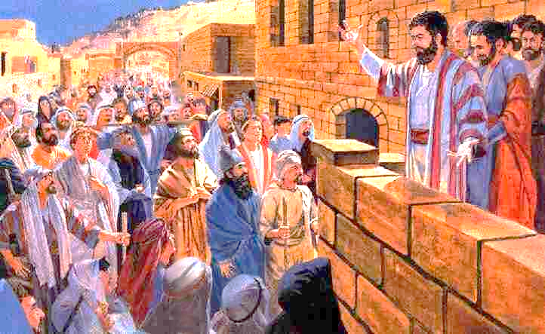
Examples of Conversions In The Book of Acts
“Men and brethren what shall we do?"
3,000 Converted Acts 2:1-47
Notes:
Acts 16:30 (NKJV) ³⁰ And he brought them out and said, "Sirs, what must I do to be saved?"
Are You Really Converted?
Raymond E. Harris Muscle Shoals, Alabama
The word "convert" means "to change" or "to turn." There are three things involved in the process of one's turning from sin to God.
1. A Change of Heart. The heart or mind can only be changed by faith. Faith comes by hearing the word of God (Rom. 10:17). Hence, the Bible teaches that people's hearts are purified "by faith" (Acts 15:9). In other words, when one learns from the Bible about the love God has toward us and the sacrifice of Jesus for us we are moved to repentance. "Repentance" and "conversion" are terms that go hand in hand. When one changes his mind about God and Jesus and sin he will have:
2. A Change of Life. A change of heart will lead to a change of life. Repentance is defined as "a change of mind that leads to a change of life." Hence, we see the evolution of conversion. As a result of faith produced by the word of God, man is led to repentance. This reformation in behavior is very visible as the person turns from sin to obedience, from wickedness to righteousness. And when obedience is completed there is:
3. A Change of Relationship. In this world there are two classes of accountable people - the wicked and the righteous - the children of the Devil and the children of God. No one can be translated from the kingdom of darkness to the kingdom of God without a change of heart and a change of life. But one must have remission of sins to make conversion complete. When one's sins are forgiven, he enters a state or relationship with God. Baptism is". . for the remission of sins" (Acts 2:38). Also the Bible says people are baptized "into Christ" (Gal. 3:26-27). Hence, the converted are buried with Christ in baptism and raised to walk in "newness of life" (Rom. 6:3-5).
Faith changes the heart, repentance changes the life, and baptism changes the relationship to God. One's sins are not forgiven merely because we believe that Jesus is the Savior or because we quit committing them. Sins are forgiven by God when we complete our conversion in baptism. Have you been converted? Truly converted? Fully converted, according to the scriptural plan?
Guardian of Truth XXX: 2, p. 43 January 16, 1986

Slide 2
3,000 Converted Acts 2:1-47
Convert; Converted
transitive verb
1 - a : to bring over from one belief, view, or party to another b : to bring about a religious conversion in
2 - a : to alter the physical or chemical nature or properties of especially in manufacturing b (1) : to change from one form or function to another (2) : to alter for more effective utilization

Slide 3
3,000 Converted Acts 2:1-47
Convert; Converted
Matthew 18:3-4 (NKJV) ³ and said, "Assuredly, I say to you, unless you are converted and become as little children, you will by no means enter the kingdom of heaven. ⁴ Therefore whoever humbles himself as this little child is the greatest in the kingdom of heaven.

Slide 4
3,000 Converted Acts 2:1-47
Convert; Converted
Acts 3:19 (NKJV) ¹⁹ Repent therefore and be converted, that your sins may be blotted out, so that times of refreshing may come from the presence of the Lord,

Slide 5
3,000 Converted Acts 2:1-47
Convert; Converted
James 5:19-20 (NKJV) ¹⁹ Brethren, if anyone among you wanders from the truth, and someone turns him back, (convert him KJV) ²⁰ let him know that he who turns (converteth – KJV) a sinner from the error of his way will save a soul from death and cover a multitude of sins.

Slide 6
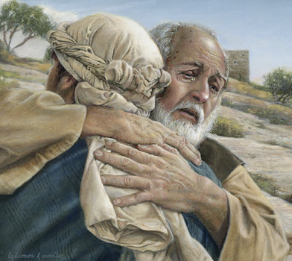
3,000 Converted Acts 2:1-47
Convert; Converted
Not merely a change in actions –
A change in knowledge –
A change in conviction -
A change in allegiance –
A change in thinking & will –
A change in commitment – resulting in a change in relationship & identity -
A change in who we are – how we talk – where we go – what we do -
Luke 15:11-24

Slide 7
3,000 Converted Acts 2:1-47
Psalm 19:7 (NKJV) ⁷ The law of the LORD is perfect, converting the soul; The testimony of the LORD is sure, making wise the simple;

Slide 8
Brief Analysis of Acts 2:1-47
Verses 1-4 – The apostles baptized with the Holy Spirit as promised – (Mat 3:11; Luke 3:16; 24:47-49; John 14:26; 15:26;16:7,8,13; Acts 1:1-8)
Verses 5-13 – The people present, and their response to what they had seen and heard in their own language, i.e. “tongue”
Verses 14-36 – Peter’s sermon: His proposition, proof and conclusion – Jesus of Nazareth is the promised Messiah.
Verses 37-41 – The effects the truth had on many of those who heard the truth – their response, the instructions they were given and their compliance.
Verses 41-47 – Those converted continued steadfastly in the apostles doctrine having been added by the Lord to His church

Slide 9
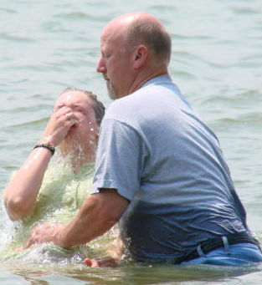
Significance of This Account of Conversion
The beginning of the great commission – (Mat 28:18-20; Mark 16:15,16; Luke 24:46-49)
The very first to hear the gospel and become Christians – (Isa 2:3; Mic 4:2; Acts 11:15)
The beginning of the church – (Acts 2:47; Mat 16:18)

Slide 10
Significance of This Account of Conversion
This account does not stand alone secluded from the others,
Every particular found is not a part of the repeated pattern.
Some things not specifically mentioned are clearly implied.
Elements of this conversion are consistent with every other account and necessary for every conversion to Christ.

Slide 11
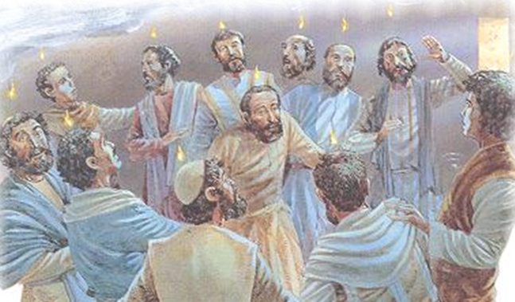
3,000 Converted Acts 2:1-47
Apostles Equipped & Confirmed
Verses 1-4
Fulfilling Jesus’ promise - (Mat 3:11; Luke 3:16; 24:47-49; John 14:26; 15:26;16:7,8,13; Acts 1:1-8)
Holy Spirit baptism limited to the apostles – (cf. above promises; nearest antecedent to pronouns – 1:26; 2:1-4,6,7,11,13,14)
Confirming the authenticity of the message preached – (Mark 16:20; Acts 14:3; Heb 2:4)
Notes:
It is verification – validation – confirmation – of what?
That Jesus was the sacrifice for sin – Acts 2:22-28
That Jesus was raised to be King of God’s kingdom – Acts 2:29-32
That Jesus took the throne of God – Acts 2:33
That Jesus as King received from the Father the promise of the Holy Spirit –Acts 2:33-34
That Jesus truly is Lord and Christ – Acts 2:36
That believers can have life in Jesus Christ – Acts 2:37-47

Slide 12
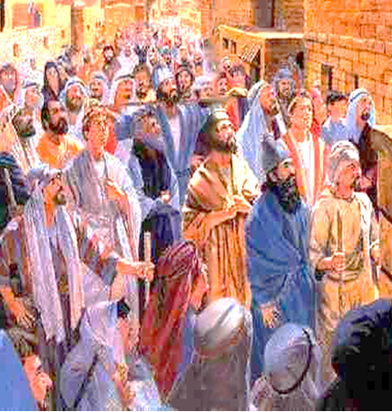
3,000 Converted Acts 2:1-47
Those Present & Initial Response
Verses 5-13
Significance of the day of Pentecost – (Lev. 23:15-21; Ex. 34:22,23)
Devout Jews from every nation under heaven – including proselytes – (vss. 5-11)

Slide 13
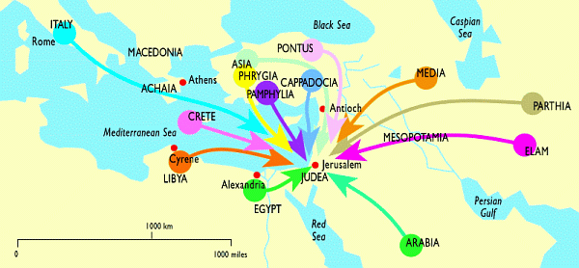
3,000 Converted Acts 2:1-47
Those Present & Initial Response
Verses 5-13

Slide 14
3,000 Converted Acts 2:1-47
Those Present & Initial Response
Verses 5-13
Significance of the day of Pentecost – (Lev. 23:15-21; Ex. 34:22,23)
Devout Jews from every nation under heaven – including proselytes – (vss. 5-11)
Heard the apostles speaking in their own language the wonderful works of God – (vss. 5-11)
Some wondered with curiosity – others mocked – (vs. 12,13)

Slide 15
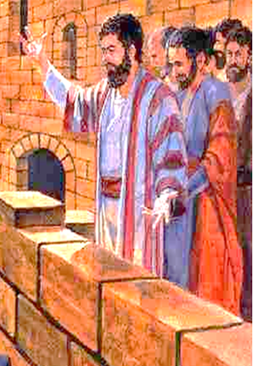
3,000 Converted Acts 2:1-47
Peter’s Sermon – “Jesus Is The Christ!”
Verses 14-36
The events were the fulfillment of prophecy – indicating the beginning of the kingdom of God when all men could call upon the name of the Lord and be saved - (14-21; Joel 2:28-32)
Jesus Christ is the promised Messiah (Anointed One, Savior), and Lord (King) . . .

Slide 16
3,000 Converted Acts 2:1-47
Peter’s Sermon – “Jesus Is The Christ!”
Verses 14-36
The MIRACLES of Jesus – verse 22
The crucifixion was according to God’s foreknowledge – 23
God raised Him from the dead – 24
Agrees with prophecy –vs.25-29; (Ps 16:8-11)
To sit on David’s throne -30,31; (Ps 132:11)
The apostles Testimony –v.32
Testimony of the Holy Spirit –v.33
Confirmed by OT – v.34-35 (Ps 110)

Slide 17
3,000 Converted Acts 2:1-47
3,000 Convicted & Converted!
Verses 37-41
Acts 2:37 (NKJV) ³⁷ Now when they heard this, they were cut to the heart, and said to Peter and the rest of the apostles, "Men and brethren, what shall we do?"
Acts 2:37 (NKJV) ³⁷ Now when they heard this, they were cut to the heart, and said to Peter and the rest of the apostles, "Men and brethren, what shall we do?"
Hearts pricked by the evidence – 37

Slide 18
3,000 Converted Acts 2:1-47
3,000 Convicted & Converted!
Verses 37-41
Acts 2:38 (NKJV) ³⁸ Then Peter said to them, "Repent, and let every one of you be baptized in the name of Jesus Christ for the remission of sins; and you shall receive the gift of the Holy Spirit.
Hearts pricked by the evidence – 37
Peter instructs them what as to what they must do – 38-40

Slide 19
3,000 Converted Acts 2:1-47
3,000 Convicted & Converted!
Verses 37-41
Acts 2:39 (NKJV) ³⁹ For the promise is to you and to your children, and to all who are afar off, as many as the Lord our God will call."
Hearts pricked by the evidence – 37
Peter instructs them what as to what they must do – 38-40

Slide 20
3,000 Converted Acts 2:1-47
3,000 Convicted & Converted!
Verses 37-41
Acts 2:40 (NKJV) ⁴⁰ And with many other words he testified and exhorted them, saying, "Be saved from this perverse generation."
Hearts pricked by the evidence – 37
Peter instructs them what as to what they must do – 38-40

Slide 21
3,000 Converted Acts 2:1-47
3,000 Convicted & Converted!
Verses 37-41
Acts 2:41 (NKJV) ⁴¹ Then those who gladly received his word were baptized; and that day about three thousand souls were added to them.
Acts 2:41 (NKJV) ⁴¹ Then those who gladly received his word were baptized; and that day about three thousand souls were added to them.
Acts 2:41 (NKJV) ⁴¹ Then those who gladly received his word were baptized; and that day about three thousand souls were added to them.
Hearts pricked by the evidence – 37
Peter instructs them what as to what they must do – 38-40
Those who gladly received his words complied - 41

Slide 22
3,000 Converted Acts 2:1-47
3,000 Continued In Apostles Doctrine!
Verses 42-47
Acts 2:42 (NKJV) ⁴² And they continued steadfastly in the apostles' doctrine and fellowship, in the breaking of bread, and in prayers.
Worship – true doctrine – spiritual communion – Lord’s supper - prayer

Slide 23
3,000 Converted Acts 2:1-47
3,000 Continued In Apostles Doctrine!
Verses 42-47
Acts 2:43 (NKJV) ⁴³ Then fear came upon every soul, and many wonders and signs were done through the apostles.
Worship – true doctrine – spiritual communion – Lord’s supper – prayer
Respect – for God and His word – Marl 16:20

Slide 24
3,000 Converted Acts 2:1-47
3,000 Continued In Apostles Doctrine!
Verses 42-47
Acts 2:44-46 (NKJV) ⁴⁴ Now all who believed were together, and had all things in common, ⁴⁵ and sold their possessions and goods, and divided them among all, as anyone had need.
Worship – true doctrine – spiritual communion – Lord’s supper – prayer
Respect – for God and His word – Marl 16:20
Love – providing for one another’s needs – gladly serving God and sharing.

Slide 25
3,000 Converted Acts 2:1-47
3,000 Continued In Apostles Doctrine!
Verses 42-47
Acts 2:44-46 (NKJV) ⁴⁶ So continuing daily with one accord in the temple, and breaking bread from house to house, they ate their food with gladness and simplicity of heart,
Worship – true doctrine – spiritual communion – Lord’s supper – prayer
Respect – for God and His word – Marl 16:20
Love – providing for one another’s needs – gladly serving God and sharing.

Slide 26
3,000 Converted Acts 2:1-47
3,000 Continued In Apostles Doctrine!
Verses 42-47
Acts 2:47 (NKJV) ⁴⁷ praising God and having favor with all the people. And the Lord added to the church daily those who were being saved.
Praise – for His goodness and grace . . .
Goodness – their humble, serious, devoted life was appreciated . . .
Saved – added to the Lord’s church by the Lord Himself.
Notes:
their humble, serious, and devoted lives — Barnes' Notes on the New Testament

Slide 27
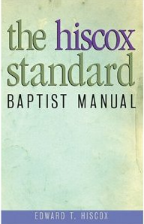
3,000 Converted Acts 2:1-47
“It is most likely that in the Apostolic age when there was but one Lord, one faith, and one baptism, and no differing denominations existed, the baptism of a convert by that very act constituted him a member of the church, and at once endowed him with all the rights and privileges of full membership. In that sense, baptism was the door into the church. Now, it is different”
(page 22)

Slide 28
Conversions In Acts
Examples
Pentecost – 2:14-41
Samaria – 8:5-13
Eunuch – 8:35-39
Saul – 9,22,26
Cornelius - 10:34-48
Lydia – 16:13-15
Jailor – 16:30-34
Corinthians - 18:8
Ephesians - 19:3-5
Believed
Implied
12
36,37
Implied
43
14
31
8
Implied
Repented
37,38
Implied
Implied
Implied
Implied
Implied
Implied
Implied
Implied
Confessed
Implied
Implied
37
Implied
Implied
Implied
Implied
Implied
Implied
Baptized
38,41
12,13
38
22:16
48
15
33
8
5

Slide 29
Have You Been Converted?
Not merely “have you changed your actions”
But have you been changed in your convictions, allegiance, thinking, will, commitment, and relationship with God through a knowledge of the truth –
True conversion results in a change in who we are – how we talk – where we go – what we do – “proving what is that acceptable and perfect will of God” in our lives -

Slide 30
Have You Been Converted?
To believe and do what Peter told those on the day of Pentecost will make one today the same thing it made them:
Forgiven sinner – Acts 2:38; 22:16
Saved – Acts 2:39-41; 1 Peter 3:21
A part of the family of God – Acts 2:42-46
A member of the Lord’s church – Acts 2:47

Slide 32
3,000 Converted
Acts 2:1-47
Charts by Don McClain
Prepared June 30-July 2, 2011
Preached July 3, 2011
West 65th Street church of Christ
P.O. Box 190062
Little Rock AR 72219
501-568-1062
Prepared using PPT 2010 –
Email – donmcclain@sbcglobal.net
More PPT & Audio Sermons:
http://w65stchurchofchrist.org/donmaccla/2011SermonPage.html

