Slide 1
Examples of Conversions In
Conversion of
The Samaritans
Acts 8:1-25
Notes:
Acts 16:30 (NKJV) ³⁰ And he brought them out and said, "Sirs, what must I do to be saved?"
Are You Really Converted?
Raymond E. Harris Muscle Shoals, Alabama
The word "convert" means "to change" or "to turn." There are three things involved in the process of one's turning from sin to God.
1. A Change of Heart. The heart or mind can only be changed by faith. Faith comes by hearing the word of God (Rom. 10:17). Hence, the Bible teaches that people's hearts are purified "by faith" (Acts 15:9). In other words, when one learns from the Bible about the love God has toward us and the sacrifice of Jesus for us we are moved to repentance. "Repentance" and "conversion" are terms that go hand in hand. When one changes his mind about God and Jesus and sin he will have:
2. A Change of Life. A change of heart will lead to a change of life. Repentance is defined as "a change of mind that leads to a change of life." Hence, we see the evolution of conversion. As a result of faith produced by the word of God, man is led to repentance. This reformation in behavior is very visible as the person turns from sin to obedience, from wickedness to righteousness. And when obedience is completed there is:
3. A Change of Relationship. In this world there are two classes of accountable people - the wicked and the righteous - the children of the Devil and the children of God. No one can be translated from the kingdom of darkness to the kingdom of God without a change of heart and a change of life. But one must have remission of sins to make conversion complete. When one's sins are forgiven, he enters a state or relationship with God. Baptism is". . for the remission of sins" (Acts 2:38). Also the Bible says people are baptized "into Christ" (Gal. 3:26-27). Hence, the converted are buried with Christ in baptism and raised to walk in "newness of life" (Rom. 6:3-5).
Faith changes the heart, repentance changes the life, and baptism changes the relationship to God. One's sins are not forgiven merely because we believe that Jesus is the Savior or because we quit committing them. Sins are forgiven by God when we complete our conversion in baptism. Have you been converted? Truly converted? Fully converted, according to the scriptural plan?
Guardian of Truth XXX: 2, p. 43 January 16, 1986

Slide 2
3,000 Converted Acts 2:1-47
Convert; Converted
transitive verb
1 - a : to bring over from one belief, view, or party to another b : to bring about a religious conversion in
2 - a : to alter the physical or chemical nature or properties of especially in manufacturing b (1) : to change from one form or function to another (2) : to alter for more effective utilization

Slide 3
3,000 Converted Acts 2:1-47
Convert; Converted
Matthew 18:3-4 (NKJV) ³ and said, "Assuredly, I say to you, unless you are converted and become as little children, you will by no means enter the kingdom of heaven. ⁴ Therefore whoever humbles himself as this little child is the greatest in the kingdom of heaven.

Slide 4
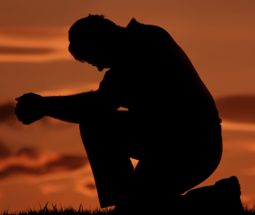
3,000 Converted Acts 2:1-47
Convert; Converted
Acts 3:19 (NKJV) ¹⁹ Repent therefore and be converted, that your sins may be blotted out, so that times of refreshing may come from the presence of the Lord,

Slide 5
3,000 Converted Acts 2:1-47
Convert; Converted
James 5:19-20 (NKJV) ¹⁹ Brethren, if anyone among you wanders from the truth, and someone turns him back, (convert him KJV) ²⁰ let him know that he who turns (converteth – KJV) a sinner from the error of his way will save a soul from death and cover a multitude of sins.

Slide 6
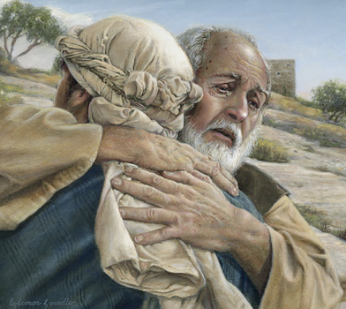
3,000 Converted Acts 2:1-47
Convert; Converted
Not merely a change in actions –
A change in knowledge –
A change in conviction -
A change in allegiance –
A change in thinking & will –
A change in commitment – resulting in a change in relationship & identity -
A change in who we are – how we talk – where we go – what we do -
Luke 15:11-24

Slide 7
3,000 Converted Acts 2:1-47
Psalm 19:7 (NKJV) ⁷ The law of the LORD is perfect, converting the soul; The testimony of the LORD is sure, making wise the simple;

Slide 8
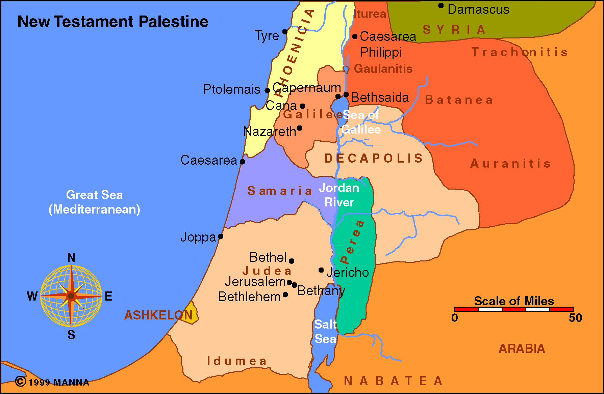
Assyrian Captivity - 2 Kings 17
Their religion, though basically Jewish, was mixed with idolatry - 2 Kings 17:32-34,41
Jews and Samaritans had no dealings with each other - John 4:3-9; Luke 10:30-37
Though not regarded as totally heathenistic, they were despised by the Jews. – John 8:48

Slide 9
The great commission – Mat. 28:18-21; Mark 16:15,16; Luke 24:47; Acts 1:8
Acts chapters 2 – 7 tells of the preaching in Jerusalem and Judea.
Acts 4-8:4 we see that persecution arose against Christians
Acts 8:4-25 tells of the Evangelist Philip preaching in Samaria.

Slide 10
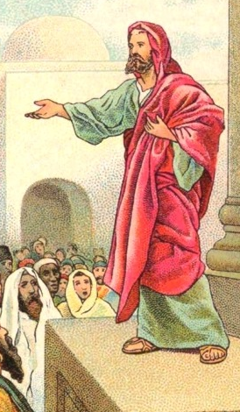
Brief Analysis of Acts 8:1-25
Verses 1-3 – Great persecution arose against the church – the involvement of Saul – (Acts 9:1,2,21; 22:3,4; 26:9-11; 1 Cor. 15:9; Gal. 1:13; 1 Tim 1:13)
Verses 1,4 – Disciples driven from Jerusalem and went everywhere preaching the Word – (Acts 11:19-21; 1:8)
Verses 5 – Phillip preaches Jesus – (8:35)
Verses 6-13 – Samaritans converted
Verses 14-17 – Apostles send Peter and John to the Samaritans that they may receive miraculous spiritual gifts – (Mark 16:17-20)
Verse 18-25 – One of the Samaritans, (Simon), falls and is restored – (Gal. 5:4; James 5:19,20)

Slide 11
The Church Scattered
Evil Can Work For Good!
Verses 1-3
Acts 8:1-3 (NKJV) ¹ Now Saul was consenting to his death. At that time a great persecution arose against the church which was at Jerusalem; and they were all scattered throughout the regions of Judea and Samaria, except the apostles.
We can be guilty of participation by consent – 1, cf. 7:58; 22:20; Rom 1:32; Eph 5:7,11
God’s enemies can’t overcome His plans – Mat. 28:18-20; Luke 24:47; Acts 1:8; 2:23; Rom 8:18-39

Slide 12
The Church Scattered
Evil Can Work For Good!
Verses 1-3
Acts 8:1-3 (NKJV) ² And devout men carried Stephen to his burial, and made great lamentation over him. ³ As for Saul, he made havoc of the church, entering every house, and dragging off men and women, committing them to prison.
There is actual honor in death for the godly – 2; cf. Eccl. 8:10-13; 1 Thes 4:13-18; Rev 14:13
What if we faced the kind of persecution the early church faced? – 3; 2 Tim 3:12; 1 Pt. 4:12-16; Jam 1:1-12

Slide 13
The Church Scattered
The Converted Are Evangelistic!
Verses 1,4
Acts 8:4 (NKJV) ⁴ Therefore those who were scattered went everywhere preaching the word.
If we are truly converted to the cause of Christ – wouldn’t we naturally want to tell others? – 4; cf. Acts 4:12,19,20; 1 Thes 1:8
All need the gospel – which is the only hope for the lost – Rom 3:23; 1:16,17

Slide 14
The Samaritans Converted
Preaching Christ Involves:
Verses 5-13
Acts 8:5 (NKJV) ⁵ Then Philip went down to the city of Samaria and preached Christ to them.
The Word of God - (8:4,14,25,35)
Jesus as the Christ - death, burial and resurrection - (8:5,32-35; 1 Cor. 1:23; 15:1-34)
The Kingdom of God (8:12)
The Name of Jesus - (8:12)
Baptism (8:12,36; Mk 16:16)

Slide 15
The Samaritans Converted
The Samaritans Believed
Verses 5-13
Acts 8:6,12,13 (NKJV) ⁶heeded
⁶hearing and seeing
¹²Believed as he preached
¹²baptized
¹³Simon believed and when he was baptized
The Word of God - (8:4,14,25,35)
Jesus as the Christ - death, burial and resurrection - (8:5,32-35; 1 Cor. 1:23; 15:1-34)
The Kingdom of God (8:12)
The Name of Jesus - (8:12)
Baptism (8:12,36; Mk 16:16)
Notes:
Acts 8:6-13 (NKJV) ⁶ And the multitudes with one accord heeded the things spoken by Philip, hearing and seeing the miracles which he did. ⁷ For unclean spirits, crying with a loud voice, came out of many who were possessed; and many who were paralyzed and lame were healed. ⁸ And there was great joy in that city. ⁹ But there was a certain man called Simon, who previously practiced sorcery in the city and astonished the people of Samaria, claiming that he was someone great, ¹⁰ to whom they all gave heed, from the least to the greatest, saying, "This man is the great power of God." ¹¹ And they heeded him because he had astonished them with his sorceries for a long time. ¹² But when they believed Philip as he preached the things concerning the kingdom of God and the name of Jesus Christ, both men and women were baptized. ¹³ Then Simon himself also believed; and when he was baptized he continued with Philip, and was amazed, seeing the miracles and signs which were done.

Slide 16
The Samaritans Converted
Miracles Served To Confirm
Verses 6-21; Mark 16:19,20; Acts 14:3; Hebrews 2:4
The need for miraculous confirmation in each stage of advancement of the gospel - Act 2; Acts 8:6-21; Acts 10
The contrast between the miracles of God and the deceptions of men – 9-13
“Baptism in the name of Jesus” NOT Holy Spirit baptism – 14-19
Acts 8:6 (NKJV) ⁶ And the multitudes with one accord heeded the things spoken by Philip, hearing and seeing the miracles which he did.
Notes:
Acts 8:6-13 (NKJV) ⁶ And the multitudes with one accord heeded the things spoken by Philip, hearing and seeing the miracles which he did. ⁷ For unclean spirits, crying with a loud voice, came out of many who were possessed; and many who were paralyzed and lame were healed. ⁸ And there was great joy in that city. ⁹ But there was a certain man called Simon, who previously practiced sorcery in the city and astonished the people of Samaria, claiming that he was someone great, ¹⁰ to whom they all gave heed, from the least to the greatest, saying, "This man is the great power of God." ¹¹ And they heeded him because he had astonished them with his sorceries for a long time. ¹² But when they believed Philip as he preached the things concerning the kingdom of God and the name of Jesus Christ, both men and women were baptized. ¹³ Then Simon himself also believed; and when he was baptized he continued with Philip, and was amazed, seeing the miracles and signs which were done.

Slide 17
The Samaritans Converted
Miracles Served To Confirm
Miracles Have Ceased
Acts 8:18 (NKJV) ¹⁸ And when Simon saw that through the laying on of the apostles' hands the Holy Spirit was given, he offered them money,
The means of passing them on is not available - 6:6; 8:14-18; 19:6; Rom 1:11; 2 Tim 1:6
Genuine miracles could not be denied – even by the critics – Acts 4:16; 8:13,18,19
They served their appointed purpose – 1 Cor. 13:8-13; 2 Tim 3:16,17
Notes:
Acts 8:6-13 (NKJV) ⁶ And the multitudes with one accord heeded the things spoken by Philip, hearing and seeing the miracles which he did. ⁷ For unclean spirits, crying with a loud voice, came out of many who were possessed; and many who were paralyzed and lame were healed. ⁸ And there was great joy in that city. ⁹ But there was a certain man called Simon, who previously practiced sorcery in the city and astonished the people of Samaria, claiming that he was someone great, ¹⁰ to whom they all gave heed, from the least to the greatest, saying, "This man is the great power of God." ¹¹ And they heeded him because he had astonished them with his sorceries for a long time. ¹² But when they believed Philip as he preached the things concerning the kingdom of God and the name of Jesus Christ, both men and women were baptized. ¹³ Then Simon himself also believed; and when he was baptized he continued with Philip, and was amazed, seeing the miracles and signs which were done.

Slide 18
The Samaritans Converted
The Fall of Simon
Believers Can Fall From Grace – verses 18-24
He was in danger of perishing– 20; 1 Tim 6:9; 2 Pet. 2:14-17
His heart was not right with God - 21; Ps 78:37
Poisoned by bitterness and bound by iniquity – Heb 12:15; John 8:34; Rom. 6:1-23
Needed to repent and pray – 22,24; 1 John 1:9,10
Acts 8:20 (NKJV) ²⁰ But Peter said to him, "Your money perish with you, because you thought that the gift of God could be purchased with money!
Notes:
Acts 8:23 (NKJV) ²³ For I see that you are poisoned by bitterness and bound by iniquity."

Slide 19
The Samaritans Converted
The Continued Efforts
Acts 8:25 (NKJV) ²⁵ So when they had testified and preached the word of the Lord, they returned to Jerusalem, preaching the gospel in many villages of the Samaritans.
Notes:
Acts 8:23 (NKJV) ²³ For I see that you are poisoned by bitterness and bound by iniquity."

Slide 20
Conversions In Acts
Examples
Pentecost – 2:14-41
Samaria – 8:5-13
Eunuch – 8:35-39
Saul – 9,22,26
Cornelius - 10:34-48
Lydia – 16:13-15
Jailor – 16:30-34
Corinthians - 18:8
Ephesians - 19:3-5
Believed
Implied
12
36,37
Implied
43
14
31
8
Implied
Repented
37,38
Implied
Implied
Implied
Implied
Implied
Implied
Implied
Implied
Confessed
Implied
Implied
37
Implied
Implied
Implied
Implied
Implied
Implied
Baptized
38,41
12,13
38
22:16
48
15
33
8
5

Slide 21
Have You Been Converted?
Not merely “have you changed your actions”
But have you been changed in your convictions, allegiance, thinking, will, commitment, and relationship with God through a knowledge of the truth –
True conversion results in a change in who we are – how we talk – where we go – what we do – “proving what is that acceptable and perfect will of God” in our lives -

Slide 22
Have You Been Converted?
They believed the Word of God and heeded it - (8:4,14,25)
They believed that Jesus is the Christ - (8:5; John 8:24)
They were obedient to Jesus in being baptized – (Mk 16:16)
They became citizens in the Kingdom of God (Col. 1:13)
The one who stumbled repented and prayed – (8:24)
To believe and do what the Samaritans did will make us the same thing it made them:

Slide 24
The Samaritans Converted
Acts 8:1-25
Charts by Don McClain
Prepared July 7-9, 2011
Preached July 10, 2011
West 65th Street church of Christ
P.O. Box 190062
Little Rock AR 72219
501-568-1062
Prepared using PPT 2010 –
Email – donmcclain@sbcglobal.net
More PPT & Audio Sermons:
http://w65stchurchofchrist.org/donmaccla/2011SermonPage.html

